Slide 1
Common IP Fixes What are the most common questions game developers might ask about IP?
Leveling UP your IP: Strategies for Videogame Developers
Belgrade, 22nd September 2022
Mr. Michał Pękała, Partner, Head of Video Games & Entertainment, Maruta Wachta, Warsaw, Poland

Slide 2
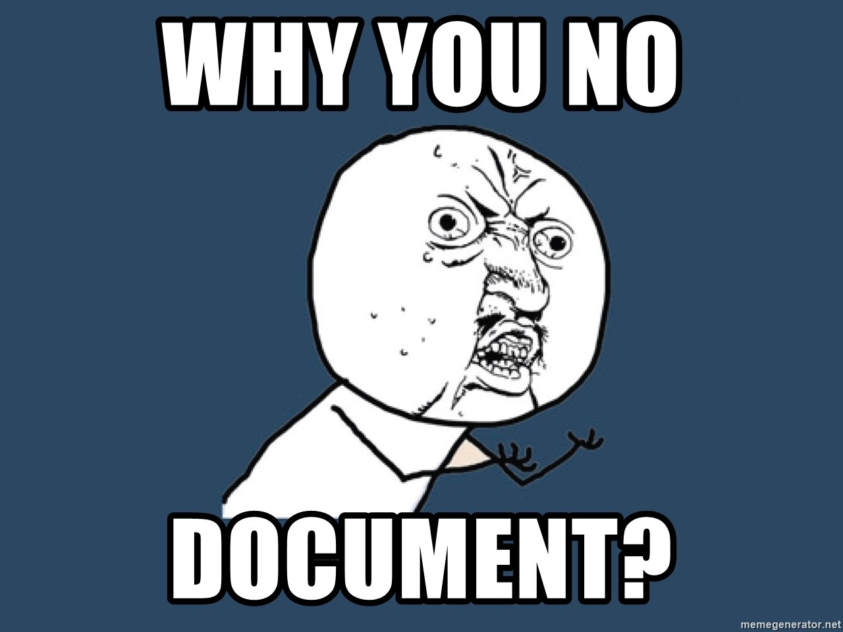
DO WE REALLY NEED TO DO ALL THESE PAPERWORK? SO MANY TREES WILL DIE…
#5
No agreement = no proof of ownership / right / exclusiveness / license / etc.
No agreement = no IP ownership transfer
No agreement = only implied limited license to use
Risk of IP transferred onto third party (around 30% cases)
Problems with investors / publishers during due dilligence
Tax implications with created IP -> tax incentives / deduction without documents? Forget.

Slide 3
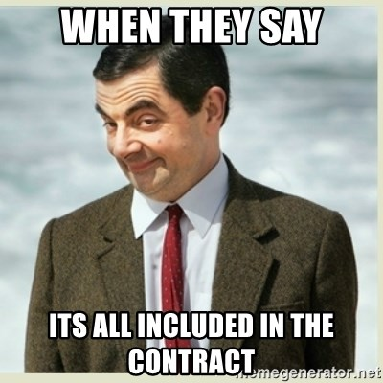
NO, WE DIDN’T READ THE ENTIRE CONTRACT. THEY LOOKED TRUSTWORTHY AND WE NEEDED MONEY
#4
No read = you agreed to „something” and took obligations which you don’t understand
”Something” may be transferring your IP (or kidney) to the other party
The devil is in the details
Hidden obligations and reservations
Potentially nuclear implications for the studio:
Giving away IP to the game to publisher
No IP to localizations, ports, merch, marketing materials
Indemnity for actions of the other party
Unliimited liability
Court venue on the other side of the world
No trademark protection
More, and more, and more…

Slide 4
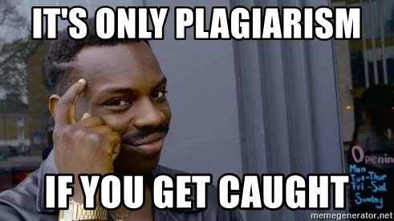
WE HAVE TAKEN A TINY BIT FROM THEIR GAME! IT’S ALLOWED BY LAW!
#3
Rule: you need permission to use others works (in 99% cases)
Your case in 99% cases is not that 1% case
Taking without permission means copy-pasting
Copy-pasting = plagiarism
Plagiarism = risk of IP infringement
IP infringement may result in legal claims
Claims may result in:
Taking down the game
Damages
Injunction relief
Reputation damage
Other (depending on jurisdiction)

Slide 5
WHAT’S THE PROBLEM WITH USING OPEN SOURCE? EVERYONE DOES IT!
#2
LICENSE TYPE | LICENSE NAME | ESSENTIAL OBLIGATIONS OF LICENSEE
STRONG COPYLEFT | GNU GPL 2.0, GNU GPL 3.0, GNU AGPL 1.0, GNU AGPL 3.0 | License requires to preserve the copyright and license notices, and license requires for distributors to make the source code of the component and any derivative works under the same terms.
WEAK COPYLEFT | LGPL 2.1, LGPL 3.0, MPL 1.1, MPL 2.0 | License requires to preserve the copyright and license notices, and license requires for distributors to make the source code of the component and any modifications of this component under the same terms. Please note, not every derivative work needs to be released under the terms of the license.
PERMISSIVE | MIT, BSD, Apache 2.0 | License requires to preserve the copyright and license notices, but distribution is allowed under different terms without disclosing source code.

Slide 6
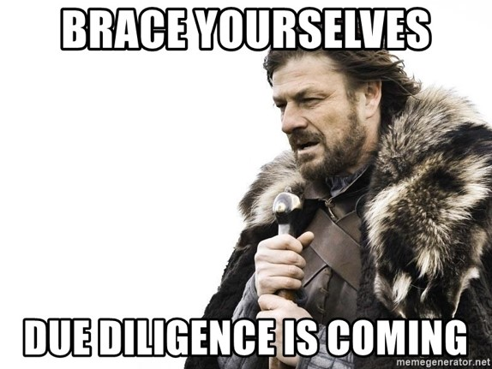
WE DON’T KNOW WHO MADE THIS PART OF CODE. IS THERE A PROBLEM?
#1
Author unknown
Origins of the code unknown
Verification of IP transfer impossible
Problems with legal due dilligence
Potential ”deep pocket” scenario
Reps & Warr risks in all deals

Slide 7
Q&A Session
Ask me anything!

Slide 8
Michał Pękała
Partner, Head of Video Games & Entertainment
Advocate with over 9 years of experience in advising companies from video games market.
More information:
https://maruta.pl/video-games-and-entertainment/
mpekala@maruta.pl + 48 662 011 061

