Slide 1

WIPO and PRV
12 March 2014
Susanne Ås Sivborg
Director General, PRV

Slide 2
Relations between two offices – PRV & WIPO
PRV in short

Slide 3
Facts about Sweden and PRV
Sweden is one of the top innovative countries in the world
Paris Convention 1884
Bern Convention 1904
PCT and EPC 1979
Madrid system 1996
EU Trademark and Design systems
PCT-authority since 1979

Slide 4
Sweden and PRV are active in
GA
CoCo
SCP
SCT
SCCR
IGC
CDIP
MIA (and PschA)
PCT WG
And many many more (incl. CWS and IPC)

Slide 5
Collaboration PRV WIPO SIDA
3 program/year – 3 w + 1 w after 6 m
IP in the global economy
Industrial rights for LDC
Copyright and related rights
~25 participants at each program
National projects
10 y program sequence to be evaluated 2014

Slide 6

PRV in short
Financed by fees
Belongs to the Ministry of Enterprise, Communication and Energy
Offices in Stockholm and Söderhamn
DG Susanne Ås Sivborg
Turnover of about 330 MSEK
About 350 employees
ISO-certified since 2007

Slide 7
2013 facts and numbers
National applications:
2500 patent applications
8800 trademark applications
485 design applications
International applications:
1550 PCT-applications
1990 Madrid applications
Search services:
11300 hours

Slide 8
PRV:s mandate
PRV has two main tasks:
to ensure well-functioning systems for the registration of industrial property rights and
to inform and give service in intellectual property matters.
Our instructions adds further:
PRV shall work to promote growth and strengthen innovation and competitiveness in the whole country
This should be done through information about and contribution to increased knowledge and understanding of the importance of intellectual property in companies and stakeholders in the public innovation system

Slide 9
Information and knowledge
Directed mainly to
SMEs
Advisors in the publicly funded innovation system
Universities R&D and innovation centres
Together with Vinnova – the innovation agency of Sweden and other organisations in the publicly funded innovations system

Slide 10
Some examples
Meetings
Seminars
Courses
But most importantly
Our Webpage – www.prv.se

Slide 11
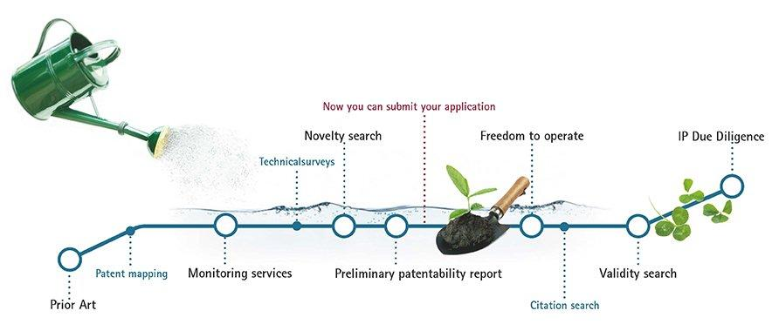
Search Services - Patents

Slide 12
Thank you
Any questions?

Slide 13

Search Services - Trademarks
Pre-filing searches
Monitoring searches
Freedom to Operate
IP Due Diligence

