Slide 1
Topic 3:
Web Resources on Patent Landscape Reports (PLR)
Rio de Janeiro
26 August 2013
Irene Kitsara
Patent Information Section, Access to Information and Knowledge Division

Slide 2
Outline
Introduction
Web Resources for PLR….
  Terminology
  Methodology
  Tools
  Content
  Collections
  Similar analyses
  Providers

Slide 3
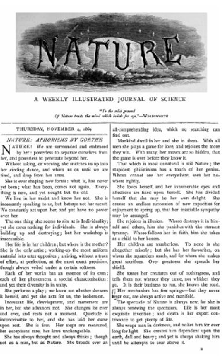
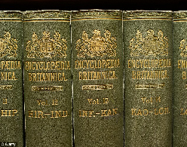
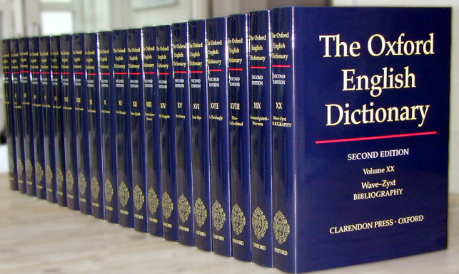
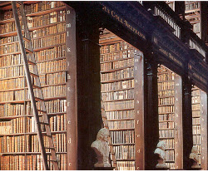
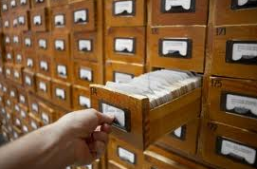
Introduction
Reference sources → research work
Traditionally → Encyclopedias, dictionaries, handbooks, journals in hard-copies
Location → Libraries

Slide 4
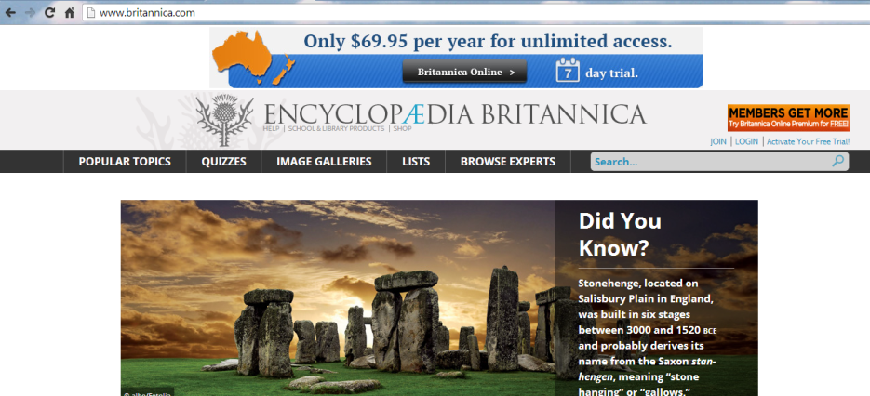
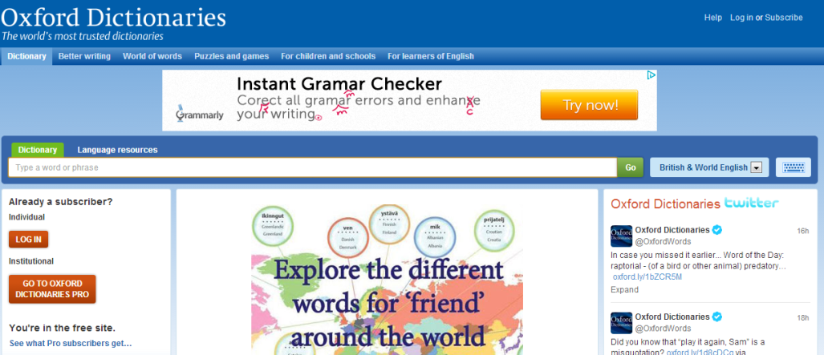

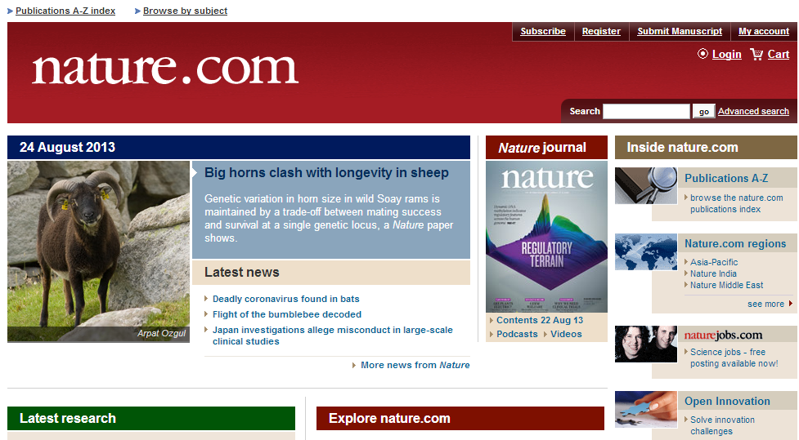
Traditional Reference Sources → Online

Slide 5
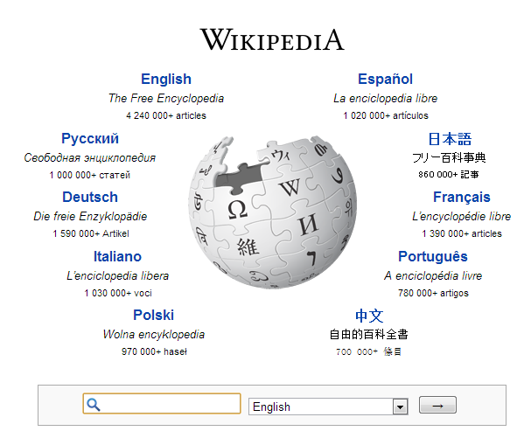







Search tools and depositories of information

Slide 6
New Web Resources
Exclusively online content (online journals…)
Online slideshows
Webinars
Videos (youtube etc…)
Social Media
Blogs

Slide 7
Patent Landscapes Web Resources
PLR → standardized practice in the industry
Challenge → availability for free
Background → cost of the report, business intelligence information included → disclosure problematic
Methodology followed – data crossing made
Online availability of PLR and related info →limited
Available PLR Resources:
  IPO as a service to the interested public and the patent information users
  Private companies promoting their patent landscaping services through landscaping examples

Slide 8
Patent Landscaping Web Resources
Information relevant to PLR:
  Terminology
  Methodology
  Tools for PLR preparation
  Patent Landscape Reports collections/compilations
  Content – specific Patent Landscape Reports
  Similar to PLR analysis types

Slide 9
Where is the information available?
General information repositories → Wikipedia, youtube…
Online journals and books
Social Media → LinkedIn etc.
Websites of IP Offices and other public sector institutions
Public sector service providers
Blogs, Fora
Information:
Free of charge or
Fee-based

Slide 10



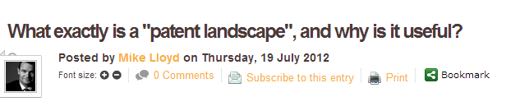

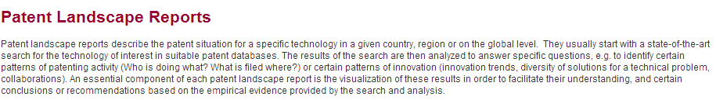
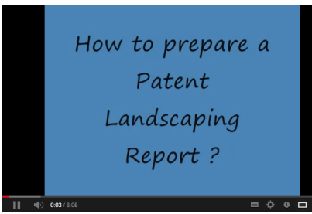


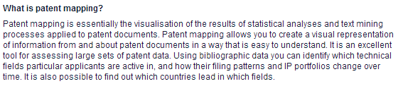
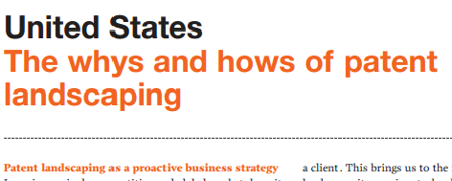

Web Resources for PLR Terminology and Methodology

Slide 11
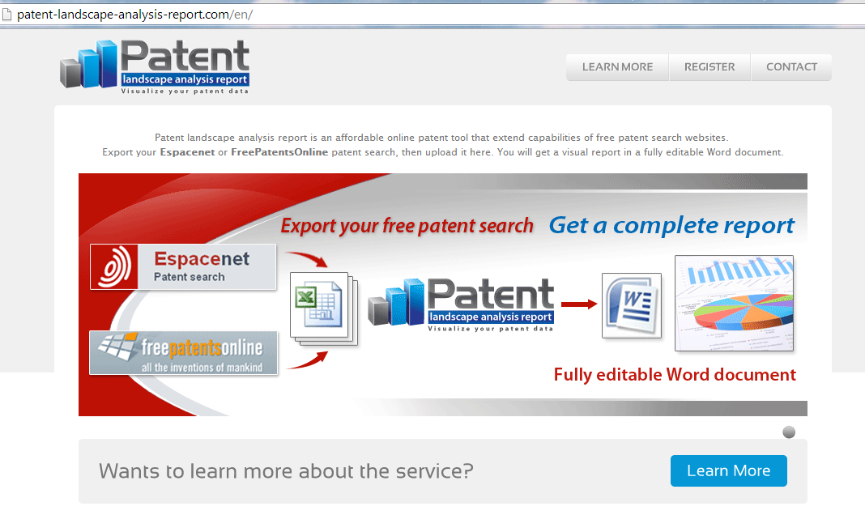
Tools for PLR preparation
Online tools used in the course of preparation of a PLR → beyond the scope of this presentation
Efforts about online semi-automated tools for the preparation of (semi-) automated PLR, e.g.

Slide 12
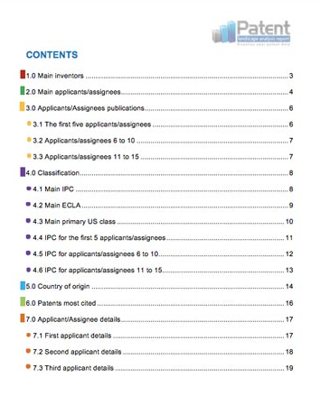
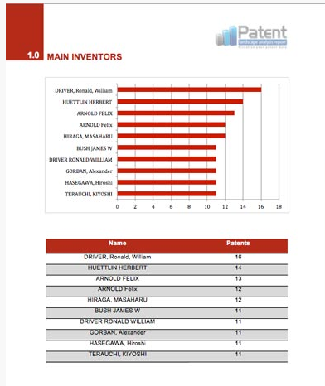
Tools for PLR preparation (2)
http://patent-landscape-analysis-report.com

Slide 13
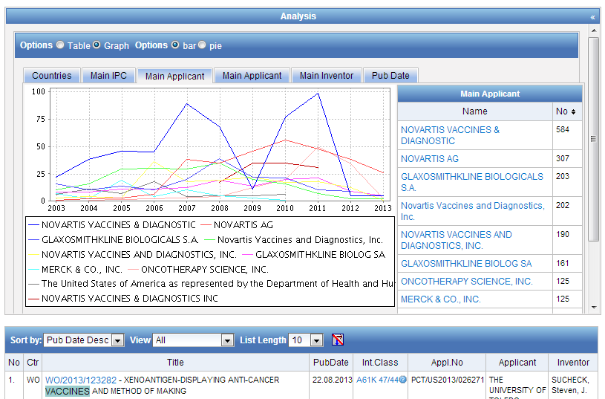
Tools for PLR preparation (3)
PATENTSCOPE search results visualization

Slide 14
Content Web Resources – specific Patent Landscape Reports
A. National Patent Offices Websites:
  INPI Brazil → PLR on nanobiotechnology, stem cells, nanotextiles and biofuel
  Cuban IPO → Ethanol Production from Lignocellulosic Residues
  UK IPO → Stem cells, graphene, nanotechnology, recycling and separation technologies, energy from waste, 3DTV
  Colombia → Use of IP by big pharmaceutical companies in the area of major antiretrovirals
  Austrian Institute of technology → Environmental technologies

Slide 15
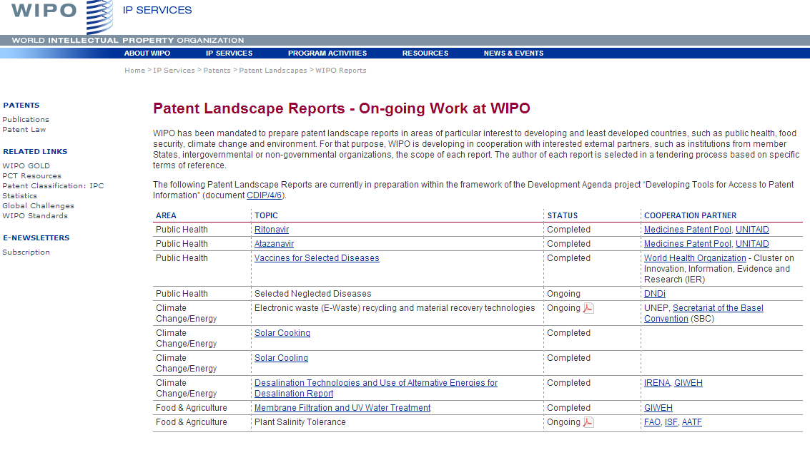
Content Web Resources – specific Patent Landscape Reports (2)
B. WIPO and EPO:
  EPO: Patents and clean energy, patents and clean energy in Africa
  WIPO: dedicated Website to WIPO PLR
http://www.wipo.int/patentscope/en/programs/patent_landscapes/reports/

Slide 16
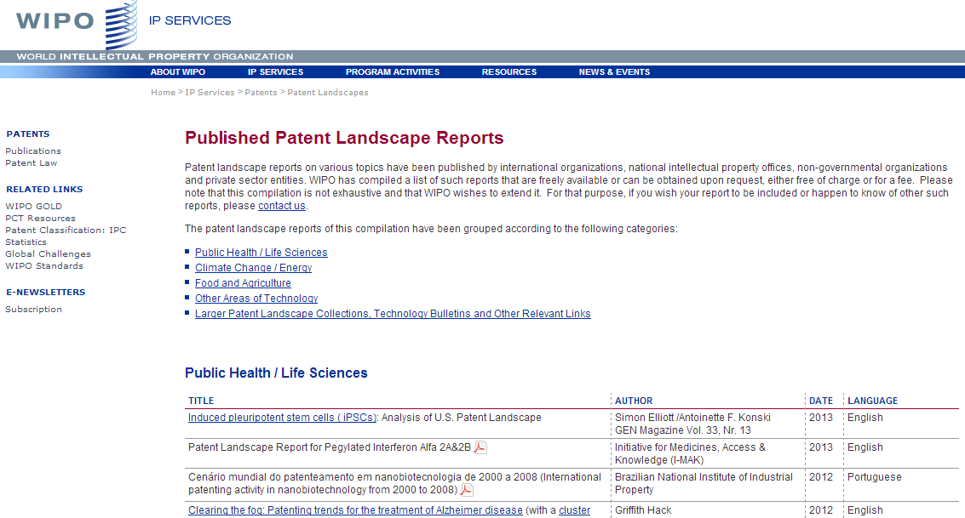
Content Web Resources – specific Patent Landscape Reports (3)
http://www.wipo.int/patentscope/en/programs/patent_landscapes/published_reports.html

Slide 17
Web Resources for PLR collections

Slide 18
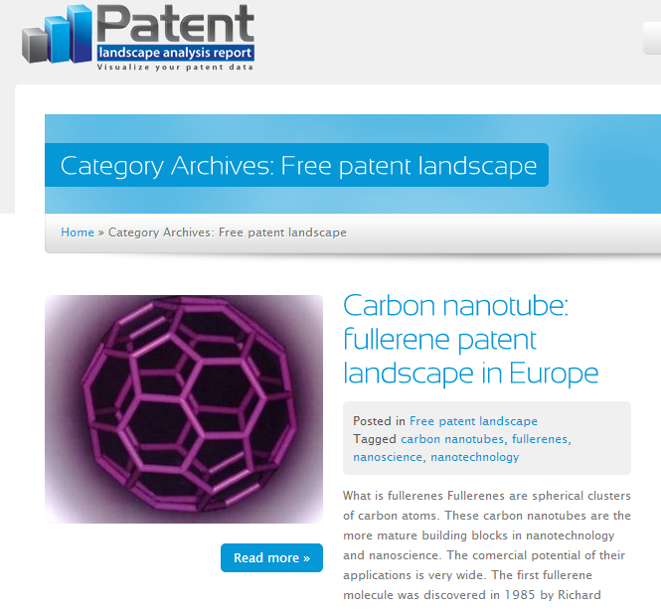
Web Resources for PLR collections (2)
http://patent-landscape-analysis-report.com/en/category/free-patent-landscape/

Slide 19
Social Media – Linkedin Groups on landscaping
Patent Searching and Landscaping - http://www.linkedin.com/groups?home=&gid=110874&trk=anet_ug_hm
IP Intelligence - http://www.linkedin.com/groups?gid=124885&trk=myg_ugrp_ovr
Patinformatics - http://www.linkedin.com/groups?gid=2391676&trk=myg_ugrp_ovr
Patent Landscaping Innovations - http://www.linkedin.com/groups/Patent-Landscaping-Innovations-1883637?trk=myg_ugrp_ovr
Patent Analysis & Landscaping - http://www.linkedin.com/groups/Patent-Analysis-Landscaping-1794428?trk=myg_ugrp_ovr
Patent Informatics Group - http://www.linkedin.com/groups?gid=76745&trk=myg_ugrp_ovr
Patent Landscapes - http://www.linkedin.com/groups?gid=2846540&trk=myg_ugrp_ovr
Competitive Intelligence from Patent Analytics - http://www.linkedin.com/groups/Competitive-intelligence-from-patent-analytics-3891330?trk=myg_ugrp_ovr

Slide 20
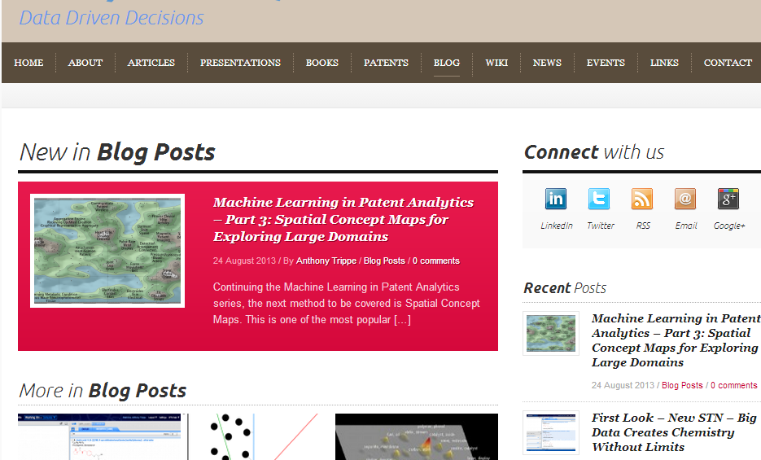
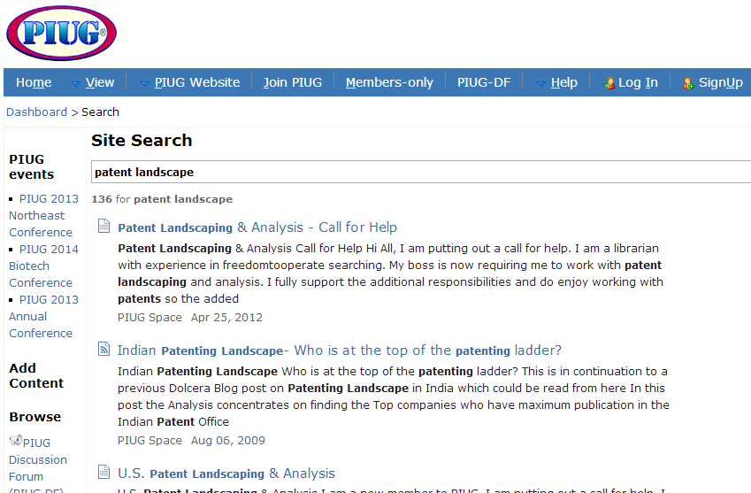
Blogs/Wiki/Online Fora on Patent Landscaping
http://www.patinformatics.com/
http://wiki.piug.org

Slide 21
Similar analyses to PLR
Patent Watch
Technology Alerts
Technology Bulletins
Patent Map Bulletin

Slide 22
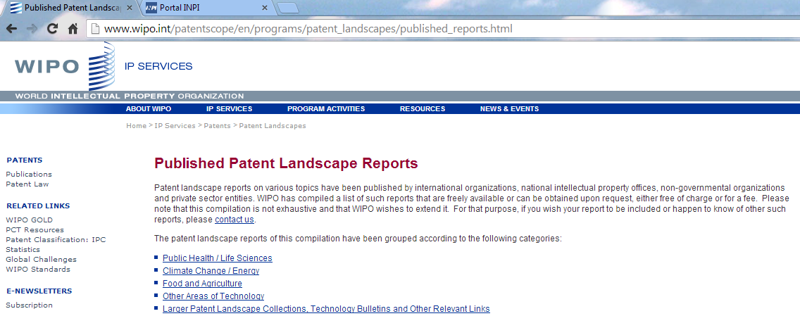
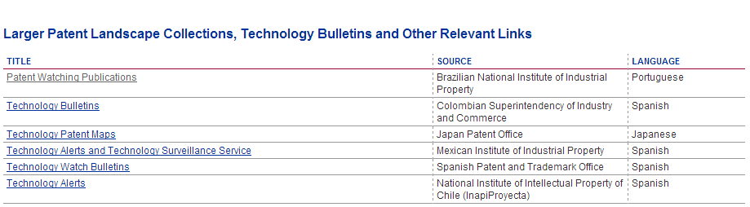
Web Resources for Similar to PLR Analyses

Slide 23
Web Resources on Providers of PLR services
Individual websites of:
IP Offices
Other Public Sector entities
Private sector providers
Envisaged → add to WIPO PLR website a list of patent landscaping providers

Slide 24
Thank you! Questions? Comments?
Muito obrigada!
Alguma pergunta? Comentários sobre o conteúdo ou a estrutura?
Irene.Kitsara@wipo.int

