Slide 1
Topic 20:
Writing and Publishing the Report
Rio de Janeiro
28 August 2013
Irene Kitsara
Patent Information Section, Access to Information and Knowledge Division

Slide 2
I. Writing a Patent Landscape Report

Slide 3
Landscape Report Reader Profile
Policy maker?
Lawyer/Patent Attorney?
Researcher?
Economist?
Market/Business analyst?
Patent Information user/expert?

Slide 4
Matching the reader profile to their needs
What is the report needed for? What kind of decision is at stake?
Patenting activity trends and innovation patterns overview?
Detailed technical information?
Access to the individual documents/search results required?
Legal status/Legal information needed?
Additional information to be included? (e.g. licensing, network analysis)
Visualizations depending on focus of interest (e.g. granted patents or all patent filings?)
Results/Conclusions/Recommendations required?

Slide 5
Matching the reader needs to the structure of the report
Components which can be included in the report:
  Background information
  Executive Summary
  Key findings
  Description of Methodology
  Analysis of the results
  Technology/Geographical focus
  Additional analysis (market/business/competitor/portfolio analysis)
  Conclusions
  Recommendations
  Annexes

Slide 6
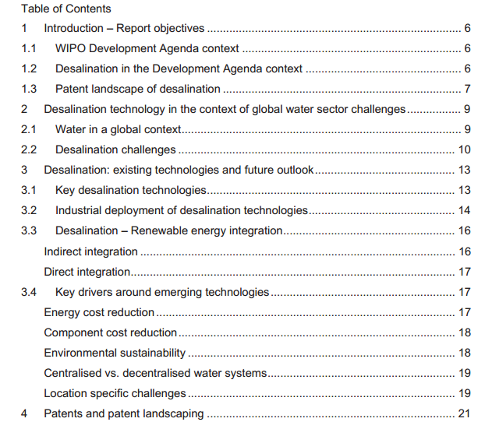
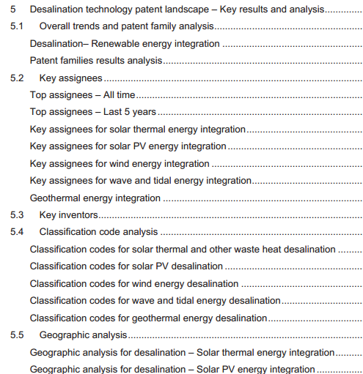
Example of a WIPO PLR

Slide 7
II. Publishing a Patent Landscape Report

Slide 8
Publication Options
Hard copies
PDF/Word
Power Point Presentations (.PPT)
Web-based reports

Slide 9
Pros and cons of each format
Word and .PDF widely spread formats
Word allows editing (advantageous for the graphs/images that can be copied and some of them even edited)
.PDF along with the .PPT format allow for the same visualization and printing format independent from various computer settings
Web-based content is user-friendly, dynamic and interactive, but access to the Internet is required

Slide 10
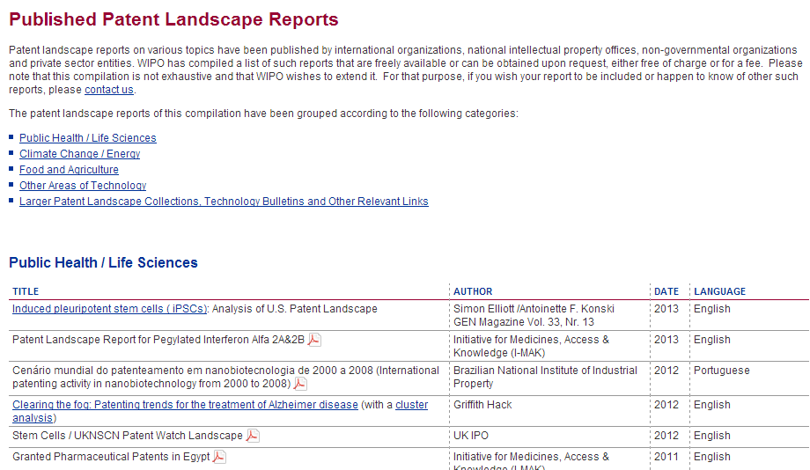
PDF – widely spread PLR publication format

Slide 11
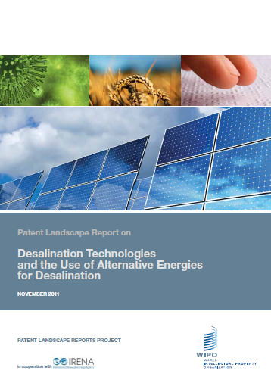

WIPO Patent Landscape Reports – hard copies and PDF format
Free WIPO Publications
Hard copies and electronic format (PDF)

Slide 12
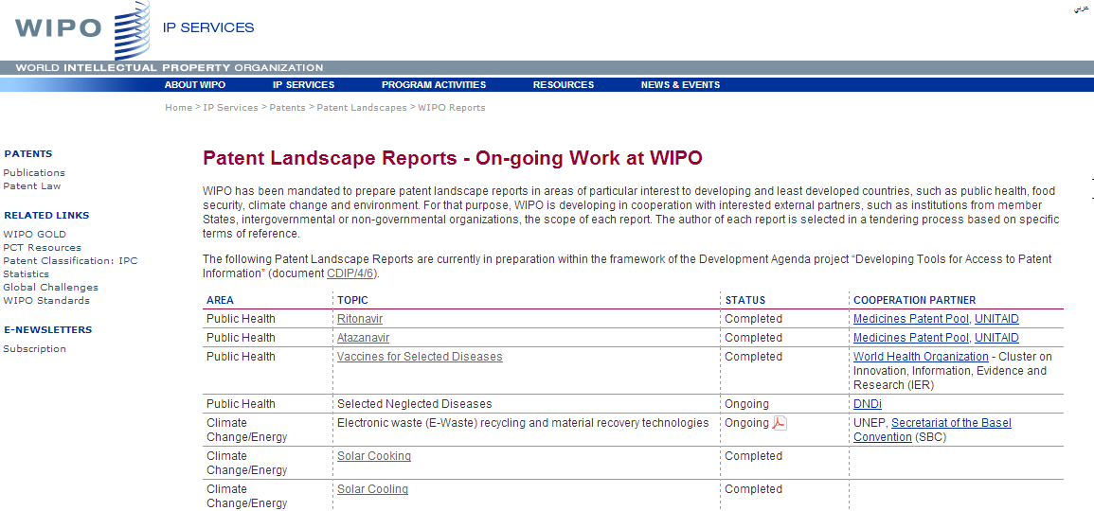
WIPO PLR – Web Presence
http://www.wipo.int/patentscope/en/programs/patent_landscapes/reports/

Slide 13
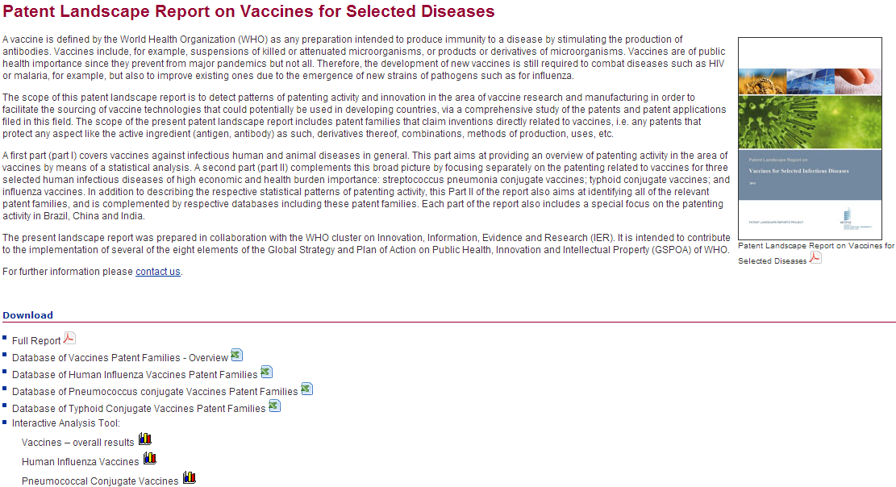
WIPO PLR – Web Presence

Slide 14
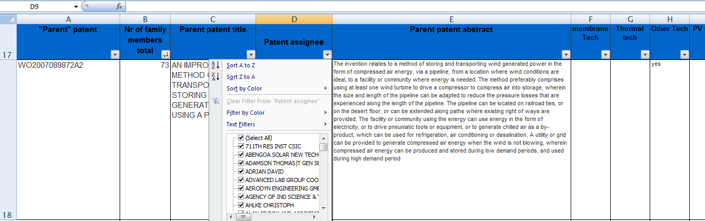
WIPO PLR – additional data beyond the report
.xls with search results dataset:
can be sorted by various criteria
hyperlinked to the full-text documents
grouped by technologies/subtechnologies

Slide 15
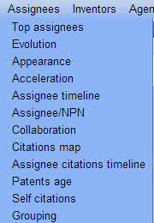
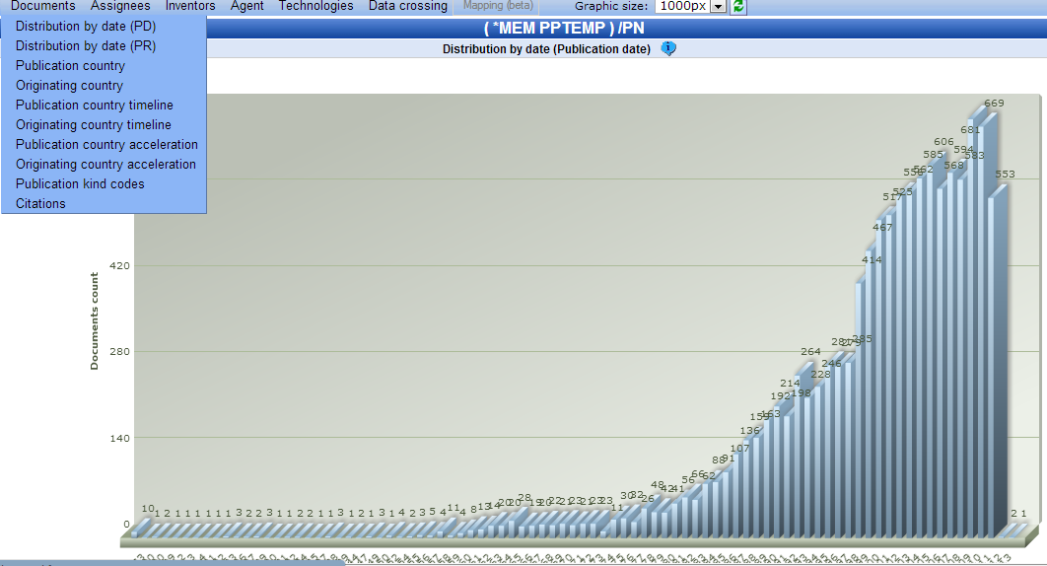
WIPO PLR – additional interactive visualization tool

Slide 16
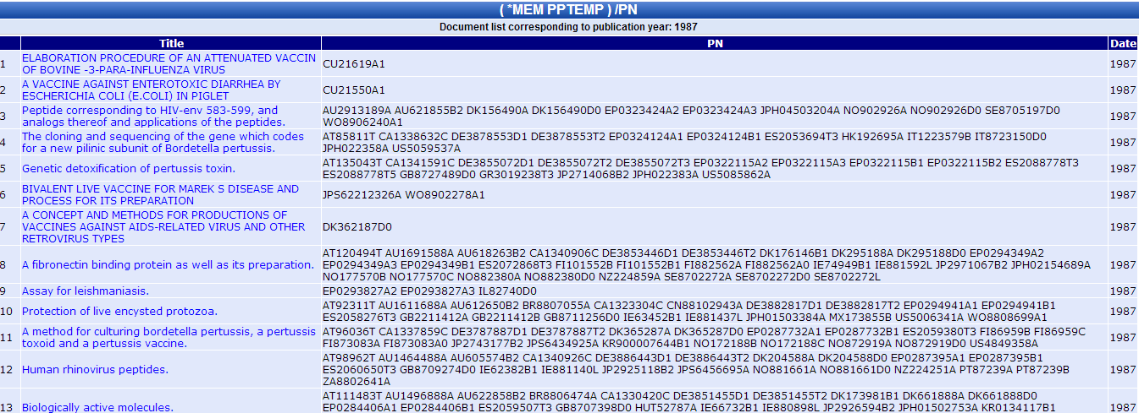
WIPO PLR – additional interactive visualization tool
Interactive graphs – linked to search results and individual records

Slide 17
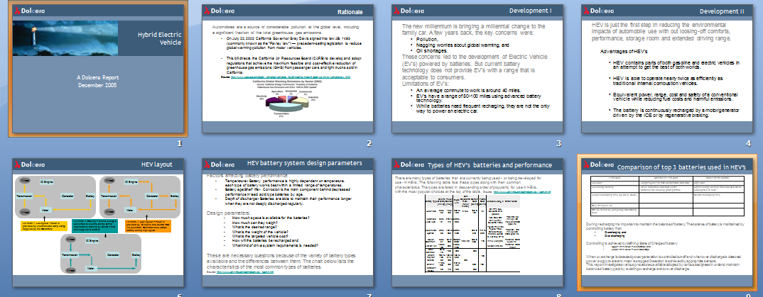
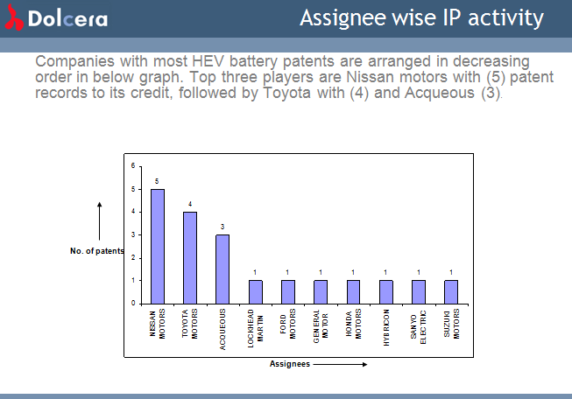
Patent Landscape Reports in .PPT Format
Hybrid Electric Vehicle PLR, Dolcera 2005

Slide 18
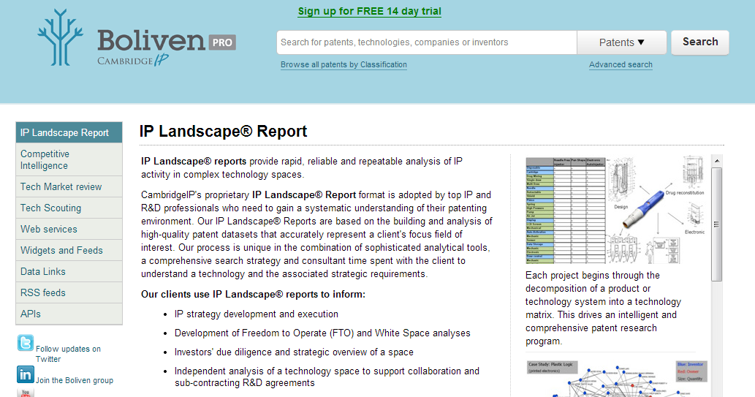
Web-based Patent Landscape Reports
www.boliven.com

Slide 19
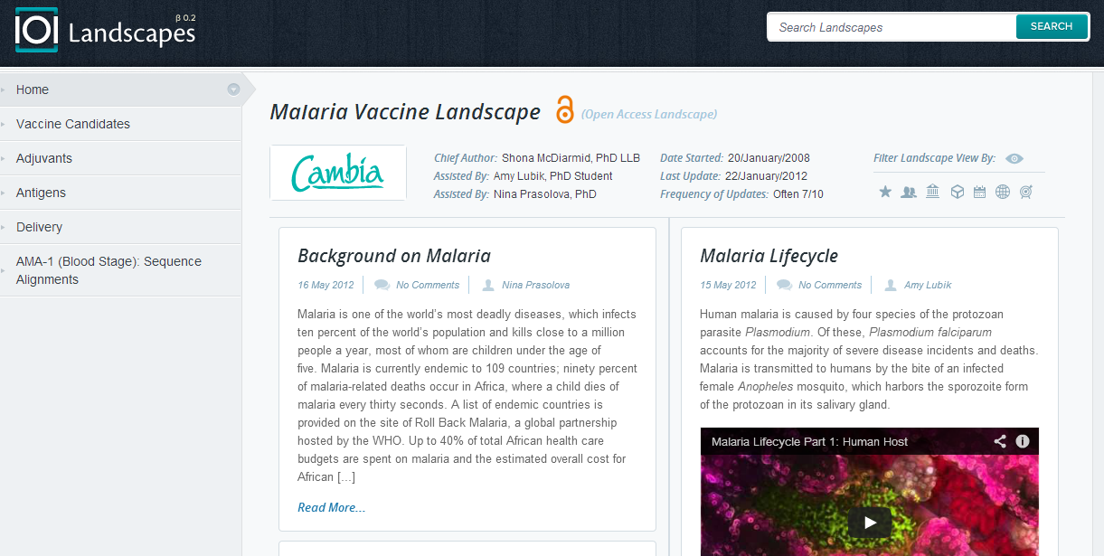
Interactive Web-based PLR
http://blogs.cambia.org/landscape/

Slide 20
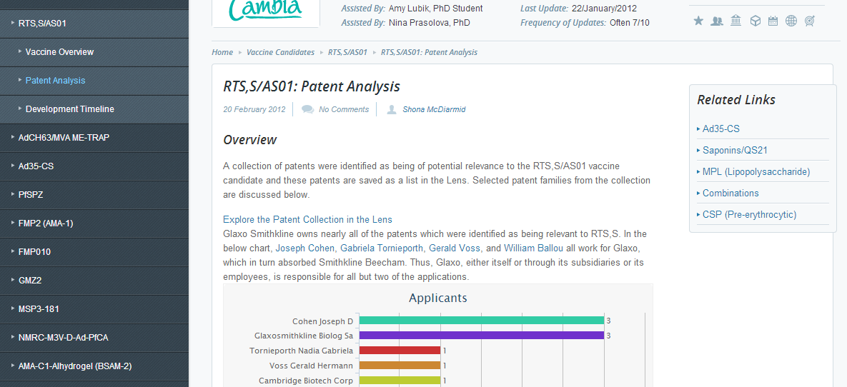
Interactive Web-based PLR (2)

Slide 21
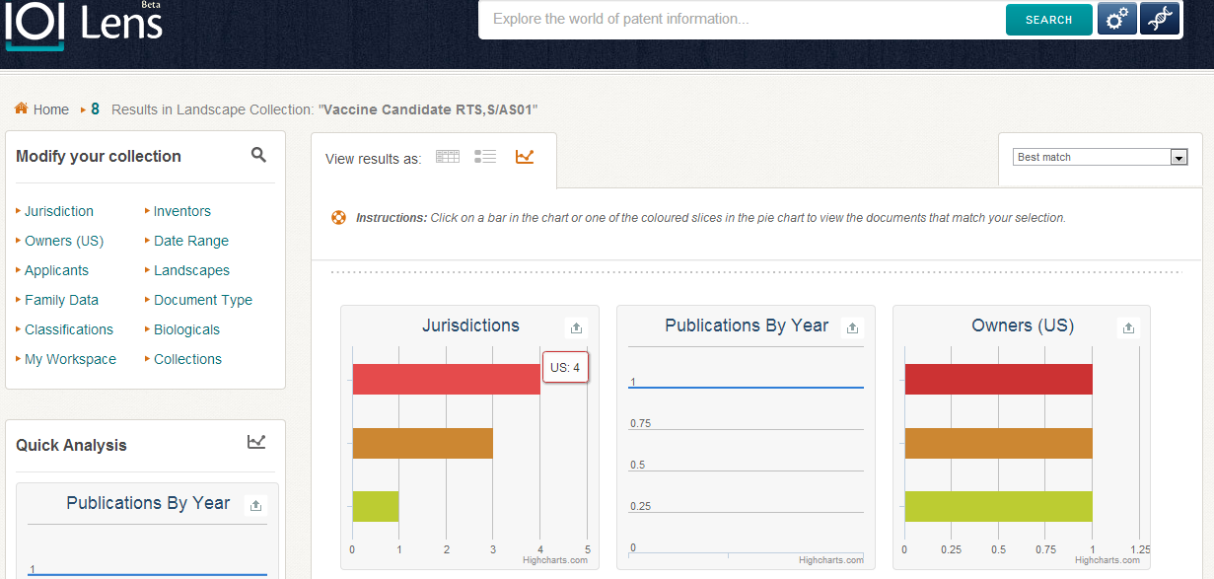
Interactive Web-based PLR

Slide 22

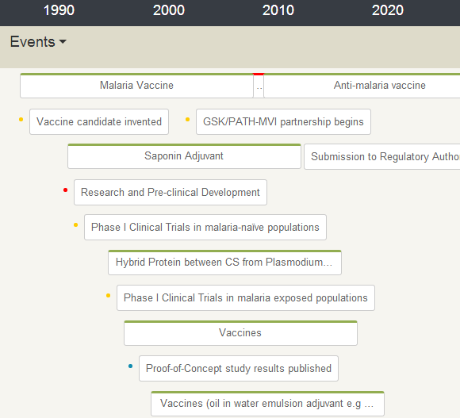
Interactive Web-based PLR (3)
Yellow dots: Publications
Red dots: Clinical Trials
Blue dots: Related patent families

Slide 23
  Obrigada!
  Irene.Kitsara@wipo.int

