Slide 1

IP AND SPORTS IN
LITHUANIA
www.vpb.lrv.lt
Irmina Valaitė
29 May 2019

Slide 2


Slide 3


Slide 4




Slide 5
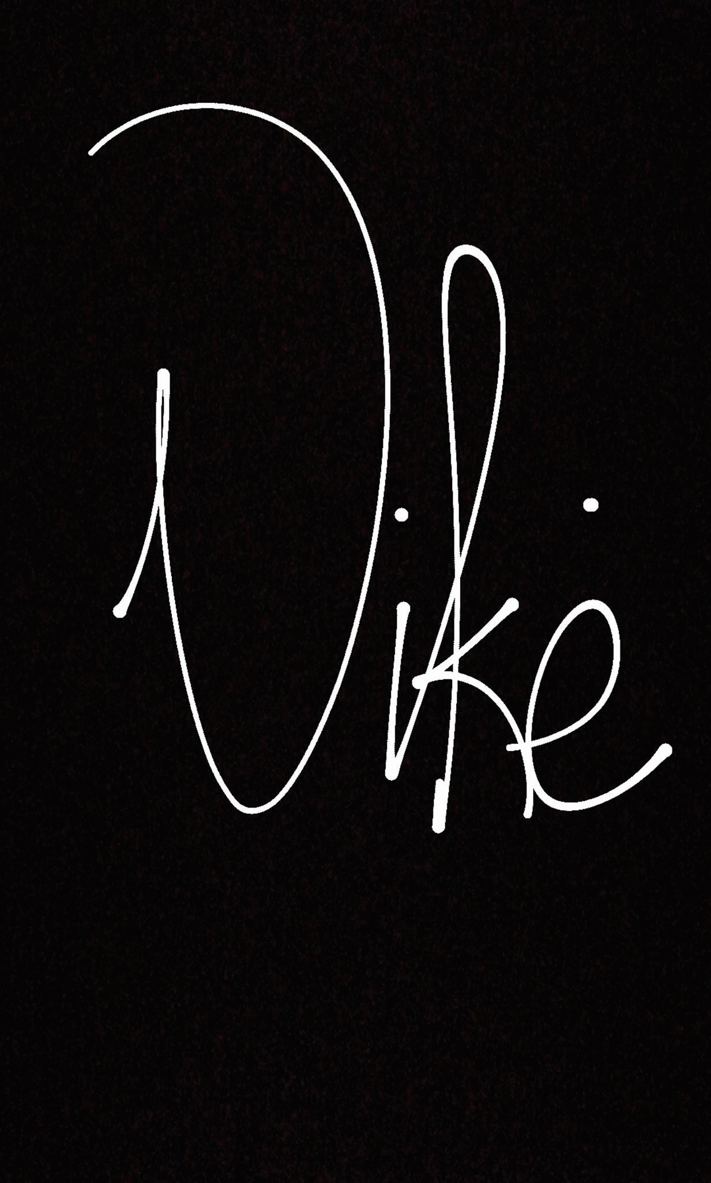

Slide 6
Irmina Valaitė
Appeals Division
Industrial Property Information Division
Email: irmina.valaite@vpb.gov.lt
Phone: + 370 5 211 3533
Kalvarijų str. 3, 09310 Vilnius, Lithuania
www.vpb.lrv.lt

