Slide 1

IP in Sport - Hungary
Michael Lantos
Hungarian and European Patent Attorney
Danubia Patent & Law Office LLC
lantos@danubia.hu

Slide 2
IP legislation - in general
Laws and Rules are in harmony with European practice.
Status cases:
First instance: Hungarian Intellectual Property Office (HIPO)
1st Court level: Metropolitan Court
2nd Court level: Metropolitan Appeal Court
Supervisory Tribunal: Kuria
Bifurcation system: if status is issued it is decided separately
Consequences:long proceedings
Preliminary injunction: faster but not very fast, requires 2-4 months.
In trademark cases: somewhat faster

Slide 3
Patent experiences
Oroszi-vs Adidas litigation:
Inventor had a patent that concerned regions with special ribs/grooves on shooting surface of boots.
In the period 2000 to 2004 the Predator Precision and Mania shoes comprised similar ribs.
Oroszi sued for patent infringement. Adidas filed revocation proceeding. The validity proceeding required 10 years in three rounds, the patent was upheld.
Then the infringement proceeding resumed, in October 2015 a final decision determined: Adidas infringed Oroszi’s patent in the period 2000 to 2004.
June 2017: Decision of the Kuria on the pecuniary compensation. Award after the utilization in Hungary only

Slide 4
New invention of Oroszi
Coating the shooting surface in spaced regions with a double layer of rubber granules of random shape wherein the outer surface of the grains are uncoated, and the regions have excellent grip to the ball, and the direction of the edges of the regions (stripes) assist targeting, and additionally ribs/grooves can be formed.
HU patent application filed: July, 2012
PCT application filed: July 2013
Patents granted: EP (2018), Japan (2017), EA (2019), China (2019),
Pending: US, KP, CA, BR, etc.
Two developments: HU filed May 2018, PCT filed May 2019.
Intensive development and tests.

Slide 5
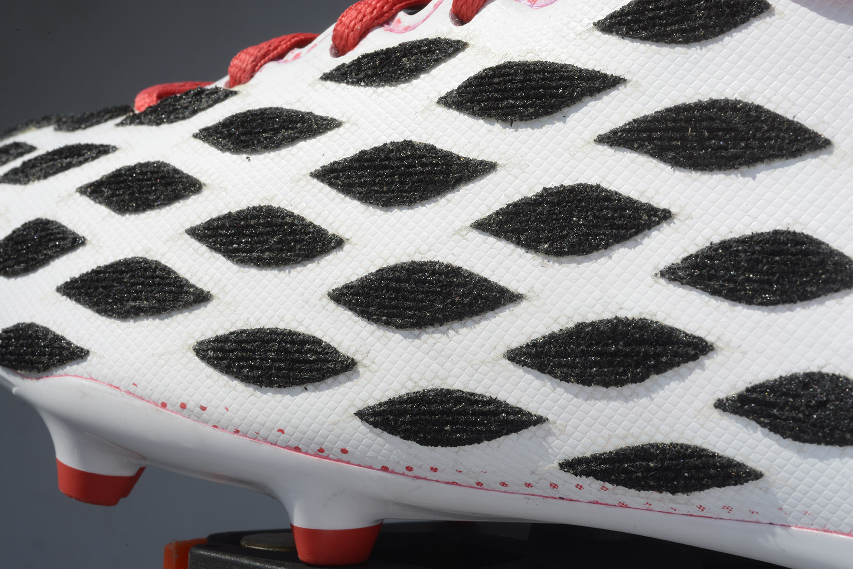
Almond Pattern

Slide 6
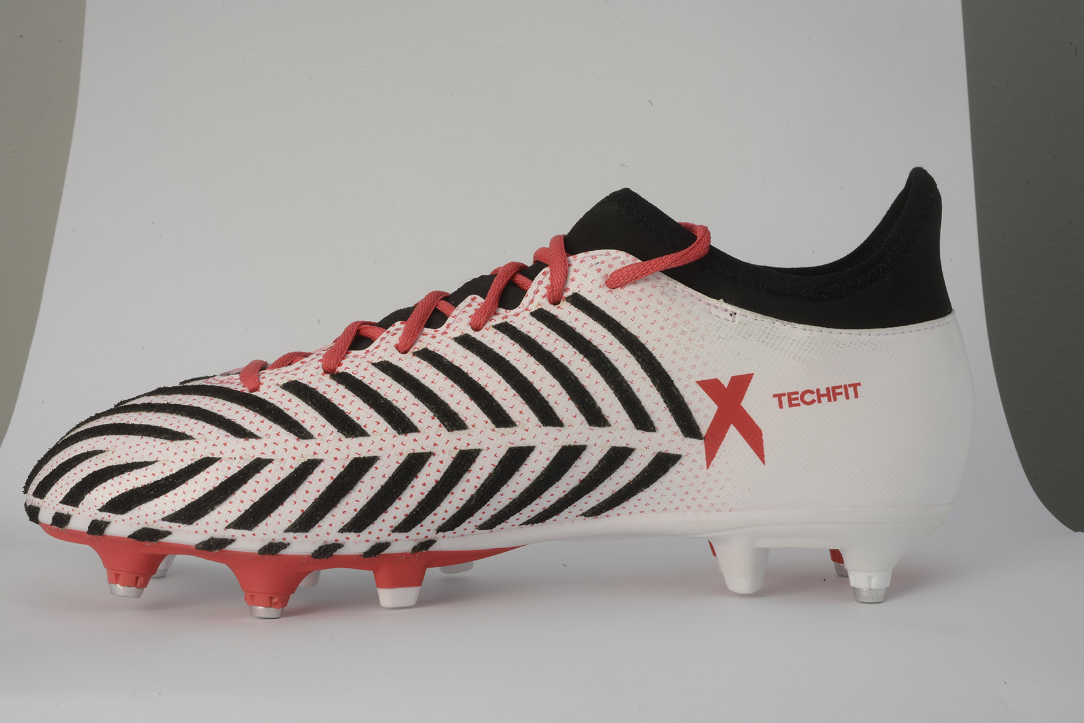
Trapezoid Pattern

Slide 7
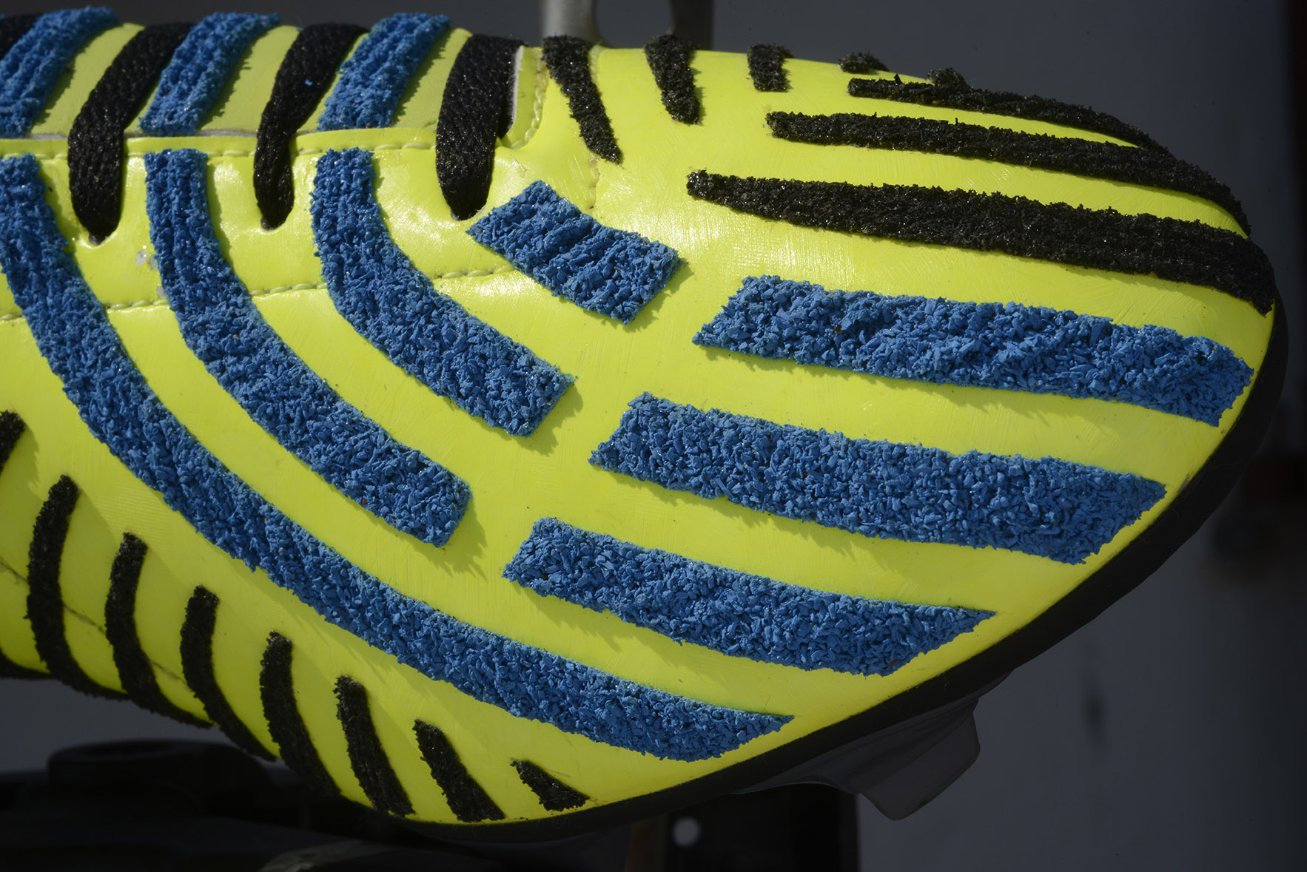
Surface details

Slide 8
The tests confirmed the envisaged properties:
- Better grip to the ball
- Easier ball handling and targeting
- Patterns for all players’ positions
- Comfortable
- Good under wet conditions
- useable for futsal and footgolf

