Slide 1
Licensing, Sponsorship and Merchandising
CELIA SUEIRAS VILLALOBOS
May 28, 2018

Slide 2
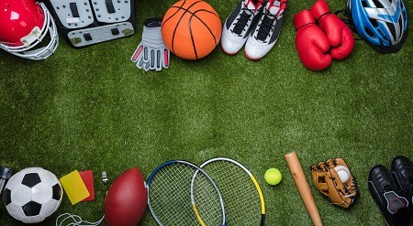
LICENSING, SPONSORSHIP AND MERCHANDISING
SPORTS INDUSTRY REVENUE
The share of sport-related Gross Domestic Product within the EU is 2.12 % and amounts to € 279.7 bn.
The organization of sport competitions has positive effects over other economic sectors (e.g. employment, infrastructures, tourism, etc.)
A national strategy that comprises the government and the private sector is necessary in order to facilitate the creation of an effective legal framework
The legal framework must ensure an adequate protection of IP rights in order to attract investment in the sports industry

Slide 3
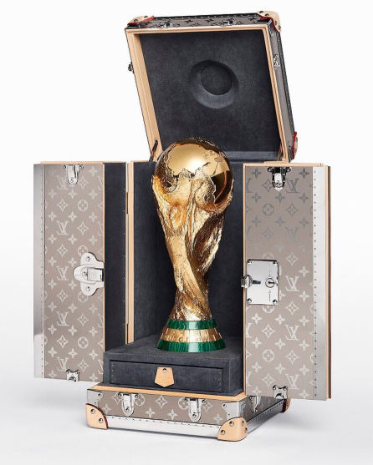
LICENSING, SPONSORSHIP AND MERCHANDISING
A license defines the relationship between the owner of a trademark (licensor) and the producer of the goods or services to which the mark is to be affixed (the licensee).
While licensors are not involved in the manufacturing of the products, it is in their best interest to ensure that licensees maintain the quality of the product bearing their trademark.
Licenses grant rights without transferring IP ownership. For example:
for entertainment purposes / news dissemination
for merchandising and other use of trade marks (e.g. brand collaborations)
for use of technology
LICENSING GENERATES THE REVENUES NEEDED TO TAKE SPORTS TO HIGHER LEVELS OF PRODUCTIVITY

Slide 4
LICENSING, SPONSORSHIP AND MERCHANDISING
Merchandising Agreements
+
ASSIGNMENT LICENSE
ASSIGNOR (SELLER) TRANSFERS OWNERSHIP, FOR CONSIDERATION | LICENSOR TRANSFERS THE RIGHT TO USE A SPECIFIC ASSET, FOR CONSIDERATION
ASSIGNEE (BUYER) SUBSTITUTES THE ASSIGNOR IN ITS POSITION | LICENSEE OBTAINS A RIGHT TO EXPLOIT OR USE THE ASSET FOR A SPECIFIC PERIOD OF TIME
AFTER THE TRANSACTION IS COMPLETED THE SELLER RETAINS NO RIGHTS OVER THE ASSIGNED IP | ONCE THE LICENCE IS TERMINATED, THE RIGHTS OVER LICENSED IP REVERT TO THE OWNER
ONE-SHOT TRANSACTION | ONGOING, LONG-TERM TRANSACTION

Slide 5
LICENSING, SPONSORSHIP AND MERCHANDISING
Sponsorship Agreements
Sponsorship: any communication by which a sponsor, for the mutual benefit of sponsor and sponsored party, contractually provides financing or other support in order to establish a positive association between the sponsor's image, brands, products or services and a sponsored event, activity, organization or individual.
ICC Code on Sponsorship

Slide 6
LICENSING, SPONSORSHIP AND MERCHANDISING
SPONSORSHIP AGREEMENTS
“It’s like the Olympic rings: if a company has the Olympic rings on its business card it means they are top-level and leading their industry segment. A partnership with Manchester United, Real Madrid or FC Barcelona in many markets has the same effect. If you partner with a Real Madrid as a telecommunications firm in Indonesia you are a leading telco in Indonesia.”
https://nielsensports.com/europe-sponsorship-market-euro-2016-mega-clubs-evolving-models/

Slide 7
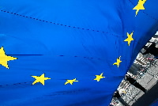
LICENSING, SPONSORSHIP AND MERCHANDISING
Image Rights
US, the right of publicity arises from the concept of privacy, referred to in the Fourth Amendment. The right of publicity is considered an economic right (the right of ownership in an intangible asset)
CONTINENTAL EUROPE, conceived as a personality right and, as such, a fundamental right. The commercial aspect of this right has traditionally been of secondary importance. European experts and the European courts are moving ever closer to the U.S. model because of its greater economic functionality
UNITED KINGDOM, does not recognize a general privacy right or a right of personal portrayal as such. Case law protection: passing off and breach of confidence

Slide 8
LICENSING, SPONSORSHIP AND MERCHANDISING
Piecemeal regulation across the European Union
The right to one’s own image is regulated pursuant to the internal law of each Member State
There has been no attempt at harmonization.
In the United States, the right of publicity is not protected under federal legislation either.
The right to one’s own image is protected via the courts of each State (common law)
Some states have adopted laws that contain and systematize case law (statutes)

Slide 9
LICENSING, SPONSORSHIP AND MERCHANDISING

Slide 10
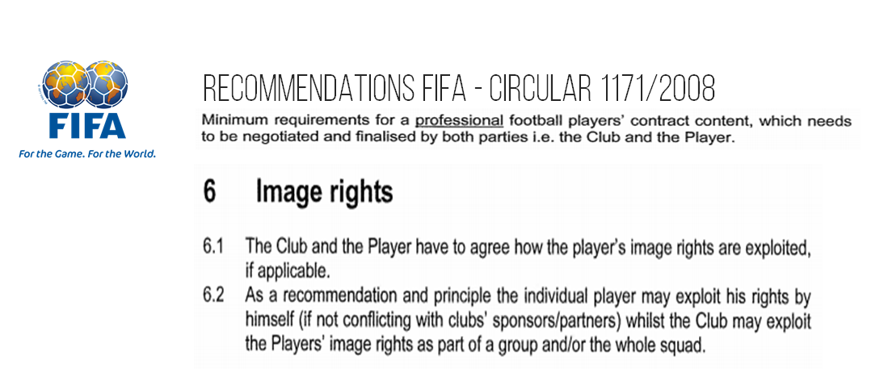
LICENSING, SPONSORSHIP AND MERCHANDISING

Slide 11
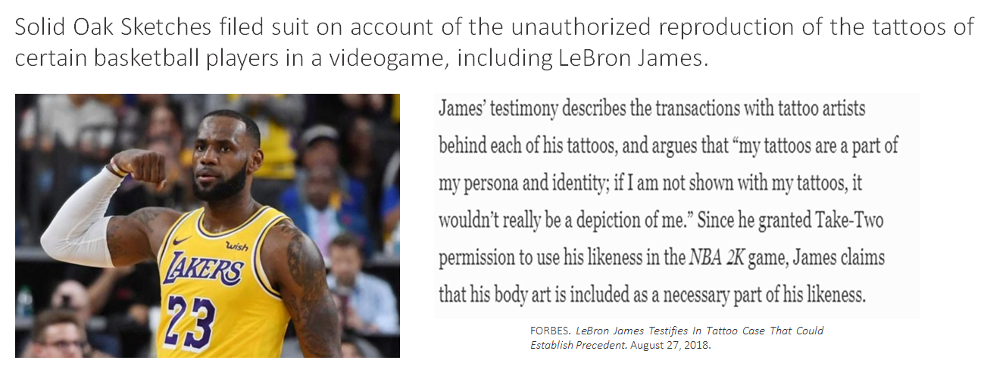
LICENSING, SPONSORSHIP AND MERCHANDISING
Do athletes ‘own’ their skin?

Slide 12
LICENSING, SPONSORSHIP AND MERCHANDISING
Do athletes ‘own’ their skin?

Slide 13
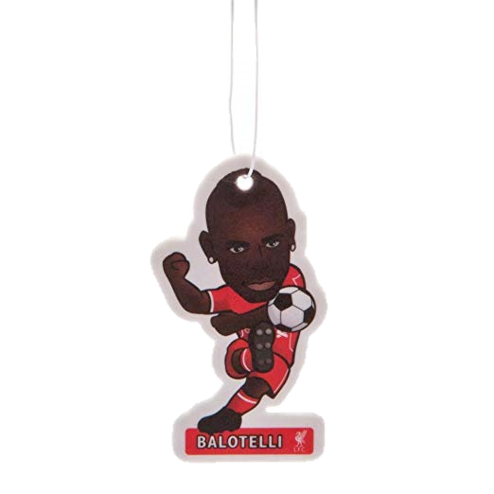
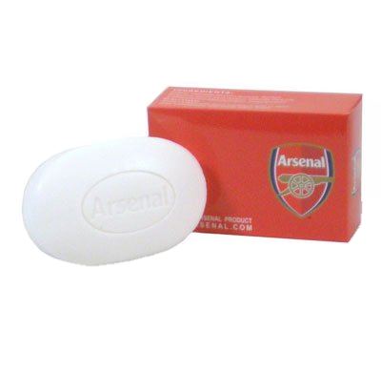
LICENSING, SPONSORSHIP AND MERCHANDISING
Merchandising Agreements
Based on the selling power of the event or brand:
Merchandising can be defined as a trademark license used in conjunction with certain products and/or services generally unrelated to those for which the mark is known
Marketing goods and/or services different from those offered by the brand owner (e.g. T-shirts, watches, bags, etc.) further stimulates appeal and demand
Notes:
13

Slide 14
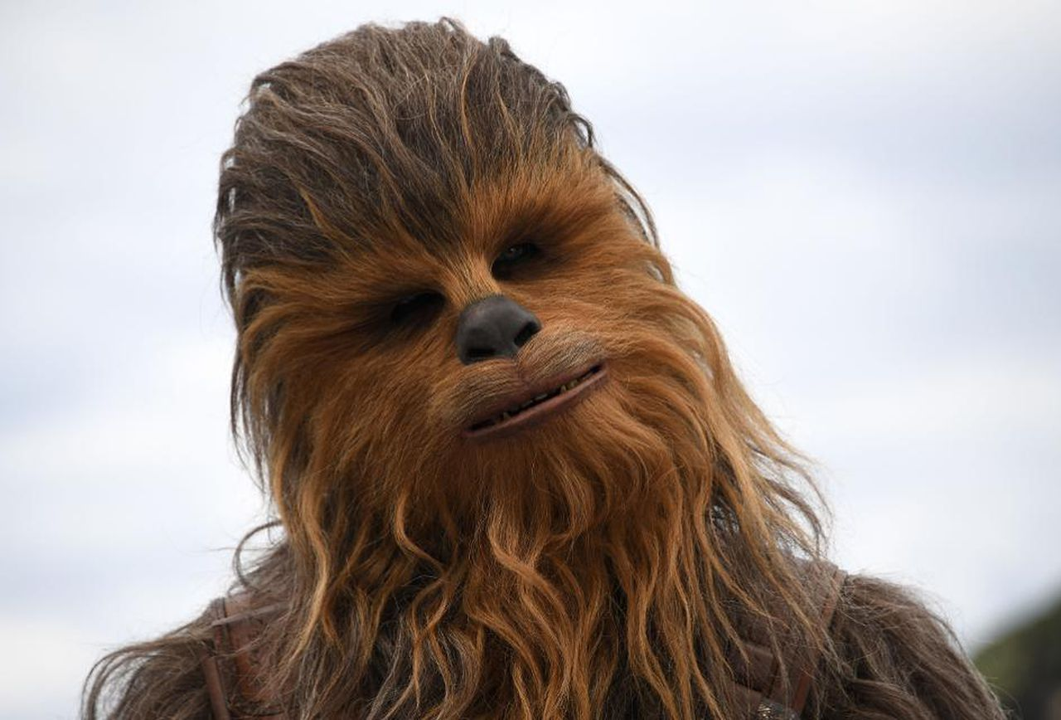
LICENSING, SPONSORSHIP AND MERCHANDISING
STAR WARS REVENUE
https://www.valuewalk.com/2015/12/disney-star-wars/

Slide 15
LICENSING, SPONSORSHIP AND MERCHANDISING
PREVIOUS STEPS: Due Diligence
Trademark licensing usually configures a long-term relationship.
Check who the right holder is;
Know your licensee;
Check the licensed trade marks are registered and in force in all the relevant countries;
Check if there are other licenses in force in the relevant markets;
Check for third party claims regarding the trade marks;
Is the acquisition of other rights necessary for the exploitation of the license? (e.g. copyrights)

Slide 16
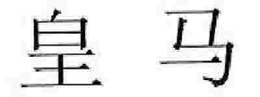
LICENSING, SPONSORSHIP AND MERCHANDISING
CLAUSES
Correct identification of the licensed rights (normally through exhibits)
Possibility of including an application for registration
Include adequate mechanisms for extension/reduction of the license
Scope of the license:
Develop, manufacture, sell products
Reproduction, transformation, registration
HUANG MA

Slide 17
LICENSING, SPONSORSHIP AND MERCHANDISING
CLAUSES
Exclusive or non-exclusive license?
Capacity to sublicense?
How much? Flat fee, royalty, bonus
Third-party infringement
Reps & Warranties (valid-enforceable-not infringing)
Global or partial license:
Global: for all goods and services covered by the mark
Partial: for only part of such goods and services
Termination clauses: Is it linked to the termination of an employment contract?
Removal upon termination: Third-party platforms
Dispute resolution (mediation, arbitration)

Slide 18
LICENSING, SPONSORSHIP AND MERCHANDISING
Quality Standards
Trademark owner should monitor the quality of the products manufactured by the licensee
The aim is to avoid reputational damage
Product liability
Licensor must ensure that Licensee does not damage the commercial value of the brand
Material quality
Control Labelling
Supply sources
Notes:
18

Slide 19
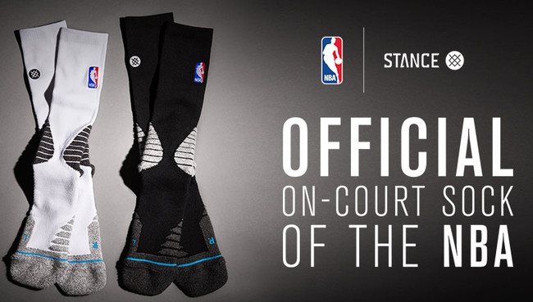
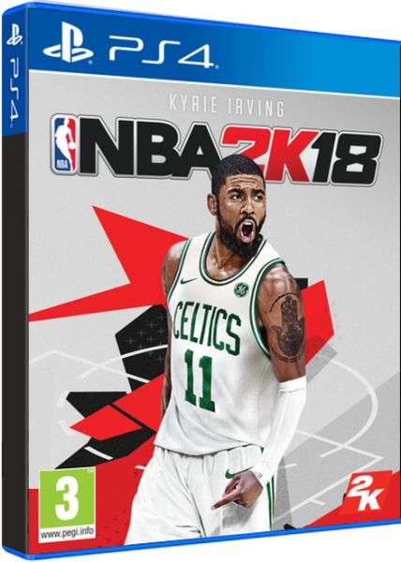
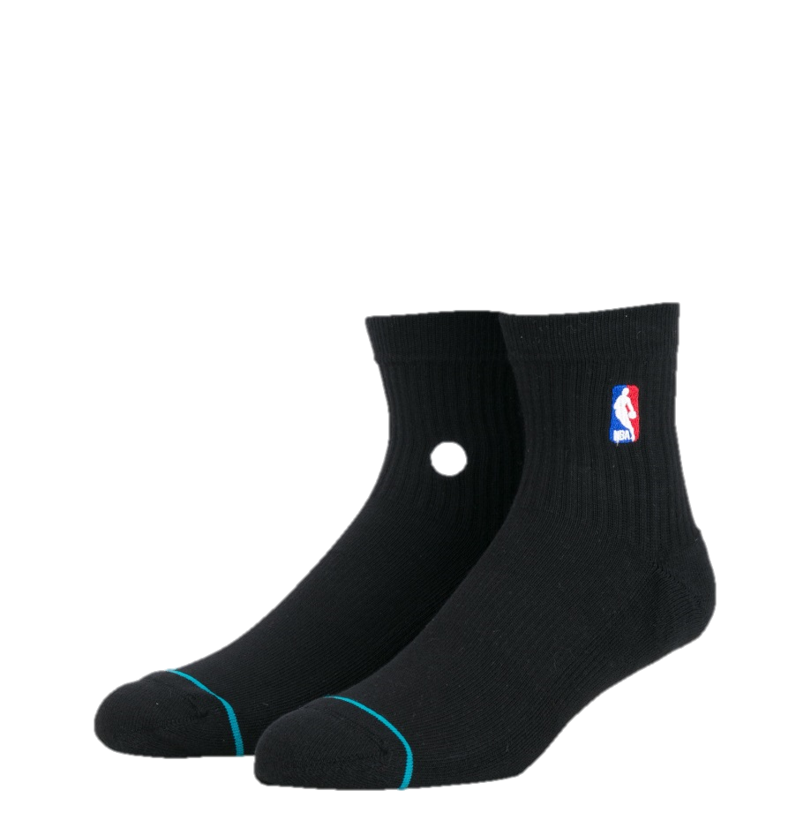
LICENSING, SPONSORSHIP AND MERCHANDISING
HOW MUCH IS A NBA LICENSE WORTH?
FROM SOCKS... …TO VIDEOGAMES
$1MILLION
(ONE YEAR)
$1.1billion (SEVEN YEARS)

Slide 20
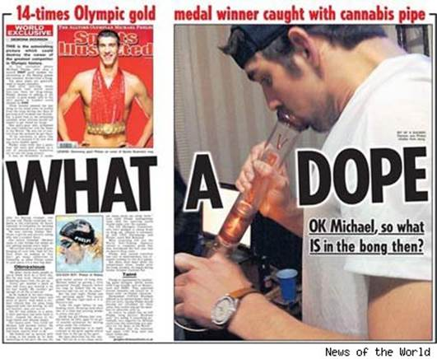
LICENSING, SPONSORSHIP AND MERCHANDISING
SPONSORSHIP AGREEMENTS: WHEN THE UNEXPECTED HAPPENS

Slide 21
Hvala!
CELIA SUEIRAS VILLALOBOS
May 28, 2018

