Slide 1
IP in the Textile, Fashion and Creative industries
Nathalie Frigant & Marina Foschi
Brands and Designs Sector

Slide 2
How much IP in fashion?
Trademark/Design
Patent
Utility model
Trade secret
Copyright

Slide 3
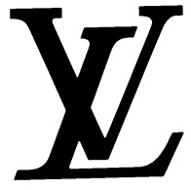
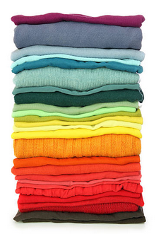
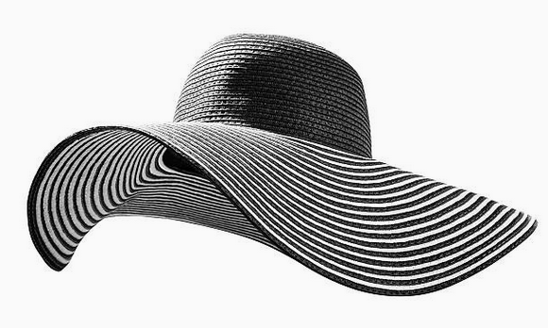
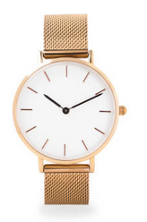
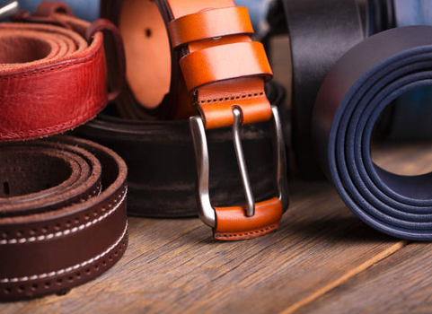
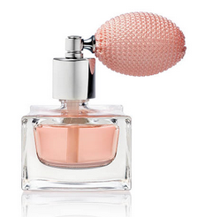
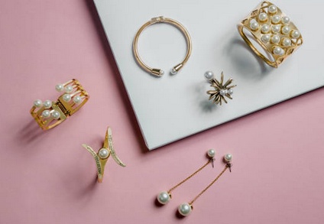
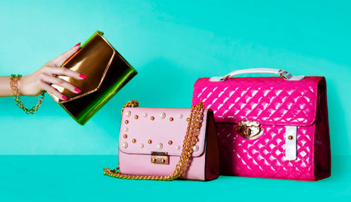
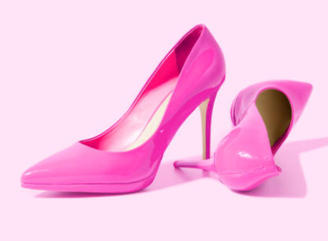
Fashion
Clothes
Watches and Jewerly
Shoes
Accessories

Slide 4
Why protect trademarks and designs?

Slide 5
IP Protection - Why protect a trademark or a design?
Exclusive rights
License / Transfer of ownership
Business asset - Financial value

Slide 6
Trademarks in the textile, fashion and creative industries

Slide 7
Designs in the textile, fashion and creative industries

Slide 8
Basics - What is an industrial design?
Appearance of a product or a packaging
How a product looks

Slide 9
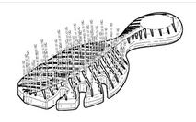
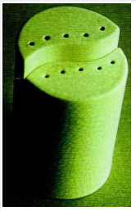
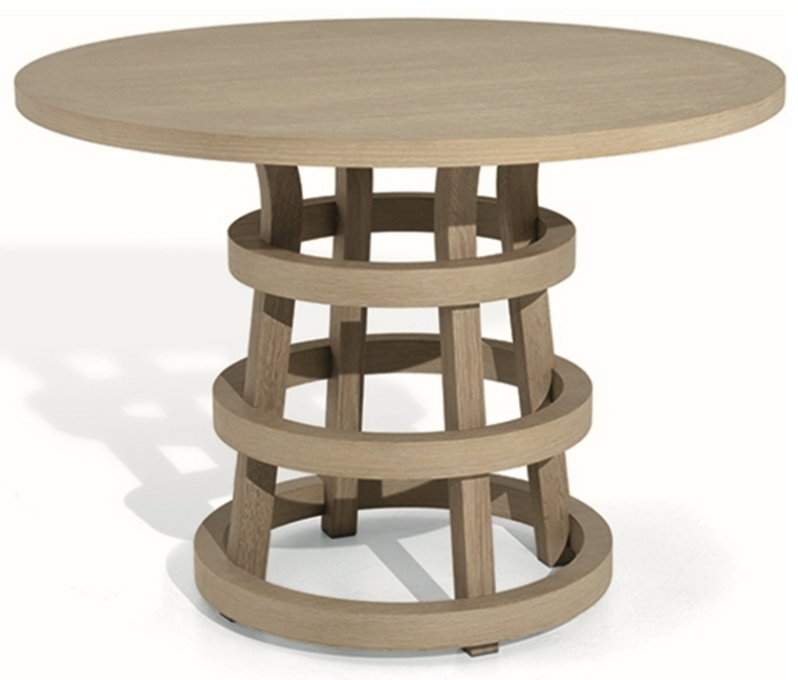
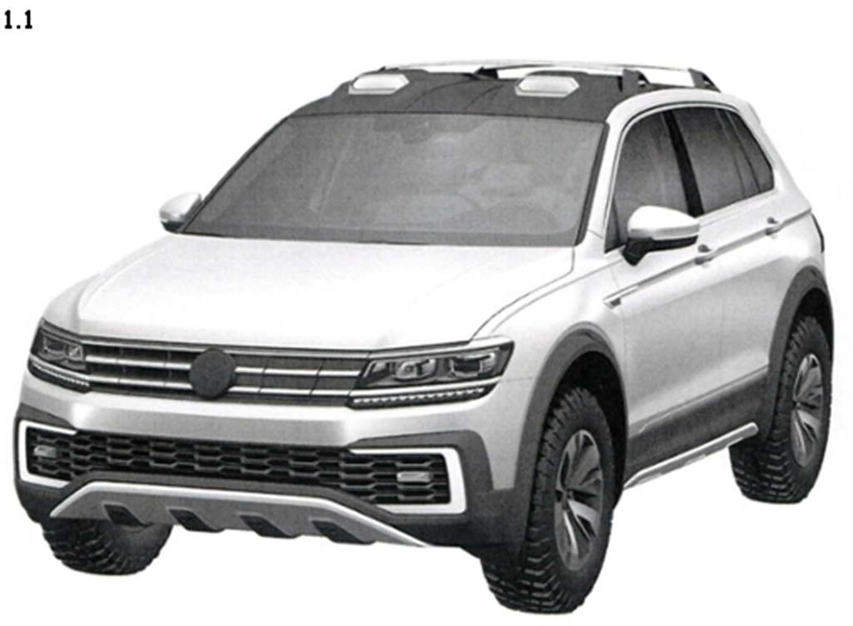
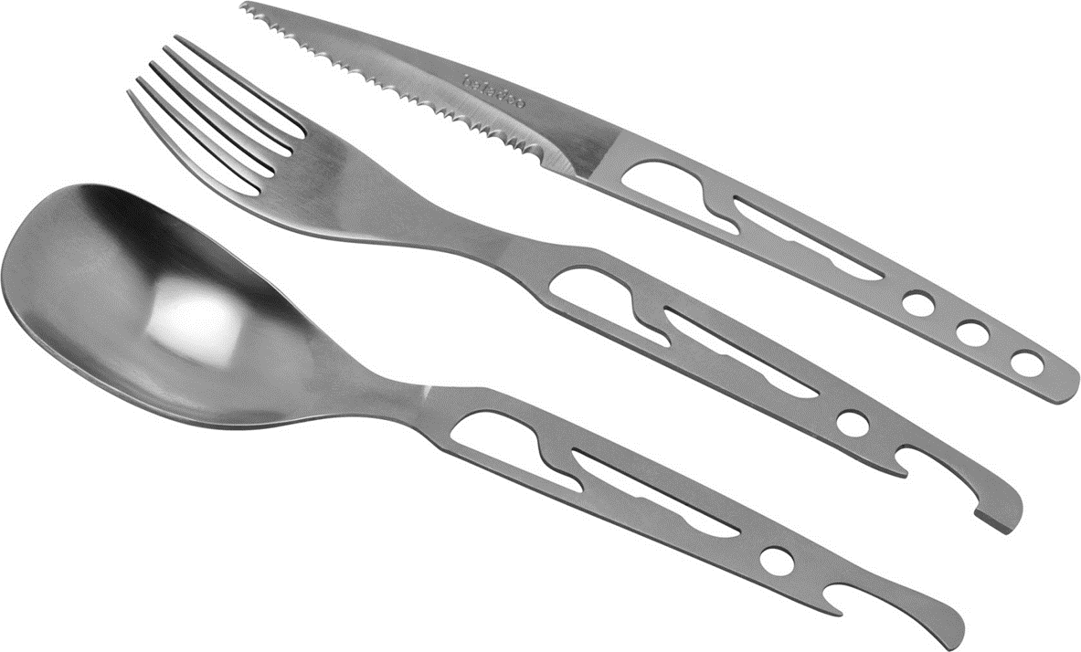
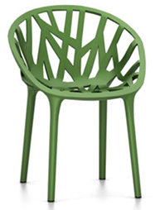
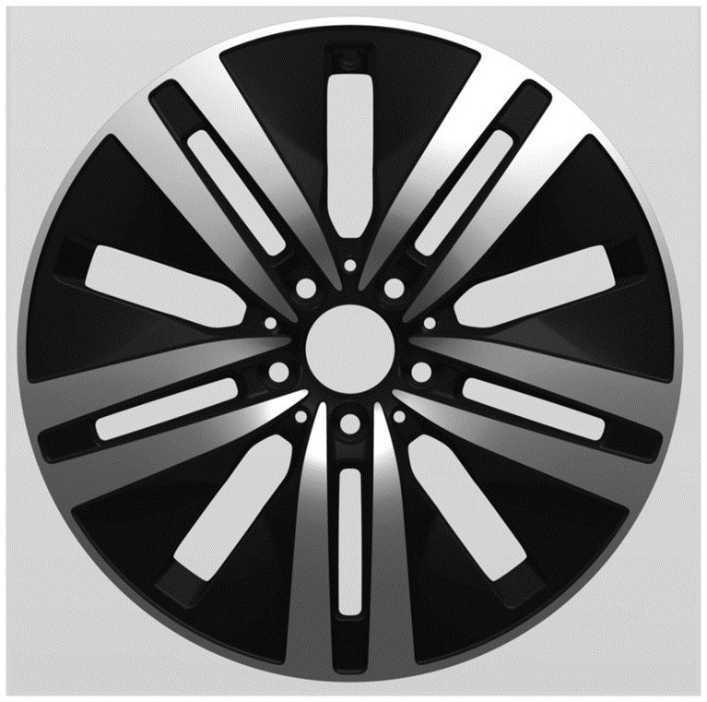
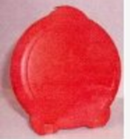
Designs are everywhere

Slide 10
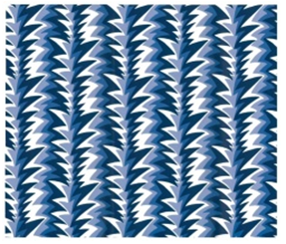
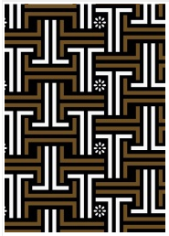
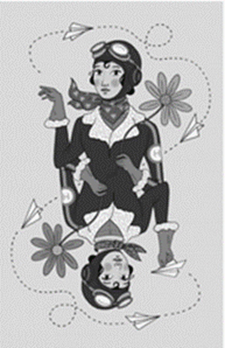
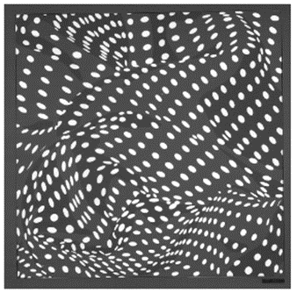
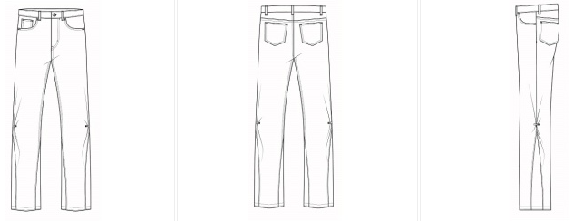
Designs in the fashion industry - Examples
Two-dimensional

Slide 11
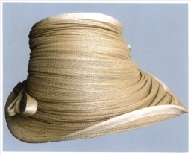
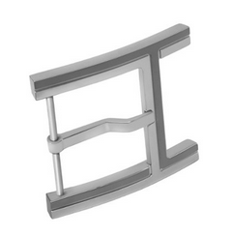
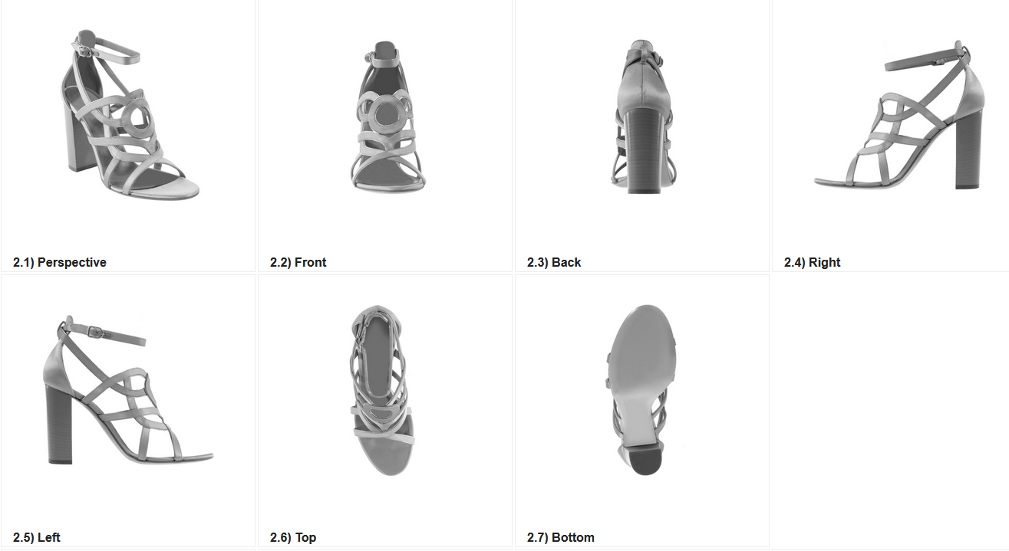
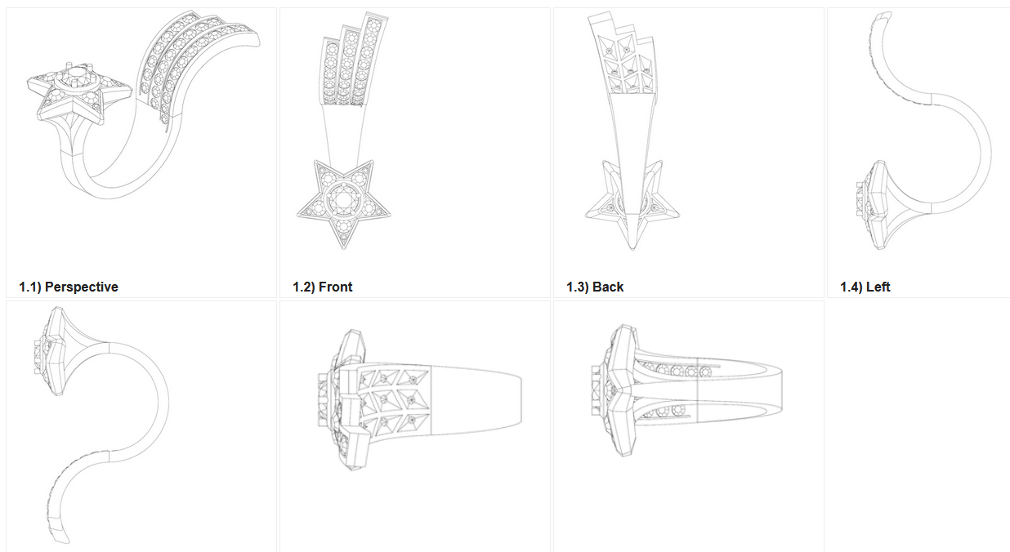
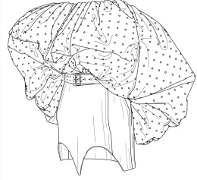
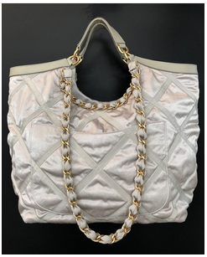
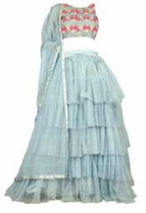
Designs in the fashion industry - Examples
Three-dimensional

Slide 12
How to protect a design?
Different systems of protection throughout the World
Protection based on copyrights
Protection based on a registration system (design rights /design patent)
«Unregistered» design rights system
Requirement - Originality/Novelty – CAREFUL: DISCLOSURE!!!
Availability of the design (not infringing rights acquired by third parties) – Prior designs search in the Global Design Database - https://www3.wipo.int/designdb/en/

Slide 13
Where to protect a design?
Design rights are territorial rights
Different routes:
National
Regional (e.g., EUIPO)
International Registration of industrial designs : Hague System
https://www.wipo.int/hague/en/

Slide 14
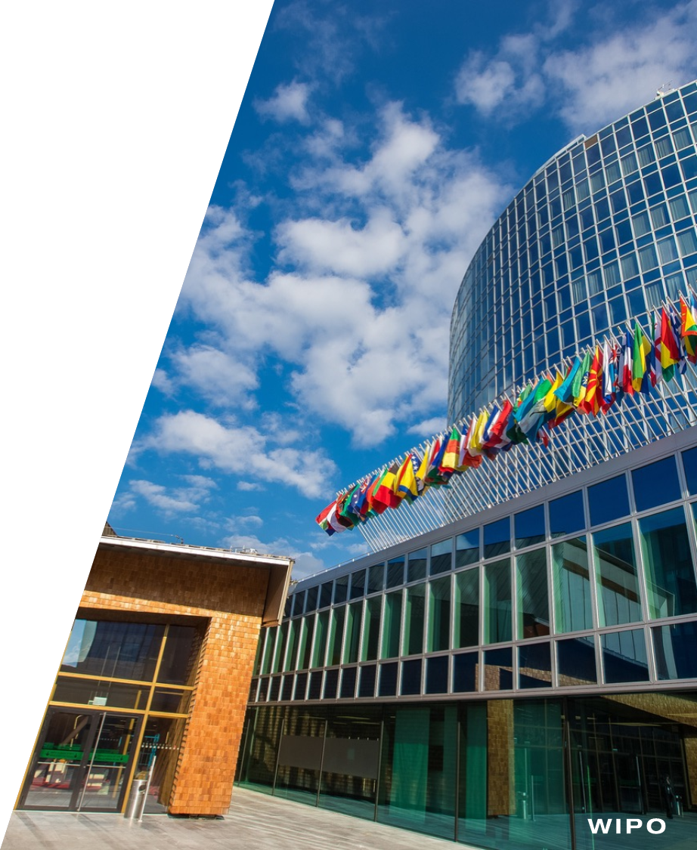
Conclusion
Information on IP: www.wipo.int
Education/training on IP:
https://www.wipo.int/academy/en/

