Slide 1

Asia-Pacific Women Innovators and Entrepreneurs Program
The Patent Cooperation Treaty (PCT) – A System for International Patent Protection
Ms. Anjali Aeri, Counsellor
PCT International Cooperation, PCT Legal and International Affairs Department, World Intellectual Property Organization (WIPO) anjali.aeri@wipo.int
August 3, Geneva

Slide 2
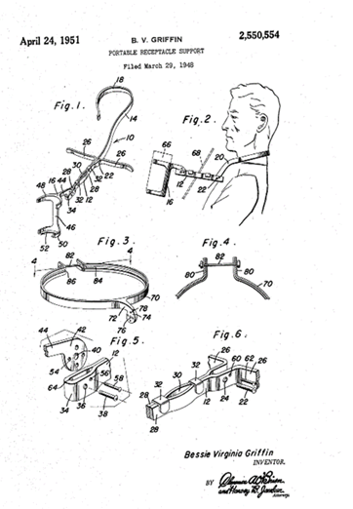
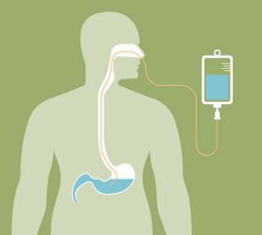
Women Inventions – Leading the way
Source: https://www.klemen-homecare.de/blog/enterale-ern%C3%A4hrung-definition-indikation-ziele/
Notes:
- A 1940s African-american nurse paved the way for modern feeding and invented a device that allowed her patients to feed themselves. Many of her patients were World War II veterans.

Slide 3
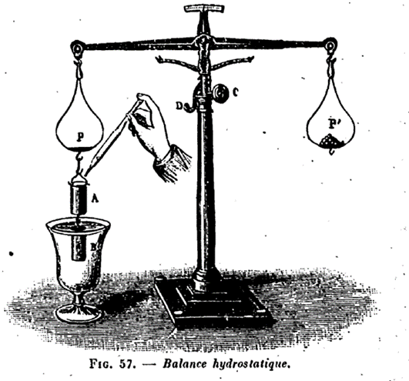

Patent system
Protection of rights: Reward/investment for creating a new invention = patent: exclusive right granted for a product/process, that provides a new way of doing something, or a new technical solution to a problem
Disclosure: Publish technical information of invention
  Innovation and economic growth
  Opportunity for commercialization
  (license, sell, merger)
  Inclusion of women in STEM
Image source: https://i.huffpost.com/gen/1393530/thumbs/o-WOMEN-IN-SCIENCE-facebook.jpg

Slide 4
Prior art (for international search
(PCT Article 15(2) and Rule 33))
Prior art:
  everything which has been made available to the public,
  anywhere in the world,
  by means of written disclosure,
  which is capable of being of assistance in determining that the claimed invention is or is not new and that it does or does not involve an inventive step,
  provided the making available to the public occurred prior to the international filing date.
PCT Minimum Documentation (Rule 34)

Slide 5
PCT vs. Paris route (traditional)
File applications abroad
Costs for:
translations (≈ 18–36% of total)
Patent Office fees (≈33%)
local agents (≈ 25-50%)
(months)
Traditional route
0
12
File local
application
States
18 months
Enter national
phase
International
publication
(months)
PCT route
0
12
16
18
22
28
30
File local
application
File PCT
Application
Typically filed in same national Office - one set of fees, one language, one set of formality requirements and legal effect in PCT States
International search report & written opinion
(optional)
File demand for international preliminary examination
International
preliminary report on patentability
Notes:
International reach: One application has effect in 155 PCT Member States
Postponement of costs: 18 extra months before you have to pay for local filings
Information gathering: 18 extra months to receive substantive feedback on your patent application and to do market research and testing
Most Foreign filings are via PCT vs. Paris: Businesses 86.4%, Individuals 6.2%, Universities 5.6% Government 1.9%

Slide 6
Key Advantages of the PCT
International reach: One application has effect in 155 PCT Member States
Postponement of costs: 18 extra months before you have to pay for local filings
Information gathering: 18 extra months to receive substantive feedback on your patent application and to do market research and testing
Notes:
The PCT offers a number of advantages:
1. Harmonized sets of rules and regulations – legal clarity;
2. Streamlined and cost-effective means of obtaining protection in multiple countries;
3. With one single international application can trigger the process of obtaining patent protection in multiple countries.

Slide 7
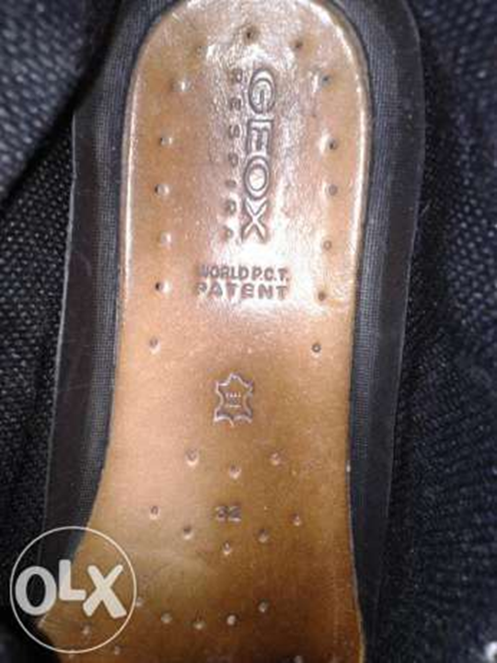
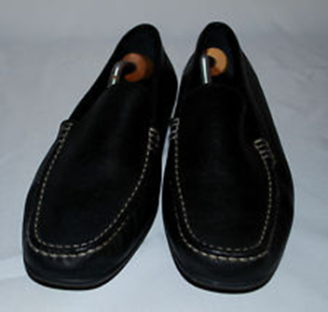
General remarks on the PCT system
Only inventions may be protected via the PCT
The PCT is a patent “filing” system, not a patent “granting” one.
The decision on granting patents is taken exclusively by national/regional Offices

Slide 8
PCT Statistics – Filings & Membership

Slide 9
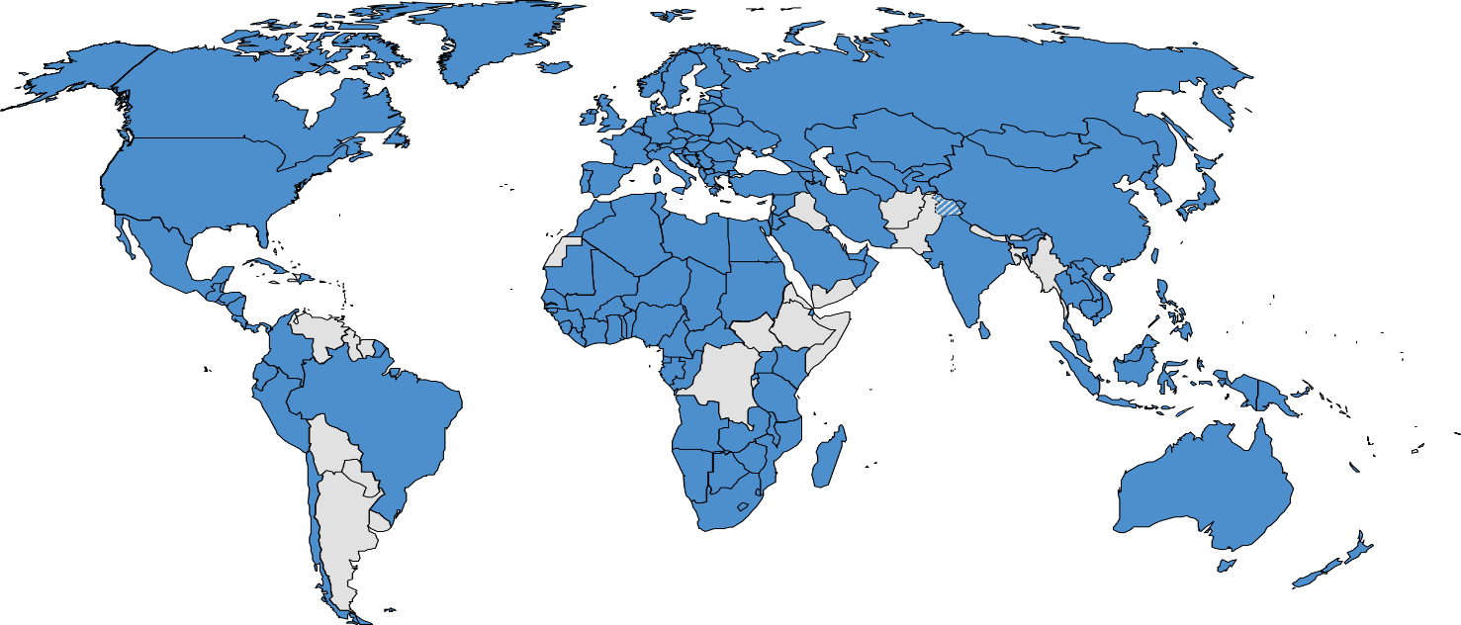

156 PCT States
Recent accessions: Cabo Verde Iraq
=PCT
Albania
Algeria
Angola
Antigua and Barbuda
Armenia
Australia
Austria
Azerbaijan
Bahrain
Barbados
Belarus
Belgium
Belize
Benin
Bosnia and Herzegovina
Botswana
Brazil
Brunei Darussalam
Bulgaria
Burkina Faso
Cabo Verde (July 6, ’22)
Cambodia
Cameroon
Canada
Central African Republic
Chad
Chile
China
Colombia
Comoros
Congo
Costa Rica
Côte d'Ivoire
Croatia
Cuba
Cyprus
Czech Republic
Democratic People's
Republic of Korea
Denmark
Djibouti
Dominica
Dominican Republic
Ecuador
Egypt
El Salvador
Equatorial Guinea
Estonia
Finland
France,
Gabon
Gambia
Georgia
Germany
Ghana
Greece
Grenada
Guatemala
Guinea
Malawi
Malaysia
Mali
Malta
Mauritania
Mexico
Monaco
Mongolia
Montenegro
Morocco
Mozambique
Namibia
Netherlands
New Zealand
Nicaragua
Niger
Nigeria
Norway
Oman
Panama
Papua New Guinea
Peru
Philippines
Guinea-Bissau
Honduras
Hungary
Iceland
India
Indonesia
Iran (Islamic Republic of)
Iraq (Apr. 30, ’22)
Ireland
Israel
Italy
Jamaica
Japan
Jordan
Kazakhstan
Kenya
Kuwait
Kyrgyzstan
Lao People’s Dem Rep.
Latvia
Lesotho
Liberia
Libya
Liechtenstein
Lithuania
Luxembourg
Madagascar
Poland
Portugal
Qatar
Republic of Korea
Republic of Moldova
Romania
Rwanda
Russian Federation
Saint Lucia
Saint Vincent and
the Grenadines
Samoa
San Marino
Sao Tomé e Principe
Saudi Arabia
Senegal
Serbia
Seychelles
Sierra Leone
Singapore
Slovakia
Slovenia
South Africa
Spain
Sri Lanka
Sudan
Swaziland
St. Kitts and Nevis
Sweden
Switzerland
Syrian Arab Republic
Tajikistan
Thailand
The former Yugoslav
Republic of Macedonia
Togo
Trinidad and Tobago
Tunisia
Turkey
Turkmenistan
Uganda
Ukraine
United Arab Emirates
United Kingdom
  United Republic of Tanzania
  United States of America
Uzbekistan
Viet Nam
Zambia
Zimbabwe
Notes:
Cabo Verde, April 6, 2022
Iraq, January 31, 2022
Jamaica, November 10, 2021
Samoa, October 2, 2019

Slide 10
Countries not (yet) PCT Contracting States (37)
Afghanistan
Andorra
Argentina
Bahamas
Bangladesh
Bhutan
Bolivia
Burundi
Democratic Republic of Congo
Eritrea
Ethiopia
Fiji
Guyana
Haiti
Kiribati
Lebanon
Maldives
Marshall Islands
Mauritius
Micronesia
Myanmar
Nauru
Nepal
Pakistan
Palau
Paraguay
Solomon Islands
Somalia
South Sudan
Suriname
Timor-Leste
Tonga
Tuvalu
Uruguay
Vanuatu
Venezuela
Yemen
Notes:
ASEAN – Association of Southeast Asian Nations - all 10 members, ID, TH, VN, SG, MY, PH, BN, LA, KH, except Myanmar
SAARC - The South Asian Association for Regional Cooperation (Afghanistan, Bangladesh, Bhutan, India, Maldives, Nepal, Pakistan, and Sri Lanka)

Slide 11
Growth of PCT Filings

Slide 12
PCT applications by country of origin in 2021
25.1% originating from China, 21.5% from US, 18.1% from Japan

Slide 13
A slow increase of the share of women using PCT
Notes:
-In 25 years, the % of women PCT applicants hasn’t even doubled, some years no progress, therefore WIPO estimates that it will take almost 40 years to reach parity!
Share of women among PCT inventors - 16.5% (+1 percentage point in 2021)
The gender gap among PCT inventors varies considerably between countries. Of the top 20 origins, China, Spain and Turkey had the largest proportion of inventors who were women in 2021. In contrast, for Austria and Japan slightly less than one-tenth of inventors in applications
published in 2021 were women.
- Those technology fields relating to the life sciences had comparatively higher proportions of women among inventors listed in PCT applications published in 2020
- Overall, women represented more than one-quarter of inventors in the fields of analysis of biological materials, biotechnology, food chemistry, organic fine chemistry and pharmaceuticals.

Slide 14
By Region: share of women using PCT
Notes:
-In 25 years, the % of women PCT applicants hasn’t even doubled, some years no progress, therefore WIPO estimates that it will take almost 40 years to reach parity!
Share of women among PCT inventors - 16.5% (+1 percentage point in 2021)
The gender gap among PCT inventors varies considerably between countries. Of the top 20 origins, China, Spain and Turkey had the largest proportion of inventors who were women in 2021. In contrast, for Austria and Japan slightly less than one-tenth of inventors in applications
published in 2021 were women.
- Those technology fields relating to the life sciences had comparatively higher proportions of women among inventors listed in PCT applications published in 2020
- Overall, women represented more than one-quarter of inventors in the fields of analysis of biological materials, biotechnology, food chemistry, organic fine chemistry and pharmaceuticals.

Slide 15
Share of women inventors: Asia-Pacific
 | Region | Country | PCT Share of women inventors in PCT applications by origin, 2021
 | Asia | Philippines | 37.7%
 | Asia | Malaysia | 26.7%
 | Asia | Thailand | 26.3%
 | Asia | Kazakhstan | 26.2%
 | Asia | Sri Lanka | 25.0%
 | Asia | Turkey | 24.2%
 | Asia | Viet Nam | 24.1%
 | Asia | Oman | 23.8%
 | Asia | China | 23.7%
 | Asia | Iran (Islamic Republic of) | 23.2%
 | Asia | Jordan | 20.0%
 | Asia | Israel | 16.5%
 | Asia | Singapore | 15.5%
 | Asia | Republic of Korea | 15.3%
 | Asia | Cyprus | 14.3%
 | Asia | United Arab Emirates | 11.3%
 | Asia | India | 10.2%
 | Asia | Japan | 9.8%
 | Asia | Indonesia | 9.4%
 | Asia | Qatar | 7.0%
 | Asia | Saudi Arabia | 6.7%
Notes:
Note: shares are provided for origins with more than 10 published PCT applications. Data are based on the applicant's origin.
Source: WIPO Statistics Database, March 2022.
ASEAN (Brunei, Cambodia, Indonesia, Laos, Malaysia, Myanmar, Philippines, Singapore, Thailand, and Viet Nam). The ASEAN share grew from 17.2% in 2011 to 18% in 2021. Singapore has a sharp impact on the ASEAN share.
Most women using the PCT system work in universities or public research organizations

Slide 16
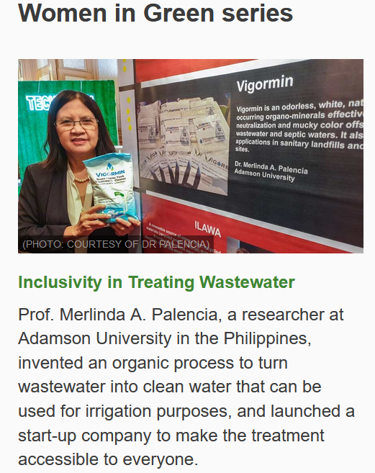
WIPO GREEN
Notes:
In March 2020 – launched Women in Green series
Inventor Prof. Merlinda A. Palencia – Inventor and Entrepreneur:
Vigormin is a technology currently protected as a trade secret by Adamson University.
Our company has registered it with the Bureau of Patents of the IP Office of the Philippines (IPOPHL) as a utility model and open to adapt our strategy in the future.
In addition, the names Vigormin and Envigor are registered as trademarks in the Philippines.

Slide 17
WIPO GREEN - The Marketplace for Sustainable Technology
WIPO GREEN - online platform for technology exchange
Supports global efforts to address climate change by connecting providers and seekers of environmentally friendly technologies
Entrepreneurs network - acceleration projects bring together key players to catalyze green technology innovation
Assembles technologies at all stages of development, from prototypes to marketable products, which are available for license, collaboration, joint ventures, and sale.
Eco-friendly technologies as well as technology “needs” - WIPO GREEN is a go-to platform for green technology innovation
https://www.wipo.int/wipo-match/en/

Slide 18
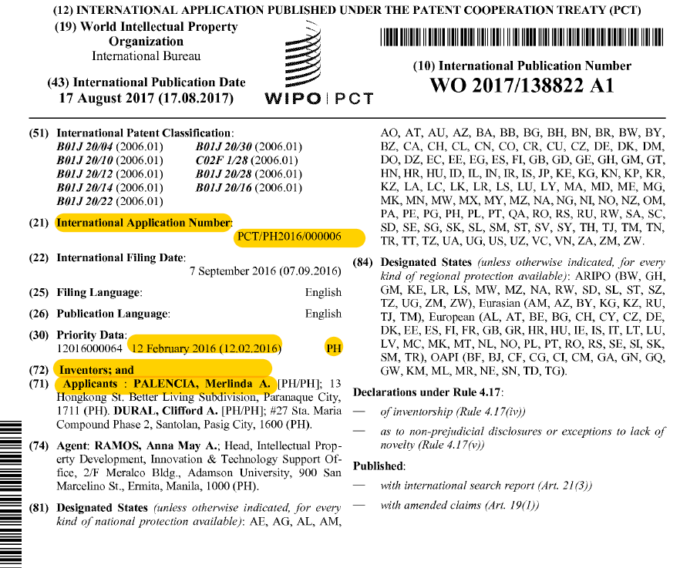
IP Strategy - PCT
Notes:
IP Strategy - WO2017138822 - LOW COST ORGANOMINERALS FOR WASTEWATER TREATMENT AND ODOR NEUTRALIZER
And Now: as of January 2020
Vigormin is a technology currently protected as a trade secret by Adamson University.
Our company has registered it with the Bureau of Patents of the IP Office of the Philippines (IPOPHL) as a utility model and open to adapt our strategy in the future.
In addition, the names Vigormin and Envigor are registered as trademarks in the Philippines.
Vigormin is only available on the national level, however, potential collaborations are being explored with companies in Singapore, Thailand, and the United Arab Emirates. If these negotiations come to fruition, we will apply for trademark protection in some of these countries.

Slide 19
PATENTSCOPE
PATENTSCOPE: https://patentscope.wipo.int
4.3 million published PCT applications!
102 million patent documents (data from 72 regional or national collections)
National Phase Entry Data for 66 countries
Patent Register Portal: https://www.wipo.int/patent_register_portal/en/index.html Over 200 jurisdictions and patent collections – i.e. ASEAN
The WIPO COVID-19 Search Facility of PATENTSCOPE https://patentscope.wipo.int/search/en/covid19.jsf

Slide 20
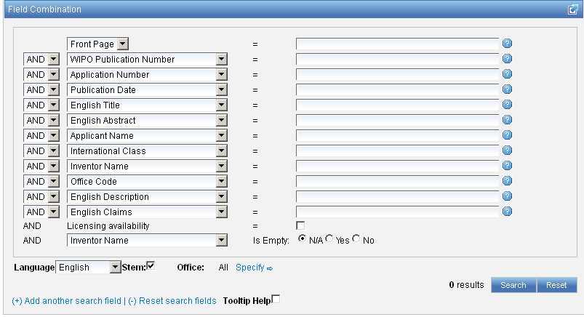
Licensing Availability - Patentscope
Additional search fields can be selected
Notes:
Applicants interested in concluding license agreements in relation to their international application may request the International Bureau to make this information available in PATENTSCOPE:
How? Applicants should submit a “Licensing Availability Request” to the IB using an ePCT “Action”
Alternatively, Form PCT/IB/382 may be used
When? At the time of filing or within 30 months from the priority date
Free of charge
Applicants can file multiple licensing requests or update previously submitted ones (within 30 months from the priority date)
Licensing indications will be made publicly available after international publication of the application
The licensing indications will be visible on PATENTSCOPE under the “Bibliographic data” tab with a link to the submitted licensing request itself
International applications containing licensing information can be searched for in PATENTSCOPE
The licensing indication displayed under the “Bibliographic data” tab may be revoked by the applicant at any time, that is, also after 30 months from the priority date

Slide 21
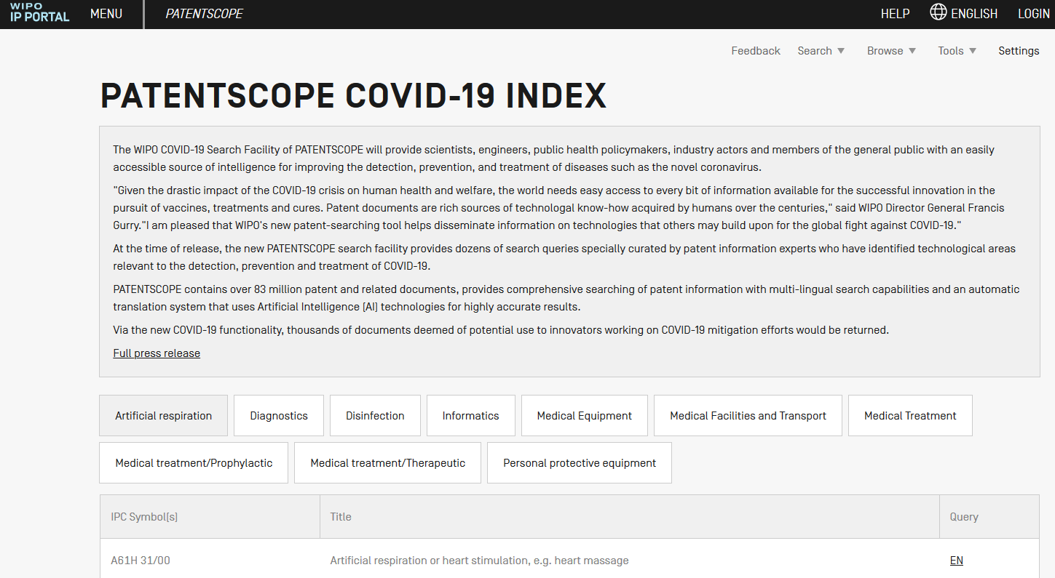
PATENTSCOPE Database – Search COVID-19 Innovations (2)
Notes:
The new facility allows users to search, retrieve and analyze valuable sources of specifically selected technologies in 10 languages with little language barrier.
- WIPO organizes webinars to share tips of patent information search on PATENTSCOPE.

Slide 22
PATENTSCOPE Database – Search COVID-19 Innovations (1)
WIPO’s global patent database, PATENTSCOPE, contains new feature in response to pandemic:
Search facility that supports COVID-19 innovations
What can the search retrieve?
  Technical information contained in published patent documents that can aid inventors in creating and transferring new technologies to combat COVID-19
  The access is free of charge, disseminating technical information for the benefit of all innovators, and found at: https://patentscope.wipo.int/search/en/covid19.jsf

Slide 23

PCT Information and Training
29 video segments on PCT topics, available on WIPO’s Youtube channel and WIPO’s PCT webpage
PCT distance learning course available in 10 PCT publication languages, and an advanced DL course under preparation
PCT Webinars
In-person/Virtual PCT Seminars/training sessions: see PCT seminar calendar (http://www.wipo.int/pct/en/seminar/seminar.pdf)
Monthly PCT Newsletter (http://www.wipo.int/pct/en/newslett/)

Slide 24
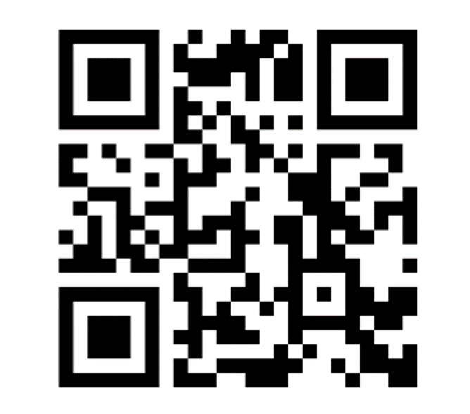
www.wipo.int/pct
Ms. Anjali Aeri, Counsellor, WIPO
anjali.aeri@wipo.int
PCT: https://www.wipo.int/pct/en/

Slide 25
Where to file the international application
(Rule 19)
With a national Office, i.e. IPOPHL
  Languages accepted: English, Filipino*
  Choice of ISA/IPEA (6): Australian Patent Office, European Patent Office, IPOPHL, Japan Patent Office, Korean Intellectual Property Office, or United States Patent and Trademark Office.
With the International Bureau of WIPO, or
With a regional Office
For details, see PCT Applicant’s Guide, International Phase, General Information, Annexes B1 and B2
Notes:
ePCT: Applicants filed 98.4% of PCT applications electronically and the remaining 1.6% on paper in 2020.
In 2020, 71 ROs accepted ePCT-filings and applicants filed 44,514 PCT applications
This represents an increase of 29.4% over 2019 and corresponds to 16.1% of all PCT applications filed in 2020

Slide 26
Minimum requirements for an international filing date (Article 11(1))
Note that if:
  none of the applicants have the right to file with the receiving Office for reasons of residence or nationality (Rules 18 and 19); or
  the application is filed in a language not accepted by the receiving Office for that purpose (Rule 12.1),
the receiving Office will transmit the application to the receiving Office of the International Bureau for further processing (Rule 19.4)
Notes:
And/
The application must contain at least:
an indication that it is intended as an international application
a request which has the effect of making all possible designations (Article 4 and Rules 3 and 4.9)
the name of the applicant (Rule 4.5)
a description (Rule 5)
a claim (Rule 6)

Slide 27



The Inventor Assistance Program (IAP)
http://www.wipo.int/iap
under-resourced inventor selected
for the IAP
inventor is matched with
a patent specialist to navigate the patent system
invention gets evaluated
on its merits
increasing the odds of a granted patent
Notes:
WIPO initiative in cooperation with the World Economic Forum – is the first global program to match developing country inventors and small businesses with limited financial means with patent attorneys. These experts provide pro bono legal assistance to help inventors secure patent protection.
Local resident of an IAP country:
6 countries Colombia, Morocco, Philippines, South Africa, Ecuador, Peru

Slide 28

Leveraging the PCT to support under-resourced inventors
to build global
patent families
The IAP plugs domestic programs for inventors into
a global network of experts who provide support with PCT regional & national phase

Slide 29

Key Barriers to Gender Parity in IP ?
Inclusion and advancement of women in STEM fields
IP-concentrated fields – women & girls
Courses
These limitations:
Hinder understanding of the value of IP as a key, intangible business asset…and ultimately…
Widen the gender gap! ☹
Workshops
- Lack of IP Awareness/Education
Education Grants
Prevents prosecution of IPRs & sex-aggregated data
Networking
Relationships
Mentors
Accessibility to networks in innovation & technology
Notes:
“Raise awareness about the importance of bridging the gender innovation gap and increase participation by women and girls in the IP ecosystem;
Promote the results of WIPO’s work in this area; and
Bring together stakeholders from around the world to share their experience and practices in addressing the barriers faced by women and girls in accessing the IP system.”

