Slide 1


Access to the Results of International Publicly Funded R&D for Health Emergencies
Discussion Paper on IP and Access to Publicly Funded Research Results in Health Emergencies
World Intellectual Property Organization (WIPO), 6 February 2024 (hybrid)
Suerie Moon, MPA, PhD
Professor of Practice, International Relations & Political Science Department & Interdisciplinary Programmes
Director, Global Health Centre, Graduate Institute of International and Development Studies, Geneva
Yiqi Liu, Research Assistant, Global Health Centre, Graduate Institute of International and Development Studies, Geneva

Slide 2
Part 1. Framing remarks

Slide 3
3 key ideas
Public sector drives health emergency R&D
Access conditions the norm for international R&D projects for health emergencies
Growing LMIC R&D and production capacity

Slide 4
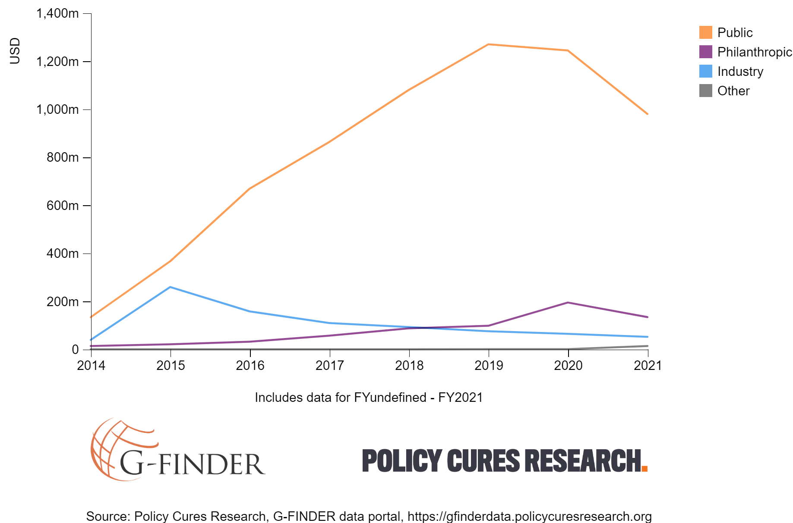
Public sector role: Intensive and Extensive
Emerging Infectious Disease (EID) R&D
Inter-pandemic times:
Unclear if, when & how much product needed →
Very high risk →
Public sector drives R&D
Notes:
For further information, see Sunyoto, T. (2020) Research Synthesis: Biosecurity Research & Development. Available: https://www.knowledgeportalia.org/biosecurityrd

Slide 5
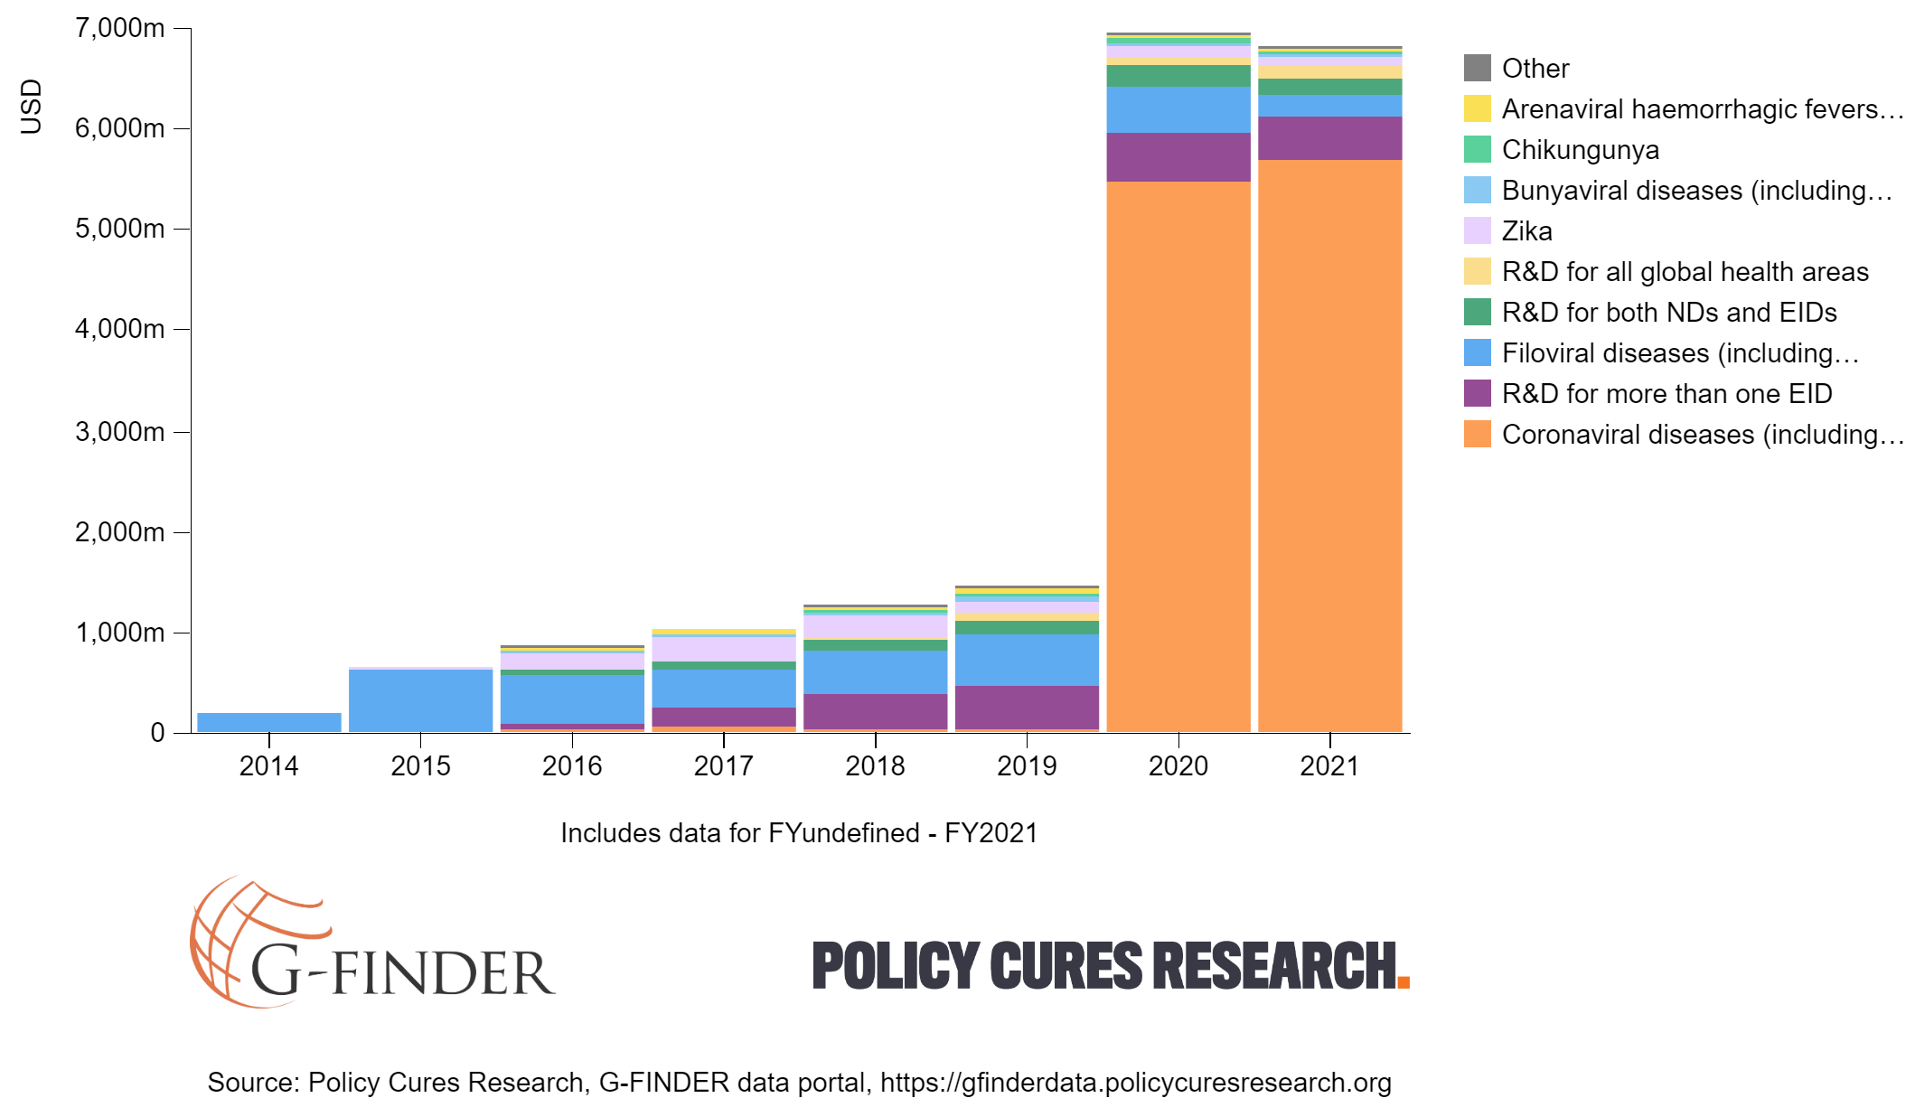
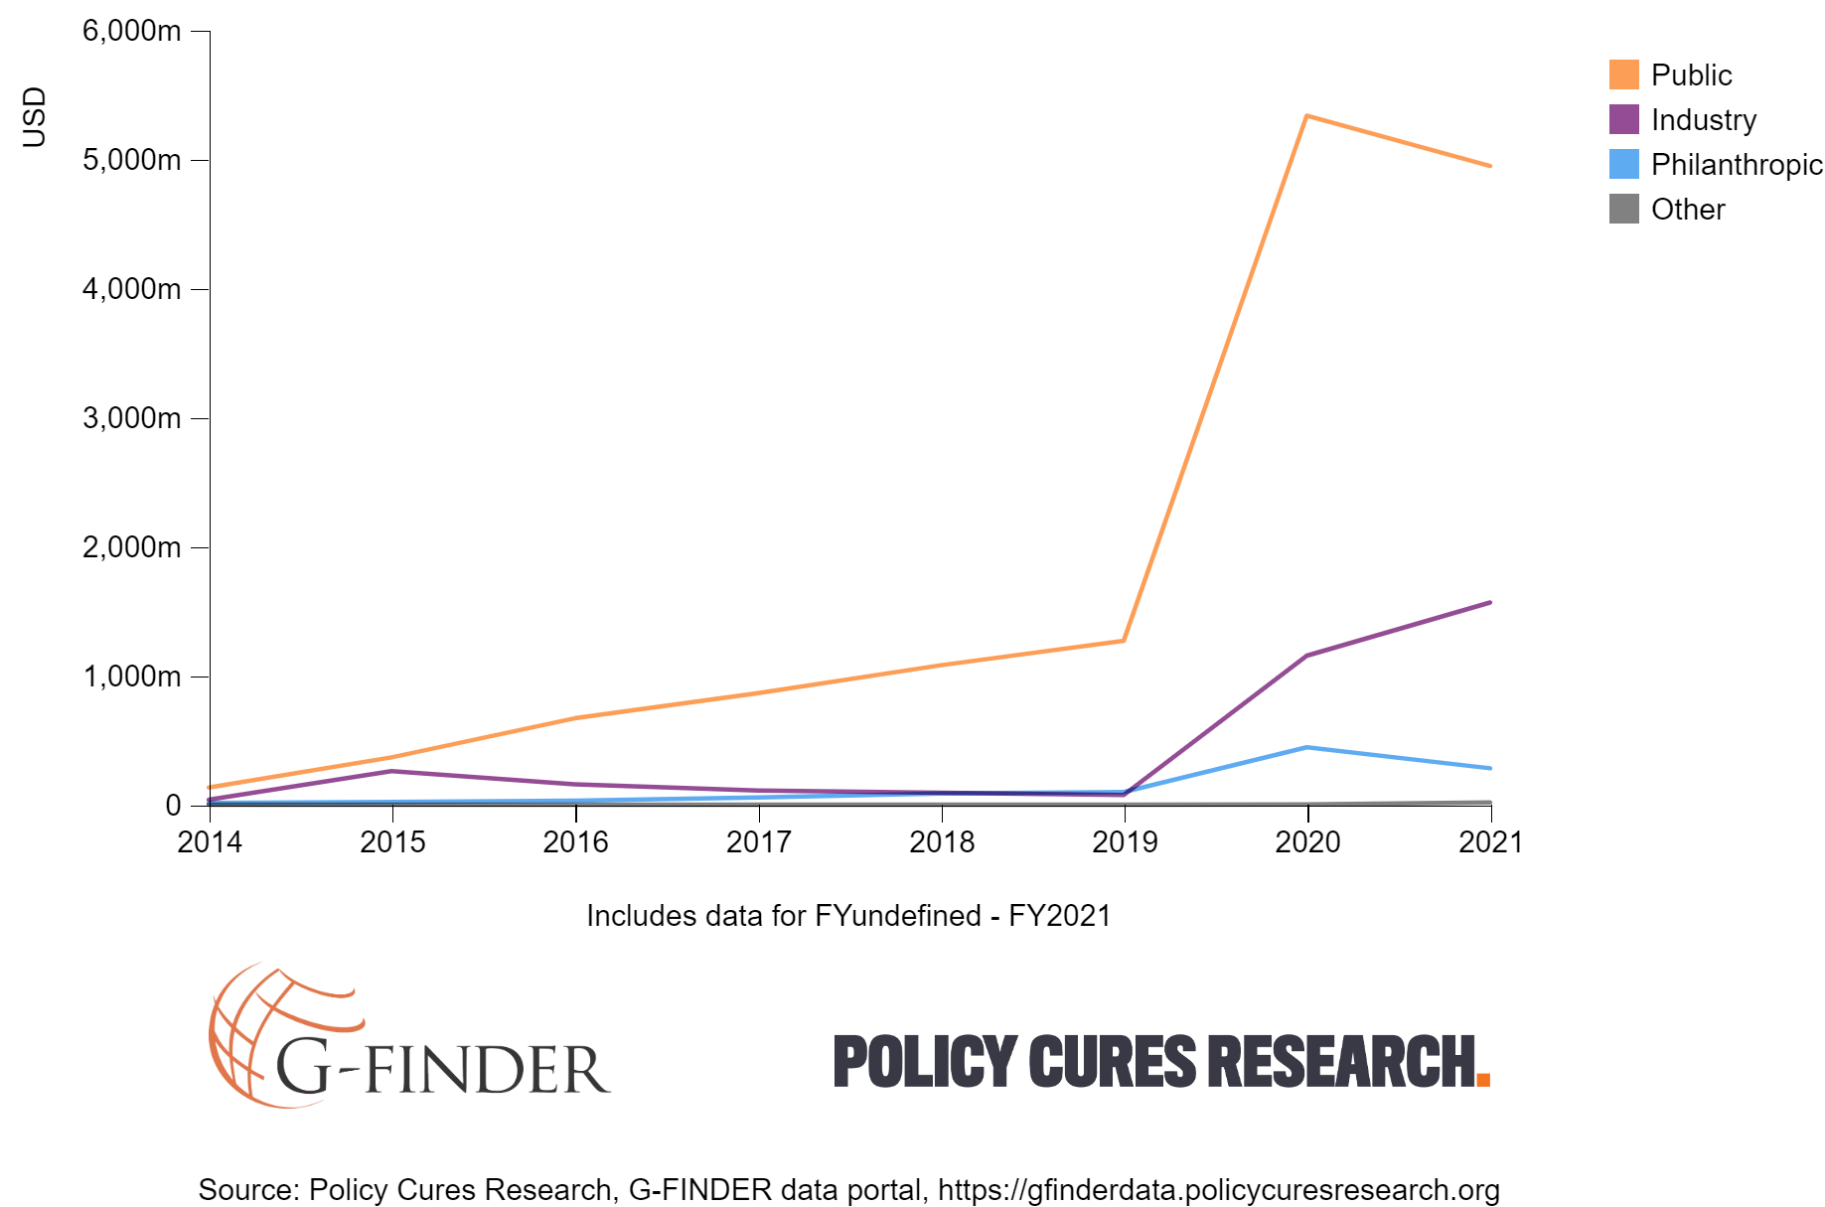
With Covid-19 R&D funding

Slide 6
3 key ideas
Public sector drives health emergency R&D
Access conditions the norm for international R&D projects for health emergencies
Growing LMIC R&D and production capacity

Slide 7
Public funding an important tool for leverage
Tying conditions to funding: a common, proven practice to improve access to fruits of R&D in international projects for health emergencies
  Open access publication and sharing of data and study results
  Pricing commitments
  Supply commitments
  Funder retention of IP and other rights
  Transparency

Slide 8
3 key ideas
Public sector drives health emergency R&D
Access conditions the norm for international R&D projects for health emergencies
Growing LMIC R&D and production capacity

Slide 9
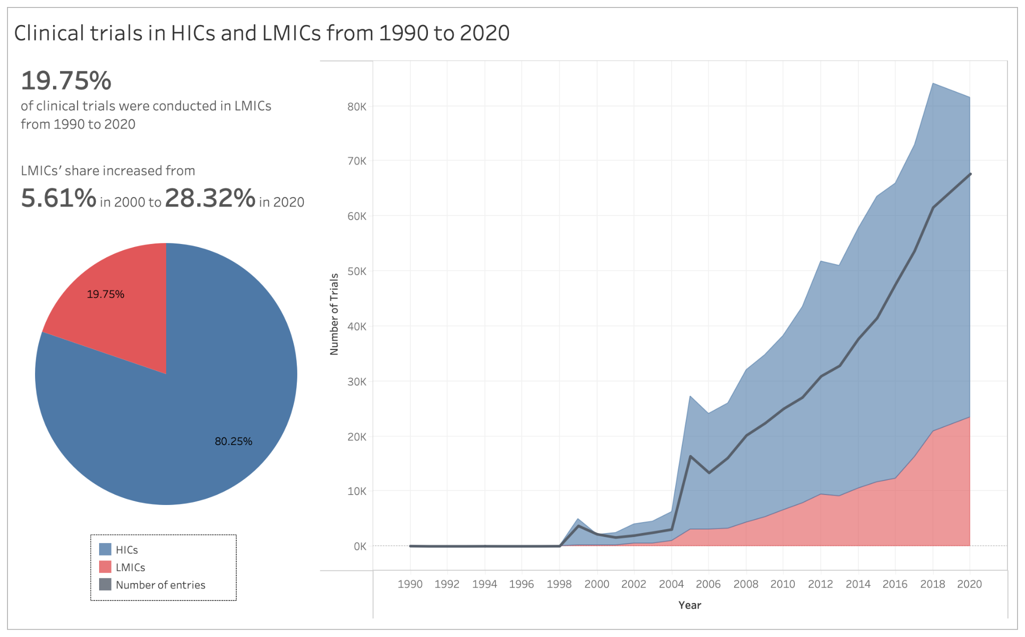

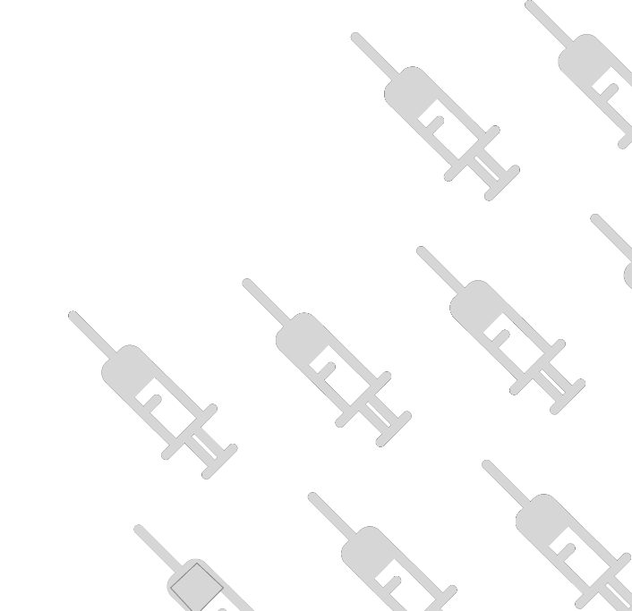
From 2010-20, number of trials in LMICs increased by 375%.
Source: Vieira et al (2023). Rising pharmaceutical innovation in the Global South: a landscape study | Journal of Pharmaceutical Policy and Practice | Full Text (biomedcentral.com)

Slide 10
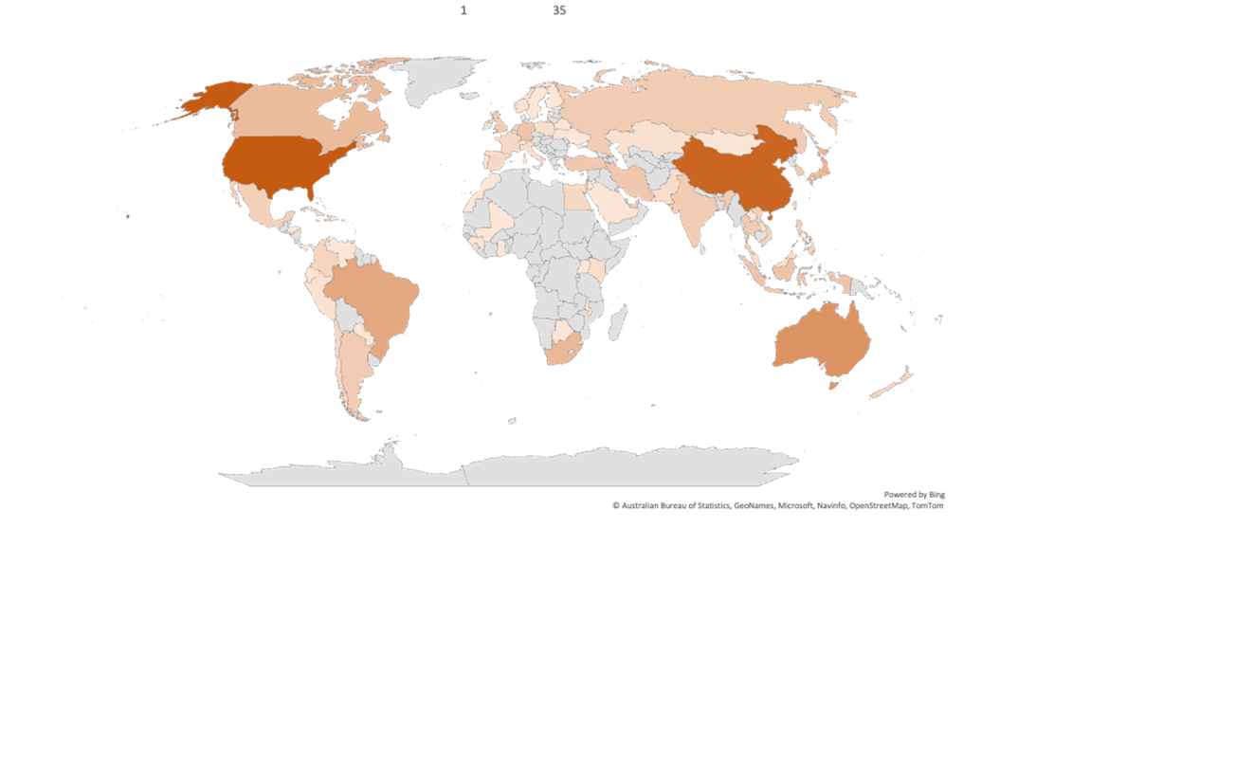

2022 snapshot: A global system of Covid-19 vaccine R&D
 |  | Developer
Development stage | Number of candidates | HICs | LMICs | HICs+LMICs
Pre-clinical | 199 | 55% | 39% | 6%
Clinical | 172 | 53% | 41% | 6%
Total in development | 371
Total approved | 50
Top 10 trial locations
1 | US | 35
2 | China | 32
3 | Australia | 21
4 | Brazil | 16
5 | Japan | 13
6 | South Africa | 12
7 | Canada | 11
8 | Germany | 9
 | Indonesia | 9
9 | Iran | 8
 | South Korea | 8
 | Turkey | 8
10 | Argentina | 7
 | India | 7
 | Russia | 7
 | Thailand | 7
 | UAE | 7
 | UK | 7
Source: Luana Bermudez data analysis for the Global Health Centre. Data sources: WHO and LSHTM Covid-19 vaccine trackers

Slide 11
3 key ideas
Public sector drives health emergency R&D
Access conditions the norm for international R&D projects for health emergencies
Growing LMIC R&D and production capacity

Slide 12
Part 2. Case studies of international projects

Slide 13
Case studies of International R&D Projects for Health Emergencies
1. CEPI - Novavax COVID-19 Vaccine (NVX-CoV2373) Project
3. GARDP - Entasis Novel Antibiotic for Gonorrhea (Zoliflodacin) Project
4. International Collaboration on Ebola Vaccine (rVSV-ZEBOV)
5. Baylor - Biological E COVID-19 vaccine (Corbevax) Project
2. Unitaid - FIND Hepatitis C Diagnostics Project

Slide 14
Case 1: CEPI - Novavax COVID-19 Vaccine (NVX-CoV2373) Project
Operational Model
Public Funding (CEPI’s donors)
CEPI
Novavax
Funding from the US government
(pre-COVID)
IP Management
Novavax has IP ownership.
In general, CEPI does not take IP ownership, except through a “Public Health License”.

Slide 15
Case 1: CEPI - Novavax COVID-19 Vaccine (NVX-CoV2373) Project
Progress of the Project
Dec 2021, NVX-CoV2373 was granted the WHO EUL.
Feb 2021, Novavax committed 1.1 billion doses to COVAX through Gavi. The agreement was terminated in Nov 2022, reportedly due to difficulties in the rollout of the vaccine on Novavax’s side.
Around 59 million doses sold, almost all to high-income countries via bilateral agreements.
Discussion
CEPI as an intermediary → conditions to facilitate equitable access
        Acceptability of CEPI’s conditions (and $$$): Smaller companies or academic institutions vs. some larger and more experienced firms.
        Global entities like CEPI are at a competitive disadvantage if large public donors do not have strings attached to their funding.

Slide 16
Case 2: Unitaid - FIND Hepatitis C Diagnostics Project
Operational Model
Public Funding (Unitaid’s donors)
FIND
Contract developer (work for hire)
IP Management
FIND owned the IP, and the manufacturer would operate under an exclusive license, in exchange for appropriate pricing commitments in LMICs.
Largely technical know-how, not patents

Slide 17
Case 2: Unitaid - FIND Hepatitis C Diagnostics Project
Progress of the Project
In 2019, FIND identified a suitable commercial partner and the product was originally expected to be available for manufacturing in mid-2020.
The emergence of COVID-19 derailed (at least temporarily) the HCV project.
As the need for COVID-19 diagnostics has ramped down, the cAg RDT may be picked up again for final stage development.
Discussion
Conditions on public funding can be leveraged in different ways.
        The relatively small market size for health tools targeting LMICs means that public funding is often necessary to drive R&D.
        Paying the full costs of R&D with public funds allowed FIND to retain full control of the IP, and then to leverage that control to offer a manufacturer a monopoly in exchange for global access commitments.

Slide 18
Case 3: GARDP - Entasis Novel Antibiotic for Gonorrhea (Zoliflodacin)
Operational Model
Public Funding (GARDP’s donors)
GARDP
Entasis
Funding from the US government
(for Phase I and II Clinical Trials)
IP Management
Entasis held patents on the active pharmaceutical ingredient for zoliflodacin.
Entasis granted GARDP an exclusive and royalty-free license for use in the treatment of gonorrhea with sublicensing rights for manufacturing worldwide and for the sale and/or distribution in 168 countries or territories, covering all LMICs and a few HICs. Entasis retained rights in most HICs.

Slide 19
Case 3: GARDP - Entasis Novel Antibiotic for Gonorrhea (Zoliflodacin)
Progress of the Project
Phase 3 trials completed in May 2023*. Zoliflodacin has been designated a Qualified Infectious Disease Product by the FDA and awarded a Fast Track status.
GARDP has started initial discussions with potential partners to facilitate the commercialization and distribution of the product once it is developed.
Discussion
GARDP is in charge of the product distribution in LMICs, which would have not been considered a priority otherwise.
An alternative approach to funding conditions and IP management, compared with the more common approach of attaching conditions and relying on the developers/manufacturers to ensure access in LMICs.
The need to ensure both globally equitable access and responsible stewardship.
* GARDP annonced positive results of the phase 3 trials in November 2023.

Slide 20
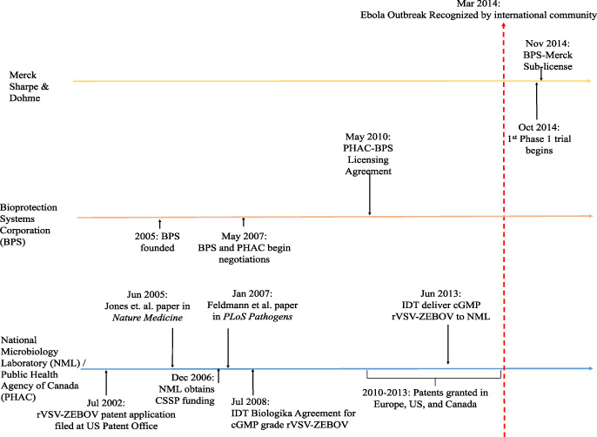
Case 4: International Collaboration on Ebola Vaccine (rVSV-ZEBOV)
Key milestones and events during the development of rVSV-ZEBOV in the lead up to the 2014–2015 Ebola epidemic
WHO
&
Additional public funding (Norway, UK, Canada, US, etc)
Limited progress
* Image reproduced from Herder et al (2020) under a Creative Commons license.

Slide 21
Case 4: International Collaboration on Ebola Vaccine (rVSV-ZEBOV)
Operational Model
Public Funding
WHO
Study Implementers
(GSK, BPS)
Funding from the US government and the Canadian governnent
(prior to the 2014 outbreak)
IP Management
In Nov 2014, Newlink granted Merck exclusive rights to the vaccine and any follow-on products. It received US$ 50 million from the license. In the agreement, PHAC retained non-commercial rights on the vaccine candidate.
No specific conditions on IP in the agreement between Merck and WHO.

Slide 22
Case 4: International Collaboration on Ebola Vaccine (rVSV-ZEBOV)
Discussion
Very limited commercial interest in the R&D of the Ebola vaccine. Predominantly supported by the public sector for both R&D and procurement.
It would be beneficial to agree in advance on the norms and principles that should govern such R&D contracts and to pre-negotiate contractual provisions to serve as a baseline for negotiation in a crisis.
“This question of pricing, access, and IP management was always treated in the agreements that we [WHO] had with the industry. But not in an emergency. In an emergency, all this appeared secondary as there was no doubt that someone would fund the product once available. What is important is to try to push this down the line as quickly as possible.”
---- Interview with Dr. Marie-Paule Kieny,
former Assistant Director-General, WHO

Slide 23
Case 5: Baylor - Biological E Partnership on COVID-19 vaccine (Corbevax)
Operational Model
Funding from the Indian government
Biological E
Baylor
Funding from the US government
(pre-COVID)
IP Management
The core technology has been well-known and available off-patent for many years.
Open Access approach.
During the COVID-19 pandemic, Baylor decided to not go through any IP protection process.
Know-how

Slide 24
Case 5: Baylor - Biological E Partnership on COVID-19 vaccine (Corbevax)
Progress of the Project
In Dec 2021, BioE received emergency use authorization for Corbevax in India. As of May 2023, around 84 million doses administrated in India.
Baylor also licensed the vaccine in parallel to BioFarma in Indonesia, which successfully developed Indonesia’s first Halal-certified domestically produced COVID-19 vaccine. Approximately 10 million doses were administered in Indonesia.
Discussion
How an open science approach could be adopted to facilitate global equitable access.
The Baylor project did not receive large-scale public funding during the COVID-19 pandemic. One reason may be that funders did not consider the established protein technology at the beginning.

Slide 25
Summary of Examples’ Conditions on Funding and IP management
Examples | Conditions on Funding from Major Government Donors | Conditions on Funding from Intermediaries and IP Management
Case 1: CEPI - Novavax COVID-19 Vaccine (NVX-CoV2373) | No specific conditions - Donors are involved in high-level decision-making through the Investor Council. | (CEPI) Public Health License; affordable pricing; supply commitment to a global distribution entity; publication of data and study results.
Case 2: Unitaid - FIND Hepatitis C Diagnostics project | No specific conditions - Donors are involved in high-level decision-making through donor representatives on the Executive Board | (Unitaid) General conditions to ensure access; (FIND) Retained rights, affordable pricing, and supply commitment in target countries; publication of data and study results.
Case 3: GARDP - Entasis Novel Antibiotic for Gonorrhea (Zoliflodacin) project | No specific conditions - Donors are involved in high-level decision-making through the Board and the Donor Partnership Advisory Committee | (GARDP) Control of technology in 168 countries; Affordable and sustainable pricing; publication of data and study results.
Case 4: International Collabora3ion on Ebola Vaccine (rVSV-ZEBOV) | No specific conditions - Donors did not put conditions in the urgency of the health crisis. | (WHO) Retained IP rights; supply commitment and favorable pricing to the public sector; publication of data and study results.
Case 5: Baylor - Biological E COVID-19 vaccine (Corbevax) project | No global access conditions attached to the public funding. | No intermediaries; Open science approach, no patents, sharing of know-how with LMIC vaccine developers

Slide 26
Conclusion
Public funding - an important tool for leverage
Tying conditions to funding: a common, proven practice to improve access to fruits of R&D.
  Open access publication and sharing of data and study results
  Pricing commitments
  Supply commitments
  Funder retention of IP and other rights
  Transparency
Pre-negotiated common approaches among public funders and similar conditions on funding could deliver more impactful, equitable access to products.
Both clear government obligations on funding recipients, and flexibility to adopt strategies tailored to specific products, diseases and crises needed.

