Slide 1

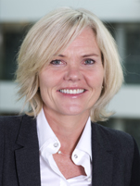
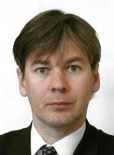

Seminar on WIPO Services and Initiatives
London
Oct. 06, 2014,
Manchester
Oct. 08, 2014, and
Glasgow
Oct. 09, 2014.

Slide 2


Speaker: Mr. Victor Vazquez Lopez, Section for Coordination of Developed Countries, Department for Transition and Developed Countries (TDC), WIPO

Slide 3
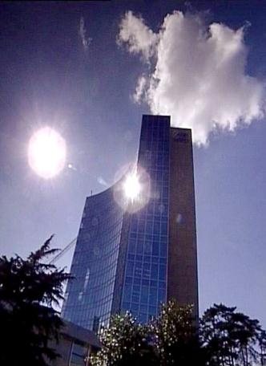
FACTS ABOUT WIPO
MISSION: Promote the protection of IP rights worldwide and extend the benefits of the international IP system to all member states.
MEMBER STATES: 186
OBSERVERS: + 390
STAFF: 950 FROM 101 COUNTRIES
ADMINISTERED TREATIES: 26
MAIN BODIES: GA, CC, WIPO CONFERENCE

Slide 4
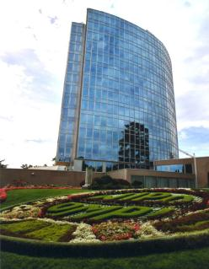
MILESTONES: 1883 - 2013
2013
MARRAKESH TREATY
2012
2006
BEIJING TREATY
2000
STLT
1996
PATENT LAW TREATY
INTERNET TREATIES
1989
MADRID PROTOCOL
1970
PCT ESTABLISHED
1967
1960
WIPO CONVENTION
1925
BIRPI MOVES TO GENEVA
1893
HAGUE AGREEMENT
1891
BIRPI
1886
1883
MADRID AGREEMENT
BERNE CONVENTION
PARIS CONVENTION

Slide 5
INTELLECTUAL PROPERTY OUTREACH
PUBLIC SECTOR & POLICY MAKERS
BUILDING AWARENESS
INTELLECTUAL PROPERTY OFFICES
GENERAL PUBLIC & CIVIL SOCIETY

Slide 6

Economic Development
Norm Setting
Services to Industry
Global Infrastructure

Slide 7
PROVIDER OF PREMIER
GLOBAL IP SERVICES
Core business areas:
  Patent Cooperation Treaty (Patents)
  Madrid System (Trademarks)
  Hague System (Industrial Designs)
  Lisbon System (Geographical Indications)
  WIPO Arbitration and Mediation Center
Notes:
Patent law differs from country to country. It can be a costly, complex and lengthy process to obtain patent protection in multiple countries. WIPO’s global protection services offer a swift, reliable cost-effective and user-friendly option. Principle objective of PCT is operational excellence and provision of high quality services to benefit users of patent system, patent administrations and general public by streamlining the filing and processing of patent applications in multiple countries (through reduced duplication of work of national filing and processing) to make the grant of patents more economical (ie less diversion of public resources for patent admin.)
Emphasis on ensuing PCT beneficiaries receive adequate knowledge of system and that the system responds satisfactorily to their needs.
TRADEMARKS: In constantly changing business environment, TMs, etc. are important tools for promotion of domestic commerce and int’l. trade which, in turn, contribute to sustainable national economic growth. Indispensable in designing marketing strategies to identify and promote goods in market place and distinguish these goods from those of competitors. To be effective, need adequate legal protection at national & int’l. levels. WIPO’s registration systems facilitate the acquisition and maintenance of these IPRs in different countries
A company in Morocco requesting TMP in 12 countries - application in 3 classes would pay over 6.5 times more if it didn't use MS but opted to apply to each national office separately -Madrid = 2,162 CHF; vs. 14,245 CHF using national route). Renewal of same app. = 5+ times cheaper and cost of registering a change in ownership is 20+ times cheaper, costing 177 Swiss francs as opposed to 3,697 Swiss francs under the national route.

Slide 8
BUDGET 2014 – 2015: CHF 713.3 MILLION
Notes:
Why are you important to us?

Slide 9

Photo: Thomas Hawk / Flickr
Notes:
“Just as participation in the physical economy requires access to roads, bridges, and vehicles to transport goods,
similar infrastructure is needed in the virtual and knowledge economy.
However, here
the highway is the Internet and other networks,
the bridges are interoperable data standards,
and the vehicles are computers and databases.”

Slide 10
GLOBAL IP INFRASTRUCTURE
  Databases
  Common platform for e-data exchange among IPOs
  Other platforms
  Tools
  Standards & technical agreements
  Services
  Capacity building & networking by Technology Innovation Support Centers (TISCs)
Notes:
Databases: PATENTSCOPE, Global Brand DB & access to aRDI and ASPI
Common platform: WIPO Case for Global Dossier, the Digital Access Service
Other platforms: WIPO Green; WIPO Research.
Tools: international classifications in TMs/design; IPC, Green inventory, Nice classification
Services: International Cooperation for Patent Examination (ICE), Patent Information Services, including Legal Status of Patents

Slide 11
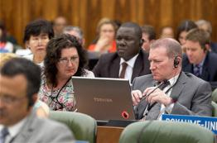

NORM SETTING
Development of international IP law that is:
  balanced
  responsive
  effective
  flexible

Slide 12
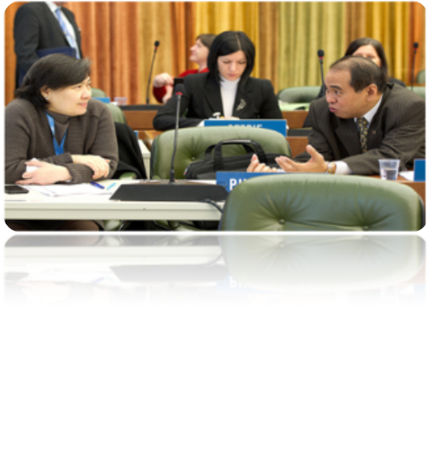
STANDING COMMITTEES
PATENTS (SCP)
COPYRIGHT & RELATED RIGHTS (SCCR)
TRADEMARKS, DESIGNS & GEOGRAPHICAL INDICATIONS (SCT)
  AIM:
      Build consensus on topical issues
      Consider interests of stakeholders for a balanced, efficient, user-friendly, cost-effective system
      N.B. Enforcement issues are discussed in the Advisory Committee on Enforcement
Notes:
PATENTS: (patent quality, E&Ls, patents & health, client-patent adviser privilege, tech transfer)
COPYRIGHT & RELATED RIGHTS: (AV performances- E&Ls VIPs/libraries/archives, broadcasting)
TRADEMARKS: (Design Law Treaty/protection of country names against registration and use as TMs)
WIPO’s work in this area is designed to reduce complexity, cost and time involved in obtaining patent protection in multiple countries and to address workload crisis facing many office because of rising number of patent applications, changing nature of applications (biotech) and duplication of work. Various activities support this endeavor, namely:
- Substantive and procedural harmonization of patent law.
- Development and adoption of reforms of PCT System.
PCT Reform: began in Oct. 2000. General objectives to simplify the system, streamline procedures, reduce costs for applicants, maintains quality of services to facilitate greater use, ensure system works to advantage of all offices irrespective of size.

Slide 13
THE STANDING COMMITTEE ON
LAW OF PATENTS
The last SCP took place from the 27th to the 31st of January 2014:
Quality of patents: the secretariat will prepare a compilation of work-sharing programs among patent offices and use of external information for search and examination
A document compiling laws and practices on confidentiality of communications between clients and their patent advisors
The Secretariat will prepare a document on how 5 different exceptions/limitations are implemented by member states and a half day seminar will also be organized on the above. A sharing session on countries’ use of health-related patent flexibilities will also be organized
The Secretariat will revise the existing document on transfer of technology by adding practical examples and experiences regarding patent-related incentives and impediments
Notes:
private and/or non-commercial use; experimental
use and/or scientific research; preparation of medicines; prior use; use of
articles on foreign vessels, aircrafts and land vehicles. The document should
also cover practical challenges encountered by Member States in
implementing them.

Slide 14
Standing Committee on the Law of Trademarks, Industrial Designs and Geographical Indications (SCT)
Protection of country names against registration or use of trademarks: overlap between private trademark rights and the interests of States to control the use and appropriation of their names
The draft text for a Design Law Treaty has made substantial progress. Pending areas of discussion relate to the inclusion of a technical assistance provision.
Next SCT: November 24 to November 26, 2014

Slide 15
OTHER NORMATIVE DEVELOPMENTS
GA September 2013 decided to convene a diplomatic conference for the adoption of a revised Lisbon Agreement on Appellations or Origins and Geographical Indications in 2015

Slide 16
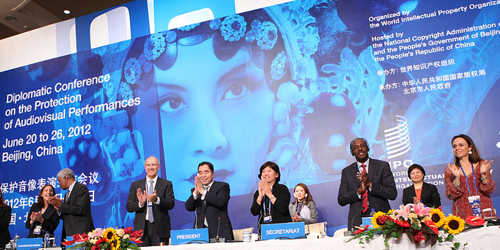
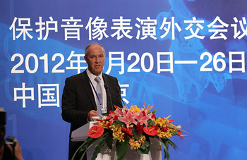
BEIJING TREATY ON AUDIOVISUAL
PERFORMANCES, 26 JUNE 2012

Slide 17


BEIJING TREATY
Adopted on June 2012
Strengthen the position of performers, giving them moral and economic rights for the international use of their performances
Parties will pay for the use of foreign audiovisual performances. Some or all of this money will go to performers
“The conclusion of the Beijing Treaty is an important milestone toward closing the gap in the international rights system for audiovisual performers”
- WIPO Director General, Francis Gurry
Notes:
The treaty will enter into force upon 30 ratifications.

Slide 18
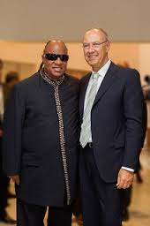
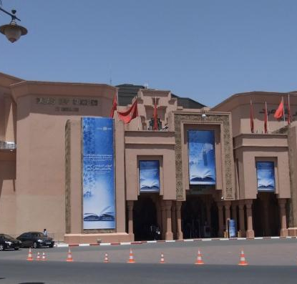
MARRAKESH TREATY TO FACILITATE ACCESS TO PUBLISHED WORKS FOR PERSONS WHO ARE BLIND, VISUALLY IMPAIRED OR OTHERWISE PRINT DISABLED
Notes:
The Diplomatic Conference took place in Marrakesh from June 18 to 28, 2013 (600 negotiators from WIPO’s 186 member states).

Slide 19

MARRAKESH TREATY
314 million blind and visually impaired persons
90% live in developing countries
Only 5% of books published are available in braille or other accessible formats
Requires parties to adopt limitations for the benefit the people who are blind, visually impaired, and print disabled
Provides for exchange of accessible format works across borders

Slide 20
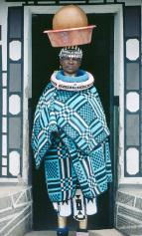
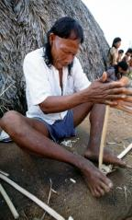
INTELLECTUAL PROPERTY AND TRADITIONAL KNOWLEDGE, ACCESS TO GENETIC RESOURCES AND FOLKORE
Objective: Agree on international legal instruments that protect traditional knowledge (TK), traditional cultural expressions (TCEs) and genetics resources (GRs).
Draft articles on TK and TCEs and a Consolidated Document Related to IP and GRs have been prepared.
  KEY ISSUES TO BE NEGOCIATED
  Objectives
  Definitions of TK/TCEs
  Options on protection
  Scope
  Beneficiaries
  Duration
Notes:
Created in 2000

Slide 21

MAJOR ECONOMIC STUDIES ON IP
A NEW WIPO UNIT – THE ECONOMICS AND STATISTICS DIVISION- REFLECTS THE GROWING CONSENSUS ON THE IMPORTANCE OF THE ECONOMIC DIMENSION OF IP.
THE DIVISION APPLIES STATISTIC AND ECONOMIC ANALYSIS TO THE USE OF WIPO SERVICES.
THIS NEW STRUCTURE ALSO IMPROVES WIPO ECONOMIC INSIGHT ON IP DEVELOPMENT.

Slide 22
STRATEGIC REALIGNMENT WITHIN WIPO
Economics and Statistics Division
WIPO Chief Economist
IP Statistics
Section
Data Development
Section
Economics
Section

Slide 23
DEMAND FOR IP RIGHTS HAS GROWN
Source: WIPO Statistics Database, October 2011

Slide 24
STUDIES AND REPORTS
World Intellectual Property Indicators (WIPI): This is our flagship IP statistics publication. It provides an overview of latest trend in IP filings and registrations covering more than 100 offices : http://www.wipo.int/ipstats/en/wipi/index.html
The PCT Yearly Review provides an overview of the performance and development of the PCT system. It includes a comprehensive set of statistics for the latest available year See: http://www.wipo.int/ipstats/en/statistics/pct/
Madrid Yearly Review: http://www.wipo.int/ipstats/en/
Hague Yearly Review: http://www.wipo.int/ipstats/en/
The WIPO IP Facts and Figures provides an overview of intellectual property (IP) activity based on the latest available year of statistics. It serves as a quick reference guide for statistics: http://www.wipo.int/ipstats/en/
WIPO IP Statistics Data Center is an on-line service enabling access to WIPO’s statistical data. Users can select from a wide range of indicators and view or download data according to their needs: http://ipstatsdb.wipo.org/ipstatv2/ipstats/patentsSearch

Slide 25


STUDIES AND REPORTS
II
New report « Brands – Reputation and Image in the Global Marketplace»
The report looks at how branding behavior and trademark use have evolved in recent history, how they differ across countries, what is behind markets for brands, what lessons economic research holds for trademark policy and how branding strategies influence companies’ innovation activities
For further information and the full report :
http://www.wipo.int/econ_stat/en/economics/wipr

Slide 26
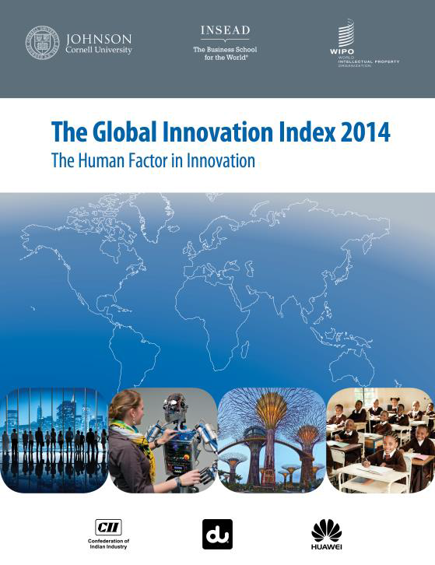
THE GLOBAL INNOVATION INDEX 2014
Annual publication that provides the latest trends in innovation activities across the world. It is co-published by INSEAD, Cornell University and WIPO http://www.wipo.int/econ_stat/en/economics/gii/index.html
Its results are useful:
  To benchmark countries against their peers
  To study countries profiles over time
  Identify countries strengths and weaknesses

Slide 27
THE GLOBAL INNOVATION INDEX 2014
The framework is revised and adjusted every year in a transparent exercise
This year, out of 81 indicators, 67 are identical to GII 2013, and a total of 17 indicators were modified
4 indicators were deleted or replaced
10 underwent methodological changes (new computation methodology at the source, change of scaling factor, change of classification, etc.)
3 changed indicator number as a result of the framework adjustments.
Care needs to be exercised when analyzing year-on-year changes in GII ranks.

Slide 28
GLOBAL INNOVATION INDEX FRAMEWORK
OUTPUT SUB INDEX
INPUT SUB INDEX
SCIENTIFIC OUTPUT
CREATIVE OUTPUT
HUMAN CAPITAL AND RESEARCH
INFRASTRUCTURE
MARKET SOPHISTICATION
BUSINESS SOPHISTICATION

Slide 29

UK PROFILE
istockphotos/Aidas85
Millennium bridge and St Paul’s Cathedral

Slide 30

THE GLOBAL INNOVATION INDEX
RANKING 2013
RANKING 2014
1. SWITZERLAND
2. SWEDEN
3. UNITED KINGDOM
4. NETHERLANDS
5. UNITED STATES OF AMERICA
6. FINLAND
7. HONG KONG (CHINA)
8. SINGAPORE
9. DENMARK
10. IRELAND
1. SWITZERLAND
2. UNITED KINGDOM
3. SWEDEN
4. FINLAND
5. NETHERLANDS
6. UNITED STATES OF AMERICA
7. SINGAPORE
8. DENMARK
9. LUXEMBOURG
10. HONG KONG (CHINA)

Slide 31
UK PROFILE
  UK is ranked 2nd in the 2014 Global Innovation Index
  UK ranks higher on the input sub-index category (3rd) than the output sub-index category (4th). Most of UK’s strengths at the variable level are on the Innovation Input side: average score top 3 universities (1st), government's online service (4th), eparticipation (5th), ease of getting credit (1st), total value of stocks traded, % GDP (1st), intensity of local competition (2nd) and university/industry research collaboration (5th).
  On the Output side, UK exhibits particular strengths in: citable documents H index (1st), cultural and creative services exports (% of total trade) (1st) and country-code TLDs/th pop. 15–69 (6th).
  UK’s relative weaknesses are relatively evenly spread across the input and output pillars and include:
    On the Input side: political stability (50th), ease of starting a business (49th), pupil teacher ratio, secondary (50th), graduates in science & engineering, % (37th), gross capital formation, % GDP (132nd), non-agricultural market access weighted tariff, % (97th) and FDI net inflows, % GDP (80th); and
    On the Output side: Growth rate of PPP$ GDP/worker, % (102nd) 7.1.1 Domestic res trademark registrations/tr PPP$ GD (56th) 7.1.2 Madrid trademark reg. holders/bn PPP$ GDP (30th).

Slide 32
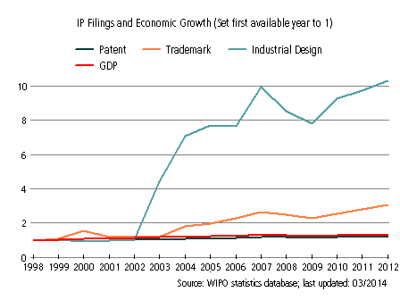
UK’s evolution with respect to IP filings and
Economic Growth from 1998 to 2012
Filings for industrial designs and trademarks have increased strongly since 2002 despite slow-downs in the periods around 2004 and 2009. This growth has greatly outpaced corresponding growth in GDP. In 2012 there were 56,038 industrial designs filings and 354,152 trademark filings (including resident, abroad and regional filings)
Filings for patent have grown more steadily since 2002, growing approximately in line with the growth in GDP. In 2012 there were 51,238 patent filings (including resident, abroad and regional filings)
Notes:
GDP : GROSS DOMESTIC PRODUCT

Slide 33
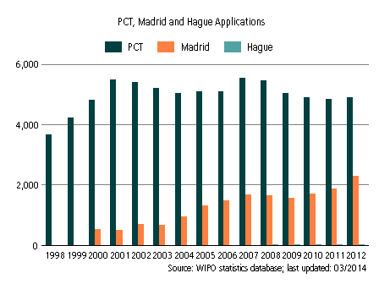
INTERNATIONAL APPLICATIONS
VIA WIPO ADMINISTERED TREATIES

Slide 34
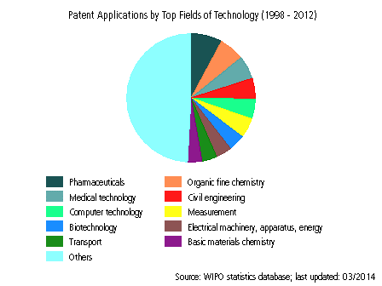
PATENT APPLICATIONS (1998-2012)

Slide 35
THANK YOU!
Mr. Víctor Vázquez
Head, Section for the Coordination of Developed Countries
World Intellectual Property Organization (WIPO)
34 chemin des Colombettes, 1211 Geneva 20, Switzerland victor.vazquez-lopez@wipo.int
Notes:
Welcome ….
Today, we are going to explain to you, in very general terms,
what this Organization does and why?

Slide 36

Patent Cooperation Treaty (PCT)
Introduction and Future Developments
October 2014
Michael Richardson
Deputy Director, PCT Business Development Division

Slide 37
Patent Protection

Slide 38
Do you need a patent?
Have you made an invention?
Is it commercially significant?
Is the best way to exploit it to seek exclusive rights?

Slide 39
Process for GB protection
Prepare application (use a patent attorney)
File application at UKIPO (or EPO) – pay Office fees
GB (or EP) Office
  checks formalities
  searches to determine whether invention is new and inventive
  examines other requirements
  decides whether or not to grant a patent

Slide 40
International Protection

Slide 41
Where do you need a patent?
UK?
Europe?
A few other countries?
The whole world?
No idea yet?
Patents are territorial.
Inventions must be “new” when you apply – you can’t (usually) change your mind and apply for protection once it’s known

Slide 42





Traditional international procedure
Paris Convention gives 12 month “period of priority” from filing first application. Within that time (before GB outcome is usually known):
  appoint local representatives in other countries
  prepare translations
  pay fees
  begin equivalent procedures, all carried out independently
GB grant
Prepare
National search and examination
Prep
National search and examination
Prep
National search and examination
Trans
Prep
National search and examination
AU grant
Trans
Prep
National search and examination
0 months
GB filing
12 months
rest of world filing
24 months
36 months

Slide 43
The Patent Cooperation Treaty

Slide 44
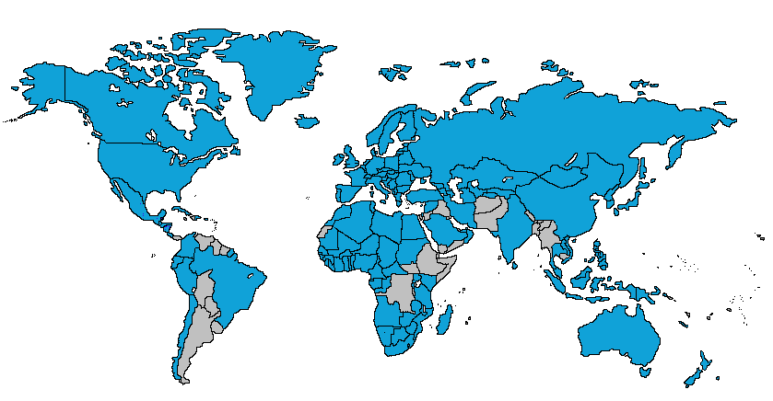
Patent Cooperation Treaty
148 Contracting States

Slide 45
International application
One application
  filed with one Office
  in one language (usually – always OK if in English)
  one set of formalities requirements
By default designates all 148 States
Has the effect of a regular national filing in each designated State – national filing date is international filing date; establishes “priority” date

Slide 46
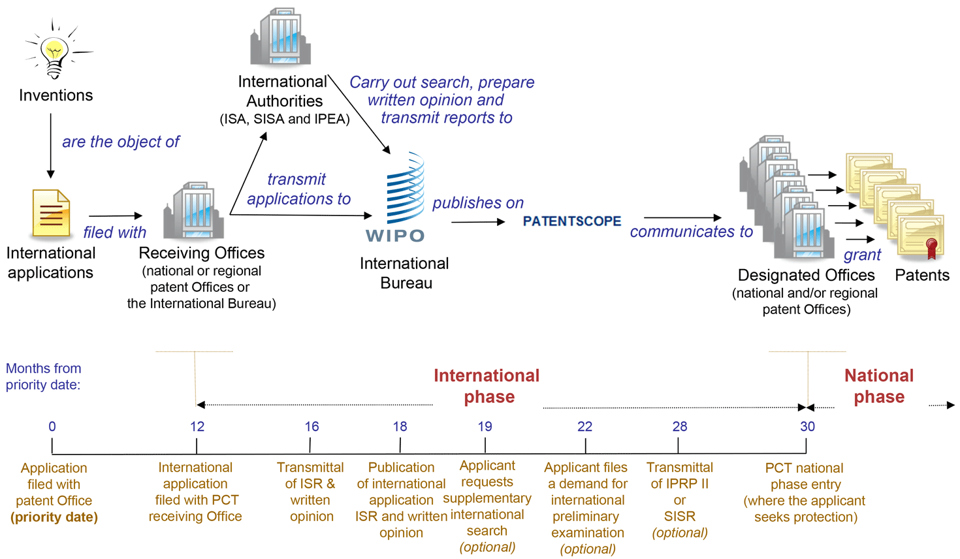
The PCT system

Slide 47
No international patent
Still need local agents, translations, independent national processes to decide grants
BUT
Delays national processing until 30 months from priority
International reports provide improved basis for decision making
Opportunity for centralized correction of defects

Slide 48
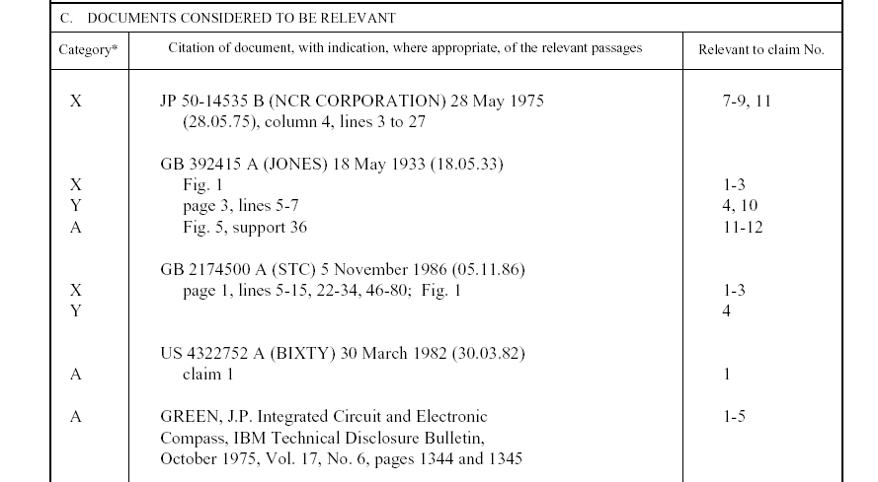
International search report
Symbols indicating
which aspect of patentability
the document cited is
relevant to (for example, novelty, inventive step, etc.)
Documents relevant to whether or not your invention may be patentable
The claim numbers
in your application to
which the document is
relevant

Slide 49
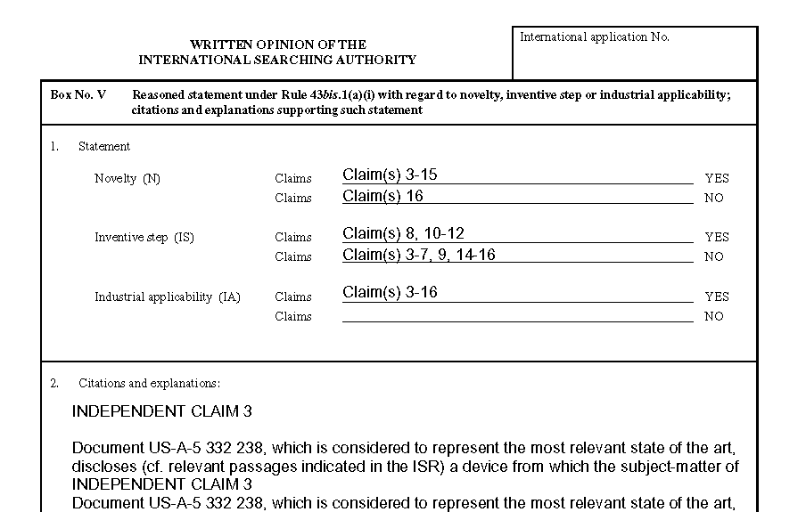
Written opinion
Patentability assessment
of claims
Reasoning supporting the assessment

Slide 50
PCT Key Advantages
postpones major costs of internationalizing a patent application
provides a strong basis for patenting decisions
harmonizes formal requirements
protects applicant from certain inadvertent errors
evolves to meet user needs

Slide 51
PCT Market Share

Slide 52
What’s New

Slide 53
ePCT
International application process handled by several different Offices
  receiving Office (GB, EP or IB) – initial receipt and review
  International Searching Authority (EP) – determine whether new
  International Bureau (WIPO in Geneva) – publication etc.
Traditionally, for any process need to write or use separate online system to deal with each
ePCT offers possibility of using one system for entire international phase
  EP filing component expected to be activated in November

Slide 54
ePCT (2)
Also much improved functionality over earlier systems
  Better data checks – eliminate many errors before they are submitted
  Real time checks of current status
  Optional notifications to warn of new documents, changes of status, approaching deadlines
  Securely share views of draft and submitted information with other relevant people (agent, applicant, associate for national phase in other country, etc.)

Slide 55
Improving quality and consistency
Searching is difficult
“Prior art” is published in many languages
Instinctive lack of trust for work “not done here”
International Authorities working together to
  improve quality of search tools and databases
  improve quality of information to applicants and Offices
Aim – more reliable information for applicants and Offices to base decisions – lower costs

Slide 56
More Information

Slide 57
Training
29 segment video introduction to different PCT issues
  http://www.wipo.int/pct/en/training/index.html
Distance learning course
    http://www.wipo.int/pct/en/distance_learning/index.html
Webinars
  http://www.wipo.int/pct/en/seminar/webinars/index.html
Seminars and training sessions
  http://www.wipo.int/pct/en/seminar/seminar.pdf

Slide 58
Ask a patent attorney
The Chartered Institute of Patent Attorneys
  www.cipa.org.uk

Slide 59
PCT Information Service
    Tel: +41 22 338 8338
    Fax: +41 22 338 8339
    E-mail: pct.infoline@wipo.int
www.wipo.int/pct

Slide 60
Seminar on WIPO Services and Initiatives
The Madrid System
The Hague System
Asta Valdimarsdottir
September, 2014
Notes:
60

Slide 61



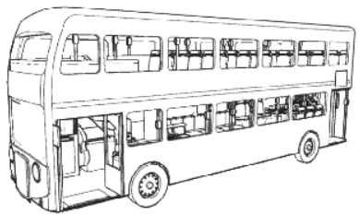

Trademarks
IRN 866596
IRN 781638
Designs
IPO UK number 4009939

Slide 62



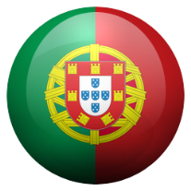








Trademark and design protection
National route
NATIONAL OFFICES
APPLICANT

Slide 63




















Trademark and design protection
International route
INTERNATIONAL PROCEDURE
MADRID
NATIONAL OFFICE
WIPO
WIPO
MAINTENANCE
Basic
HAGUE
NATIONAL OFFICE
WIPO
Basic
WIPO
MAINTENANCE
USER

Slide 64
The Madrid System

Slide 65
Trademarks
"A brand incarnates an enterprise's reputation and image and so is one of an enterprise's most valuable assets” (Director General, Francis Gurry)
Trademarks are the most widely used form of registered intellectual property (IP) throughout the world
The demand for trademark protection has grown from just under 1 million applications per year in 1985 to 4.2 million by 2011(WIPO’s report on Brands, reputation and Image in the Global market)
Notes:
WIPOs report “Brands, reputation and Image in the Global market

Slide 66
The Madrid System - Facts and figures
Worldwide trademark filings + 9.3% from 2008 - 2013
Madrid filings
  + 4.1% in 2012
  + 6.4% in 2013
  + 6.3% this year
578.320 international registrations in force
5.61 million designations in force
191.759 holders of international registrations

Slide 67
Madrid Union
Notes:
Currently 92 – one state still left only member of the Agreement (Algeria)

Slide 68
Madrid Union – Future Contracting Parties
Notes:
If we include all the potential Members the map will look like this – end of 2015, or 2016
Potential Member:
Brunei
Cambodia (deposit late September 2014 – entry into force late December 2014)
Canada
Gambia
Jamaica
Malawi
Malaysia
Trinidad and Tobago
Benin (OAPI)
Burkina Faso (OAPI)
Cameroon (OAPI)
Central African Republic (OAPI)
Chad (OAPI)
Comoros (OAPI)
Congo (OAPI)
Côte d'Ivoire (OAPI)
Equatorial Guinea (OAPI)
Gabon (OAPI)
Guinea (OAPI)
Guinea Bissau (OAPI)
Mali (OAPI)
Mauritania (OAPI)
Niger (OAPI)
Senegal (OAPI)
Togo (OAPI)

Slide 69
Example of the life cycle of an international registration
International Registration, designating US, CN and KR
Statement of Grant of Protection from US and CN
Subsequent Designation for AU and NZ
Renewal
Amending of the licenses for the US
Change in the address of the holder
Licenses for US
Appointment of a representative
Limitation of the list of G&S for KR
Renewal
Change in Ownership
Provisional Refusal from KR
Final decision grating protection from KR
Request of an Extract
8686: is it possible to amend a license and how to do it?
Statement of grant of protection from AU and NZ
Registration date
10 years
10 years
The Madrid customer service and the Madrid teams are always available by phone or e-mail
Notes:
42 transactions

Slide 70
Good practice – Before filing
Plan ahead where you want to protect your trademark
  Search for possible conflicting prior rights
  Compile a list of G&S (properly classified, ambitious, realistic and well-balanced)
  Check particular territorial requirements (i.e., use of the mark, etc.)
  Fees - Cost
  Be aware that the time limits and the requirements to respond to refusals are different in each state
  Certificates one protection is granted
  Etc.

Slide 71
The National Route vs. the Madrid Route
Filing in several Offices
Many application forms
Several languages
Several currencies
Several registrations
Several renewals
Several modifications
Foreign attorney needed from filing
Filing in one Office
One application form
One language (E/F/S)
One currency (CHF)
One international registration
One renewal
One modification
Foreign attorney first needed in case of refusal
Notes:
71

Slide 72
Madrid system – I
A registration system for 92 Contracting Parties
One application – one language – one set of fees
Three main stages
  Basic application/basic registration > International application
  Formal examination by WIPO
  Examination and decisions by the Offices of the designated Contracting Parties
Notes:
In order to use the Madrid system, you need a connection with a Contracting Party (CP), such as establishment, domicile or nationality, and a mark applied for or registered (basic mark) with that CP (Office of origin)
A CP will need to refuse protection within 12/18 months, otherwise the mark will be deemed protected

Slide 73
Madrid system – II
One registration covering multiple territories
Manage a portfolio of trademarks via a single centralized system
Renew in all designated Contracting Parties with one request
Expand protection to new Contracting Parties
Notes:
Expand your protection to states that have already been members for some time

Slide 74
General Profile 2013
44,414 International Registrations
Average Number of Designations | 6.9
Average Number of Classes | 2.47
Average Fee | CHF 3,039
All Fees | 70% < 3,039 CHF
Notes:
74
Over 80% of our users have rather small portfolios

Slide 75
Madrid Services
E – filing
Web forms
MPM – Madrid Portfolio Manager
Information services
  Global Brand Database
  MGS – Madrid Goods & Services
  MRS – Madrid Real Time Status
  MEA – Madrid Electronic Alert
Notes:
Almost every improvement today is linked to an IT process
Mention the most relevant developments for Madrid system

Slide 76
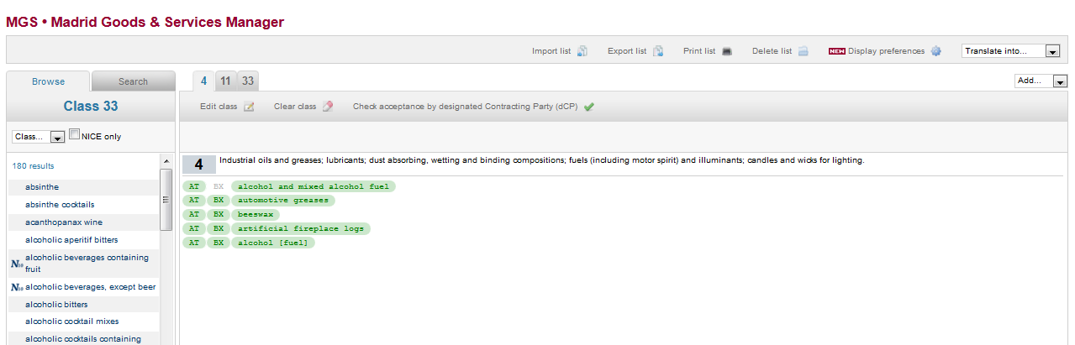
MGS – Madrid Goods & Services
Useful tool for applicants to prepare the list of G&S in a national, regional or international application
Nice Classification (updated) + pre-accepted terms by WIPO and many National Offices – to avoid irregularities or refusals
Madrid languages + 12 other searching languages available
Notes:
With MGS, you can compile the complete list of G&S needed to file a trademark
application using pre-accepted terms. This helps reduce delays and costs linked to irregularity notices from WIPO.
You can also see which G&S terms are rejected by participating IP offices for the Contracting
Parties designated in your application. This can reduce delays and costs linked to provisional refusals
MGS is available in the three working languages of the Madrid System, namely English, French and Spanish.
Other language versions of MGS - 12 national languages not Madrid: Arabic, Chinese (simplified & traditional), Dutch, German, Hebrew, Italian, Japanese, Norwegian, Portuguese, Russian and Turkish.
How many terms?
TM class?

Slide 77
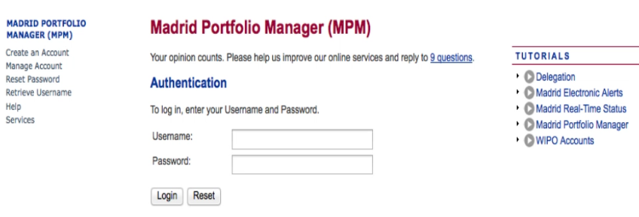
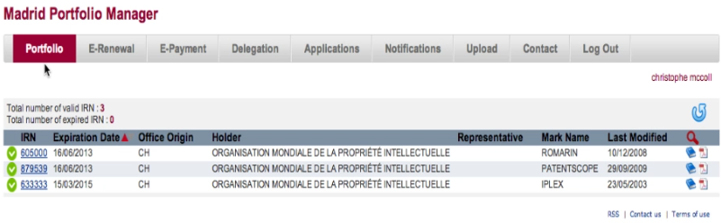
MPM – Madrid Portfolio Manager
Online access to your international trademark portfolio:
  WIPO User account linked to an e-mail address
  International registrations linked to the same e-mail address
Helpful when submitting new requests for recordal
Notes:
Useful for sending applications and other forms. Forms are uploaded, filled in and sent to WIPO
Increase the webforms
587 users have an actual portfolio for a total of 60.384 IRNS
Option to delegate rights
To create a portfolio the e-mail address used for your WIPO account has to be the same that the one linked to every IRN.
For questions or assistance: e-marks@wipo.int

Slide 78
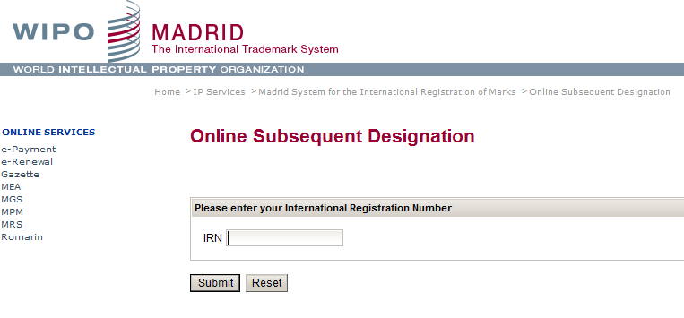
E - Subsequent Designation

Slide 79
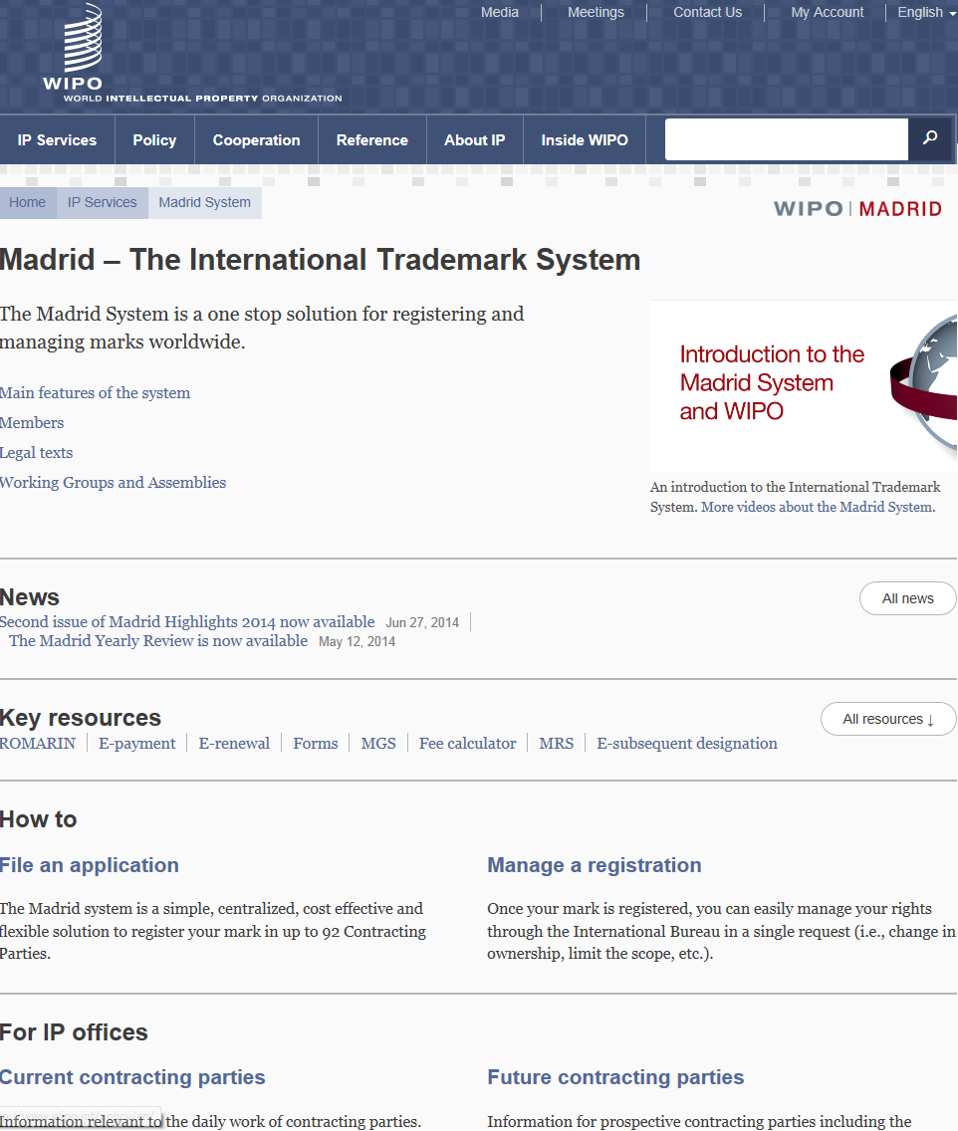

Slide 80
International Applications vs Registrations from the UK

Slide 81
Designations in international registrations and subsequent designations – Country of the holder: UK
Notes:
Designations to UK –

Slide 82
Irregularities - general
Classification of goods and/or services – Office of origin
  Goods and services are not in the appropriate classes or not classified (Rule 12)
Indication of goods and/or services – Office of origin
  Too vague for the purposes of classification or incomprehensible or linguistically incorrect (Rule 13)
Fees (Rule 11(3))
Miscellaneous – Office of origin, applicant or both
  Signature of the Office of origin, entitlement of the applicant, basic registration/application, priority claim, MM18 Form (Rule 11(4))

Slide 83
International Applications from the UK

Slide 84
International Applications from the UK

Slide 85
Breakdown of Irregularity letters from UK in the Madrid system

Slide 86
Breakdown of Irregularity letters from UK in the Madrid system (Jan – Aug 2014)
International applications | 1315
Number of Errors | 367
Number of Irregularity Letters | 389

Slide 87
Irregularities: average Madrid vs United Kingdom

Slide 88
The Hague System
Notes:
Protection for design – the line between trademark protection and designs.
For a bottle – only the design but as trademark the product

Slide 89
Hague Union
47 Geneva Act (1999) (including EU and OAPI)
15 Hague Act (1960)
62 Contracting Parties

Slide 90
Foreseen Expansion of the Hague system
Coming Soon!
Notes:
ACCESSIONS:
2010: Germany, Norway, Azerbaijan
2011: Finland, Monaco, Rwanda
2012: Montenegro, Tajikistan, Tunisia
Future accessions?
China, Japan and USA
Russian Federation and Belarus
ASEAN countries by 2015
Barbados and Trinidad & Tobago
Madagascar and Morocco

Slide 91
The Use of the Hague System in 2012
2,604 international applications filed (12,454 designs)
2,440 international registrations recorded (11,971 designs)
Largest filers: Swatch AG, Daimler AG, Koninklijke Philips Electronics
Approximately 26,284 international registrations in force, containing 110,158 designs
  Equivalent to over 131,420 designations in force
  Involving 8,029 holders
Notes:
91

Slide 92
Who Can Use the System?
You need..
to be connected to a Member state
Nationality
Domicile
Real and effective industrial or commercial establishment
Habitual residence

Slide 93
The International Application
In English, French or Spanish
May be filed directly with the International Bureau through the E-filing interface (or paper format)
May comprise several different designs up to a maximum of 100 if they belong to the same class of the international classification (Locarno)
One set of fees (in CHF) is to be paid

Slide 94
The Registration Procedure
Only formal examination in the International Bureau
  Recording in the International Register
  Publication in the International Designs Bulletin
  Notification to designated CPs through the publication
Substantive examination by the designated Contracting Parties only
Refusal must be received by the International Bureau within a set time limit after publication: 6 or 12 months

Slide 95
The National Route vs. the Hague Route
Several Offices for filing
Several application forms
Several languages
Several currencies
Several registrations
Several renewals
Several modifications
Foreign attorney needed from filing
One Office for filing
One application form
One language (E/F/S)
One currency (CHF)
One international registration
One renewal
One modification
Foreign attorney first needed in case of refusal
Notes:
95
95

Slide 96
International Registration | 1162 | 775 | 270 | 153 | 80
% | 47.6% | 31.8% | 11.1% | 6.3% | 3.3%
Notes:
Most of the applicatant pay less than 1000 chf

Slide 97
Top Filing Contracting Parties
By Contracting Party of entitlement:
1. European Union
2. Switzerland
3. Germany
4. France
5. Turkey
6. Norway
7. Spain
8. Poland
9. Croatia
10. Liechtenstein
By number of designs recorded:
1. European Union
2. Switzerland
3. Turkey
4. Ukraine
5. Singapore
6. Norway
7. Croatia
8. Morocco
9. Liechtenstein
10. Serbia

Slide 98
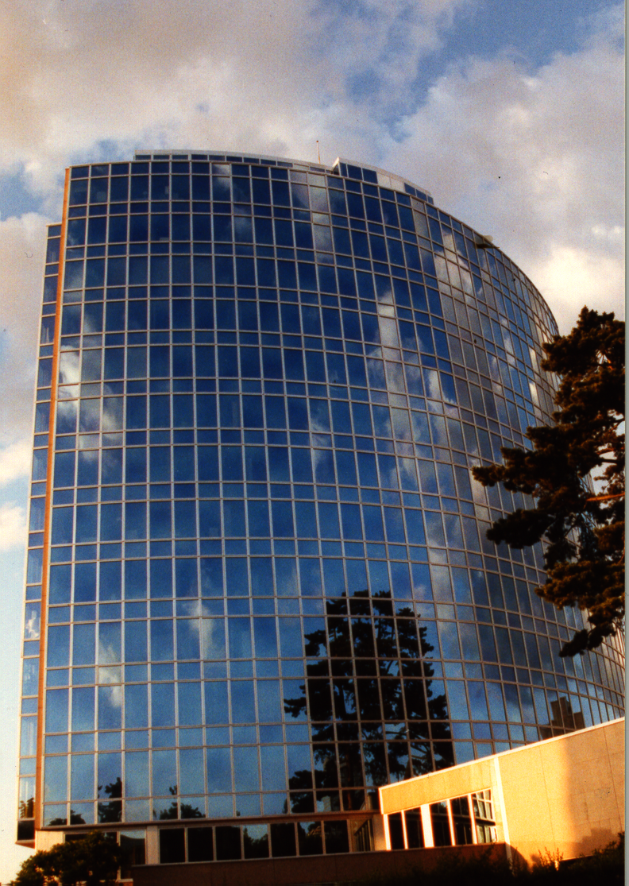
Thank you
for your attention
Asta.valdimarsdottir@wipo.int

Slide 99

Global Databases for Intellectual Property Platforms and
Tools for the Connected Knowledge Economy
UK Roving Seminars
Speaker: Yoshiyuki Takagi, Assistant Director General, Global Infrastructure Sector

Slide 100
Benefits to Stakeholders
For Innovators/IP Professionals/Business/Research:
  IP intelligence
    Is it worthwhile to protect my innovation? Is there any similar brand? Who are potential competitors?
  Partnering
    who may be interested in my innovation? Who can provide me with a chance to produce/market new things as a partner?
For IP Offices:
  Providing digital workflow and online environment
    Efficiency and timeliness with quality service

Slide 101
GLOBAL DATABASES, TOOLS, AND PLATFORMS FOR IP BUSINESS (FREE)
PATENTSCOPE
Global Brand Database
Global Design Database (coming soon!)
WIPO Lex
WIPO IPAS, WIPO DAS
WIPO CASE
WIPO GREEN

Slide 102
Background: Patent Information
More patent applications (& families) are filed in multiple countries
More non-resident applications are filed
More foreign applications filed in Asian languages (Chinese, Korean and Japanese)
Prior art search needs to cover global patent data
PCT (international publications) accounts for more than 50% of non-resident applications
Notes:
When SIPO data are excluded from the world totals data, the non-resident share has been increasing since the mid-1990’s to reach 42.3% in 2012.

Slide 103
PATENTSCOPE
2.5 million PCT data (first publish every week, high quality full text)
37 million records from 37 countries or regions
Full text data
Analyze results by graphs and charts
Search and read in your language
How to use it?

Slide 104
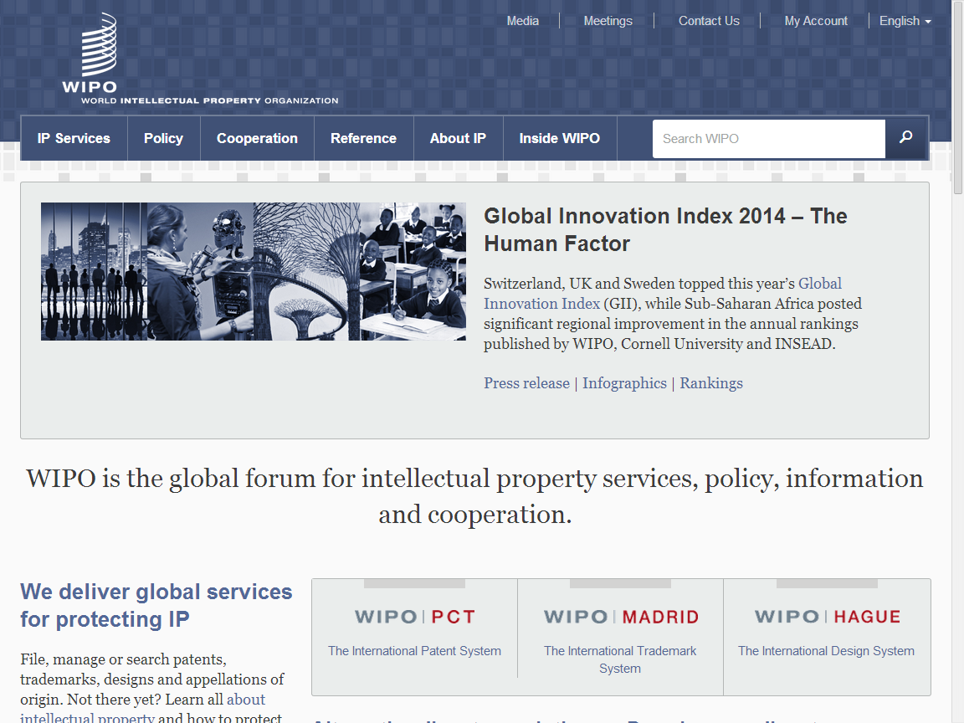
www.wipo.int

Slide 105
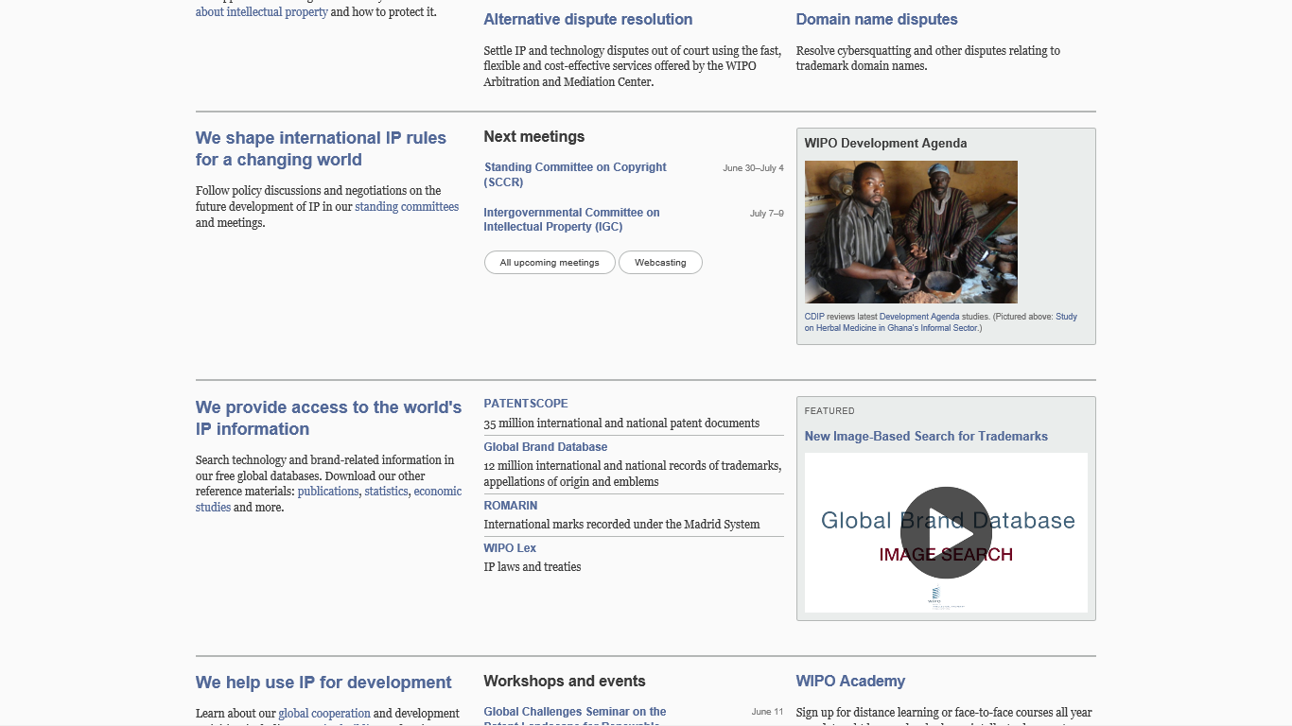

Slide 106
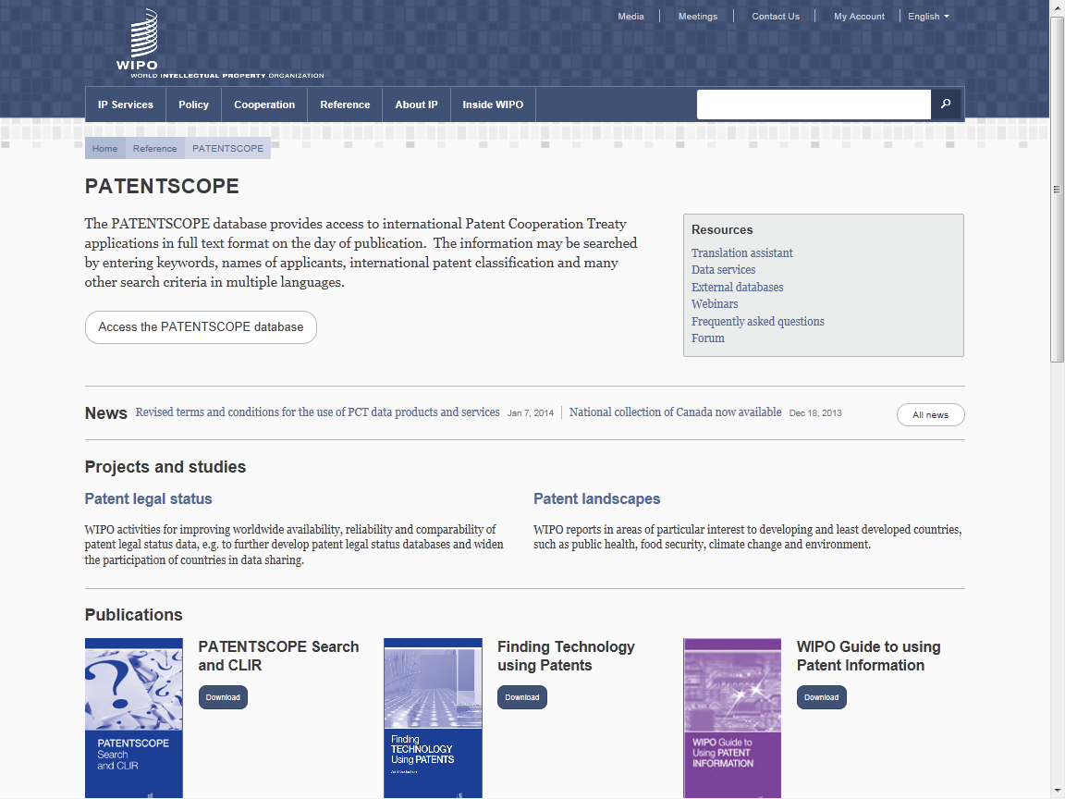

Slide 107
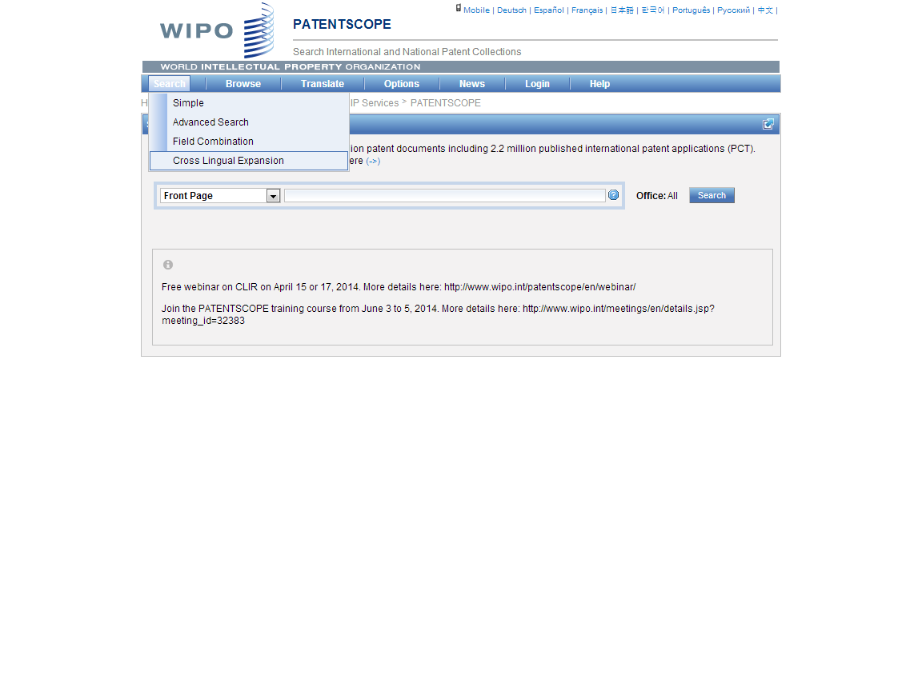
If you want to search prior art in PATENTSCOPE by key words in multiple languages, go to “Cross Lingual Expansion”

Slide 108
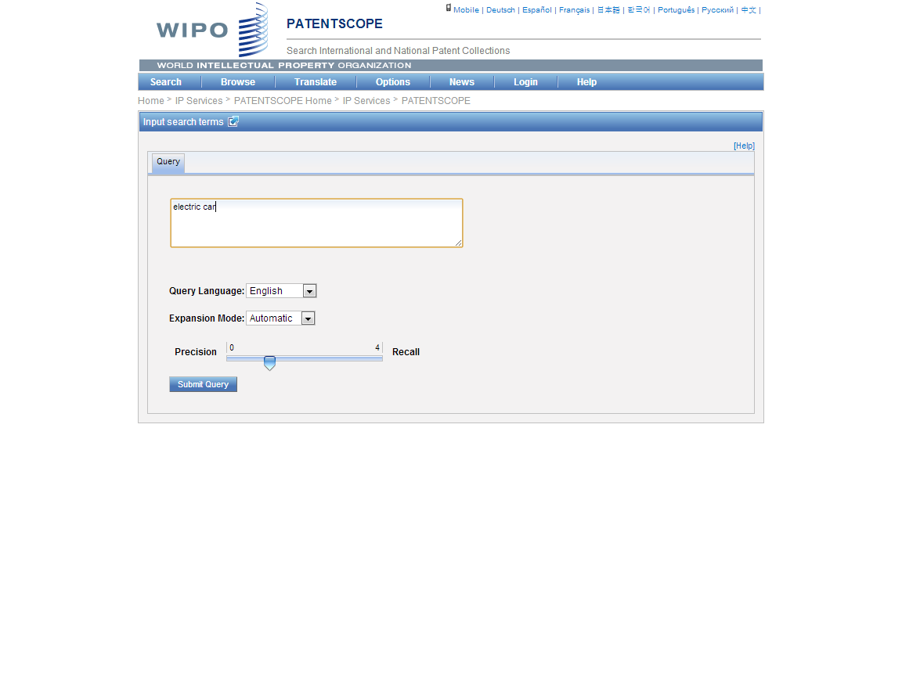
TIP: Use a key term in English. Why?
TIP; Search words – in English (best for Machine translation)

Slide 109
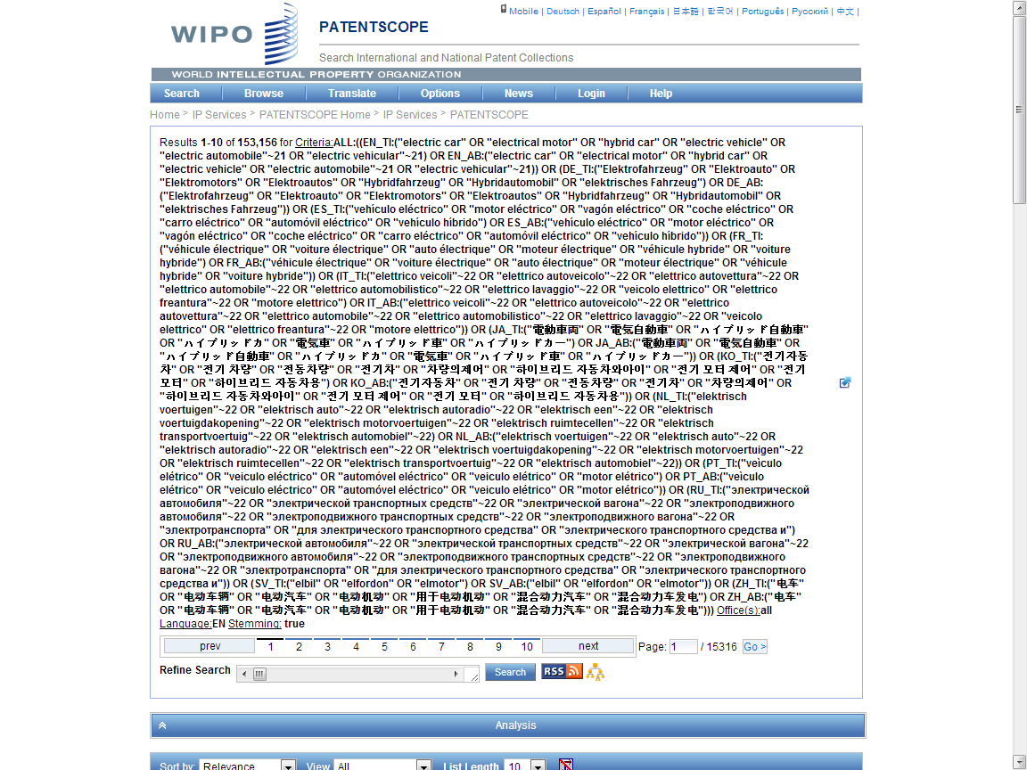
130k to 153k; 20% plus
Search Query
(synonyms & technologically related terms)

Slide 110
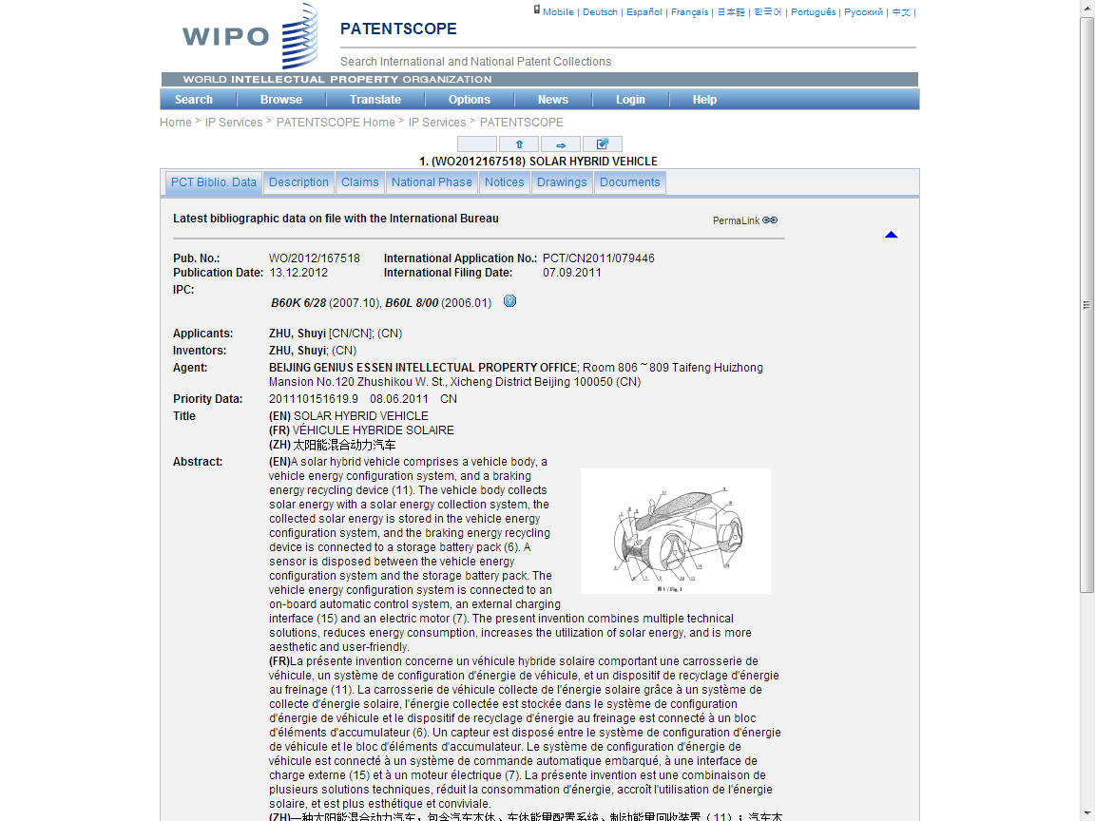

Slide 111
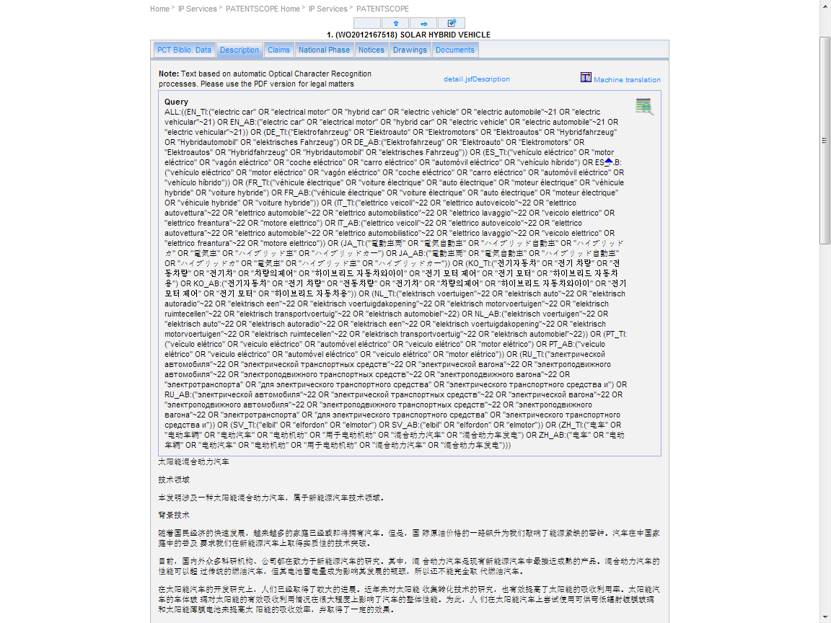

Slide 112
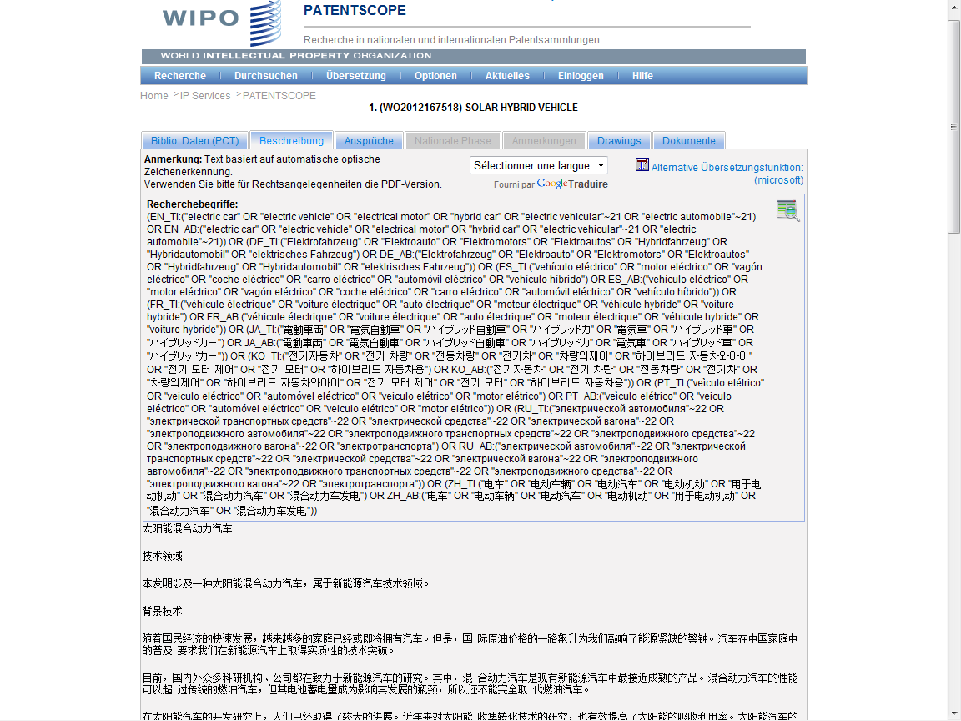

Slide 113
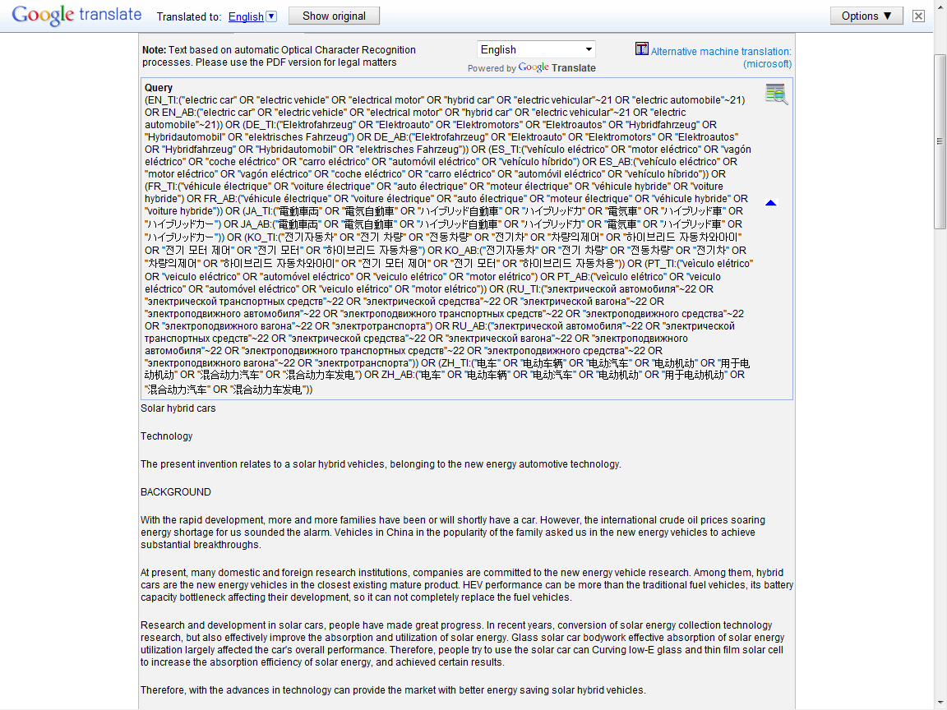

Slide 114
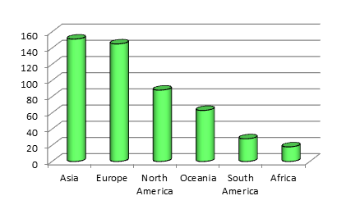
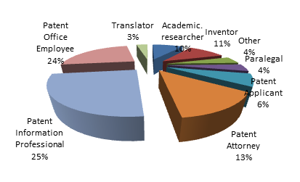
Who are using PATENTSCOPE ?

Slide 115
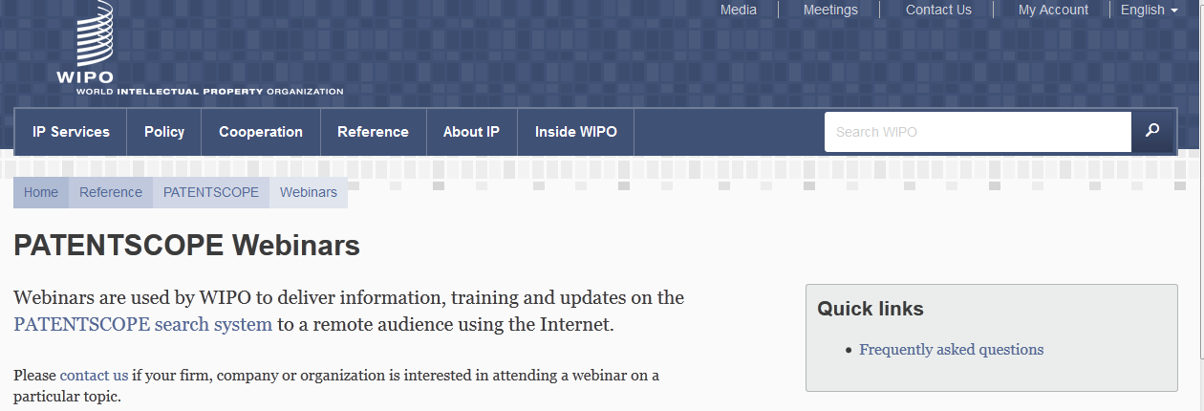
Monthly webinar

Slide 116
GLOBAL DATABASES, TOOLS, AND PLATFORMS FOR IP BUSINESS (FREE)
PATENTSCOPE
Global Brand Database
Global Design Database (coming soon!)
WIPO Lex
WIPO IPAS, WIPO DAS
WIPO CASE
WIPO GREEN

Slide 117
GLOBAL BRANDS DATABASE
Over 14 million records relating to internationally-protected trademarks, etc.
Free of charge simultaneous brand-related searches across multiple collections, including:
  Trademarks registered under Madrid System
  World premier image search tool for device marks
  Appellations of Origin registered under Lisbon System
  Emblems protected under the Paris Convention 6ter
  Algeria, Australia, Canada, Denmark, Egypt, Estonia, Israel, Morocco, NZ, Oman, Singapore, Switzerland, UAE, US, plus link to EU/OHIM TMView

Slide 118
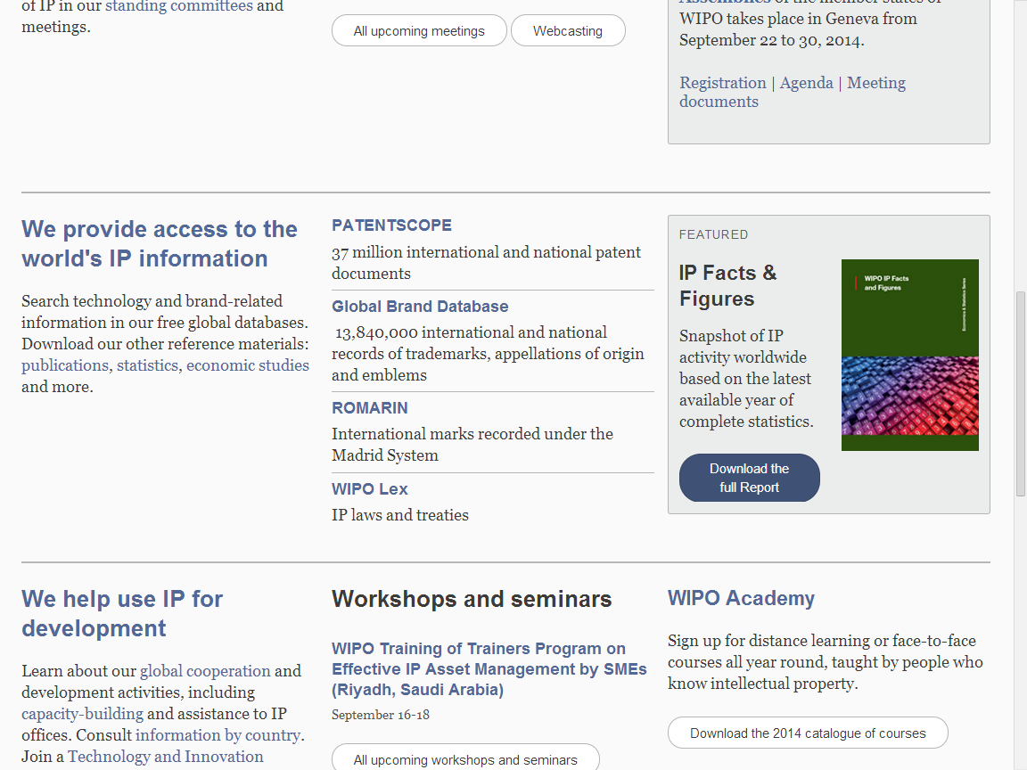

Slide 119
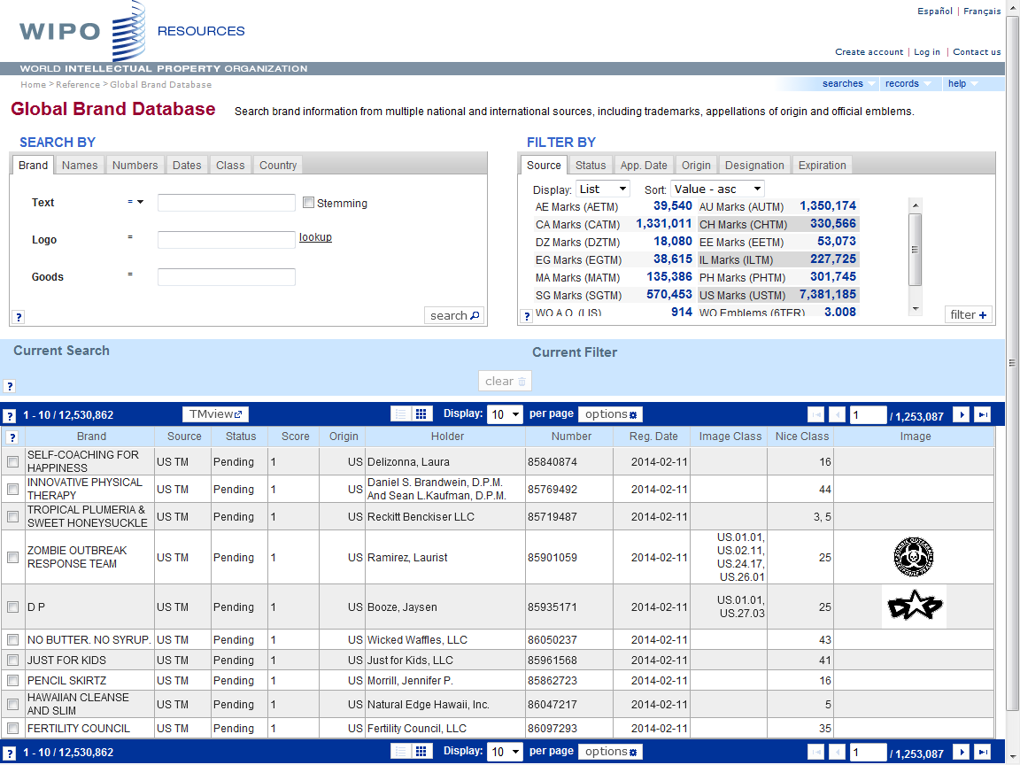

Slide 120
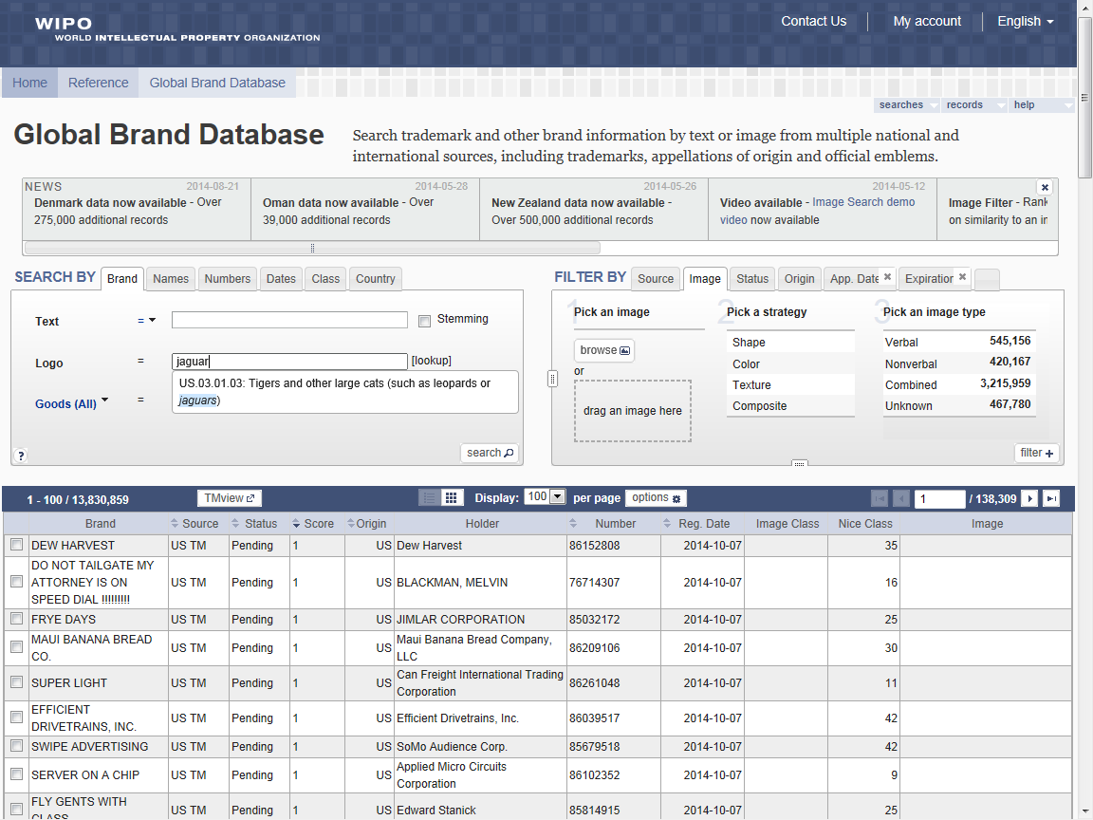

Slide 121
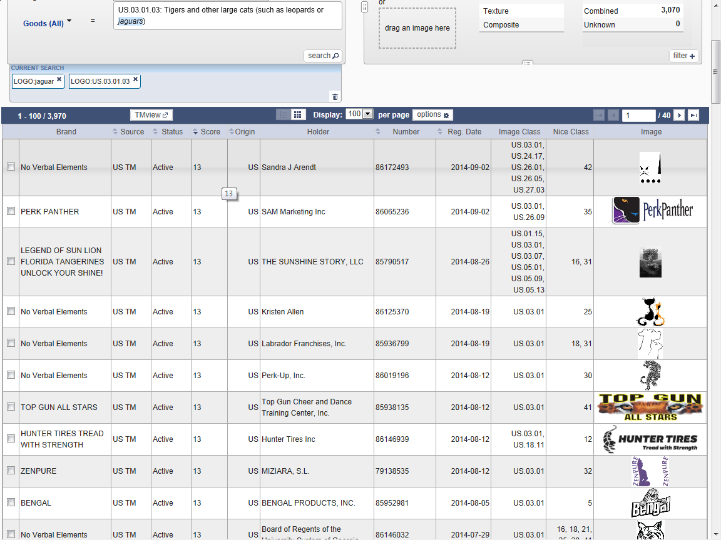

Slide 122
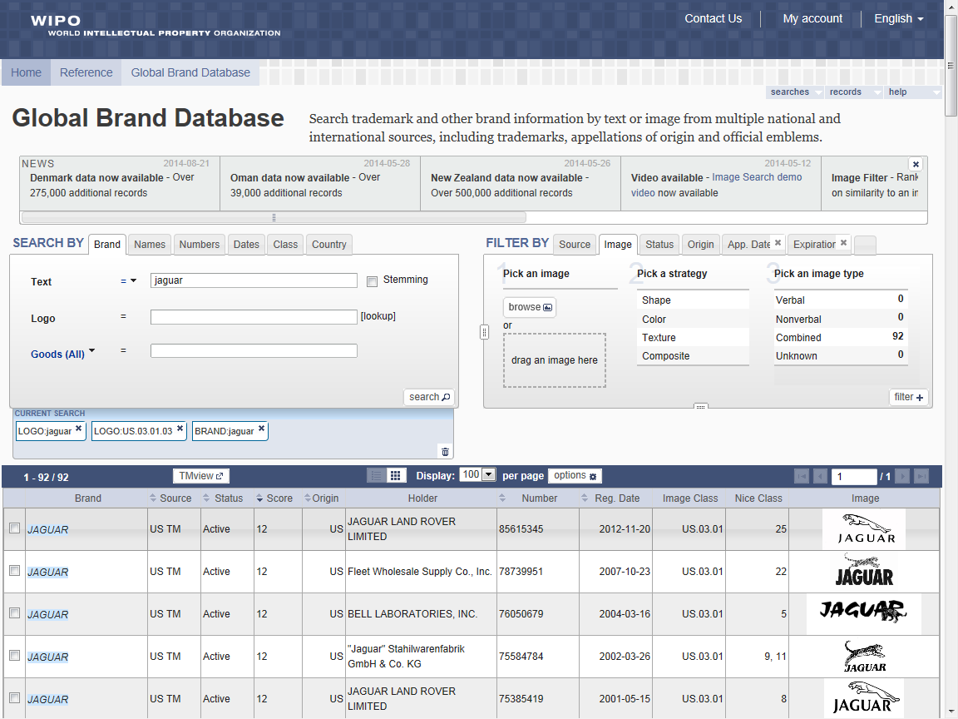

Slide 123
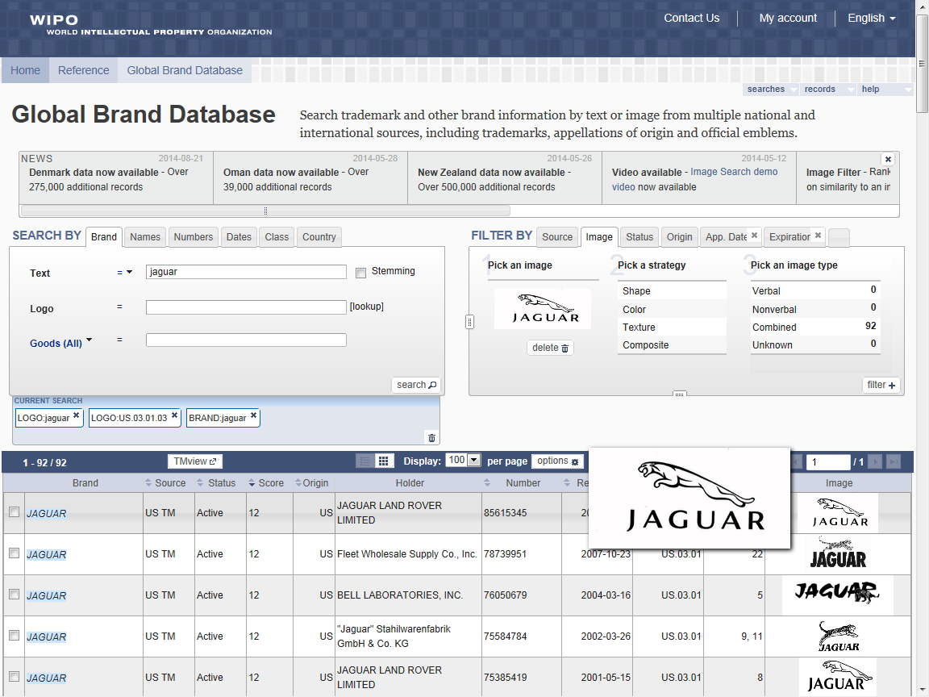

Slide 124
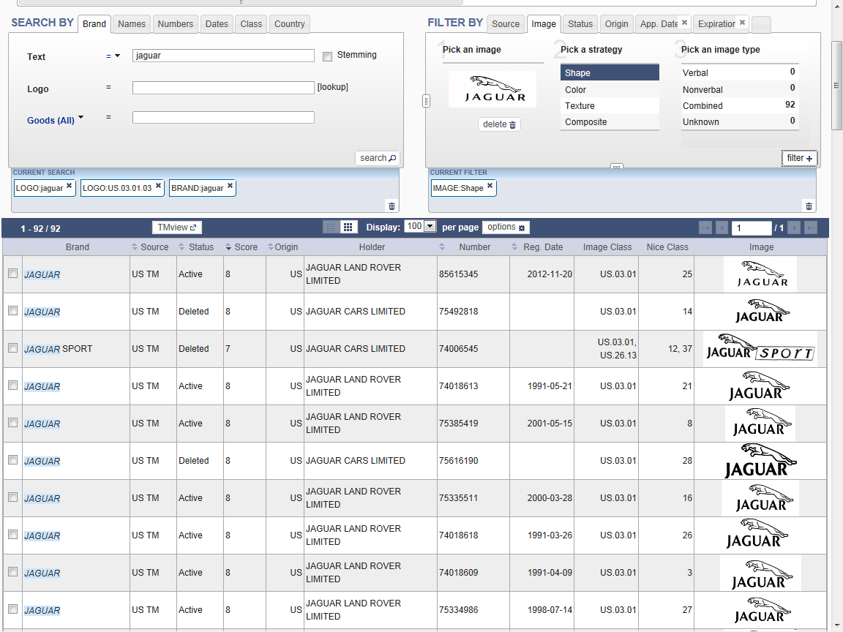

Slide 125
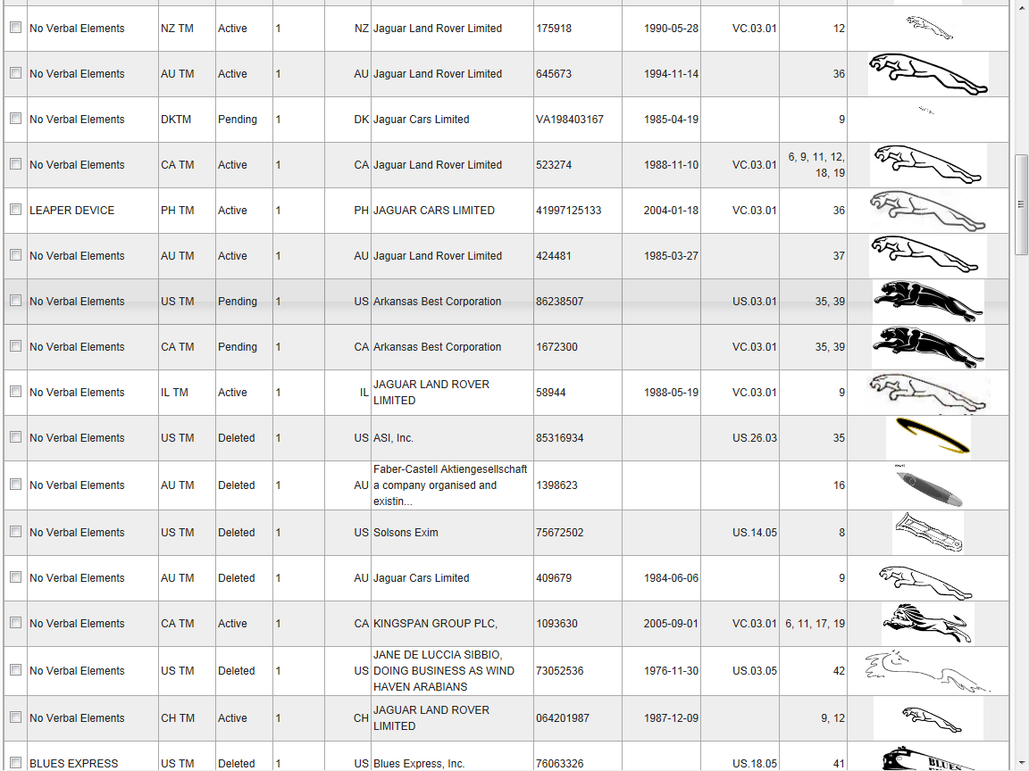

Slide 126
GLOBAL DATABASES, TOOLS, AND PLATFORMS FOR IP BUSINESS (FREE)
PATENTSCOPE
Global Brand Database
Global Design Database (coming soon!)
WIPO Lex
WIPO IPAS, WIPO DAS
WIPO CASE
WIPO GREEN

Slide 128
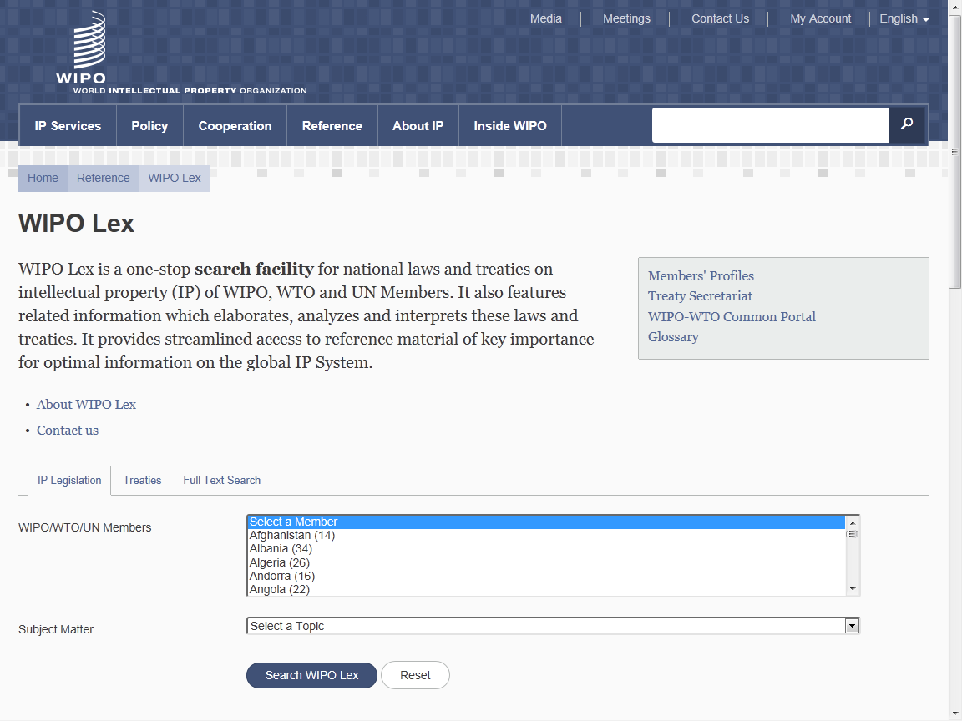

Slide 129


Slide 130


Slide 131
GLOBAL DATABASES, TOOLS, AND PLATFORMS FOR IP BUSINESS (FREE)
PATENTSCOPE
Global Brand Database
Global Design Database (coming soon!)
WIPO Lex
WIPO DAS
WIPO CASE
WIPO GREEN

Slide 132
WIPO DAS
DAS (Digital Access System) used by 11 IPOs
A System that allows IPOs and applicants to securely exchange or submit a digital copy of priority documents to multiple IPOs
Since 2012, a new simplified procedure to allow an applicant to use and give her access code directly to the office of second filing
Services are available at IPOs of AU, DK, CN, ES, FI, GB, IB, JP, KR, SE, US (EPO in 2015)

Slide 133
GLOBAL DATABASES, TOOLS, AND PLATFORMS FOR IP BUSINESS (FREE)
PATENTSCOPE
Global Brand Database
Global Design Database (coming soon!)
WIPO Lex
WIPO IPAS, WIPO DAS
WIPO CASE
WIPO GREEN

Slide 134
WIPO CASE
“Centralized Access to Search and Examination Reports”
Started with an initiative of the Vancouver Group (UK, AU, CA)
Online patent work-sharing platform for patent examiners worldwide—secure sharing search and examination documentation
IPOs can enhance quality and efficiency of patent examination
CASE will be linked to Open Portal Dossier of IP5 to become the Global Portal Dossier
How will it work?

Slide 135
WIPO CASE (CONTINUED)
The System functions to:
  search by patent number and retrieve simple results or a list of patent family members.
  view bibliographic data, citation data (if available) and lists of documents available for each patent record.
  view and/or download the available documents.
  subscribe to notifications of updates to a given patent record.
  Will be linked to OPD of IP5 -> “Global Dossier”

Slide 136
WIPO CASE and Global Dossier Databases/Platforms
Public
Public Users
PTO’s internal information
IP5 Global Dossier
PATENTSCOPE
Other PTOs
Dossier data
Australia
Malaysia
EPO
PCT published biblio. & dossier data
Dossier data(plan)
Biblio &
Dossier data
Canada
Mongolia
China
China
NZ
Linkage
WIPO CASE
Japan
Israel
Philippines
UK
Singapore
US
IP5
PCT(ePCT)
India
Viet Nam
Rep. of
Korea
?
WIPO
Member State
WIPO
Member State
WIPO
Member State
WIPO
Member State
WIPO
Member State
WIPO
Member State
WIPO
Member State
WIPO
Member State
Applicant’s filing

Slide 137
GLOBAL DATABASES, TOOLS, AND PLATFORMS FOR IP BUSINESS (FREE)
PATENTSCOPE
Global Brand Database
Global Design Database (coming soon!)
WIPO Lex
WIPO IPAS, WIPO DAS
WIPO CASE
WIPO GREEN

Slide 138

Broad aims:
  Match-making for technology transfer and collaborations
  Reduce transaction costs
  Build on comparative advantages of multi-stakeholder approaches
  Demonstrate practical means for the global policy issues
Based on the recognition that:
    Users want access to technologies, not just patent rights
    Collaboration (e.g. training) is crucial to tech transfer

Slide 139
A global database allowing users to make green technologies available for licensing or partnership, enter technology needs, search for technologies and needs
Started a pilot with Japan Intellectual Property Association in 2011
Launched in November 2013
as of September 2014, over 1,000 offers
Green tech providing companies in Germany, Japan, US etc.
Partners include companies, universities, UN agencies, governments, IPOs, NGOs, etc.

Slide 140































Partners of WIPO GREEN

Slide 141

www.wipo.int/green

Slide 142



Example: Product to license or sell
TEIJIN Limited (Japan)

Slide 143
Conclusion
WIPO Global Databases and Platforms will promote/are promoting global partnerships among multiple stakeholders
Databases, Tools, Services and Platforms need to be easy to search, up to date, interactive/dynamic, multilingual, and robust
WIPO is helping to establish critical elements of global IP infrastructure, tools and services necessary so that innovators, patent professionals and IP Offices in all countries can derive maximum benefit from the global IP system

Slide 144
ALTERNATIVE DISPUTE RESOLUTION- WIPO ARBITRATION AND MEDIATION CENTER
Speaker : Víctor Vázquez, Head, Section for Coordination of Developed Countries, Department for Transition and Developed Countries (TDC), WIPO

Slide 145
WIPO Arbitration and Mediation Center
Offices in Geneva and Singapore
International ADR Services Provider
  Specialized: WIPO panel members experienced in IP and technology
  Status as international institution
  Competitive WIPO fee structure
  Active case management, WIPO ECAF (online case management)
  Procedural guidance, training programs

Slide 146
ADR Options under WIPO Rules
WIPO Contract Clause/ Submission Agreement
Party Agreement
(Negotiation)
First Step
Mediation
Expert Determination
Expedited Arbitration
Arbitration
Procedure
Determination
Settlement
Award
Outcome

Slide 147
One Exchange of Pleadings
Shorter Time Limits
Sole Arbitrator
Shorter Hearings
Fixed Fees

Slide 148
New WIPO Mediation and (Expedited) Arbitration Rules
Effective since June 1, 2014
Accommodate certain external developments in arbitration law, including the 2010 revision of the UNCITRAL Arbitration Rules
Offer guidance on Center practice that has emerged over the years
Underscore the Center’s commitment to time and cost efficiency of proceedings conducted under its Rules
Main novelties:
  «List procedure» available in all WIPO ADR proceedings
  Multi-party arbitration: availability of joinder and consolidation orders
  Introduction of emergency relief proceedings

Slide 149

WIPO Cases: Types of Procedure

Slide 150

WIPO Cases: Subject Matter

Slide 151
Typical Subject Areas of WIPO Cases
151
Contractual
  patent licenses
  software development/license agreements
  research and development agreements
  trademark coexistence agreements
  patent pools
  distribution agreements
  joint ventures
  copyright collecting societies
  IP settlement agreements
Non-contractual infringement of IP rights

Slide 152

WIPO Cases: Business Areas

Slide 153

WIPO Arbitrators, Mediators, Experts
Support to parties in identifying/appointing a neutral
Database with 1500 arbitrators, mediators, experts from more than 70 countries
Notes:
WICHTIG!
Parteiautonomie
Schiedsrichter:
Zeit zur verfügung stellt
Experte ist
CIVIL VS COMMON LAW
Schiedsrichter der Verfahrensrecht/ Braeuche kennen
Beweisaufnahme, insbesondere discovery Guiding criteria? WIPO Rules, Article 38
Written phase tests management skill of arbitrators
Requires awareness of hybrid nature of international arbitration
Civil law style: Extensive written record, short hearings
Common law style Controlled document discovery, Controlled cross-examination

Slide 154
WIPO Survey: How Are IP/Technology Disputes Resolved?
Source: WIPO Arbitration and Mediation Center, International Survey on Dispute Resolution in Technology Transactions, 2013

Slide 155
Why ADR for IP Disputes?
Internationalization of creation/use of IP:
Calls for cross-border solutions
  WIPO Survey on Dispute Resolution in Technology Transactions (2013): 91% of respondents conclude agreements with parties from other jurisdictions, and 75% of respondents conclude agreements involving patents in several countries
Technical and specialized nature of IP:
Calls for specific expertise of the neutral
Short product and market cycles:
Calls for time-efficient procedures
Confidential nature of IP:
Calls for private procedures
Collaborative nature of IP creation and commercialization:
Calls for mechanisms that preserve relations

Slide 156
Limitations of IP ADR
Consensual
  May be difficult to agree once dispute has arisen and where there is no contractual relationship between the parties
Interim relief?
Outcome normally binding between parties only (inter partes)
  No public precedent or direct office action
Notes:
156

Slide 157
Arbitrability of Patents
In most jurisdictions arbitration affects the rights of the parties to the arbitration (inter partes effect)
Belgium and Switzerland: erga omnes effect
Arbitration of certain patent-related matters not permitted in South Africa
Parties/arbitrators can address possible sensitivities (“patent unenforceable“)

Slide 158
WIPO Survey: Relative Time and Cost of IP/Technology Dispute Resolution
Source: WIPO Arbitration and Mediation Center, International Survey on Dispute Resolution in Technology Transactions, 2013

Slide 159
Average Duration of IP/Technology Mediation and Arbitration
Mediation
  WIPO Survey: 8 months
  WIPO cases: 5 months
Arbitration
  WIPO Survey: over one year
  WIPO cases: typically between one and two years
Expedited arbitration
  WIPO Survey: 9 months
  WIPO cases: 7 months
Source: WIPO Arbitration and Mediation Center, International Survey on Dispute Resolution in Technology Transactions, 2013
Notes:
Häufigkeit Mediationsklauseln:
11% Umfrageteilnehmer: Mediation für mind. 30% der vertraglichen Streitigkeiten und 14% der nichtvertraglichen Streitigkeiten
Negativ
Präzedenzfall nötig
???: “Mediation ist ein Zeichen von Schwäche” / “Wir haben versucht zu verhandeln, daher wird ein Mediator nichts Weiteres beitragen”

Slide 160
Average Cost of IP/Technology Mediation and Arbitration
Mediation
  WIPO Survey: costs below USD 100,000 (91% of respondents)
  WIPO cases: USD 21,000
Arbitration
  WIPO Survey: USD 400,000 – USD 425,000
  WIPO cases: USD 165,000
Expedited arbitration
  WIPO Survey: typically not more than USD 50,000
  WIPO cases: USD 48,000
Source: WIPO Arbitration and Mediation Center, International Survey on Dispute Resolution in Technology Transactions, 2013
Notes:
Häufigkeit Mediationsklauseln:
11% Umfrageteilnehmer: Mediation für mind. 30% der vertraglichen Streitigkeiten und 14% der nichtvertraglichen Streitigkeiten
Negativ
Präzedenzfall nötig
???: “Mediation ist ein Zeichen von Schwäche” / “Wir haben versucht zu verhandeln, daher wird ein Mediator nichts Weiteres beitragen”

Slide 161

Fees and Costs – Reduction for Users of the PCT/Madrid/Hague Systems

Slide 162
WIPO Model Clauses
"Any dispute, controversy or claim arising under, out of or relating to this contract and any subsequent amendments of this contract, including, without limitation, its formation, validity, binding effect, interpretation, performance, breach or termination, as well as non-contractual claims, shall be submitted to mediation in accordance with the WIPO Mediation Rules. The place of mediation shall be [specify place]. The language to be used in the mediation shall be [specify language]”
If, and to the extent that, any such dispute, controversy or claim has not been settled pursuant to the mediation within [60][90] days of the commencement of the mediation, it shall, upon the filing of a Request for Arbitration by either party, be referred to and finally determined by arbitration in accordance with the WIPO Expedited Arbitration Rules. Alternatively, if, before the expiration of the said period of [60][90] days, either party fails to participate or to continue to participate in the mediation, the dispute, controversy or claim shall, upon the filing of a Request for Arbitration by the other party, be referred to and finally determined by arbitration in accordance with the WIPO Expedited Arbitration Rules. The place of arbitration shall be [specify place]. The language to be used in the arbitral proceedings shall be [specify language]. The dispute, controversy or claim referred to arbitration shall be decided in accordance with [specify jurisdiction] law."
http://www.wipo.int/amc/en/clauses/index.html
Notes:
162

Slide 163
WIPO Clauses / Submission Agreements
Parties can shape the process
Examples:
  Arbitral Tribunal (qualifications, composition, appointment procedure)
  Remedies (validity not addressed; method of damage calculation)
  Submissions (e.g. sequence and number of exchanges)
  Experiments (details, timing)
  Hearing (dates, interventions, witness examination)
  Award (timelines, reasoning)
  Recognition and enforcement of award
  Confidentiality
  Appeal

Slide 164


Settlement in WIPO-Administered Cases

Slide 165

WIPO ELECTRONIC CASE FACILITY (ECAF)
Easy; instant; centralized; location-independent; secure; available at parties’ option

Slide 166
WIPO ADR Services for Specific Sectors
Disputes arising in a specific industry sector or for a specific subject matter may benefit from ADR procedures tailored to specific types of disputes and attendant needs
Tailoring of clauses / submission agreements; rules; schedule of fees and costs; specialized panel of mediators, arbitrators, experts
Examples (www.wipo.int/amc/en/center/specific-sectors/ )
  Research & Development/Technology Transfer (DESCA, IPAG)
  Intellectual Property Offices: WIPO ADR options for parties in administrative trademark/patent procedures before IP Offices in Singapore, Brazil, Colombia and the Philippines
  Art and Cultural Heritage: ICOM-WIPO Mediation
  Patents in Standards (FRAND disputes)
  Domain Names (40,000+ cases since 1999)

Slide 167
WIPO Arbitration for FRAND/SEP Disputes
  Special WIPO list of neutrals and experts for patents in standards
  Model Submission Agreements to facilitate referral of FRAND/SEP disputes to WIPO arbitration, developed in consultation with ETSI
  http://www.wipo.int/amc/en/center/specific-sectors/ict/frand/
  Based on WIPO (Expedited) Arbitration Rules and WIPO patent case experience; builds in FRAND dispute-specific features
  Flexible, can be adapted by parties
  Two options:
    WIPO Arbitration (3 arbitrators)
    WIPO Expedited Arbitration (sole arbitrator)
  Either option can be combined with WIPO Mediation
  Tailored procedural schedule

Slide 168


Further Information
WIPO procedures, neutrals and
case examples:
http://www.wipo.int/amc/en/
2014 WIPO Rules:
http://www.wipo.int/amc/en/rules/newrules.html
Contact information, general queries
and case filing:
arbiter.mail@wipo.int
WIPO model clauses/submission
agreements:
http://www.wipo.int/amc/en/clauses/
International Survey on Dispute
Resolution in Technology Transactions http://www.wipo.int/amc/en/center/survey/results.html

