Slide 1
Introduction to WIPO:
Development of the International Legal Framework
Major IP Economic Studies
Seminar on WIPO Services and Initiatives
Víctor Vázquez
Head, Section for Coordination of Developed Countries,
Department for Transition and Developed Countries (TDC), WIPO
Copenhagen
September 6, 2013

Slide 2
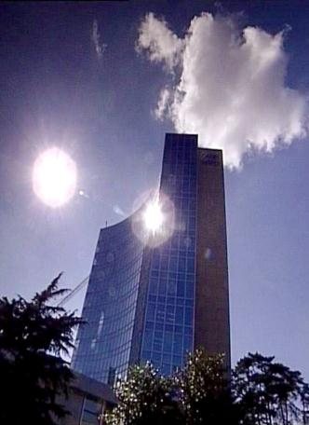
BASICS FACTS ABOUT WIPO
WIPO’s MISSION: To promote the protection of IP rights worldwide and Extend the benefits of the international IP system to All member states.
MEMBER STATES: 186
OBSERVERS : + 350
STAFF : 950 FROM 101 COUNTRIES
ADMINISTERED TREATIES : 26
MAIN ORGANS/BODIES : GA, CC, WIPO CONFERENCE

Slide 3
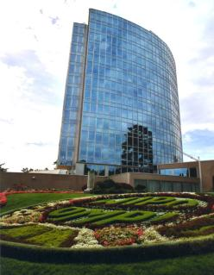
MILESTONES: 1883 - 2013
2013
MARRAKESH TREATY
2012
BEIJING TREATY
2006
STLT
1996
INTERNET TREATIES
1989
MADRID PROTOCOL
1970
PCT ESTABLISHED
1967
WIPO CONVENTION
1960
1925
BIRPI MOVES TO GENEVA
1893
HAGUE AGREEMENT
1891
BIRPI
1886
1883
MADRID AGREEMENT
BERNE CONVENTION
PARIS CONVENTION

Slide 4
INTELLECTUAL PROPERTY : OUTREACH
PUBLIC SECTOR & POLICY MAKERS
BUILDING AWARENESS
INTELLECTUAL PROPERTY OFFICES
GENERAL PUBLIC & CIVIL SOCIETY

Slide 5

WIPO’s MAIN ACTIVITIES
Services to Industry
Norm Setting
Global IP Infrastructure
Economic Development

Slide 6
GLOBAL IP INFRASTRUCTURE
“Just as participation in the physical economy requires access to roads, bridges, and vehicles to transport goods, similar infrastructure is needed in the virtual and knowledge economy. However, here the highway is the Internet and other networks, bridges are interoperable data standards, and vehicles are computers and databases.”
WIPO DIRECTOR GENERAL, FRANCIS GURRY
WIPO is coordinating with stakeholders to develop tools, services, platforms, standards, etc. that enable IP institutions to work more efficiently and provide better and high quality services.

Slide 7
GLOBAL IP INFRASTRUCTURE
ACTIVITIES INCLUDE :
  Technical assistance for modernizing IP offices;
  Capacity building & networking by Technology Innovation Support Centers (TISCs)
  Common platform for e-data exchange among IPOs
  Tools (international classifications in TMs/design (IPC, Green inventory, Nice classification)
  Standards & technical agreements
  Databases (PATENTSCOPE, Global Brand DB & access to aRDI and ASPI
  Services (International Cooperation for Patent Examination (ICE), Patent Information Services, including Legal Status of Patents)
  Forum for exchanging experience and lessons learned (Global Symposium of IP Authorities)

Slide 8
WIPO … PROVIDER OF PREMIER GLOBAL IP SERVICES
Core income generating business areas:
  Patent Cooperation Treaty (Patents)
  Madrid System (Trademarks)
  Hague System (Industrial Designs)
  Lisbon System (Geographical Indications)
  WIPO Arbitration and Mediation Center
AIM : to be the first choice for users by continuing to offer cost-effective value-added services
Notes:
Patent law differs from country to country. It can be a costly, complex and lengthy process to obtain patent protection in multiple countries. WIPO’s global protection services offer a swift, reliablecost-effective and user-friendly option. Principle objective of PCT is operational excellence and provision of high quality services to benefit users of patent system, patent administrations and general public by streamlining the filing and processing of patent applications in multiple countries (through reduced duplication of work of national filing and processing) to make the grant of patents more economical (ie less diversion of public resources for patent admin.)
Emphasis on ensuing PCT beneficiaries receive adequate knowledge of system and that the system responds satisfactorily to their needs.
TRADEMARKS: In constantly changing business environment, TMs, etc. are important tools for promotion of domestic commerce and int’l. trade which, in turn, contribute to sustainable national economic growth. Indispensable in designing marketing strategies to identify and promote goods in market place and distinguish these goods from those of competitors. To be effective, need adequate legal protection at national & int’l. levels. WIPO’s registration systems facilitate the acquisition and maintenance of these IPRs in different countries
A company in Morocco requesting TMP in 12 countries - application in 3 classes would pay over 6.5 times more if it didnt use MS but opted to apply to each national office separately -Madrid = 2,162 CHF; vs 14,245 CHF using national route). Renewal of same app. = 5+ times cheaper and cost of registering a change in ownership is 20+ times cheaper, costing 177 Swiss francs as opposed to 3,697 Swiss francs under the national route.
Patent law differs from country to country. It can be a costly, complex and lengthy process to obtain patent protection in multiple countries. WIPO’s global protection services offer a swift, reliablecost-effective and user-friendly option. Principle objective of PCT is operational excellence and provision of high quality services to benefit users of patent system, patent administrations and general public by streamlining the filing and processing of patent applications in multiple countries (through reduced duplication of work of national filing and processing) to make the grant of patents more economical (ie less diversion of public resources for patent admin.)
Emphasis on ensuing PCT beneficiaries receive adequate knowledge of system and that the system responds satisfactorily to their needs.
TRADEMARKS: In constantly changing business environment, TMs, etc. are important tools for promotion of domestic commerce and int’l. trade which, in turn, contribute to sustainable national economic growth. Indispensable in designing marketing strategies to identify and promote goods in market place and distinguish these goods from those of competitors. To be effective, need adequate legal protection at national & int’l. levels. WIPO’s registration systems facilitate the acquisition and maintenance of these IPRs in different countries
A company in Morocco requesting TMP in 12 countries - application in 3 classes would pay over 6.5 times more if it didnt use MS but opted to apply to each national office separately -Madrid = 2,162 CHF; vs 14,245 CHF using national route). Renewal of same app. = 5+ times cheaper and cost of registering a change in ownership is 20+ times cheaper, costing 177 Swiss francs as opposed to 3,697 Swiss francs under the national route.

Slide 9
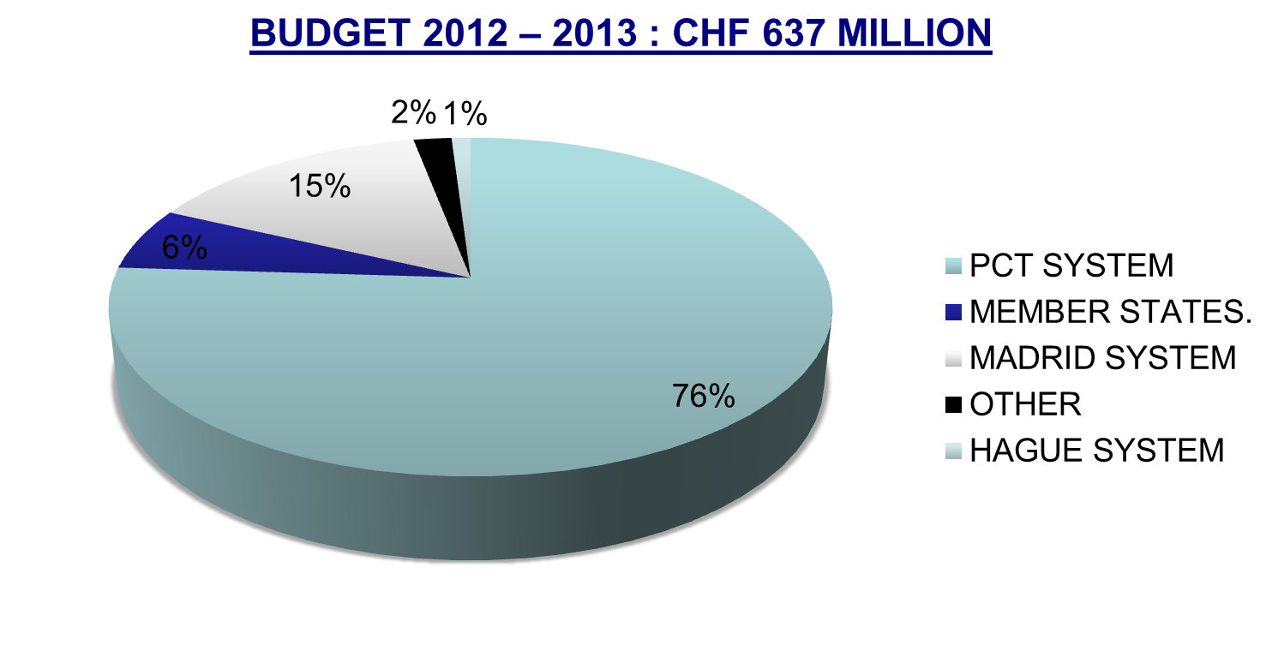
WIPO’s MAIN SOURCES OF REVENUE

Slide 10
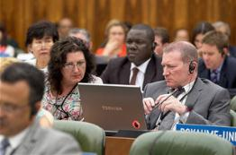

NORM SETTING
AIM → Progressive development of international IP law for an IP system that is:
  balanced/responsive to emerging needs
  effective in encouraging innovation/creativity
  sufficiently flexible to accommodate national policy objectives
Topical issues reviewed/discussed in Standing Committees

Slide 11


NORM SETTING
WIPO treaties are often closely connected to infrastructure and services:
  Treaties that provide legal support to international infrastructure and services: PCT, Madrid.
  Business simplification treaties, which simplify the operation of national infrastructure and services: Singapore Treaty on the Law of Marks (2006), Patent Law Treaty ( 2000)

Slide 12
STANDING COMMITTEES
PATENTS (SCP) (patent quality, E&Ls, patents & health, client-patent adviser privilege, tech transfer)
COPYRIGHT & RELATED RIGHTS (SCCR) (AV performances- E&Ls VIPs/libraries/archives, broadcasting)
TRADEMARKS, DESIGNS & GEOGRAPHICAL INDICATIONS (SCT) (Design Law Treaty/protection of country names against registration and use as TMs)
  AIM :
      Build consensus on topical issues
      Take into account interests of all stakeholders for a balanced, reliable, efficient, user-friendly, cost-effective system.
      N.B. Enforcement issues are discussed within the Advisory Committee on Enforcement (ACE)
Notes:
WIPO’s work in this area is designed to reduce complexity, cost and time involved in obtaining patent protection in multiple countries and to address workload crisis facing many office because of rising number of patent applications, changing nature of applications (biotech) and duplication of work. Various activities support this endeavor, namely:
- Substantive and procedural harmonization of patent law.
- Development and adoption of reforms of PCT System.
PCT Reform: began in Oct. 2000. General objectives to simplify the system, streamline procedures, reduce costs for applicants, maintains quality of services to facilitate greater use, ensure system works to advantage of all offices irrespective of size.

Slide 13
THE STANDING COMMITTEE ON LAW OF PATENTS
The last session of the Standing Committee on Law of Patents (SCP) took place in Geneva from February 25 to 28 2013
The SCP discussed the following issues :
  Exceptions and limitations to patent rights
  Quality of Patents including opposition systems
  Patents and Health
  Confidentiality of communications between clients and their patent advisors
  Transfer of Technology

Slide 14
THE STANDING COMMITTEE ON LAW OF PATENTS
PART II
For the next session of the SCP (December 9, 2013):
Quality of patents: the secretariat will prepare a compilation of worksharing programs among patent offices and use of external information for search and examination.
A document compiling laws and practices on confidentiality of communications between clients and their patent advisors
The Secretariat will prepare a document on how 5 different exceptions/limitations are implemented by member states and a half day seminar will be organized on the above A sharing session on countries’ use of health-related patent flexibilities
The Secretariat will revise the existing document on transfer of technology by adding practical examples and experiences regarding patent-related incentives and impediments
Notes:
private and/or non-commercial use; experimental
use and/or scientific research; preparation of medicines; prior use; use of
articles on foreign vessels, aircrafts and land vehicles. The document should
also cover practical challenges encountered by Member States in
implementing them.

Slide 15
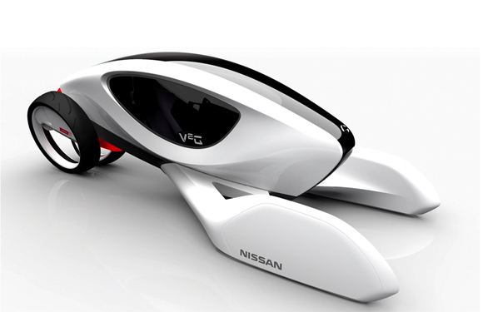
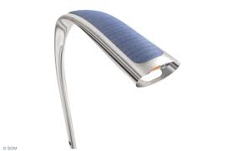
NORM SETTING :
INDUSTRIAL DESIGNS
THE STANDING COMMITTEE ON THE LAW OF TRADEMARKS, INDUSTRIAL DESIGNS AND GEOGRAPHICAL INDICATIONS (SCT)
  The SCT has substantially advanced work on the draft of a design law treaty.
  The General Assembly 2013 will decide on whether to convene a diplomatic conference in 2014.
  A business simplification treaty will simplify and standardize the registration and ancillary procedures applied to industrial designs in different countries

Slide 16
Other Items in the SCT agenda
SCT work on the protection of country names against registration or use of trademarks
Work is situated at the interface between private trademark rights and the interests of States to control the use – and appropriation - of their names
Various background papers and a draft reference paper are under consideration
Next session: November 4 to 8.

Slide 17
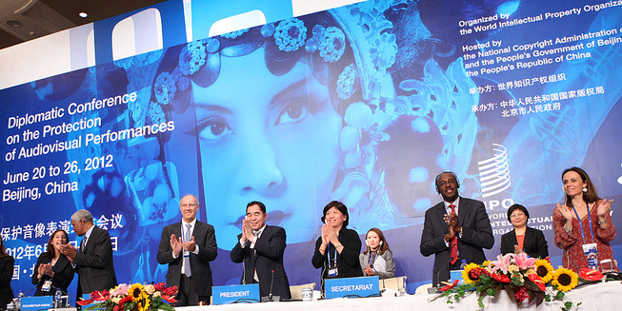
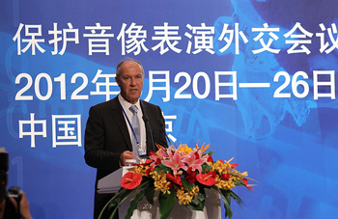
BEIJING TREATY ON AUDIOVISUAL
PERFORMANCES JUNE, 26 2012

Slide 18


BEIJING TREATY
The treaty on audiovisual performances was adopted on june 2012. the treaty will enter into force with 30 ratifications.
This treaty will strengthen the position of performers, giving them moral and economic rights for the international use of their performances.
Countries becoming party will pay for the use of foreign audiovisual performances. Some or all of this money will be going to performers.
« The conclusion of the Beijing Treaty is an important milestone toward closing the gap in the international rights system for audiovisual performers » WIPO Director General, Francis Gurry

Slide 19
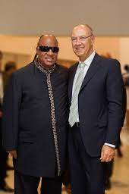
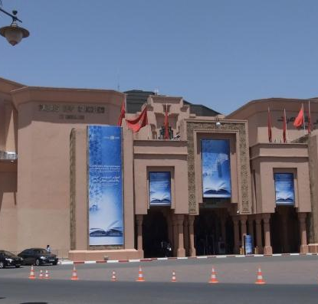
MARRAKESH TREATY TO FACILITATE ACCESS TO PUBLISHED WORKS FOR PERSONS WHO ARE BLIND, VISUALLY IMPAIRED OR OTHERWISE PRINT DISABLED

Slide 20

MARRAKESH TREATY
The Diplomatic Conference took place in Marrakesh from june 18 to 28, 2013 (600 negotiators from WIPO’s 186 member states)
There are more than 314 million blind and VIP- 90 % living in developing countries.
Only 5 % of the books published are available in braille or other accessible formats.
Requires contracting parties to adopt limitations for the benefit the people who are blind, visually impaired, and print disabled.
It also provides for the exchange of accessible format works across borders.

Slide 21
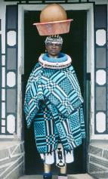
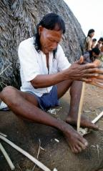
INTELLECTUAL PROPERTY AND TRADITIONAL KNOWLEDGE, ACCESS TO GENETIC RESOURCES AND FOLKORE
AIM: Generate benefits from IP to support: socio-economic development; cultural integrity of communities; address concerns of indigenous peoples
IGC: Debate broad policy and legal questions; share practical experience; and develop practical tools and mechanisms
  KEY ISSUES NEGOCIATED BY THE ICG :
  What to protect? definitions of TK/TCEs
  Why protect? Objectives
  Who will benefit? Beneficiaries
  How to protect? rights to be granted; limitations and exceptions; term of protection etc

Slide 22

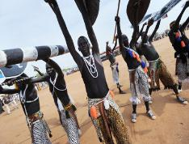
INTELLECTUAL PROPERTY AND TRADITIONAL KNOWLEDGE, ACCESS TO GENETIC RESOURCES AND FOLKORE
STATUS : Maturing process - common objectives/core principles
  Draft texts have been prepared on the three issues
  WIPO General Assembly 2013 is invited to take stock of and consider the 3 texts, progress made and decide on convening a diplomatic conference
  The GA will also decide on the mandate of the IGC for the biennium 2013-2014.
Notes:
Toolkit for management for the management of IP interests in the documentation of TK
A guide for the Protection of Expressions of Traditional Culture
Survey of practical experience in legal protection of TK.
Information materials
Best practices reflecting international consensus on IP issues concerning TK, TCEs and genetic resources

Slide 23

MAJOR ECONOMIC STUDIES ON IP
A NEW WIPO UNIT – THE ECONOMICS AND STATISTICS DIVISION- REFLECTS THE GROWING CONSENSUS ON THE IMPORTANCE OF THE ECONOMIC DIMENSION OF IP.
THE DIVISION APPLIES STATISTIC AND ECONOMIC ANALYSIS TO THE USE OF WIPO SERVICES.
THIS NEW STRUCTURE ALSO IMPROVES WIPO ECONOMIC INSIGHT ON IP DEVELOPMENT.

Slide 24
Strategic realignment within WIPO
Economics and Statistics Division
WIPO Chief Economist
IP Statistics
Section
Data Development
Section
Economics
Section

Slide 25
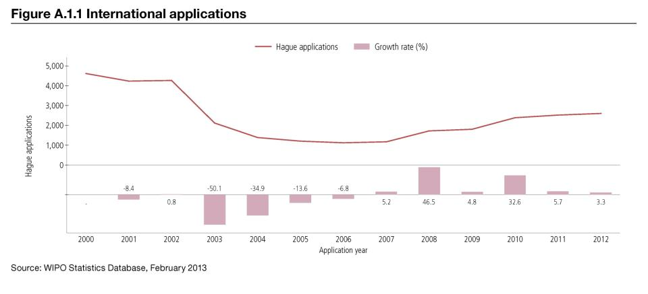
Trend in Hague filings (designs)

Slide 26
Demand for IP rights has grown
Source: WIPO Statistics Database, October 2011

Slide 27
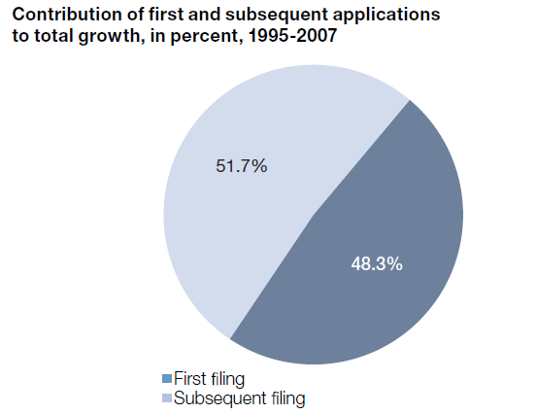
More inventions and greater internationalization
Source: WIPO (2011)

Slide 28
STUDIES AND REPORTS
World Intellectual Property Indicators (WIPI): This is our flagship IP statistics publication. It provides an overview of latest trend in IP filings and registrations covering more than 100 offices : http://www.wipo.int/ipstats/en/wipi/index.html
The PCT Yearly Review provides an overview of the performance and development of the PCT system. It includes a comprehensive set of statistics for the latest available year See: http://www.wipo.int/ipstats/en/statistics/pct/
Madrid Yearly Review: http://www.wipo.int/ipstats/en/
Hague Yearly Review: http://www.wipo.int/ipstats/en/
The WIPO IP Facts and Figures provides an overview of intellectual property (IP) activity based on the latest available year of statistics. It serves as a quick reference guide for statistics: http://www.wipo.int/ipstats/en/
WIPO IP Statistics Data Center is an on-line service enabling access to WIPO’s statistical data. Users can select from a wide range of indicators and view or download data according to their needs: http://ipstatsdb.wipo.org/ipstatv2/ipstats/patentsSearch

Slide 29
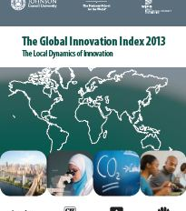
THE GLOBAL INNOVATION INDEX 2013
Annual publication that provides the latest trends in innovation activities across the world. It is co-published by INSEAD, Cornell Univ. and WIPO http://www.wipo.int/econ_stat/en/economics/gii/index.html
Its results are useful:
  To benchmark countries againt their peers
  To study countries profiles over time
  Identify countries strengths and weaknesses

Slide 30
THE GLOBAL INNOVATION INDEX 2013
The framework is revised and adjusted every year in a transparent exercise
This year, out of 84 indicators, 64 are indentical to GII 2012, and a total of 20 indicators were modified
10 indicators were deleted/replaced
10 indicators underwent changes such as the computation methodology at the source, change of scaling factor, change of classification etc
The year per year comparison has to be carefully taken into consideration

Slide 31
GLOBAL INNOVATION INDEX FRAMEWORK
OUTPUT SUB INDEX
INPUT SUB INDEX
SCIENTIFIC OUTPUT
CREATIVE OUTPUT
HUMAN CAPITAL AND RESEARCH
INFRASTRUCTURE
MARKET SOPHISTICATION
BUSINESS SOPHISTICATION

Slide 32
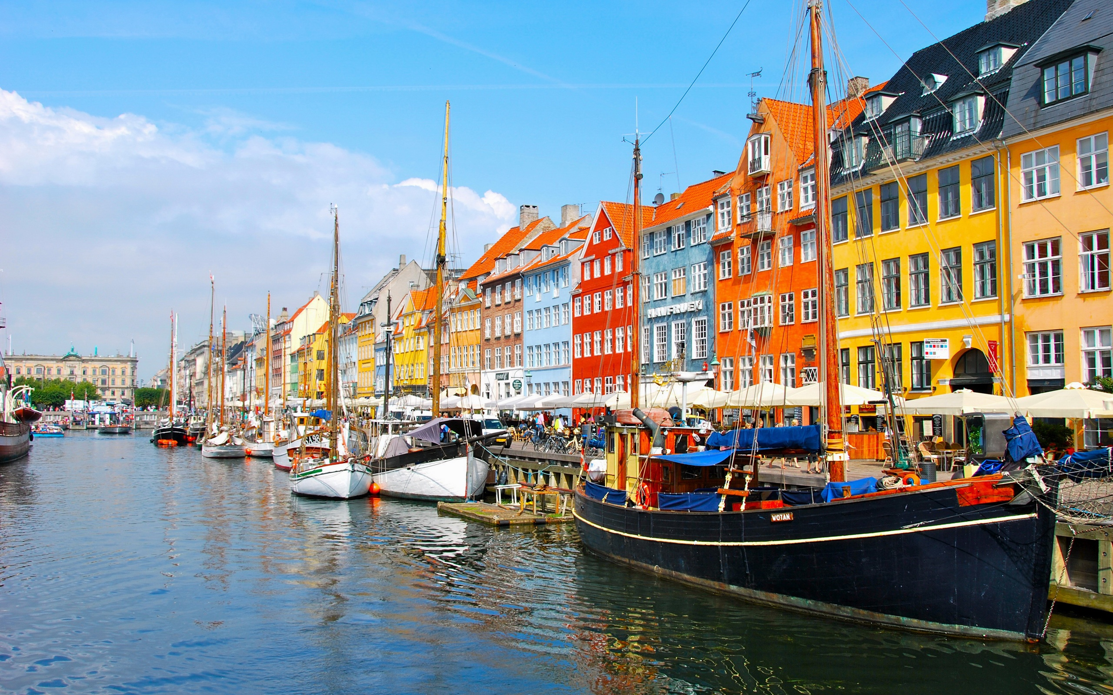
DENMARK PROFILE

Slide 33
THE GLOBAL INNOVATION INDEX
RANKING 2012
RANKING 2013
1. SWITZERLAND
2. SWEDEN
3. SINGAPORE
4. FINDAND
5. UNITED KINGDOM
6. NETHERLANDS
7. DENMARK
8. HONG KONG (CHINA)
9. IRELAND
1. SWITZERLAND
2. UNITED KINGDOM
3. SWEDEN
4. NETHERLANDS
5. UNITED STATES OF AMERICA
6. FINLAND
7. HONG KONG (CHINA)
8. SINGAPORE
9. DENMARK

Slide 34
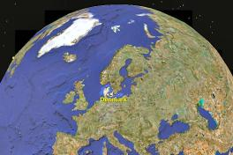
DENMARK PROFILE
  Denmark is ranked in the top ten (9th)
  Denmark has a leading position in the input sub-index (8th) due to proficiency in human capital and research (7th), infrastructure (13th), market sophistication (7th) and business sophistication fields (19th)
  Denmark reaches 95.3 out of 100 within the institution index. the political environment and its efficiency are a most valuable strength
  Denmark’s strengths are also drawn from research and development, logistic performances and the ease to obtain a credit
  Denmark’s relative weaknesses are drawn from business sophistication, as well as the knowledge & technology outputs

Slide 35
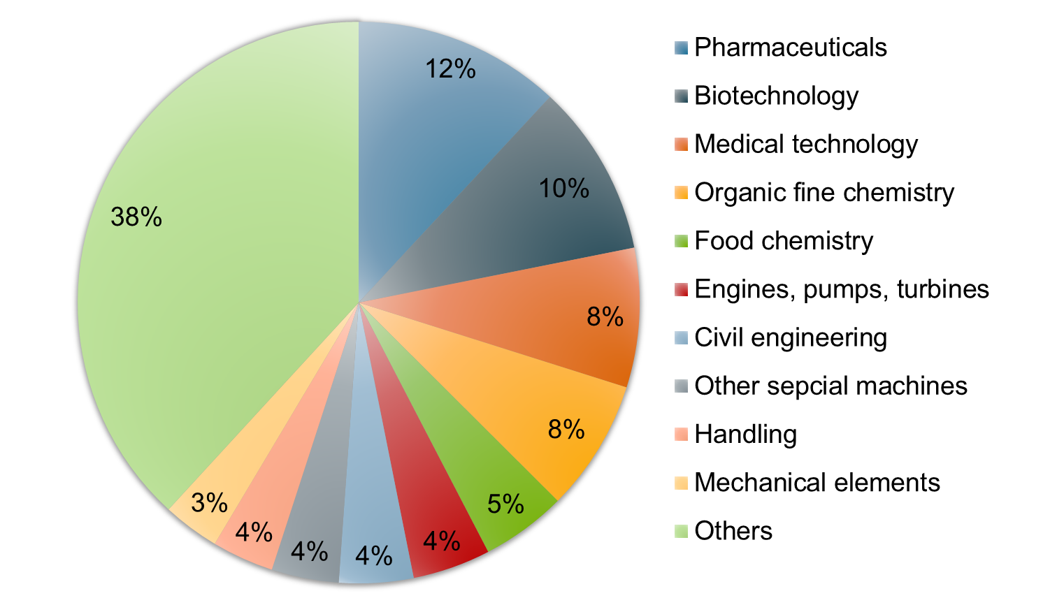
PATENT APPLICATION BY TOP FIELDS OF TECHNOLOGY (1997-2011)

Slide 36
INTERNATIONAL APPLICATIONS
VIA WIPO ADMINISTERED TREATIES
DENMARK

Slide 37
Thank you
Notes:
Welcome ….
Today, we are going to explain to you, in very general terms,
what this Organization does and why?

