Slide 1
Generative AI Regulation in China
Jun Zhu
Tsinghua University

Slide 2
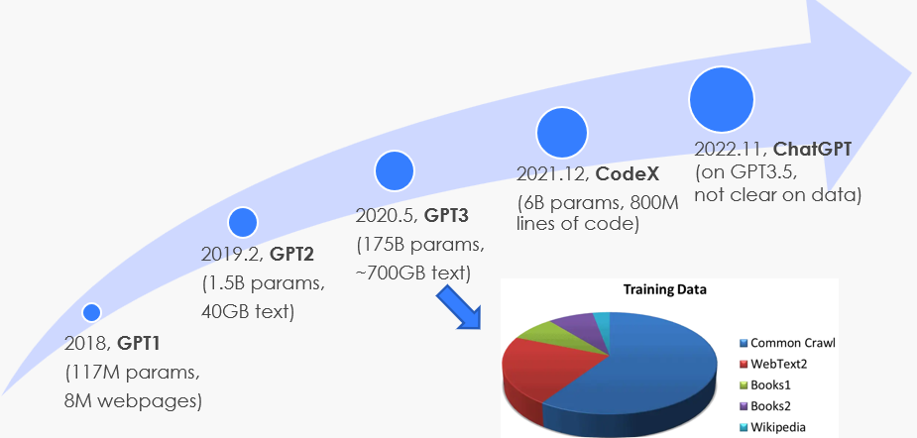
Fast Progress on Generative AI
Generative AI is developing fast, driven by Big Data, Big Model, and Big Computing
Not early text! But also image, video, audio, other sensory data …

Slide 3
Regulation on Generative AI in China
2019-06: “Governance Principles of New Generation AI: Developing Responsible AI” -- National New Generation AI Governance Professional Committee
Fairness, privacy, safety, collaboration, governance, etc
2021: “Ethics of New Generation AI”
6 basic ethic requirements: Privacy protection, fairness & quality, trustworthy, responsible etc.
2023-07-10: “Regulation on Generative AI Service” by Cyberspace Administration of China (CAC)
Emphasize on protecting copyright and data privacy
The generative AI service provider should be able to remove those data with copyright concerns
Generative AI service provider needs to pass a series of test
2023-06: “AI Law (Draft)” is a part of 2023 Legislative Work Plan of the State Council

Slide 4
Thanks

