Slide 1
Recent Activities of the
United States Copyright Office on
Copyright and Artificial Intelligence
Maria Strong
Associate Register of Copyrights and Director of Policy and International Affairs at the U.S. Copyright Office
WIPO Conversation on Intellectual Property and Frontier Technologies
Sharing Session by IP Offices on September 21, 2023

Slide 2

THE COPYRIGHT OFFICE’S AI INITIATIVE
Copyright Registration Guidance for Works Containing AI-Generated Materials (March 2023)
Four Public Listening Sessions (April-May 2023)
Two Public Educational Webinars (June-July 2023)
Registration Program and
Review Board Decisions (ongoing)
Notice of Inquiry Requesting Public Comments (issued August 30, 2023)
copyright.gov/ai
2

Slide 3
A RECENT ENTRANCE TO PARADISE
Copyright Office
Review Board Decision
(14 February 2022) at
https://copyright.gov/rulings-filings/review-board/docs/a-recent-entrance-to-paradise.pdf
Mem. Op., Thaler v. Perlmutter,
No. 22–cv– 1564, ECF No. 24
(D.D.C. 18 August 2023) at
https://copyright.gov/ai/docs/district-court-decision-affirming-refusal-of-registration.pdf
Copyright claimant: Dr. Stephen Thaler Author: The “Creativity Machine”
3

Slide 4
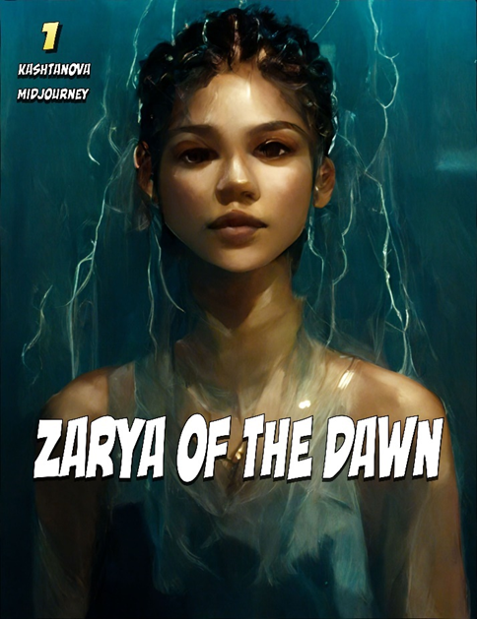
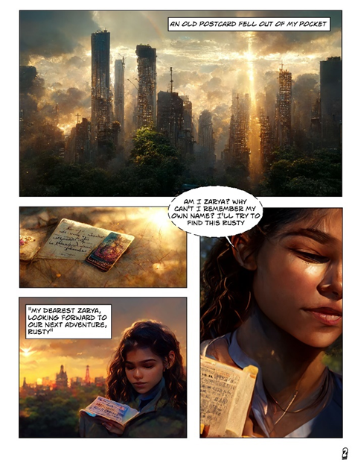
ZARYA OF THE DAWN
Images generated by Midjourney
Examples of images and text in the
graphic novel submitted for registration
Office of Registration Policy & Practice Letter (21 February 2023) at https://copyright.gov/docs/zarya-of-the-dawn.pdf
4

Slide 5
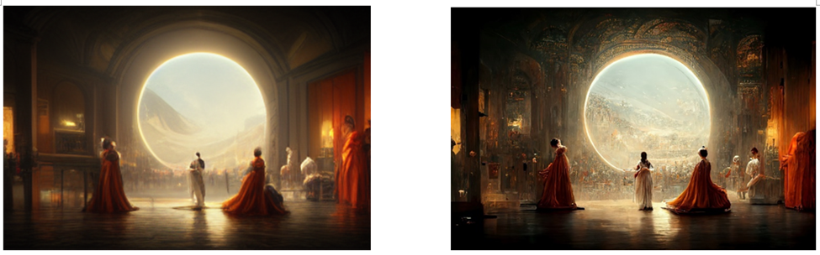
THÉÂTRE D'OPÉRA SPATIAL
Image generated by Midjourney
Image submitted for copyright registration
Copyright Office Review Board Decision (5 September 2023) at
https://copyright.gov/rulings-filings/review-board/docs/Theatre-Dopera-Spatial.pdf
5

Slide 6
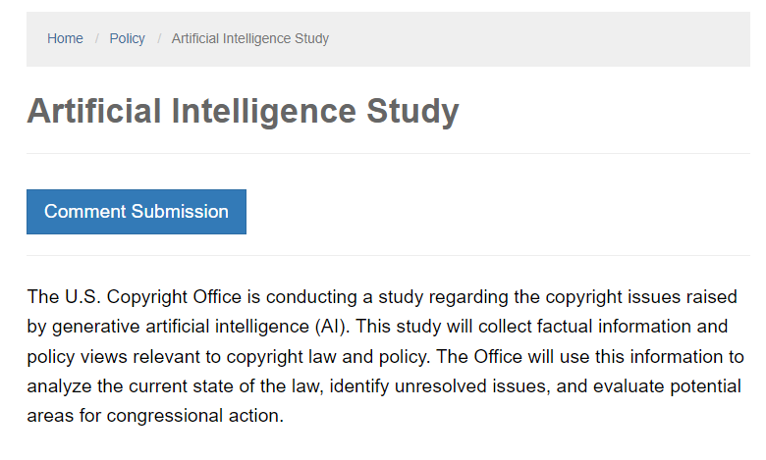
PUBLIC NOTICE OF INQUIRY
The Office has identified a wide range of copyright policy issues arising from the development and use of AI, including:
the use of copyrighted works to train AI models;
the copyrightability of material generated using AI systems;
potential liability for infringing works generated using AI systems; and
the treatment of generative AI outputs that imitate the identity or style of human artists.
The Office seeks public comments on these and related issues.
https://copyright.gov/policy/artificial-intelligence/
6

Slide 7
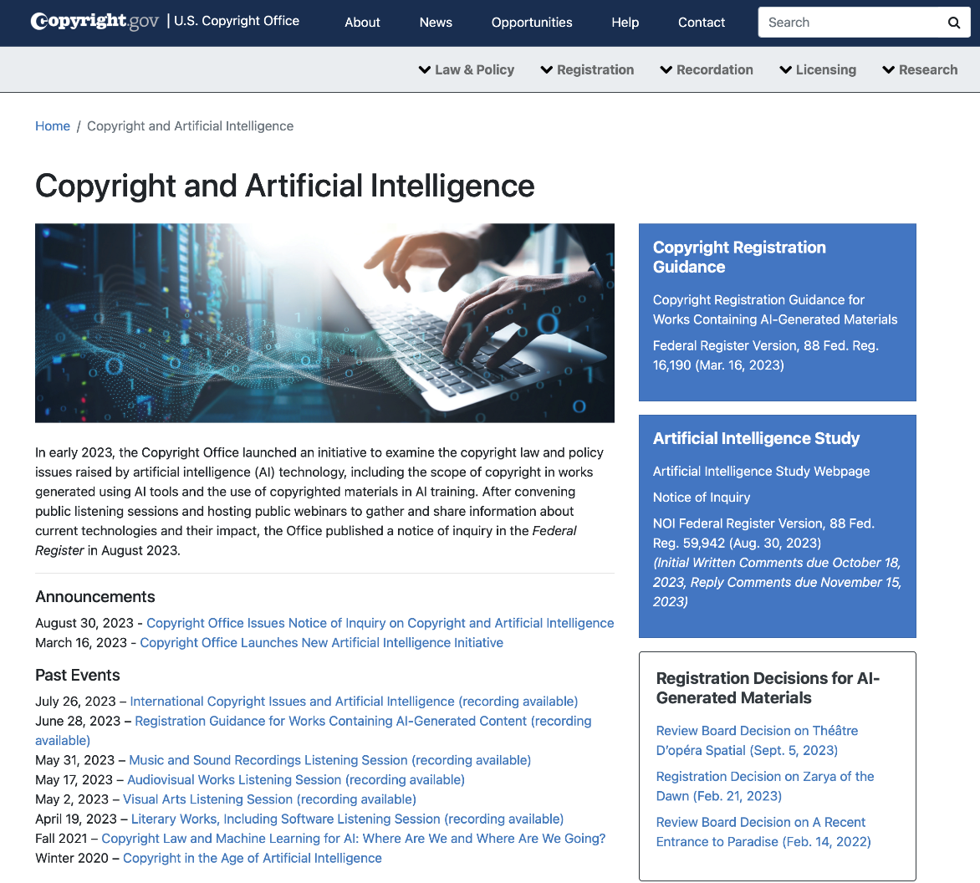




Visit our AI Initiative webpage
copyright.gov/ai
CONNECT WITH US
Subscribe to our NewsNet, blog, events and other updates at copyright.gov/subscribe
7
Notes:
Questions?

