Slide 1
IP Strategies for Innovators and Creators in the Age of Generative AI
Pedro
Gonçalves
Director of Legal and Compliance
Sep 2023

Slide 2
Language Operations Platform fuelled by an always-on AI that empowers you to bring in human review when needed

Slide 3
Center for Responsible AI Pillars
FAIRNESS
EXPLAINABILITY
SUSTAINABILITY

Slide 4
The Consortium
Feedzai
BIAL, Hospital de São João, Hospital da Luz
Pestana Group
SONAE
Life Sciences
Market
Tourism
Automaise
Emotai
NeuralShift
Priberam
Sword Health
Unbabel
VdA
Visor.ai
YData
Yoonik
Fintech
Customer Service
FAIRNESS
EXPLAINABILITY
SUSTAINABILITY
Explainability
Privacy
Champalimaud Foundation
CISUC
FEUP
Fraunhofer Portugal AICOS
INESC-ID
ISR
IT
Observability
Fairness
AI Research
Energy Efficiency

Slide 5
21 products using Responsible AI
Notes:
Guiados por estes princípios os membros do Center for Responsible AI irão desenvolver 21 produtos de IA da próxima geração
Não sendo possível falar de todos aqui por falta de tempo vou destacar quando desafios concretos de mercado que irão ser atacados por alguns destes produtos

Slide 6
Launch a new vaccine or medicine in a safer and faster way.
Notes:
Dois deles irão atacar desafios da indústria farmacêutica trazidos pela BIAL

Slide 7
Physical therapy without barriers for everyone.

Slide 8
Increase efficiency and trust on hospital discharges.

Slide 9
Cultural-aware interactions in the customer's native language.

Slide 10
Portugal Health Data Space
Creating the legal, ethical and technological foundations for the Portugal Health Data Space
Legal & Ethical
Portugal Health Data Space
European Health Data Space
Legal & Ethical protocols
Hospital de São João
Hospital da Luz
Notes:
Portugal Health Data Space
Start with the 2 hospitals
Align with the European Health Data Space
Making sure the data is benefiting the person from which it is collected
Legal & Ethical protocols
Aligned with EU AI Act
Enabler of more AI products
Forefront of AI in Europe
Responsible AI perfect fit

Slide 11
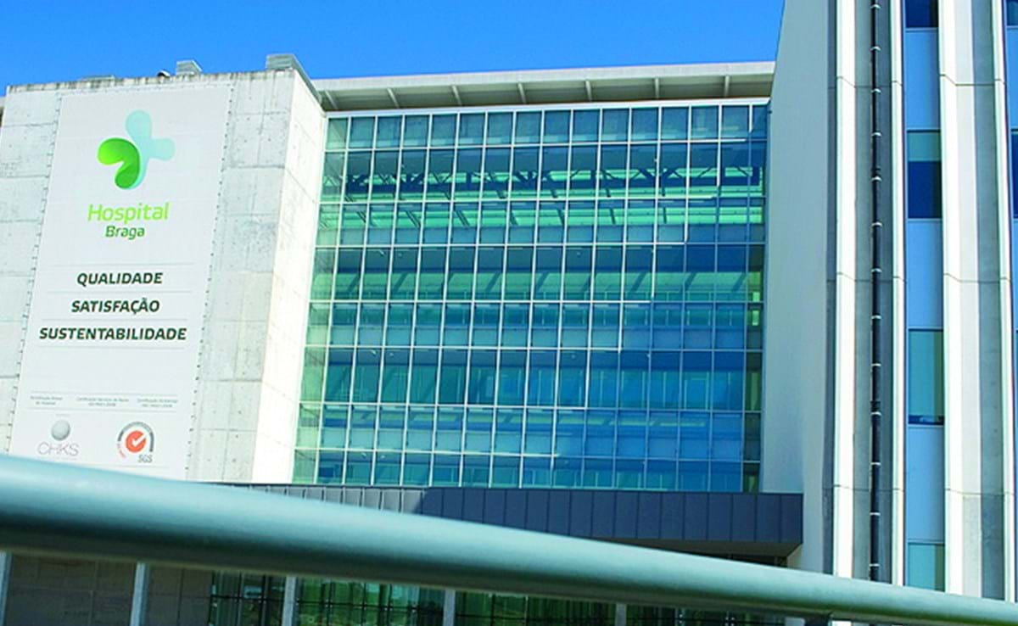
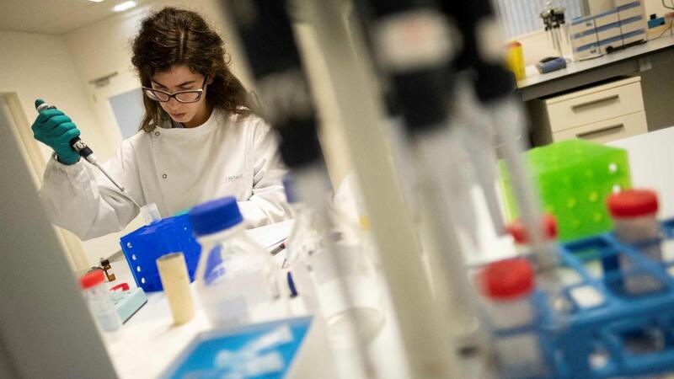
Critical mass of AI data will support advances in clinical research
Faster diagnosis in the emergency room
Taking our health data with us anywhere
Accelerate advances in clinical research
BIAL

Slide 12
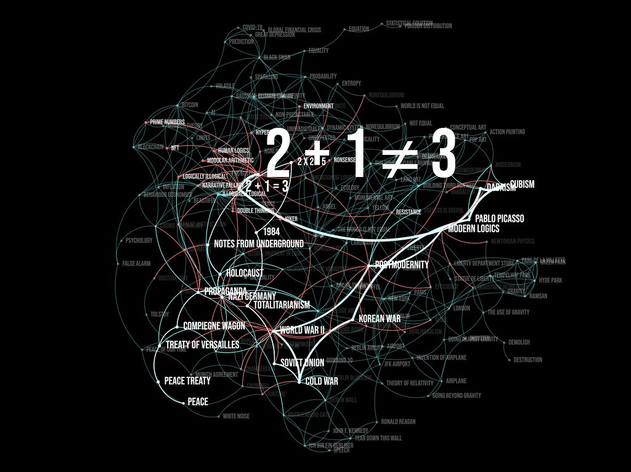
Generative AI
Machine learning algorithms that can create content autonomously.
Generative AI - A kind of magic
Notes:
Align to company OKRs

Slide 13
Generative AI – IP Constraints
Generative AI platforms are trained on data lakes and question snippets — billions of parameters that are constructed by software processing huge archives of images and text.
AI platforms recover patterns and relationships, which they then use to create rules, and then make judgments and predictions, when responding to a prompt.
This process comes with legal risks, including intellectual property infringement.
Does copyright, patent, trademark infringement apply to AI creations?
Is it clear who owns the content that generative AI platforms create for you, or your customers?
Notes:
Align to company OKRs

Slide 14
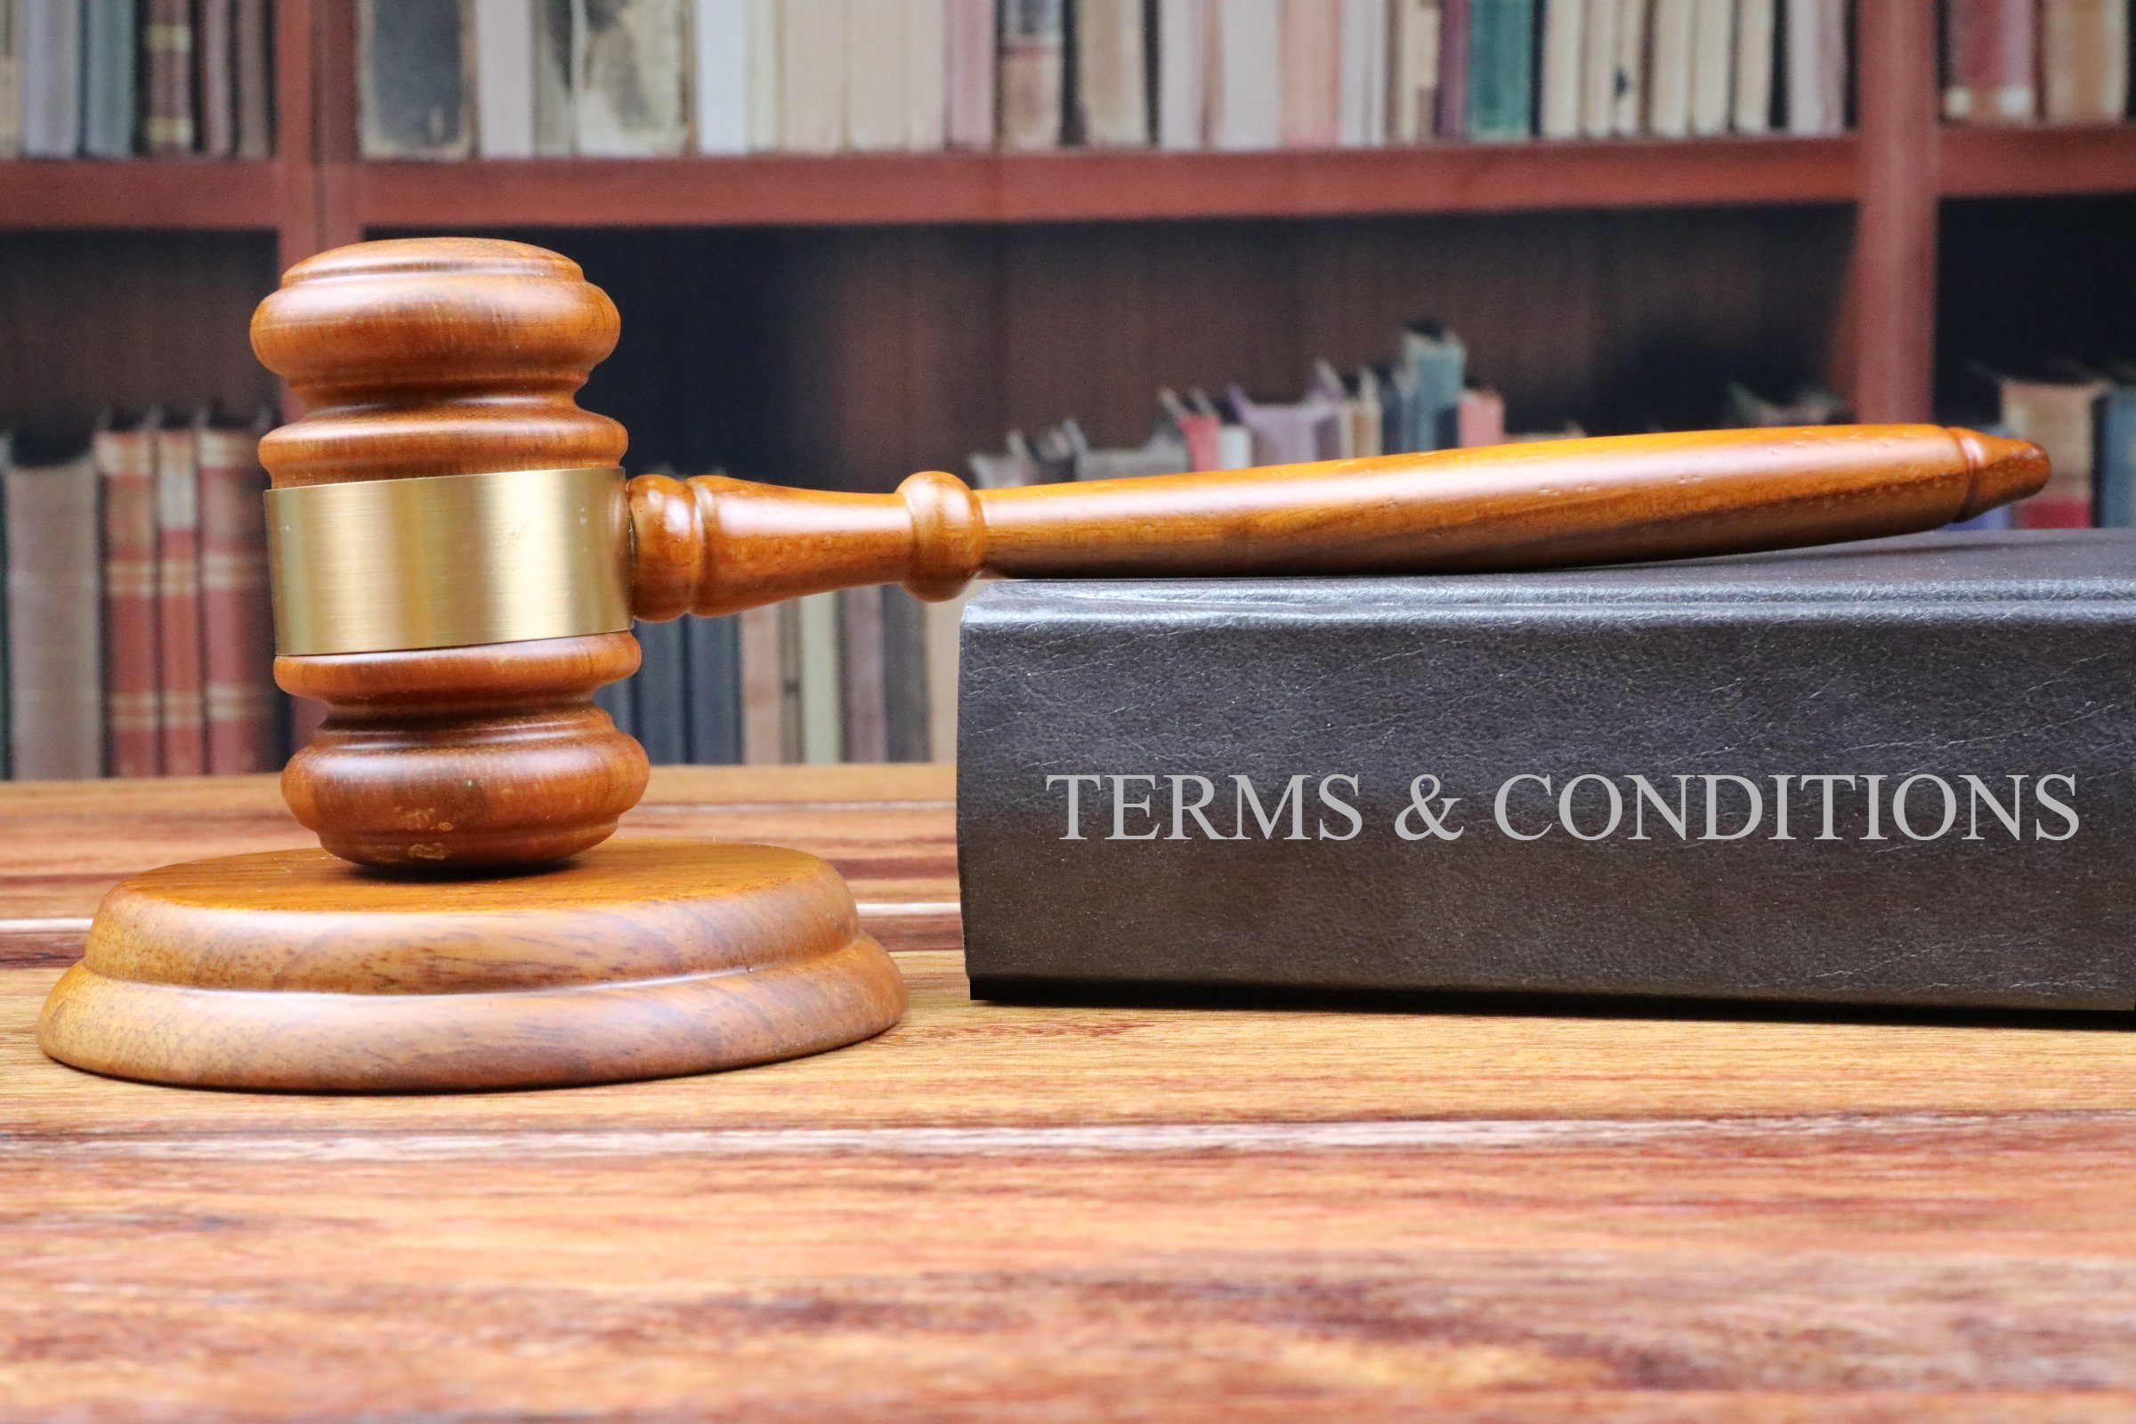
Where Generative AI Fits into Today’s Legal Landscape
courts are sorting out how the laws on the books should be applied - Andersen v. Stability AI et al.; Getty v. Stable Diffusion; Andy Warhol Foundation — brought by photographer Lynn Goldsmit
contracts silent on generative AI usage by their vendors and customers.
fair use and the difficulties of its application,
Uncertainty about ownership of AI-generated works and unlicensed content in training data are legal concerns.

Slide 15
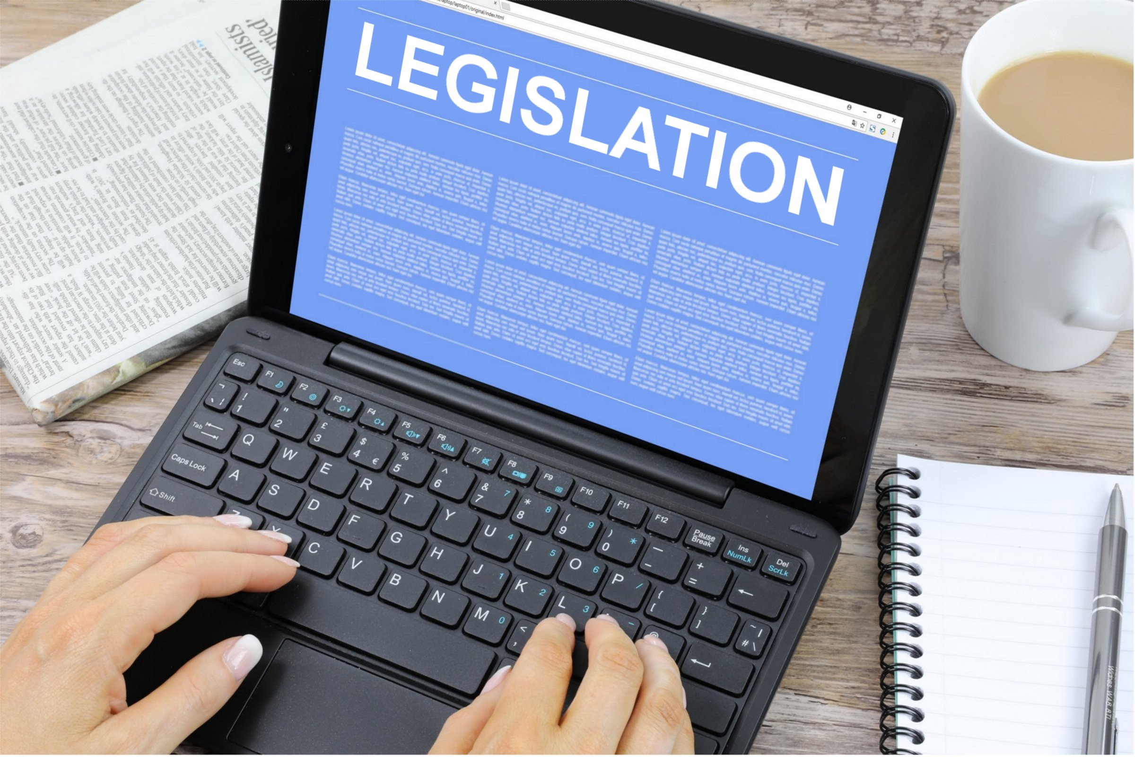
Mitigating Risk and Building a Way Forward (1/2)
licensing and compensating those individuals who own the IP that developers seek to add to their training data (e.g licensing; revenue sharing)
AI developers will need to take initiative about the ways they source their data (e.g. opt out of the next generation of the image generator)
The ownership of AI-generated works must be determined, whether it's the developer, organization, or AI model.
Transparency on the works included in the training data (e.g. recording the platform that was used to develop the content, details on the settings that were employed, tracking of seed-data’s metadata, and tags to facilitate AI reporting)

Slide 16
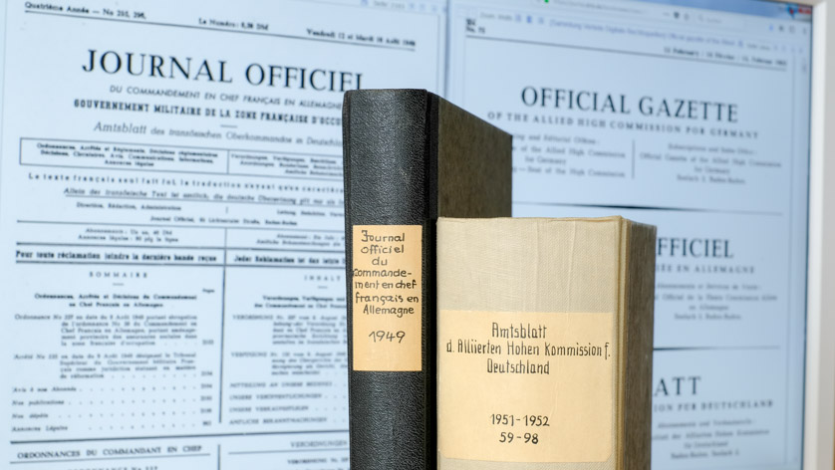
Mitigating Risk and Building a Way Forward (2/2)
operate in the open-source community, it’s pretty easy to take open-source software and make sure you keep the attribution, which is a requirement for being able to use the software,
Companies should be active in their due diligence, taking actions such as monitoring AI systems and getting adequate assurances from service and data providers.
Contracts with service and data providers should include indemnification — a mechanism for ensuring that if a company uses a product or technology in accordance with an agreement, that company is protected from legal liability.

Slide 17
Information Disclosure/Privacy concerns
Generative AI's growing capabilities and accessibility increase the risk of disclosing sensitive business information.
Clear guidelines, policies and effective communication are essential to prevent data breaches and legal consequences.
Data privacy and confidentiality should be prioritized to maintain legal compliance.
Effective governance can ensure the protection of sensitive data, intellectual property, and information.
Robust data anonymization and encryption techniques must be implemented.
Full compliance with GDPR

Slide 18
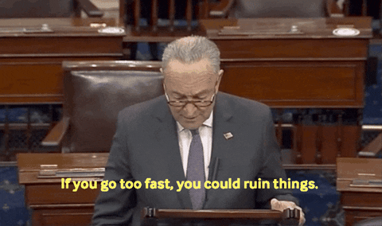
Risks of Over Regulation
While regulation is necessary, there's a concern that excessive regulations might stifle innovation.
The EU-AI ACT.
Repeating the same mistakes: As happened with autonomous vehicle, companies may move testing operations outside Europe due to regulatory complexities.
Fairness, Transparency and Explainability
Patent law and copyright law were crafted by humans, for humans. Intellectual-property law, as the world understands it, explicitly doesn’t recognize nonhuman creators.
Schumer, Chuck - USA Senator

Slide 19
Questions?
Notes:
They used to put the booking phone number on the side of their planes, it was that important to the business then.

