Slide 1
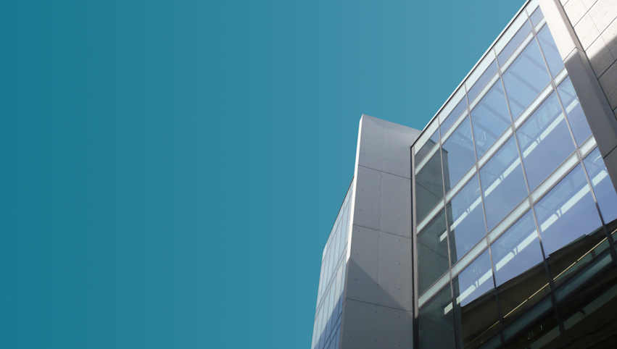
Max Planck Institute
for Innovation and Competition
Computer- or AI-generated works? A view from civil law countries
September 21, 2023
WIPO Conversation on IP and Frontier Technologies
Eighth Session
Professor Dr. Silke von Lewinski

Slide 2
“Computer generated work” in civil law countries?
Term first used in UK CDPA 1988, later followed by other Commonwealth countries
Civil law countries: no such concept:
“Work” by definition only output of human mind
eg, EU: „author’s own intellectual creation”
- requires a human being who expresses his or her feelings or thoughts in the work.
- Thus, a direct link between the human’s mind and the concrete expression is needed
Is there such direct link between human being and expression in case of AI?

Slide 3
Is a Computer-generated/AI-production a “work”?
In theory: If AI were used as a tool (like a prolonged arm, a computer/keyboard to write texts, etc.) to achieve a planned, concrete expression, then the human user would create a work by means of AI
But today: AI autonomously produces an unforeseeable product, human AI user cannot control/predict concrete outcome, cannot instruct AI system to get the exactly wanted expression
Therefore there is no work/no author/no copyright protection (since not human-made) – even if contracts state otherwise. Therefore:
Term “work” is legally wrong. Better use: AI product, AI output, AI content

Slide 4
Conclusion
AI system as a tool for human expression?
No, AI system as independent content producer

Slide 5
Human influence in AI-product – does it make it a “work”?
Human influence on AI product after output is generated
Examples
Human user chooses one of several text versions made on basis of a prompt for exploitation? (choice is not a “work”)
User improves AI-translation (attention: translation= infringement?)?
User adds new elements to AI-generated image?
Artist “collaborates” live with AI “painter”/robot on canvas?
Where changes/additions constitute an “authors’ own intellectual creation”, only those may be protected, but “AI-part” remains in public domain

Slide 6
Human influence in AI-product – does it make it a “work”?
Human influence on AI production before output is generated
Examples: music made with AIVA, texts based on prompts
If a human user chooses music style, length, mood?
If she formulates a prompt for a text?
If he chooses a set of works to be used for an AI product?
If she indicates elements to write a novel?
However, the choice of such parameters, elements alone: not sufficient for a concrete expression/an “authors’ own intellectual creation” in output; also, elements themselves regularly are not protectable

Slide 7
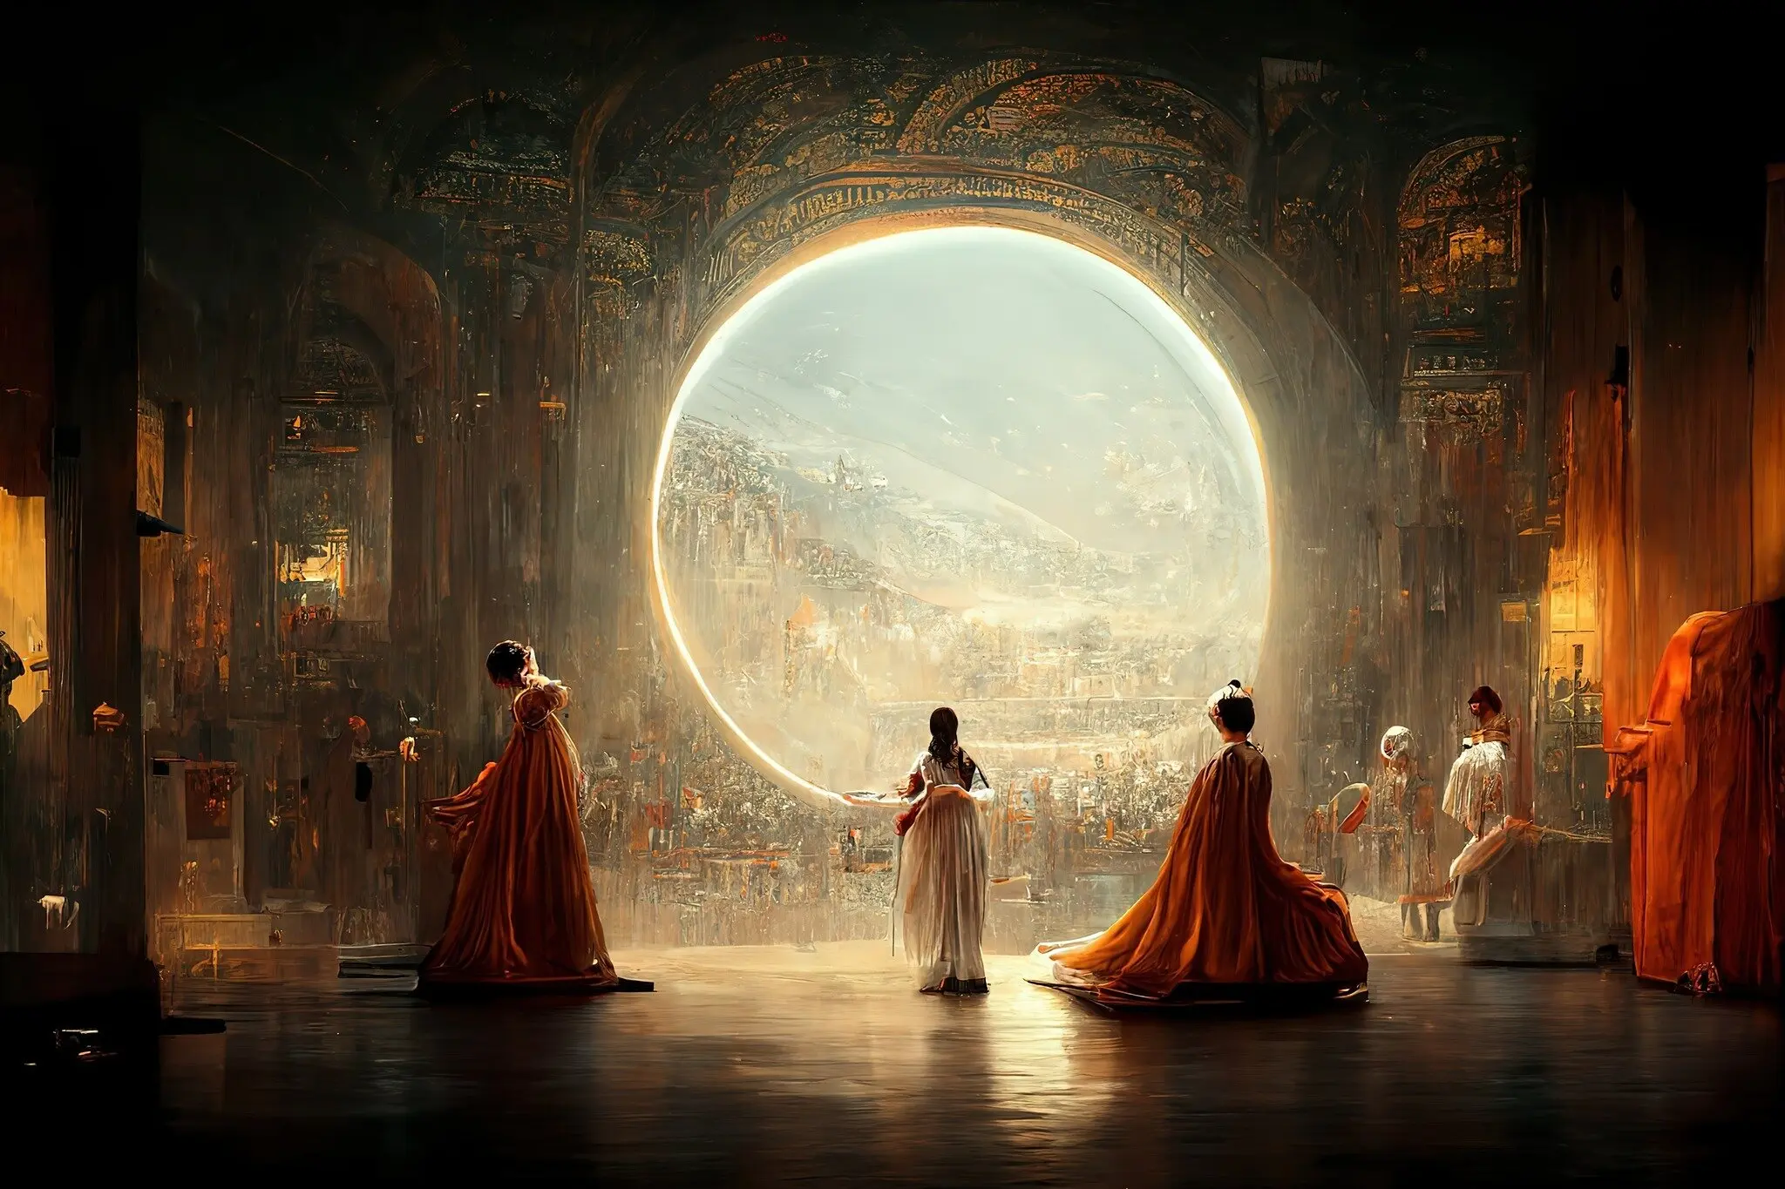
It does not matter whether outcome of AI looks nice or wins a prize – crucial: human expression
Notes:
https://www.nytimes.com/2022/09/02/technology/ai-artificial-intelligence-artists.html
Huge controversy

Slide 8
Human influence on AI product before output is generated
Main influence at outset: works copied into training databases
Human creations: essential condition for generative AI products
Works serve the training of AI systems to recognize patterns and styles and on this basis generate new outputs, according to probabilities
Quality of works used/copied reflected in output
If you use 20 Picasso paintings as input and AI makes a new one (no. 21) on this basis, looking like a Picasso – copyright by Picasso heirs in output? (no, but infringement of adaptation right?)
But: output not protected for authors of original works
Despite massive uses: authors do not benefit from commercial exploitation of output made mostly without their consent and without remuneration
Protection of authors at stage of copying into training data bases crucial!

Slide 9
Conclusions
Lack of protection for AI content: should not be a concern to legislators, but
Urgent need:
Put an end to mostly illegal copying of works into training databases for purposes of generating AI content (=beyond mere TDM)
Mostly scraped/copied without consent of authors, and from illegal sources, generating competing products (unfair competition?)
Exceptions likely not to apply (eg Art. 4 DSM Directive)
and they should not apply (imbalance); three step test!
Make licensing practicable and enforceable esp. against mega players (through CMOs?/ECLs?; transparency!)
and remunerate authors by licensing fees, to safeguard human creation
(or also by means of domaine public payant?)

