Slide 1



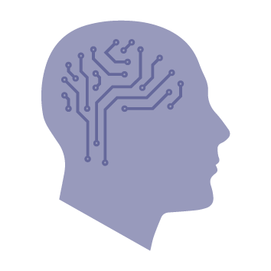
WIPO Conversation
Panel 5: Authorship and ownership of AI-generated works
Oh Pin-Ping, Partner, Intellectual Property
21 September 2023

Slide 2
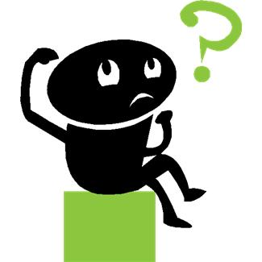
Who is the author and who is the owner of a work generated with the assistance of AI?

Slide 3

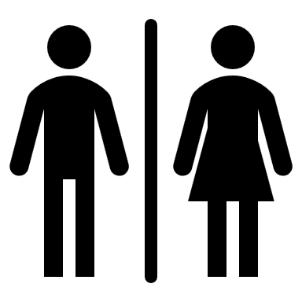
RECAP: Conditions for copyright protection
Work must be 'original' (i.e., not copied)
Work must created by identifiable human author(s)
No copyright protection for a pure AI-generated work without a human author
BUT… may be possible to identify a human author for AI-assisted works!

Slide 4

Who can be an author of a copyrighted work?
Author = Creator of the original expression in a work
An author's contribution must be of elements that were the expression of his own intellectual creation: Kogan v Martin [2019] EWCA Civ 1645
Question is whether the would-be author had exercised free and expressive choice
Relevant contributions depends on the type of work
Non-authorial contributions do not count

Slide 5
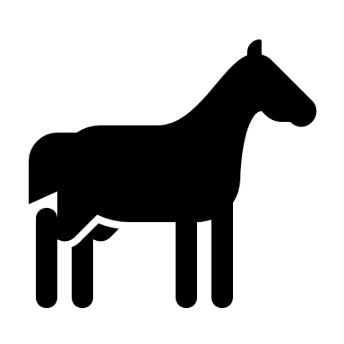
Who can be the author of a copyrighted work?
Joint authorship involves collaboration: Kogan; Acohs Pty Ltd v Ucorp Pty Ltd [2012] FCAFC 16
Implication: A derivative work would not qualify as a work of joint authorship!
A company cannot be an author: Asia Pacific Publishing Pte Ltd v Pioneers & Leaders (Publishers) Pte Ltd [2011] SGCA 37

Slide 6

Who can be the author of a copyrighted work?
In some cases, the position is governed by statute.
For example:
Section 178 of the UK Copyright, Designs and Patents Act 1988 (CDPA), grants computer-generated works copyright protection for 50 years from the date the work is made.
The author of the work is taken to be the person by whom the arrangements necessary for the creation of the work are undertaken.

Slide 7


Possible authors
User of the Gen-AI tool?
Developer of the Gen-AI tool?
Provider of the training data sets?
Author of the underlying work which the Gen-AI output is most similar to?

Slide 8
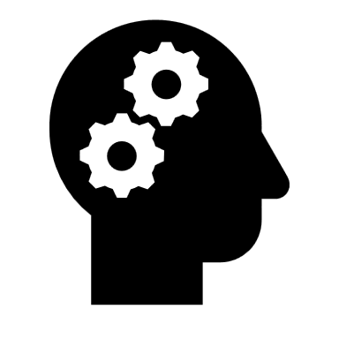



Joint authorship?
User of the Gen-AI tool
The Gen-AI tool?
Depends on whether a Gen-AI tool can be recognised as an author!
If not, then:
=
or
?

Slide 9


Who is the owner of an AI-assisted work?
In UK/Australia/Singapore, for authorial works, the author is the default first copyright owner, but this can be varied by contract
The owner of an AI-assisted work is likely to be determined by:
For publicly-available tools, the terms of use of the tool; and
For bespoke tools, the contact between the user and the Gen-AI tool developer and any other service providers

Slide 10
OpenAI's Terms of Use
(a) Your Content. You may provide input to the Services (“Input”), and receive output generated and returned by the Services based on the Input (“Output”). Input and Output are collectively “Content.” As between the parties and to the extent permitted by applicable law, you own all Input. Subject to your compliance with these Terms, OpenAI hereby assigns to you all its right, title and interest in and to Output. This means you can use Content for any purpose, including commercial purposes such as sale or publication, if you comply with these Terms. OpenAI may use Content to provide and maintain the Services, comply with applicable law, and enforce our policies. You are responsible for Content, including for ensuring that it does not violate any applicable law or these Terms.
(b) Similarity of Content. Due to the nature of machine learning, Output may not be unique across users and the Services may generate the same or similar output for OpenAI or a third party. For example, you may provide input to a model such as “What color is the sky?” and receive output such as “The sky is blue.” Other users may also ask similar questions and receive the same response. Responses that are requested by and generated for other users are not considered your Content.

Slide 11
OpenAI's Terms of Use
(c) Use of Content to Improve Services. We do not use Content that you provide to or receive from our API (“API Content”) to develop or improve our Services. We may use Content from Services other than our API (“Non-API Content”) to help develop and improve our Services. You can read more here about how Non-API Content may be used to improve model performance. If you do not want your Non-API Content used to improve Services, you can opt out by filling out this form. Please note that in some cases this may limit the ability of our Services to better address your specific use case.

Slide 12
Midjourney's Terms of Service
Rights You give to Midjourney
By using the Services, You grant to Midjourney, its successors, and assigns a perpetual, worldwide, non-exclusive, sublicensable no-charge, royalty-free, irrevocable copyright license to reproduce, prepare Derivative Works of, publicly display, publicly perform, sublicense, and distribute text, and image prompts You input into the Services, or Assets produced by the service at Your direction. This license survives termination of this Agreement by any party, for any reason.

Slide 13
Midjourney's Terms of Service
Your Rights
Subject to the above license, You own all Assets You create with the Services, provided they were created in accordance with this Agreement. … Your ownership of the Assets you created persists even if in subsequent months You downgrade or cancel Your membership. However, You do not own the Assets if You fall under the exceptions below.
If You are an employee or owner of a company with more than $1,000,000 USD a year in gross revenue and You are using the Services on behalf of Your employer, You must purchase a “Pro” or "Mega" membership for every individual accessing the Services on Your behalf in order to own Assets You create. If You are not sure whether Your use qualifies as on behalf of Your employer, please assume it does.
If You are not a Paid Member, You don’t own the Assets You create. Instead, Midjourney grants You a license to the Assets under the Creative Commons Noncommercial 4.0 Attribution International License (the “Asset License”).

Slide 14
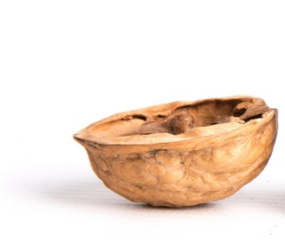
In a Nutshell
Under both OpenAI's and Midjourney's terms of use:
The user owns the copyright in the output of the Gen-AI tool provided that certain conditions are met, including that use of the Gen-AI tool must be compliant with the terms.
The user's ownership of the output is in both cases subject to the grant of a licence to the Gen-AI tool developer to use the output for certain purposes.

Slide 15
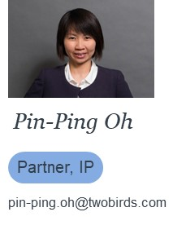
Thank you!

