Slide 1
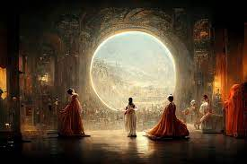
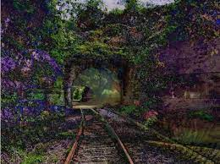
Protection of AI-Generated Works
Dr Rita Matulionyte, Macquarie university, Australia
WIPO Conversation on Generative AI and copyright, 21 sept 2023

Slide 2


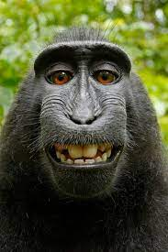


CURRENT APPROACH
IceTV Pty Ltd v Nine Network Australia Pty Ltd
[2009] HCA 14
Naruto, et al. v. Slater, et al.,
no. 15-CV-04324
(N.D. Cal. 28 January 2016)

Slide 3
AI-Generated works not protected
- Thaler v Perlmutter, 1:22-cv-01564,(D.D.C. 8/18/23),
- “Creativity machine” listed as an author
- registration and protection of AI-generated work denied by US Copyright Office
- confirmed by US District Court
See also: “Zarya of the Dawn” case – multiple prompts are not sufficient for copyright purposes
“A Recent Entrance to Paradise”, by Creativity Machine (and Stephen Thaler)

Slide 4
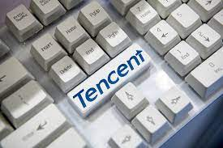
AI-assisted works – possibly protected?
Tencent v. Shanghai Yingxun Technology Co. Ltd, People’s Court of Nanshan (District of Shenzhen) (深圳市南山区人民法院(2019)粤0305民初14010号民事判决), 24 Dec 2019
Tencent’s software ‘Dreamwriter’ produces press articles
Protection confirmed due to sufficient human involvement

Slide 5
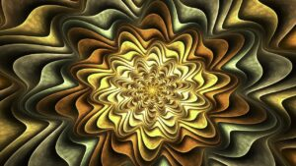
- RAI v Biancheri PDF
- Image “The Scent of the Night” was generated by Chiara Biancheri using Apophysis software
- RAI uses the image to promote Sanremo festival
- Court of Appeal (Italy) found that “the work is not a simple reproduction of a flower but a reworking of it”. Court of Cassation agrees
- AI involvement was not examined

Slide 6
How much human contribution is enough?
- Image ‘Théâtre D’opéra Spatial’ generated by Jason Allen with an assistance from MidJourney
- US Copyright Office requires clarification of a human contribution and disclaim copyright over elements generated by AI

Slide 7
ARGUMENTS IN FAVOR OF PROTECTION OF AI-GENERATED WORKS

Slide 8


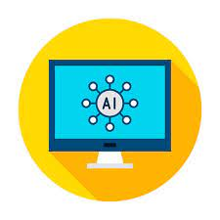

1. Incentive to innovate
AI developer
Generative AI system:
Output- press articles
AI user:
Media company
AI output:
Press articles

Slide 9
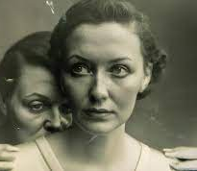
2. Inability to distinguish when/how much AI was used
‘Pseudomnesia: the Electrician’, Boris Eldagsen and DALL-E 2
‘Théâtre D’opéra Spatial’, by Jason Allen and MidJourney

Slide 10
3. AI ethics – tell the truth
“A Recent Entrance to Paradise”, by Creativity Machine
(and Stephen Thaler)
‘Théâtre D’opéra Spatial’, by Jason Allen and MidJourney

Slide 11
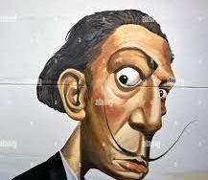
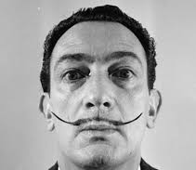
4. Technology use in arts has been always accepted

Slide 12
THANK YOU
For any questions contact:
Rita.Matulionyte@mq.edu.au

