Slide 1
Panel 5: Panel 5: Authorship and Ownership of AI-generated Works: IP is
all around
Dr Andres Guadamuz

Slide 2
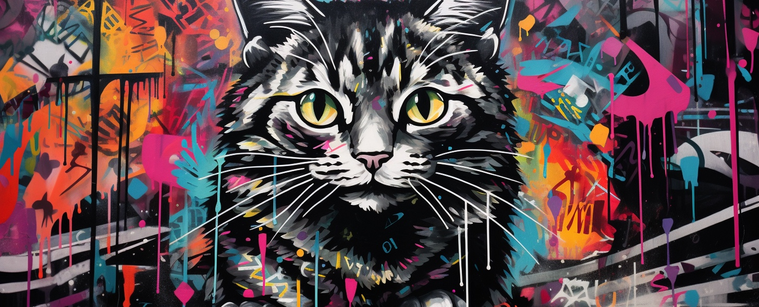
AI everywhere

Slide 3
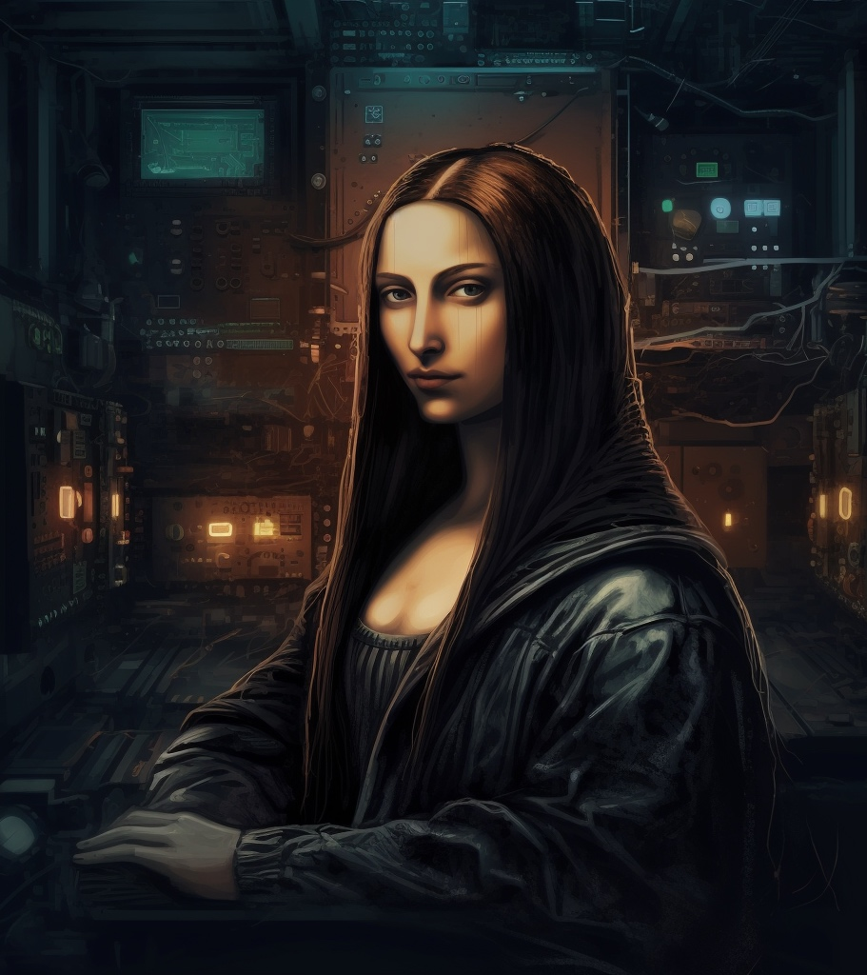
Authorship Scenarios
Only humans can create copyright: All AI-generated works are in the public domain.
Machines can create works subject to copyright protection: User, programmer.
Sui Generis rights: Akin to database rights, rewarding investment, shorter duration.

Slide 4
United States
US Copyright Office practice has been to deny registration for AI works (Zarya of the Dawn).
Stephen Thaler “A Recent Entrance to Paradise”, a work created by one of his AIs called “Creativity Machine”.
Thaler made the application citing the AI as the author.
The USCO rejected the application in Feb 2022. Appeal in court, and loses.
End of story, right?

Slide 5
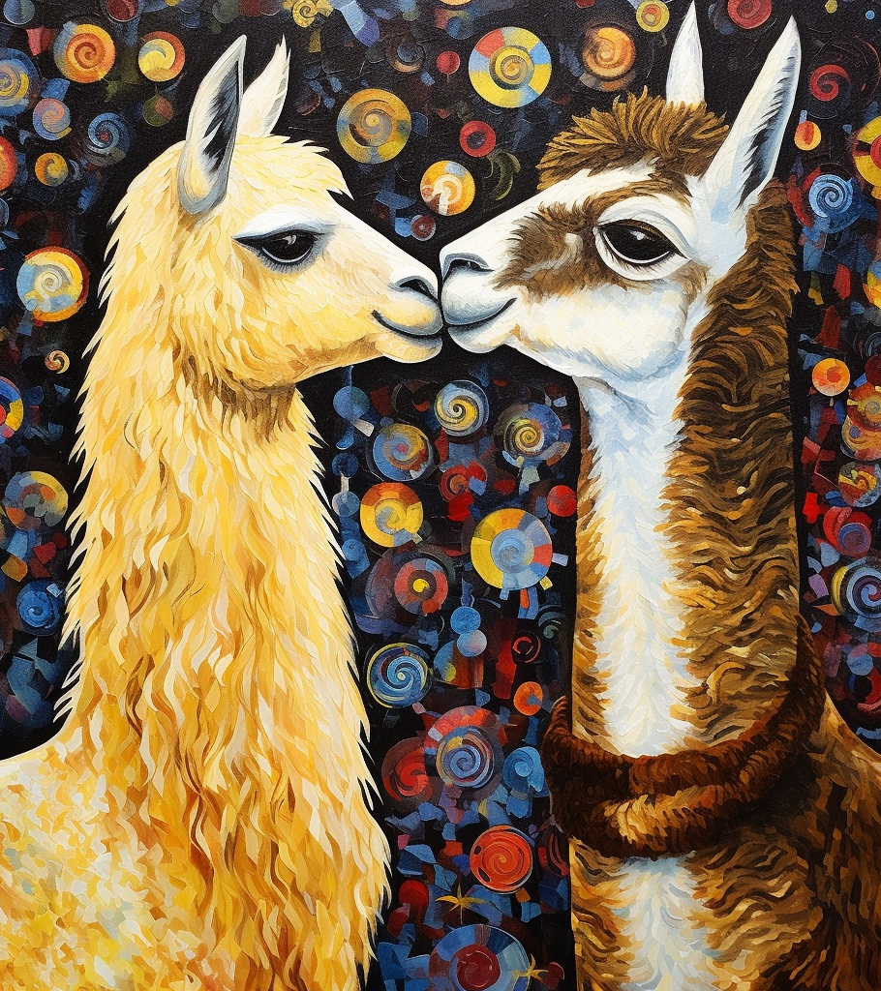
UK Law
S 9(3) “In the case of a literary, dramatic, musical or artistic work which is computer-generated, the author shall be taken to be the person by whom the arrangements necessary for the creation of the work are undertaken.”
s178: ““computer-generated”, in relation to a work, means that the work is generated by computer in circumstances such that there is no human author of the work;”
Also India, South Africa, Ireland, New Zealand.
Notes:
There are a few questions here, particularly who is the person who made the arrangements necessary for the creation of the work, is it the programmer, or is it the person who “pushed the button” as it may.

Slide 6
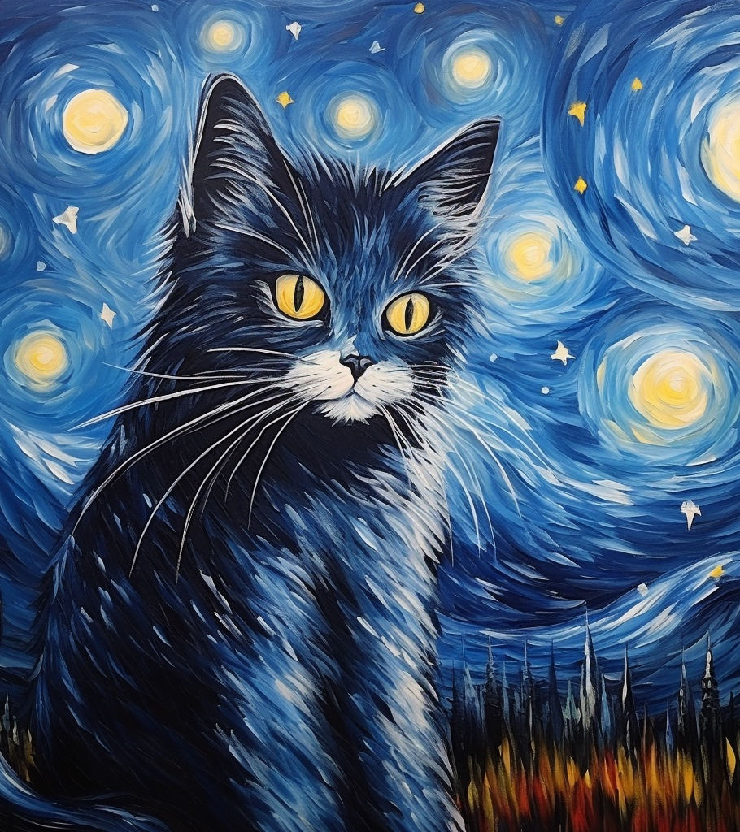
However…
s9(3) is a remnant of another time, intention was to clarify authorship of computer generated works, not AI.
No person, no creativity, no “intellectual creation”. No originality.
No case law.
UK IP Office held a consultation, no need to change the law yet.

