Slide 1
AI as a dance partner
Louise Crnkovic-Friis / Research Choreographer

Slide 2
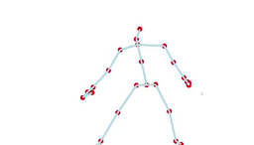
Generative Choreography
ICCC 2016 paper “Generative Choreography using Deep Learning”
Live performances 2017-2018
AI trained on my work that can create novel material in my choreographic language

Slide 3
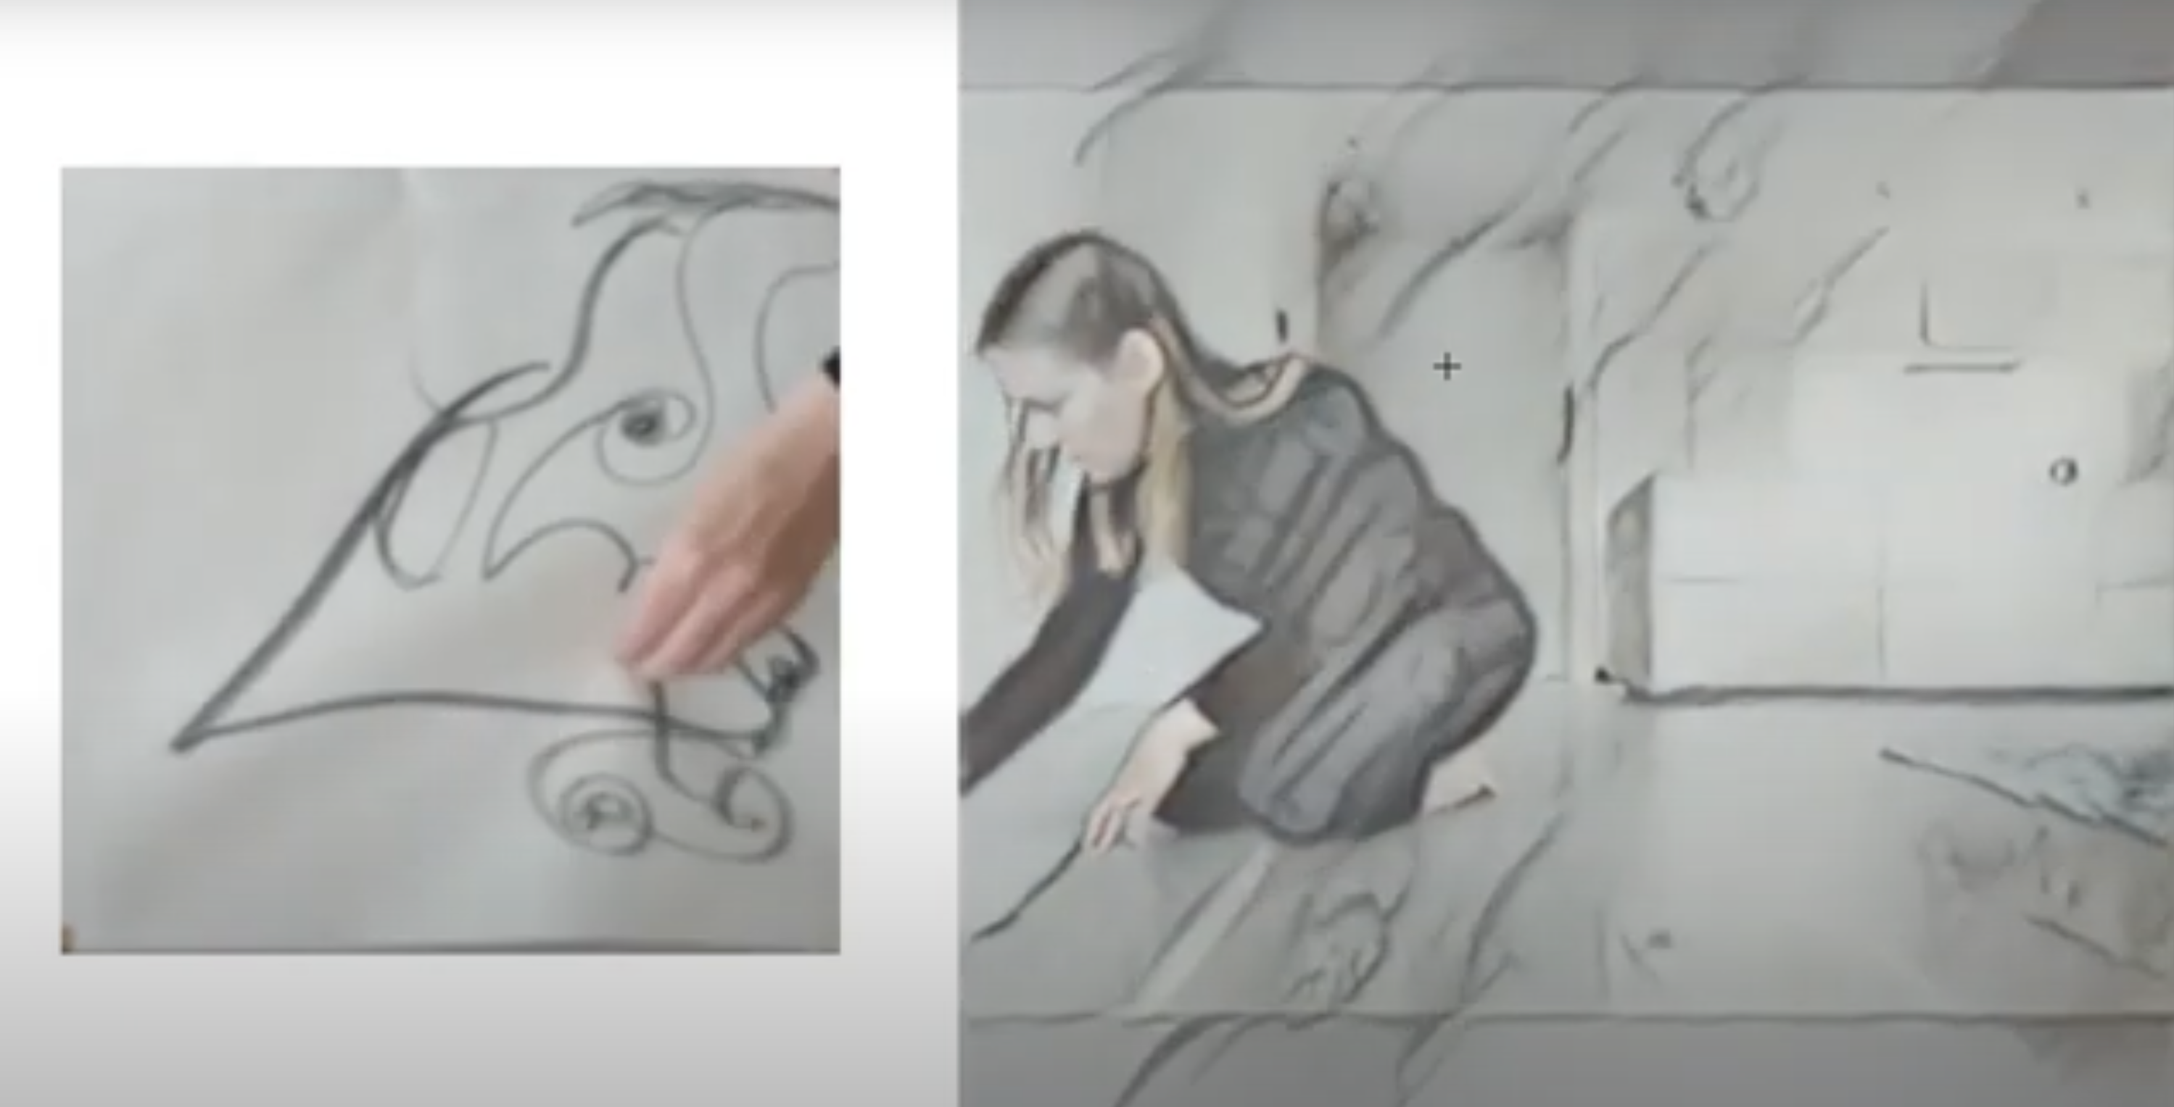
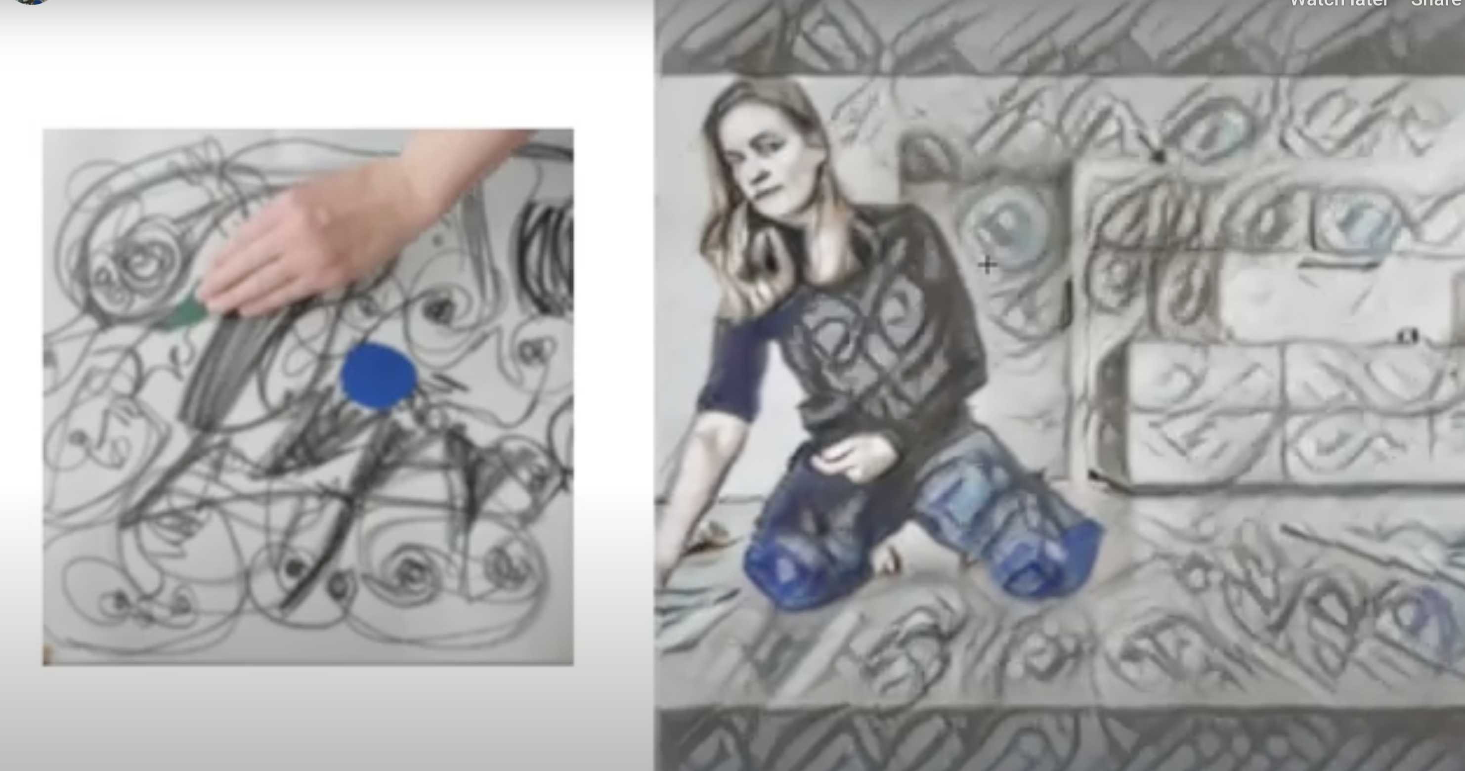
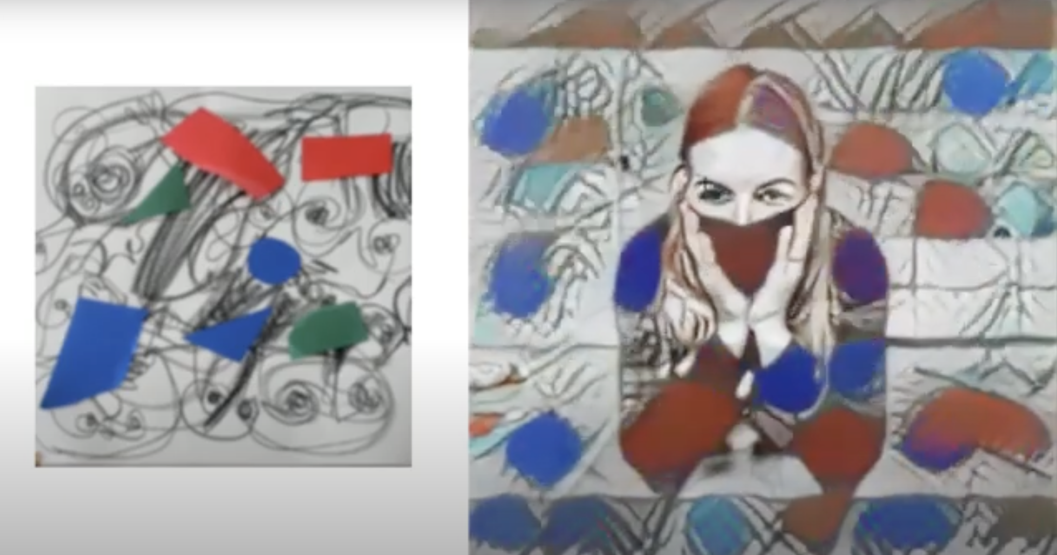
Semantic style transfer
Live Style
Live content (style applied)
Neural Style Transfer – AI powered separation of content and style.
Performances in 2019 (live), 2020-2021 (zoom)
Both content and style are captured simultaneously with two live cameras.
The style is applied in real-time to the content

Slide 4
Creation in the age of AI
What is IP in the age of creative machines?
How do we embrace the possibilities of AI while enabling human artists?

Slide 5
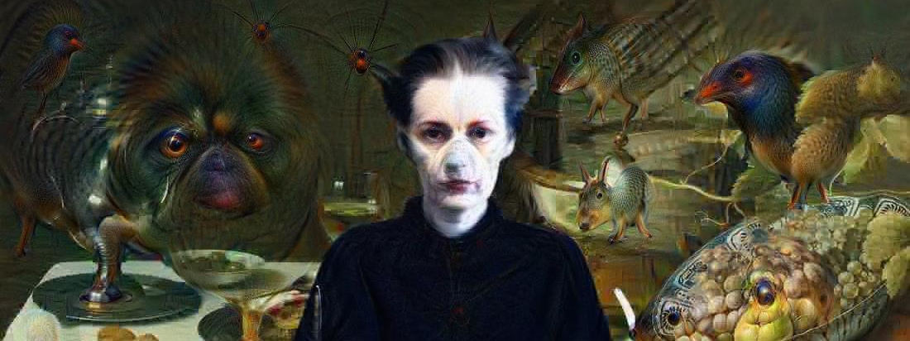
Thank you
Contact: louise@crnkovic-friis.com
Web: http://crnkovic-friis.com

