Slide 1
Introduction to
A Guide on ai and copyright
SOYEONG AHN
Culture Trade and Cooperation Division| Copyright Bureau
Ministry of Culture, Sports and Tourism(MCST)
Republic of Korea

Slide 2

AI Working Group
The increasing prevalence of generative AI services, including Chat-GPT,
is poised for use in content creation.
However, concerns about potential clashes with traditional copyright systems
grounded in human creativity persist.
It’s high time to identify issues and clarify legal framework in preparation for the AI era
“AI- Copyright Legal Framework Working Group”

Slide 3
AI Working Group : Season 1
Kick-off
(Feb.24, 2023)
Guide Publication
(Dec.27, 2023)
Meeting
(1st ~ 9^{th(}Mar ~ Oct))
Methods for AI Model Learning
Copyright Issues in the AI Learning
Application of AI Technology in the Music Industry
Collecting AI Industry Opinions on AI
···
brings together key stakeholders, including creators, academia, legal professionals,
industrial technology companies, and other relevant parties with MCST, KCC, KCOPA

Slide 4


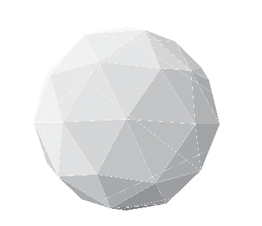
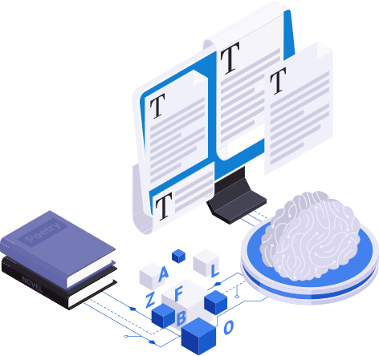

Copyright Guide for Generative AI
01.
02.
03.
04.
Guides for
AI Industry
Guides for Copyright holders
Guides for Users of Generative AI
AI Outputs and Copyright Registration
01
Stage of AI Learning
01
Considerations in the stage of AI Learning
01
Precautions for Copyright Infringement when using Generative AI
01
Copyright issues on AI Outputs
02
Stage of AI Outputs
02
Recommendations for preventing copyright infringements of AI Outputs
02
Copyright Registration for AI Outputs
02
Ethical and Policy Considerations in Research, Education, Creative Fields, etc.
03
Distinguishing AI Outputs from Human Creations
03
Cases for Copyright Registration of AI Outputs
03
Other Recommendations
04
Guides for Copyright Registration

Slide 5
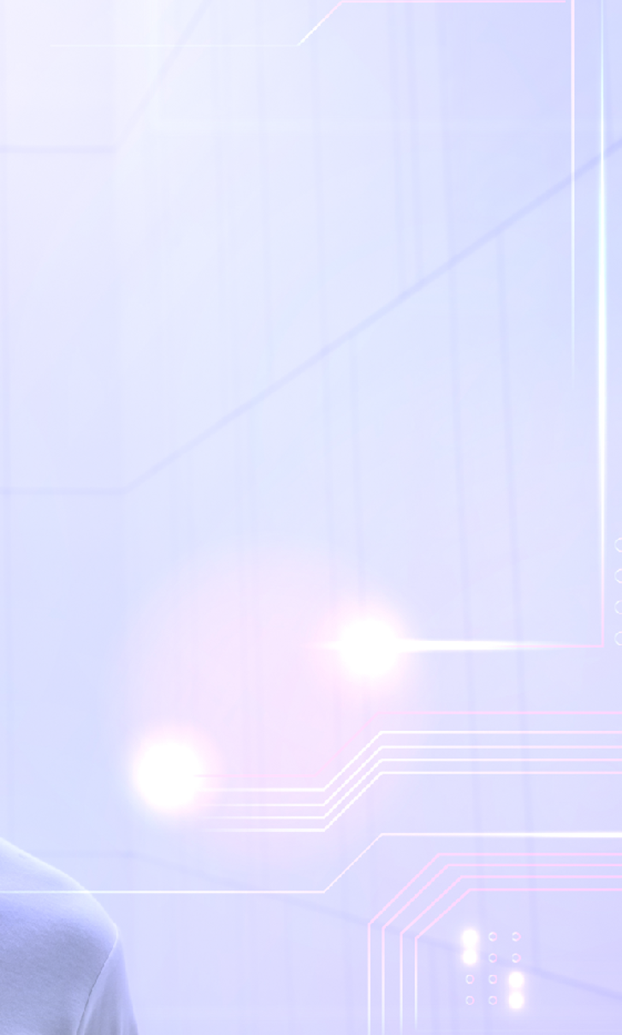
Copyright Guide for Generative AI
01. Guides for AI Industry
(Learning) It is advisable to prevent possible disputes by securing legitimate use rights. Since there are conflicting academic opinions on the applicability of fair-use doctrine and there are no domestic or foreign court cases that have directly determined.
01
(Outputs) It is advisable to prevent copyright infringement by taking filtering measures to prevent generating AI outputs that are identical or similar to existing works.
02
For businesses that provide application services using the existing Foundation Model, it is necessary to prevent copyright infringement of AI output by utilizing separate technologies, etc.
Providers of Foundation model and providers of application services utilizing the foundation model need to clarify the attribution of responsibilities when signing a license.
03
(Distinguishing) Recently, there have been discussions at home and abroad on how to separately label generative AI outputs from human-created works as having used AI technology.
AI companies need to consider technology development, research, etc. in this regard, and the government needs to prepare support measures for related technology development, etc.

Slide 6
Copyright Guide for Generative AI
02. Guides for Copyright holders
d
01
If you don't want your work to be used for AI learning, it is appropriate to express your objections in an appropriate manner, or to take technical measures to prevent it from happening.
02
Recommend that you take steps to prevent infringement of your copyright, including technologies that interfere with AI learning.

Slide 7
Copyright Guide for Generative AI
03. Guides for Users of Generative AI
01
Precautions for Copyright Infringement when using Generative AI
01
Avoiding Copyright and Other Rights Infringement
Generative AI may, in certain cases, produce outputs that resemble existing works, potentially infringing upon others’ copyright.
02
Precautions for Utilizing Generative AI
Users of Generative AI should exercise caution to avoid causing copyright infringement when inputting
In particular, for AI outputs that may infringe on copyrights, users shall take special care not to disclose them externally by utilizing them in a manner such as public performance, public exhibition, distribution, or public transmission.

Slide 8
Copyright Guide for Generative AI
03. Guides for Users of Generative AI
Ethical and Policy Considerations in Research, Education, Creative Fields, etc.
02
03
Other Considerations
01
Discussion of Generative AI in Research, Education, Creative Fields, etc.
01
Verification of Usage Terms of AI services
Ethical issues regarding the use of generative AI are being discussed mainly in research and education fields such as academia and universities.
To avoid problems that may arise from Usage Terms violations, etc. Verify all Terms beforehand.
02
Submission for Academic Journals and Competitions
02
Indication of Generative AI Usage
Review Journal and Competition Policies on Generative AI
Minimize the confusion between AI outputs and human-created works to increase public trust in creation of contents and rights attribution, etc.
When planning to submit papers or works to journals and competitions, it's crucial to review and observe the policies and guidelines concerning generative AI.
Provide Attribution for Generative AI Outputs
Authors are encouraged to verify the source of generative AI outputs before citing them in papers and other works

Slide 9
Copyright Guide for Generative AI
04. AI Outputs and Copyright Registration
01
Copyright issues on AI Outputs
Copyright Registration for
AI Outputs
02
01
Copyrightability of AI Outputs
Copyright registration is only applicable to creative works that express human ideas or emotions.
As per the current legal interpretation, products created by without human intervention AI are typically not considered copyrightable.
It is not possible for generative AI outputs that lack discernible human creative input in their expression.
However, if human creativity is added through modification, addition, editing, or arrangement, the work is only partially attributable to that part.
However, if the AI outputs are creatively modified, increased, or decreased by humans, and the additional works are recognized as copyrightable, copyright registration is possible.
02
Authorship of AI Outputs
Additionally, if there is creativity in the selection and arrangement of the outputs, rather than the AI outputs themselves, they can be registered as editorial works.
Existing Law do not attribute authorship to AI itself.
The discussion of authorship or copyright attribution is only relevant when the AI output is recognized as authored by human creativity.
An author is the person who creates a work, so an AI that is not a human or legal entity cannot be an author, so an AI cannot be registered as an author.

Slide 10


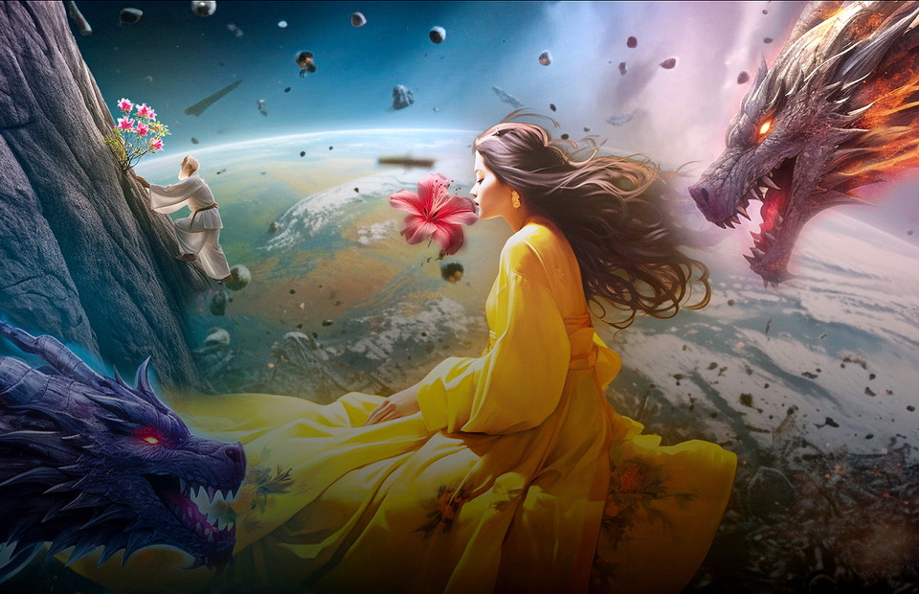
Copyright Guide for Generative AI
04. AI Outputs and Copyright Registration
03
Recent Case : AI Suro Buin

Slide 11

Working Group : Season 2 (2024~)
Protecting AI-Outputs under the Copyright Regime?
Compensating for Works used for AI training?

Slide 12
Thank You.
SOYEONG AHN
ansso27@korea.kr

