Slide 1
Training the Machines: Bytes, Rights and the Copyright Conundrum
Carlos Luna García
New Technologies Service
Digital Transformation Department
March 13-14, 2024

Slide 2
AI has already created as many images as Photographers have taken in 150 years. Statistics for 2023.

Slide 3
GENERAL PURPOSE MODELS IN THE AI ACT
Common framework to balance innovation and protect IPrs, recognizing the need for extensive data and text mining techniques in developing AI models.
Opportunities for artists and creators
Challenges regarding content creation, distribution and copyright
Providers of general-purpose AI models will have to comply with the obligations set in the new AI regulation and establish policies to respect EU copyright law.

Slide 4
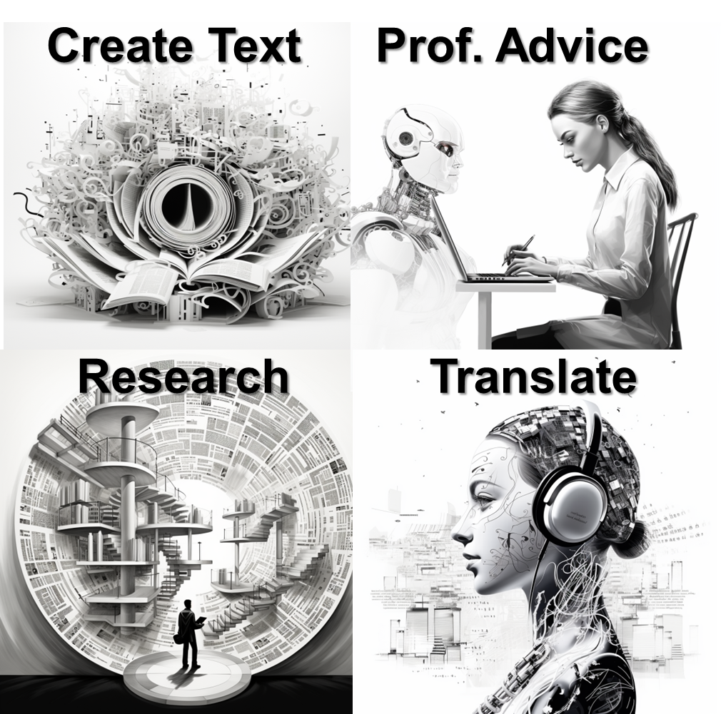
AI CAPABILITIES

Slide 5
EUIPO GUIDELINES
Guidelines¹
Staff must never share any information that is not already in the public domain, nor personal data, with an online available generative AI model.
Staff should always critically assess any response produced by an online available generative AI model for potential biases and factually inaccurate information.
Staff should always critically assess whether the outputs of an online available generative AI model are not violating intellectual property rights, in particular copyright of third parties.
Staff shall never directly replicate the output of a generative AI model in public documents, such as the creation of Office texts, notably legally binding ones.
Staff should never rely on online available generative AI models for critical and time-sensitive processes.
Notes:
Carlos /Fernando

Slide 6
ARTIFICIAL INTELLIGENCE ACT (AIA)
WHAT IS THE AI ACT
The EU AI Act is the European Union's flagship law to regulate how AI systems should be designed and used within the EU. The Act proposes a risk-based approach, classifying AI applications on a spectrum from no risk to banned entirely.
PURPOSE OF THE AI ACT
The main objective of the AIA is to ensure that AI systems within the EU are safe, and comply with existing law on fundamental rights, norms and values

Slide 7
ARTIFICIAL INTELLIGENCE ACT (AIA)
WHO WILL BE AFFECTED BY THE EU AI Act?
The AIA applies to any service provider operating an AI system within the EU and firms located outside the EU, identifying the following roles:
the providers, who place an AI system or service on the EU market;
users located within the EU market; and
providers or users of AI systems that are located outside of the EU, but whose system is used (or has an output) on the EU market

Slide 8
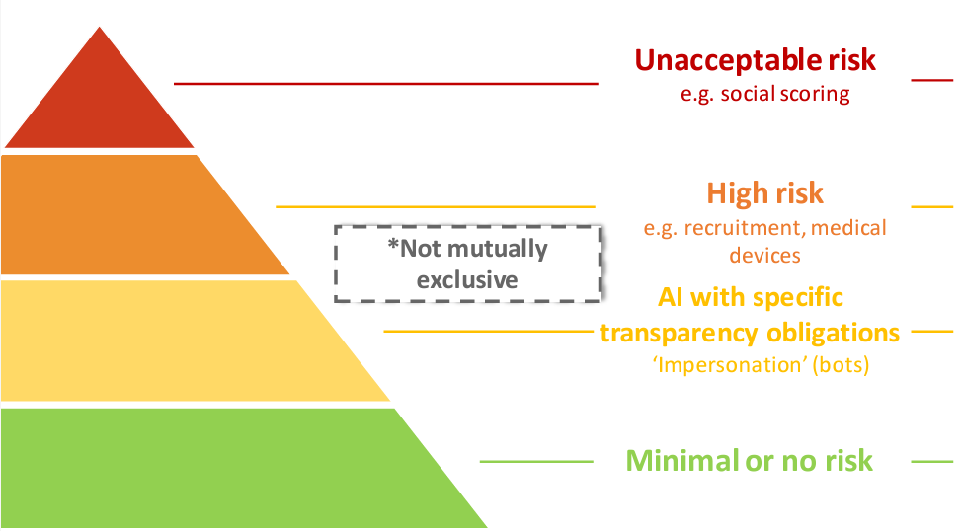
RISK-BASED APPROACH
RISK-BASED CLASSIFICATION
Prohibited
Permitted BUT subject to compliance with AI requirements and ex-ate conformity assessment
Permitted BUT subject to information/transparency obligations
Permitted with no restrictions

Slide 9
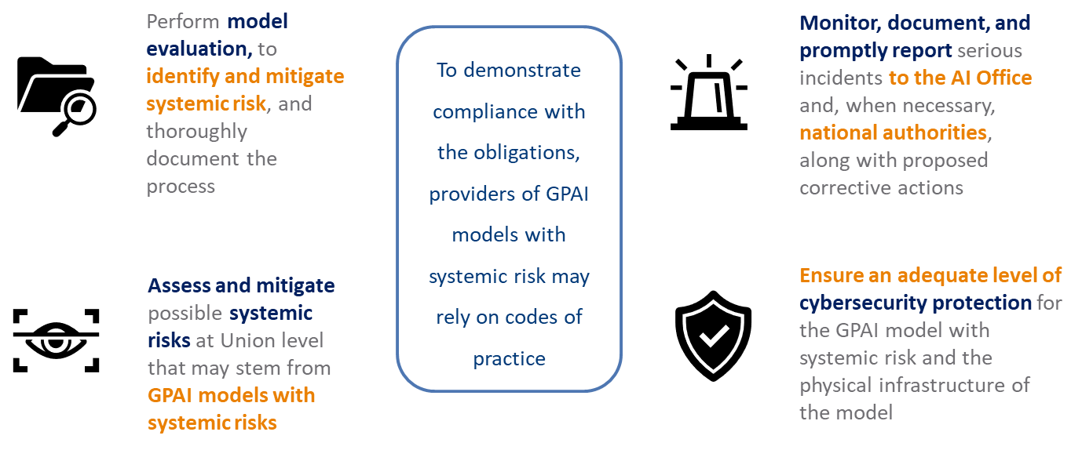
OBLIGATIONS FOR PROVIDERS OF GPAI MODELS WITH SYSTEMIC RISK
Compliance with a European harmonised standard grants providers the presumption of conformity.

Slide 10
OBLIGATIONS FOR PROVIDERS OF GPAI MODELS
Establish a copyright policy that adheres to Union copyright law, including the identification and respect of rights reservations outlined in Article 4(3) of Directive (EU) 2019/790
Create and maintain updated technical documentation for the model, detailing its training, testing processes and evaluation results
Not aplicable to providers of AI models published under an open-source licence. This exception does not apply to GPAI models with systemic risks
Create, update, and provide accessible information and documentation to AI system providers intending to integrate the GPAI model
Create and publish a detailed summary of the training data used for the GPAI model, following a template provided by the AI Office

Slide 11
@EU_IPO
euipo
EUIPO.eu
@euipo
EUIPO
THANK YOU

