Slide 1
Rospatent
Federal Service
for Intellectual Property
Data sets for training AI-based prior art search
Speaker:
Alexander Gorbunov
Head of the Center for the Development of the Scientific Direction “Artificial Intelligence”

Slide 2
USING AI IN THE EXAMINATION : INVENTIONS
The most important issue of the examination of an application for the patent is to search for a variety of documents characterizing the state of the art for this application. We suggest to name this set of documents a semantic cluster of patent documents.
A unique feature of the published patent information is, in accordance with the WIPO standard, the list of documents characterized the state of the art for this patent application according to the examiner’s opinion (thus published patent contains a Semantic cluster of patent documents).

Slide 3
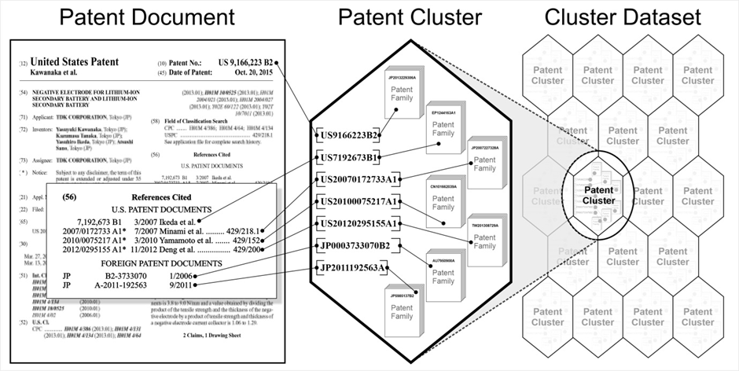
PLATFORM FUNCTIONALITY : INFRASTRUCTURE for AI-based PATENT RETRIEVAL SERVICE
DATASETS BASED ON SEMANTIC CLUSTERS
СREATING DATASETS FOR MACHINE LEARNING
The semantic cluster of patent documents is a set of patent documents, including:
an application for the patent, a description of the invention;
patent documents of the patent family, which includes this application for the patent;
patent documents referred to by examiners in publications of search reports for the the application and in the field entitled INID code (56);
patent documents of patent families, which include documents referred to by the examination;
patent documents indicated by the applicant as prototypes in the submitted application;
patent documents of patent families, which include documents referred to by references given by the applicant

Slide 4
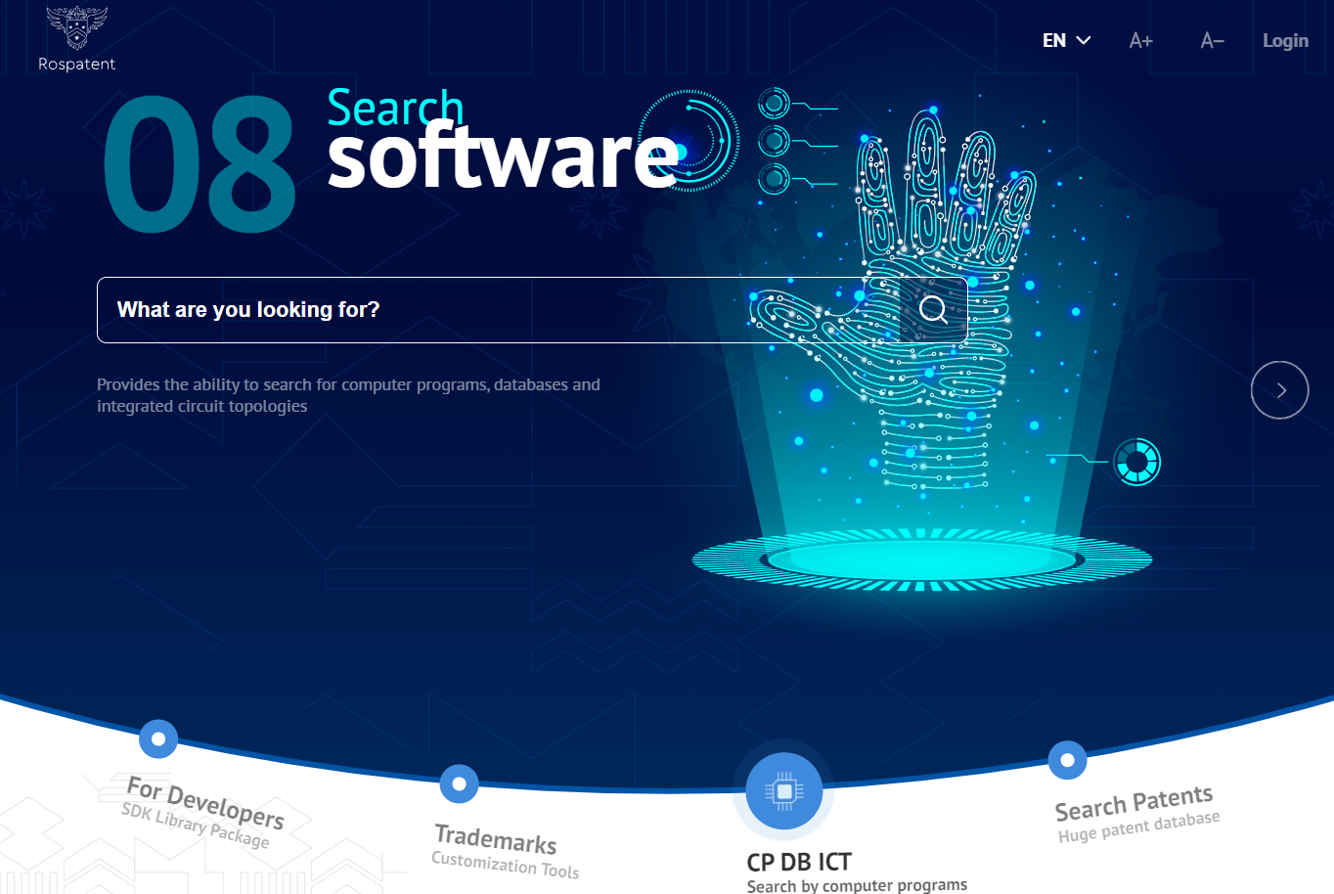
USING AI IN THE EXAMINATION : INVENTIONS
ALREADY AVAILABLE TODAY:
Dataset of semantic clusters of Russian-language patent documents(1.5 million clusters)
Dataset generator of semantic clusters of English-language patent documents (8.5 million clusters)
THE FIRST RESULTS ARE PUBLISHED:
GORBUNOV A.V., GENIN B.L., ZOLKIN D.S., «Prior art search as a problem of determining the elements of the semantic cluster of patent documents» сборник «Научно-техническая информация», серия 1, 2023, №8
B.L.Genin, D.S.Zolkin, «Similarity search in patents databases. The evaluations of the search quality», World Patent Information, Volume 64, March 2021, https://doi.org/10.1016/j.wpi.2021.102022

Slide 5
Rospatent
Federal Service
for Intellectual Property
Thank you!
Speaker:
Alexander Gorbunov
Head of the Center for the Development of the Scientific Direction “Artificial Intelligence”

