Slide 1

AI Legal Landscape in China
Dr. Seagull Song
March 14, 2024

Slide 2
Overview
China’s First AI Legislation, passed in July 2023
Three Key IP Issues relating to AIGC
  AIGC Copyrightability
  Copyright Infringement associated with Training Data
  Copyright Infringement associated with AIGC Output
Two Cases

Slide 3
China’s first ai regulation
The Interim Measures for the Management of Generative Artificial Intelligence Services, passed in July 2023
AIGC providers: who provide Gen-AI services using Gen-AI technology, including those who provide AIGC services through interfacing with other application programs (Art. 22(2))
But vague on IP, except that:
  AIGC providers shall “not infringe on the IP rights lawfully enjoyed by others”(Art.7); and
  AIGC providers shall take down infringing content when the AIGC output is infringing (Art.14).

Slide 4
THREE IP ISSUES relating TO AIGC
AIGC Copyrightability
  maybe, case-by-case analysis (Li v. Liu, Beijing Ct., 2023)
Copyright Infringement associated with Training Data
  NO TDM exception, only fair use doctrine
Copyright Infringement associated with AIGC Output
  The Ultraman case (Guangzhou Ct., Feb 2024)

Slide 5

AIGC Copyrightability Case: Li v Liu (2023)
Issue: Whether the AI-generated picture is a copyrightable work?
Ruling: Yes, because Plaintiff has exercised enough human authorship when using the AI tool to generate the AI picture, by inputting over 150 prompts and experimenting various tech parameters multiple times.
Plaintiff’s AI-generated picture

Slide 6

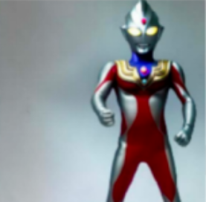


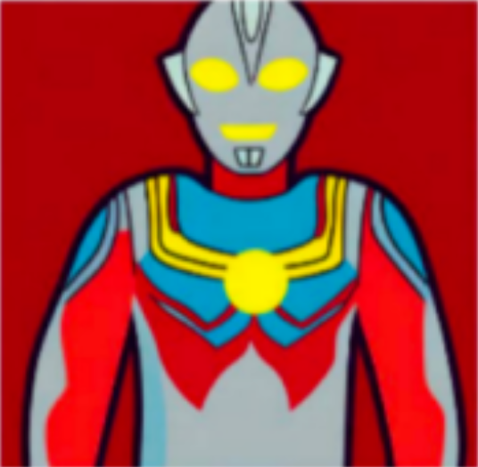
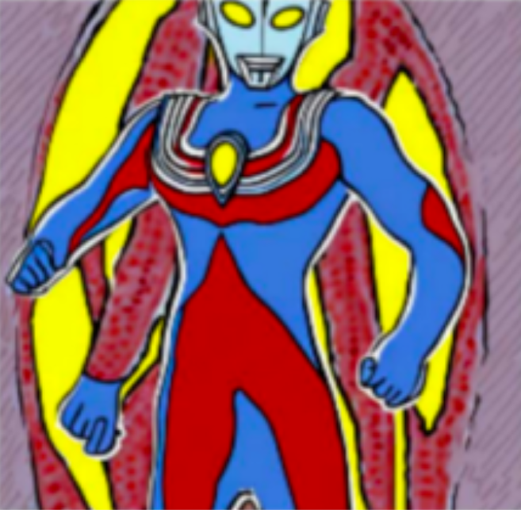



AIGC Output Infringement Case: Ultraman (2024)
Issue: Whether the AI-generated pictures infringed prior copyrightable work “Ultraman”?
Ruling: Yes, finding that Defendant
  Qualified as “AIGC provider” under China’s first AI regulation;
  Infringed P’s right of reproduction and right to prepare derivative works; and
  Failed to exercise reasonable care when providing AIGC services.
Left: “Ultraman” image owned by Tsuburaya
Defendant’s AIGC outputs

Slide 7
THANK you! seagull.song@cn.kwm.com

