Slide 1
WIPO Conversation — Panel 4: Can regulation keep up? Singapore
Simon Chesterman
March 11, 2024

Slide 2
Introduction
Rule-taker vs rule-maker
Whether and when to regulate?
Under-regulation vs over-regulation

Slide 3
1. Training Data and IP
AI depends on data
Easy case (?): Pirated or illegally obtained data

Slide 4
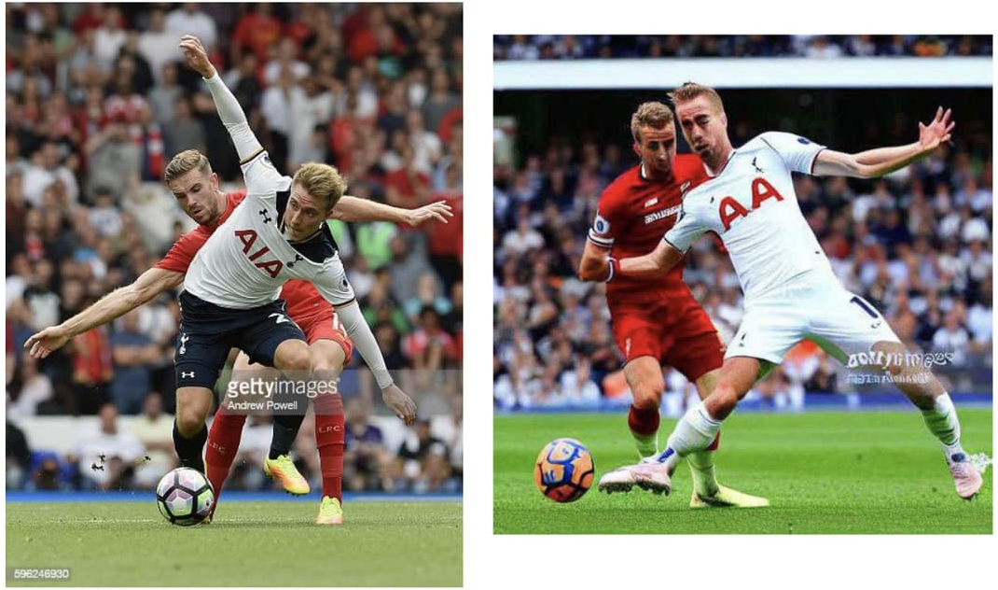

Slide 5
1. Training Data and IP
AI depends on data
Easy case (?): Pirated or illegally obtained data
Harder case: Fair use

Slide 6
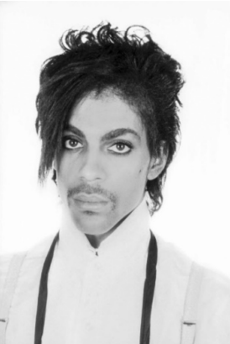
1981 1994 2016

Slide 7
1. Training Data and IP (cont’d)
Singapore: “computational data analysis” exception (2021)
“Improving the functioning of a computer program”?
Or competing with the original work?
Singapore Model AI Governance Framework for Generative AI (2024)
“resolve these difficult issues in a clear and efficient manner”
Lawsuits? (US)
Copyright guidelines? (Japan, Korea)
Codes of practice? (UK)
“expand the available pool of trusted data”
Clarkesworld; Amazon self-publishing

Slide 8
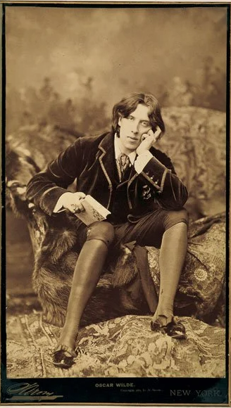
2. Output: Author, Author!
Created by a human being vs “produced by a machine or mere mechanical process that operates randomly or automatically without any creative input or intervention from a human author.”
Photographs? US Supreme Court 1884; Germany 1965

Slide 11
2. Output: Author, Author!
Created by a human being vs “produced by a machine or mere mechanical process that operates randomly or automatically without any creative input or intervention from a human author.”
Photographs? US Supreme Court 1884; Germany 1965
Computer-generated work (UK 1988)
Shorter duration
No moral rights
Considered in Singapore and not adopted
causal connection to a human exercising input or control, though determining the threshold is left to the courts

