Slide 1
EU AI Act and copyright provisions
WIPO Conversation on Intellectual Property (IP) and Frontier Technologies - Ninth Session
Thursday, March 14, 2024, 10.05 – 11.20 CET
Dr. Martin Schaefer
BOEHMERT & BOEHMERT · Anwaltspartnerschaft mbB · Patentanwälte Rechtsanwälte

Slide 2
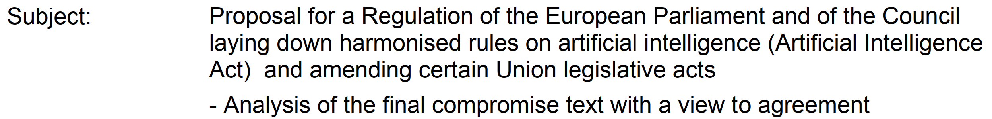
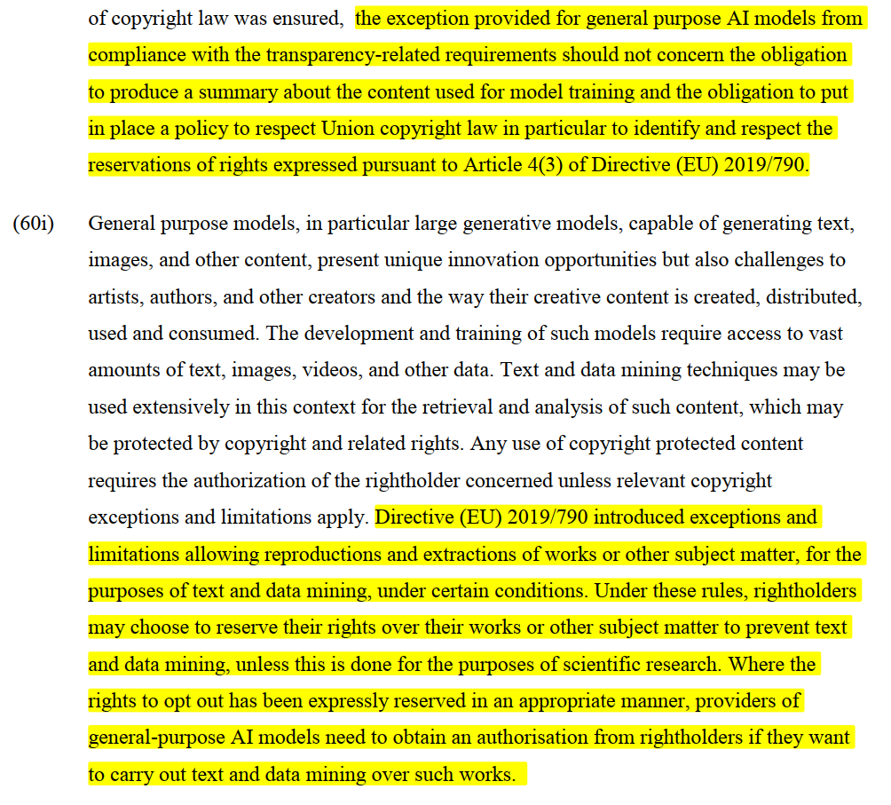
The AI Act and Copyright
Copying / public performance only with reference to source:
"Martin Schaefer BOEHMERT&BOEHMERT“

Slide 3
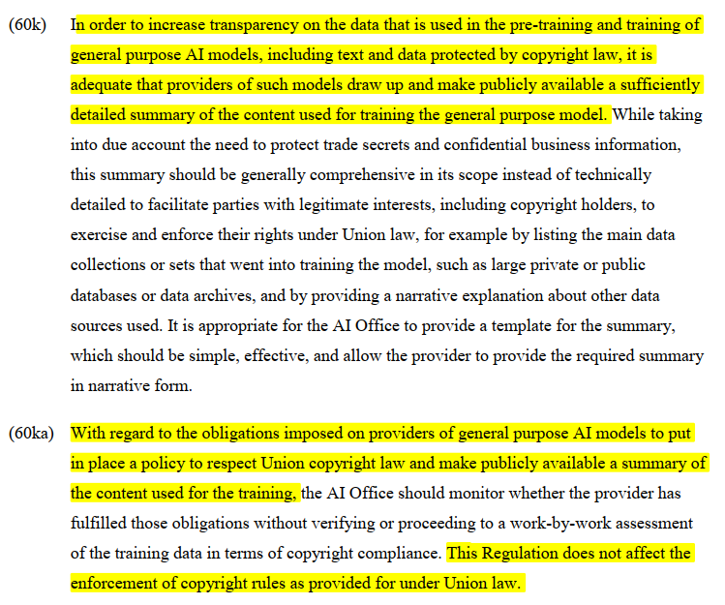
The AI Act and Copyright
Copying / public performance only with reference to source:
"Martin Schaefer BOEHMERT&BOEHMERT“

Slide 4
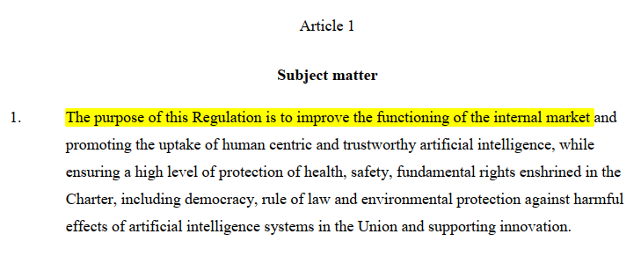
The AI Act and Copyright
                The upside, from a copyright owner´s perspective:
                The AI Act acknowledges that training of AI implies a copyright relevant use.
                The downside, from a copyright owner´s perspective:
                In the said recitals, the AI Act interferes with the EU Legislation on copyright, even though:
Copying / public performance only with reference to source:
"Martin Schaefer BOEHMERT&BOEHMERT“

Slide 5
The AI Act and Copyright
                GenAI cannot acquire copyright protection (including Article 12 Berne Convention (Right of Adaptation, Arrangement and Other Alteration)
                Yet, Gen AI can infringe copyrights
                AI cannot invoke exceptions and limitations – as those were all based on the assumption of use by humans only.
                Let´s apply the 3-step test:
                "It shall be a matter for legislation in the countries of the Union to permit the reproduction of such works
                in certain special cases,
                provided that such reproduction does not conflict with a normal exploitation of the work
                and does not unreasonably prejudice the legitimate interests of the author."
                To me, it is quite apparent that GenAI fails all three tests and as to the „reproduction“: see recital 60i AI Act: Even the AI Act deems training on protected works an act of reproduction.
Copying / public performance only with reference to source:
"Martin Schaefer BOEHMERT&BOEHMERT“

Slide 6
So – what do we have to expect?
AI as a tool and generating similarity instead of copying
Human creativity
GenAI-generated
Fully GenAI generated
GenAI as author A´s tool
Author A
Author B
No copyright protection for GenAI generated content:
Standard prompt
No editing or alteration of the output
Coyright protection for GenAI as a tool
No adaptation in the meaning of copyright but original creation
Full acknowledgement as creator
= sole author
Adaptation
In the further course of use, the work is treated as any other work and can e.g. be adapted by other (human) authors
= alleiniger Bearbeiter/Miturheber
Copying / public performance only with reference to source:
"Martin Schaefer BOEHMERT&BOEHMERT“

Slide 7
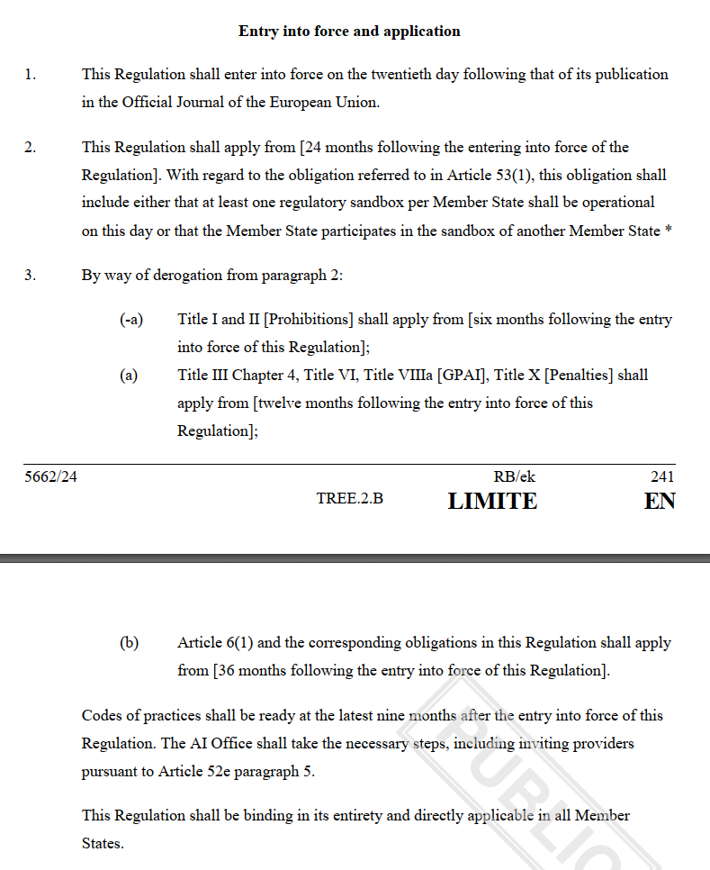
Entry into Force
Copying / public performance only with reference to source:
"Martin Schaefer BOEHMERT&BOEHMERT“

Slide 8
Thank you!
Martin Schaefer/is 06 04 2023

