Slide 1
POTENTIAL REMEDIES AND FUTURE DIRECTIONS
DR. VINCENZO IAIA POSTDOCTORAL RESEARCHER @ LUISS OF COUNSEL @ AKRAN IP
9° WIPO Conversation on Intellectual Property and Frontier Technologies, Panel 3 «Does litigation really solve everything? A litigation tracker»

Slide 2
THE PATCHY MANAGEMENT OF TRAFFIC FOR TDM

Slide 3
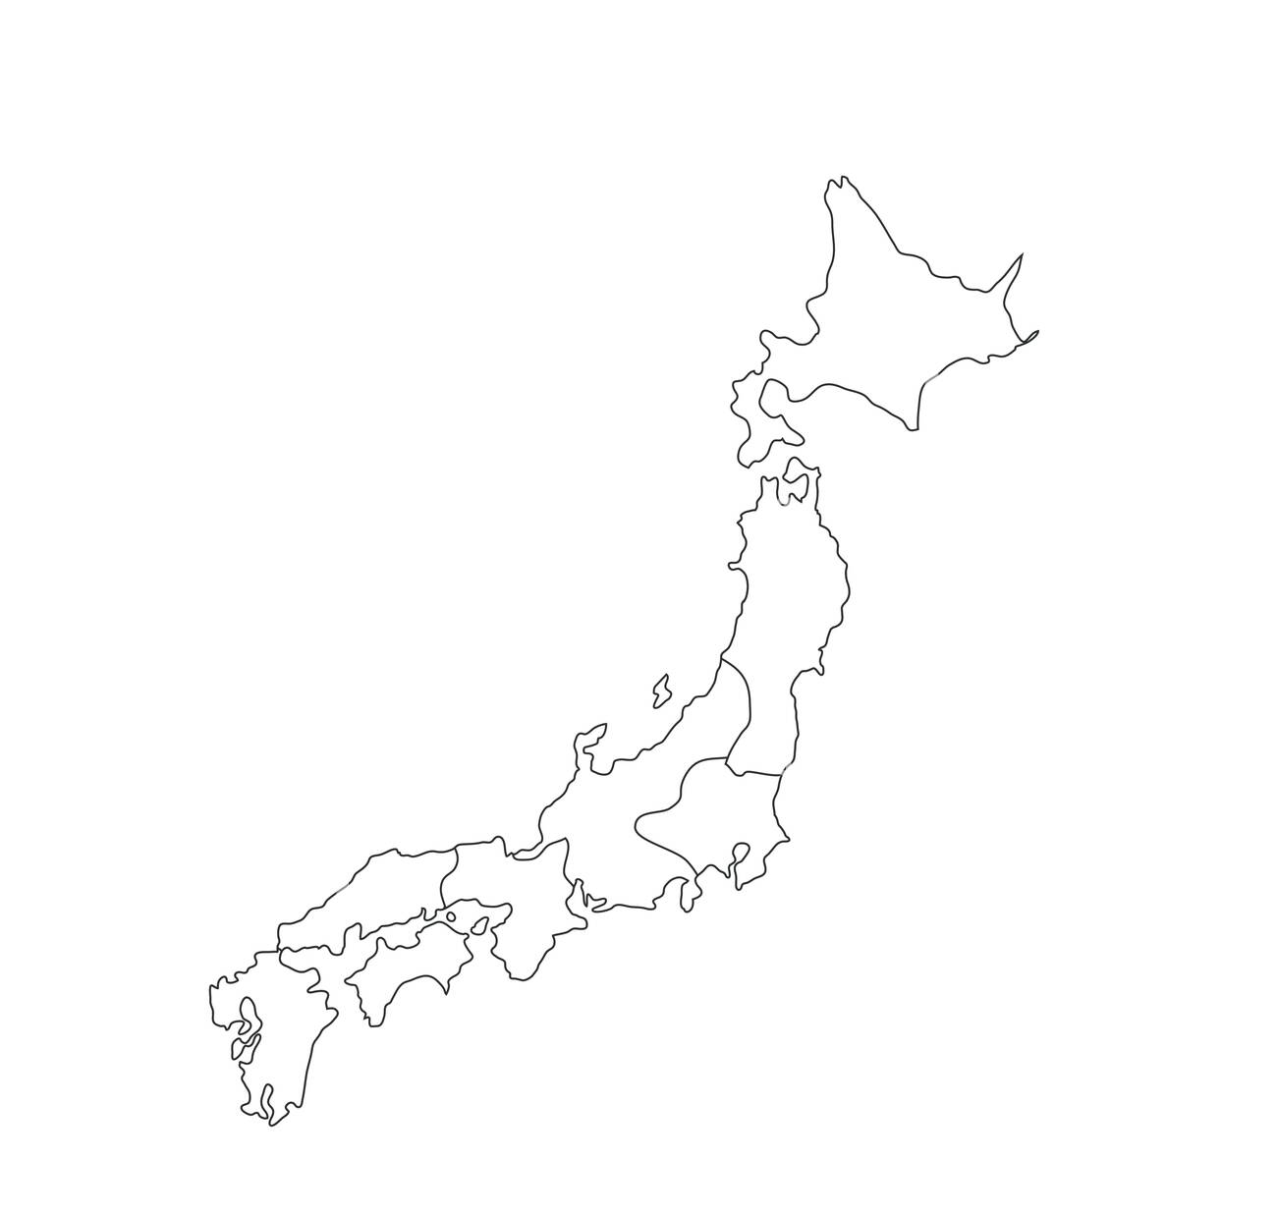
FRAGMENTATION IN EVIDENCE GATHERING

Slide 4
POTENTIAL SOLUTIONS
NO © INFRINGEMENT FOR TDM
ONE-TO-ONE NEGOTIATIONS
COLLECTIVE MANAGEMENT
a) based on inputs
b) based on outputs
STATUTORY REMUNERATION
RIGHT -> USE OF DLT + SMART
CONTRACTS

Slide 5
READINGS
👍
C. GEIGER, V. IAIA, The forgotten creator: towards a statutory remuneration right for machine learning of Generative AI, in Computer Law & Security Review, Vol. 52, 2024, preprint available on SSRN.
M. SENFTLEBEN, AI Act and author remuneration – A model for other regions?, 2024, available on SSRN.
V. IAIA, The SIAE and Meta tug-of-war: an Italian affair of European relevance, Kluwer Coyright Blog, 18 April 2023.
CONTACTS
📲
vincenzo.iaia@luiss.it
Vincenzo Iaia

