Slide 1

Learning from Copyright Disputes of the Past
Dr Cheryl Foong
LLB (Hons I) LLM (QUT); LLM (Columbia); PhD (ACU)
Senior Lecturer, Curtin Law School
cheryl.foong@curtin.edu.au
WIPO Conversation, ‘Training the Machines – Bytes, Rights and the Copyright Conundrum’
13 March 2024
1

Slide 2
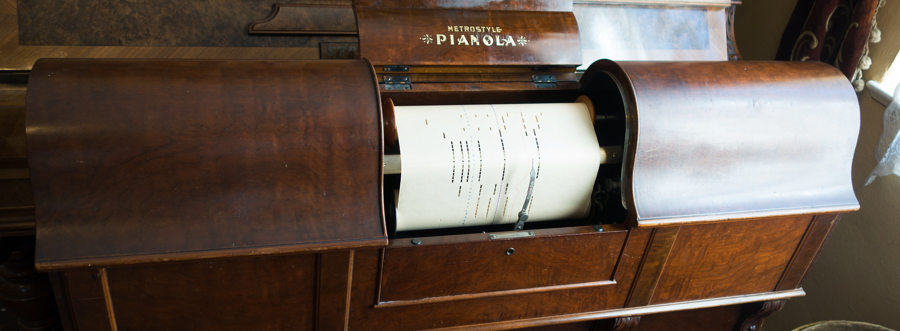
A Shift in Recognition of Value
Not human-readable copies
Repetition (copies) vs Representation (performances)
Recognition of ‘performance-commodities’
Pianola music by Thomas Quine, CC BY
White Smith Music v Apollo, 209 U.S. 1 (1908)
3
Brian Miller, Copyright and the Value of Performance, 1700-1911 (2018)

Slide 3


Copies vs Access
Access - key to ‘fairness’ analysis
  Authors Guild v Google (2015) – snippet view
  Fox News v TVEyes (2018) – watch function
Non-expressive use not infringing – fair use
  Matthew Sag, ‘Copyright and Copy-Reliant Technology’ (2009)
Purposive approach - emphasizes communicative dimension / ‘author-audience nexus’
  Abraham Drassinower, What’s Wrong with Copying? (2015)
Non-disseminative uses ‘immaterial’
  Cheryl Foong, 'Immaterial Copying in the Age of Access' (2022)
4

Slide 4
Expression and Substitution
Input
Machine Learning
Output
Expressive use?
Copying and ‘use’ that is of value
Substitution of expression? Or information
Attention diversion?
  Attractive force of content - Herbert v Shanley, 242 U.S. 591 (1917)
Audience
5

Slide 5
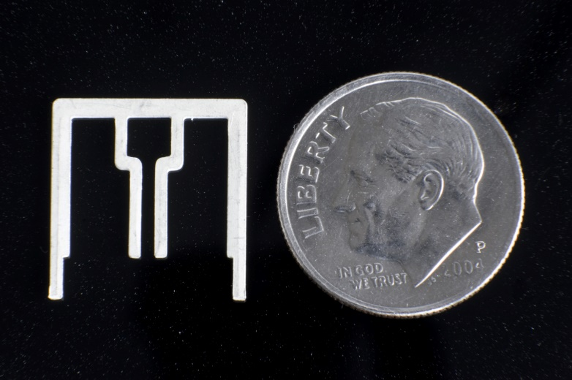
Doctrinal Questions
GenAI litigation and communication to the public
Getty Images v StabilityAI (UK)
Image-to-image feature, with ‘image strength’ slider
Question of who is communicating
          Similarity to ‘volition’ question in Aereo (2014)
          Private tool vs public communication
NY Times v Microsoft, OpenAI (US)
MS and OpenAI argue not ‘real world’ interrogation or use of the platform
Underestimates breadth of communication right / ‘transmit’ clause
MS argues could be used to infringe, no liability for multi-use ‘product’
How should fair use apply to communications to the public?
7

Slide 6
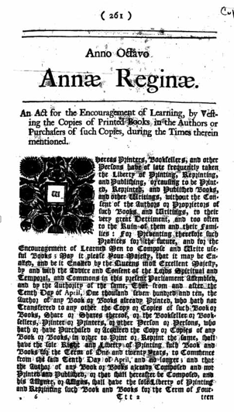
Broader Questions
8
Regulating inputs because concerned about outputs as substitutes?
  Pl’s works a fraction of overall training database…relevant?
  Unpredictability of generative AI’s capabilities
Is copyright the appropriate tool?
  Addressing broad ethical and moral concerns about capabilities of AI and how this changes human learning and society?
Thank you
chery.foong@curtin.edu.au

