Slide 1
WIPO CONVERSATION ON INTELLECTUAL ROPERTY (IP) AND FRONTIER TECHNOLOGIES
Intellectual Property and the Metaverse
Valentin Panko
Principal Examiner of the Mechanics,
Physics and Electrical Engineering Division,
Examination Department of the Eurasian Patent Office (EAPO)

Slide 2
IP Offices and the Metaverse
Sharing session (Member States and IP Offices)

Slide 3
Metaverse
METAVERSE
Technical aspects of the Metaverse
Social aspects of the Metaverse
Cultural aspects of the Metaverse
Legal aspects of the Metaverse
Intellectual property
Contracts and Business
Safety and Privacy

Slide 4
IP Offices and the Metaverse
Questions regarding IP in the METAVERSE
Are existing IP rights sufficient to protect innovations and creations in the Metaverse?
IP protection for Metaverse platforms, AI and software
IP protection for virtual objects in the Metaverse
Digital IDs and Avatars
Jurisdiction, enforcement and dispute resolution
IP search inside the Metaverse

Slide 5
IP in the Metaverse
METAVERSE
IP administration
Virtual events
Interacting with applicants
Virtual office
IP objects
Types of IP protections
IP protection

Slide 6
IP protection in the Metaverse
Technologies that powers Metaverse Infrastructure
Virtual objects created inside the Metaverse
Patent
NFT
IP objects
Types of IP protection
Design
Copyright
Digital models of real world objects in the Metaverse
Technologies that powers Human interfacing

Slide 7
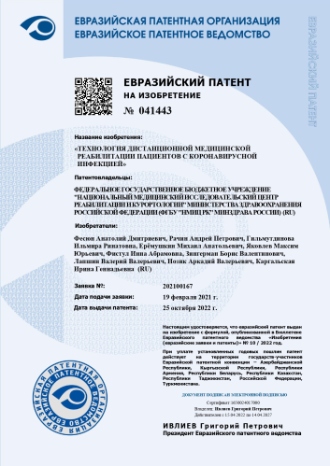
Types of IP protection in the Metaverse
Patents
Hardware technologies that powers human interfaces in the Metaverse
Software technologies that powers the Metaverse Infrastructure
Software technologies that powers human interfaces in the Metaverse
Inventions
Computer-assisted inventions
Hardware technologies that powers the Metaverse Infrastructure

Slide 8
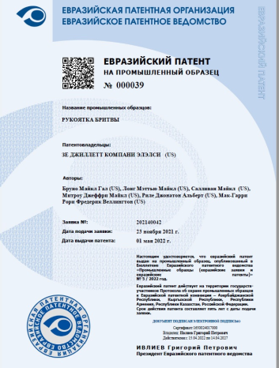
Types of IP protection in the Metaverse
Designs
Virtual objects created inside the Metaverse
Digital models of real world objects in the Metaverse
Human-Computer Interfaces
Virtual objects
Interfaces
Interactive virtual interfaces

Slide 9
IP protection issues in the Metaverse
Design, copyright and related rights
NFT
Confirmation of the fact of ownership and the right to use within the Metaverse of a digital asset
Doesn't verify that a person minting an NFT has the rights to the asset they're minting
Jurisdiction, enforcement and dispute resolution
Digital IDs and Avatars
Creations that are autonomously generated by AI
Searching process in the Metaverse

Slide 10
Conclusion
Are there any ongoing consultations or studies?
The EAPO conducts consultations on issues related to IP protection in the Metaverse and explores the possibilities of the Metaverse to improve the services provided by the office.
Are IP Offices amending their guidelines or registration classes for virtual goods to better accommodate IP issues
The EAPO is already amending the regulations, in particular, applicants have already been given the opportunity to file applications for industrial designs in the form of digital 3D models.
What topics are at the forefront of their thinking?
Now the main issues for discussion are issues related to enforcement of IP objects for which the EAPO grants patents for industrial designs.
What are the opportunities and challenges?
According to the EAPO, the opportunities of the Metaverse in relation to IP are associated with its use to improve the services provided to applicants, and the main challenges are related to the possibility of effective protection of IP.

Slide 11
THANKS FOR YOUR ATTENTION!
Intellectual Property and the Metaverse
Valentin Panko

