Slide 1
Trademark and Metaverse
- KIPO’s Guidelines for Examination of Virtual Goods
Ingyu KIM
(klein83@korea,kr)
Deputy Director,
Trademark Examination Policy Division,
Korean Intellectual Property Office(KIPO)
30 April 2023
Notes:
Good afternoon, I am In-Gyu Kim, Deputy Director of the KIPO Trademark Examination Policy Division.
I am really honored to join the WIPO Conversation on IP and the Metaverse.
Today, I would like to present the Virtual Goods Examination Guideline published by KIPO.
And as time for this presentation is limited to 7 minutes, please feel free to contact us via email if you have any additional questions about the guideline.
Next slide, please.
---------------------------------
좋은 오후입니다, KIPO Trademark Examination Policy Division의 Deputy Director인 김인규입니다.
Intellectual Property and the Metaverse에 대한 WIPO Conversation에 참여하게 되어 영광스럽게 생각합니다.
오늘 저는 KIPO에서 발간한 Virtual Goods Examination Guideline에 대해 발표하고자 합니다.
한국특허청은 늘어나는 가상상품 출원에 대응하기 위해 가이드라인을 작성하여 상표 심사에 활용하고 있습니다.
이는 내부 심사 기준으로 작용하여 일관성 있는 심사에 기여하고 있습니다. 동시에 이는 외부에 공개되어 잠재적 출원인들에게 가상상품 관련 출원을 잘 할 수 있도록 도와주고 있습니다.
발표 시간이 한정된 만큼, 가이드라인 내용에 대해 추가적인 질의가 있는 경우 메일을 통해서 언제든지 연락주시기 바랍니다.
다음 슬라이드 부탁드립니다.

Slide 2
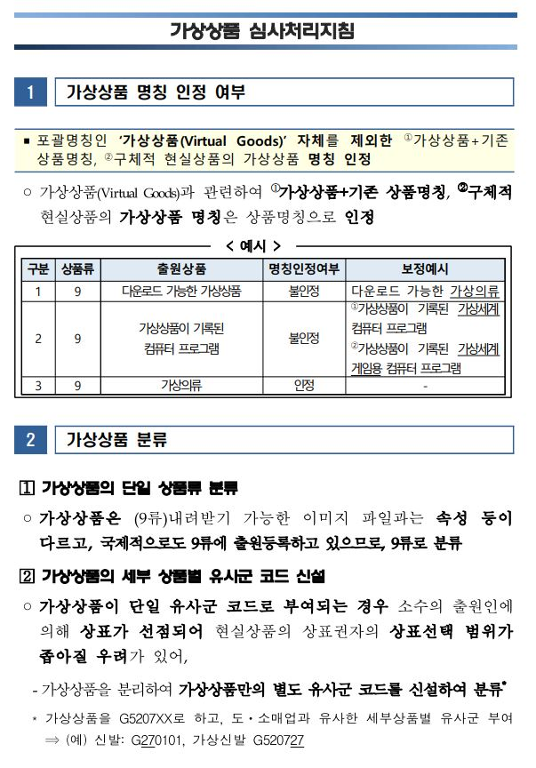
Guidelines for Examination of Virtual Goods (Published on July 14 2022)
“Virtual Goods”
The term “virtual goods” itself is not acceptable for designated goods/services because the scope of “virtual goods” is ambiguous and there is a possibility of a dispute.
EXAMPLE
As Designated Goods
“Virtual Goods”
X
“Downloadable Virtual Goods”
X
Notes:
The guideline was first published on July 14, 2022.
To cope with the increasing number of virtual goods applications, the Korean Intellectual Property Office has developed guidelines to be used in trademark examinations.
This guideline serves as an internal standard for consistent examinations and also assists potential applicants to file virtual goods-related applications.
So first, the term "virtual goods" itself cannot be registered as a designated goods name.
“Virtual Goods” itself as a designated goods name is ambiguous in product scope and there might be a potential trademark disputes.
So for example, "virtual goods" and "downloadable virtual goods" cannot be registered as designated goods name.
Next slide, please.
---------------------------
해당 가이드라인은 2022년 7월 14일에 처음으로 발간되었습니다.
가장 먼저, 가상상품의 designated goods 명칭 인정 관련입니다.
우선, ‘가상상품＇ 그 자체는 designated good 명칭으로 인정되지 못합니다.
‘가상상품＇이라는 명칭 자체는 상품의 범위가 모호하여 상표권 분쟁 발생의 소지가 있기 때문입니다.
아래 예시를 보겠습니다.
지정상품으로 ‘가상상품’, 그리고 ‘다운로드 가능한 가상상품‘은 지정상품 명칭으로 인정되지 않습니다.
다음 슬라이드 부탁드립니다.

Slide 3
Guidelines for Examination of Virtual Goods (Published on July 14 2022)
“Virtual Goods”
“Virtual” + existing terms of physical goods in the real world can be recognized as designated goods
EXAMPLE
As Designated Goods
“Virtual Clothes”
O
“Virtual Shoes”
O
Notes:
However, if "virtual" is combined with "existing terms of physical goods in the real world”, it can be recognized as designated goods, it can be recognized as a designated goods name.
For example, virtual clothing or virtual shoes can be recognized as designated goods names.
Next slide, please.
------------------------
그러나, ‘가상’ 과 ‘existing terms of physical goods in the real world can be recognized as designated goods ＇이 결합된 경우에는 상품명칭으로 인정받을 수 있습니다.
아래 예시를 보겠습니다.
가상의류, 또는 가상신발은 지정상품 명칭으로 인정받을 수 있는 것입니다.
다음 슬라이드 부탁드립니다.

Slide 4
Guidelines for Examination of Virtual Goods (Published on July 14 2022)
Similarity between physical and virtual goods
Presumed to be dissimilar
While virtual products include some elements of physical products such as name and appearance, their use is different from that of their corresponding physical products, so that they will be presumed to be dissimilar until a final judgement is reached
Note: As for trademarks that are well-known or have reputation, if there is a likelihood of confusion between virtual and physical goods as to the source of the goods, Article 34(1)11 (likelihood of confusion) and Article 34(1)12 (deception of consumers) will apply.
Notes:
So let's discuss the determination of similarity between virtual goods and physical goods.
In principle, virtual goods and physical goods are presumed to be dissimilar.
Although virtual products may share some elements with physical products, such as name and appearance, their use is different, so they will be considered dissimilar until a final judgment is reached.
However, caution is needed for well-known trademarks.
Like many other countries, Korea provides a higher level of protection for well-known trademarks.
Therefore, if a physical goods is a well-known trademark, similarity will be judged by considering the possibility of confusion and deception of consumers.
Next slide, please.
----------------------------
다음은 가상상품과 현실에 존재하는 상품의 유사 판단입니다.
원칙적으로 가상상품과 현실상품은 비유사한것으로 추정합니다.
Virtual products include some elements of physical products such as name and appearance.
But their use is different from that of their corresponding physical products, so that they will be presumed to be dissimilar until a final judgement is reached
그러나, 유명상표의 경우에는 주의할 필요가 있습니다.
다른 많은 나라와 마찬가지로, 한국은 유명상표에 대해서는 보다 높은 수준으로 보호하고 있습니다.
따라서, 현실상품이 유명상표인 경우, 혼동가능성 및 수요자 기만 가능성을 검토하여 유사 여부를 판단합니다.
다음 슬라이드 부탁드립니다.

Slide 5
Guidelines for Examination of Virtual Goods (Published on July 14 2022)
Similarity between virtual goods
Virtual goods have similar attributes in usage but consumers tend to perceive them differently by their corresponding physical goods. So, if their corresponding physical goods are dissimilar in the real world, the virtual goods will be deemed dissimilar.
Even if virtual goods share the same similar group code, they will be determined individually considering their features.
Notes:
Finally, let's discuss the determination of similarity between virtual goods.
Although virtual goods A and B have some similar attributes because they are all virtual thing, consumers tend to perceive them differently considering their corresponding physical goods.
Therefore, if their corresponding physical goods A and B are dissimilar in the real world, virtual goods A and B will also be deemed dissimilar.
Moreover, even if virtual goods share the same similar group code, they will be determined individually considering their features.
Next slide, please.
-----------------------------
마지막으로, 가상 상품 간의 유사여부 판단입니다.
We understand that virtual goods have some similar attributes in usage, we also know that the consumers tend to perceive them differently by their corresponding physical goods.
So, if their corresponding physical goods are dissimilar in the real world, the virtual goods will be deemed dissimilar.
And moreover, Even if virtual goods share the same similar group code, they will be determined individually considering their features.
다음 슬라이드 부탁드립니다.

Slide 6
THANK YOU
Ingyu KIM
(klein83@korea,kr)
Deputy Director,
Trademark Examination Policy Division, KIPO
Notes:
That concludes my presentation on KIPO's virtual goods examination criteria.
Thank you for your attention, and please contact us via email if you have any additional questions.
Thank you.
----------------------------
지금까지 KIPO의 가상상품 심사기준에 대해 말씀드렸습니다.
경청해 주셔서 감사드리며, 추가 질문은 슬라이드의 메일로 부탁드립니다.
감사합니다.

