Slide 1
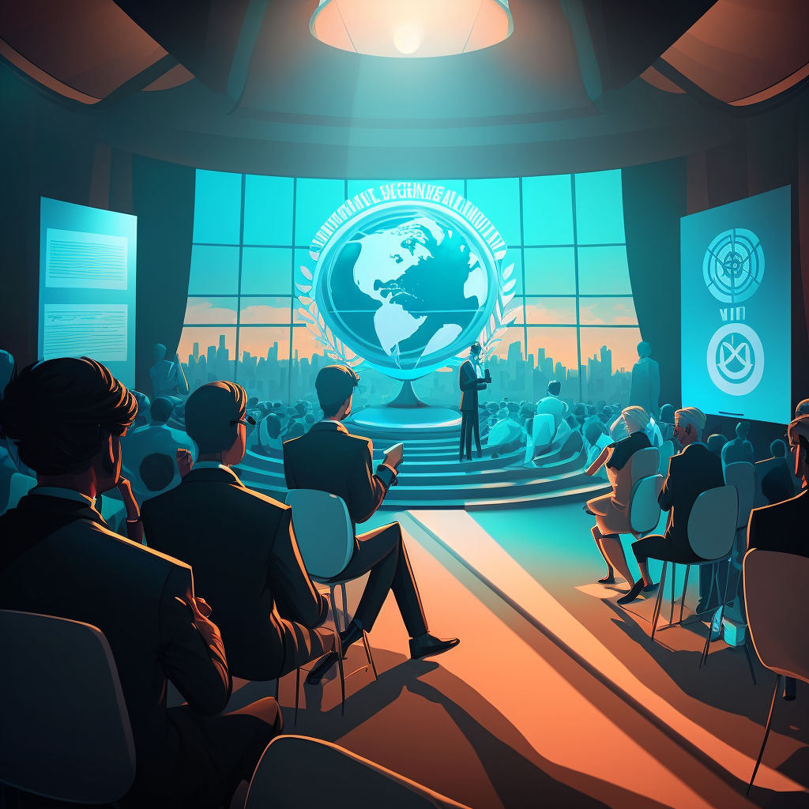
WIPO Conversation
Intellectual Property and the Metaverse
29th March, 2023

Slide 2
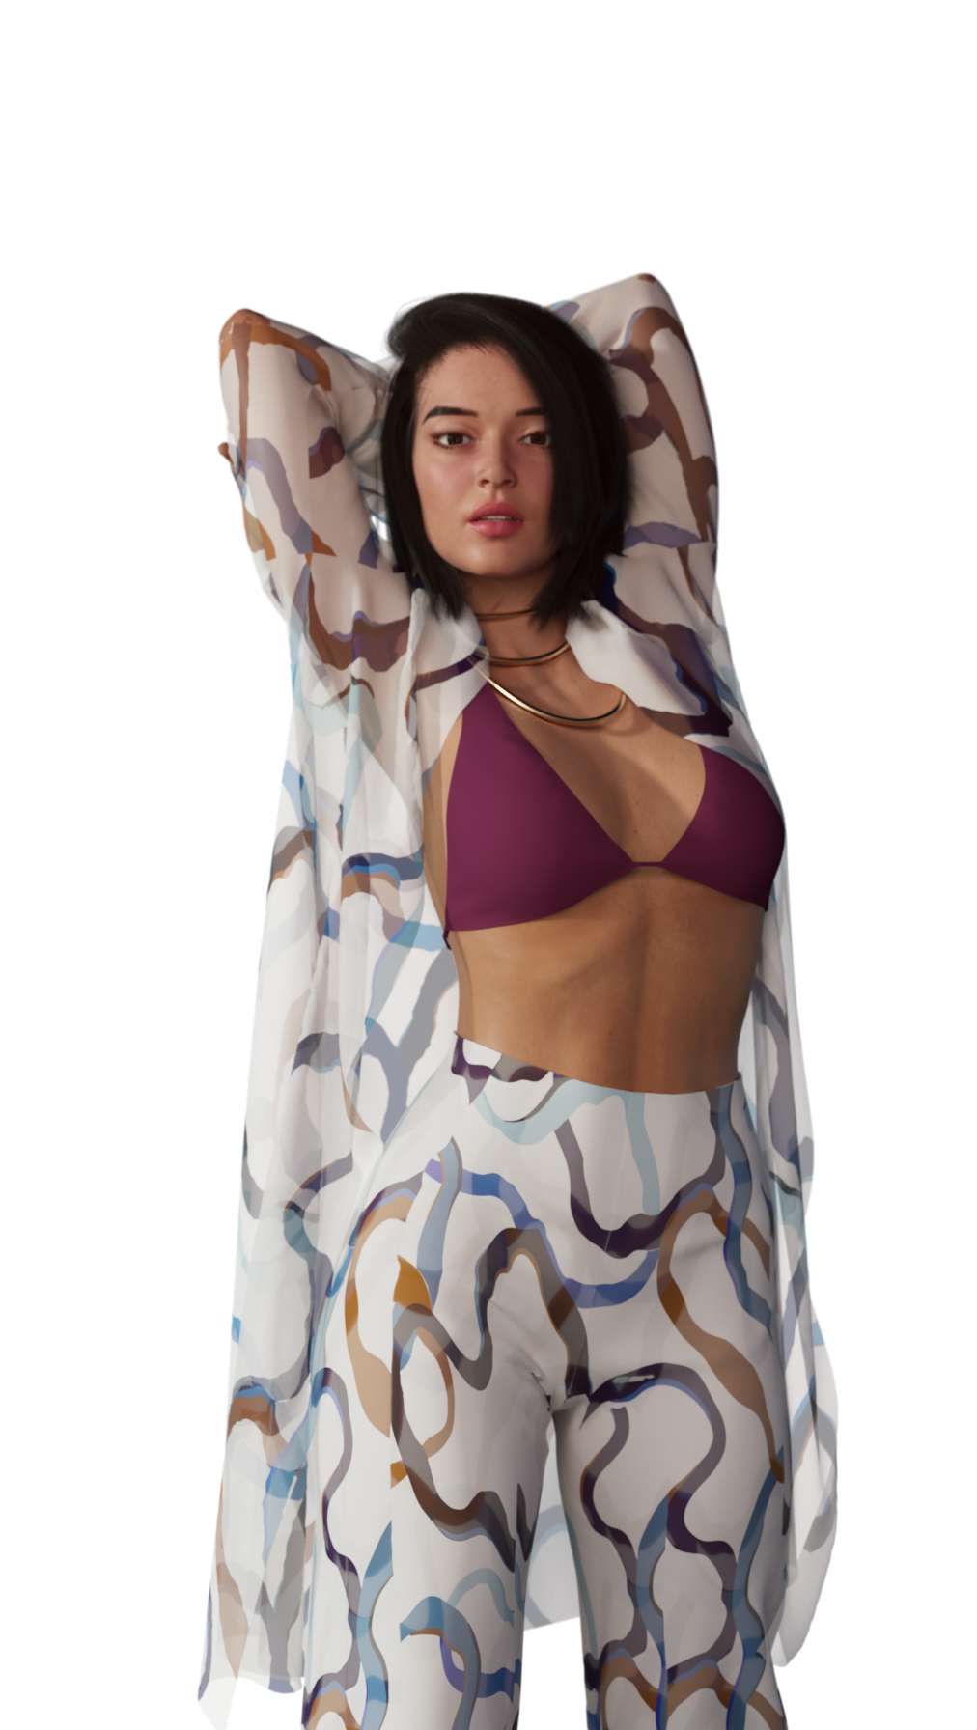
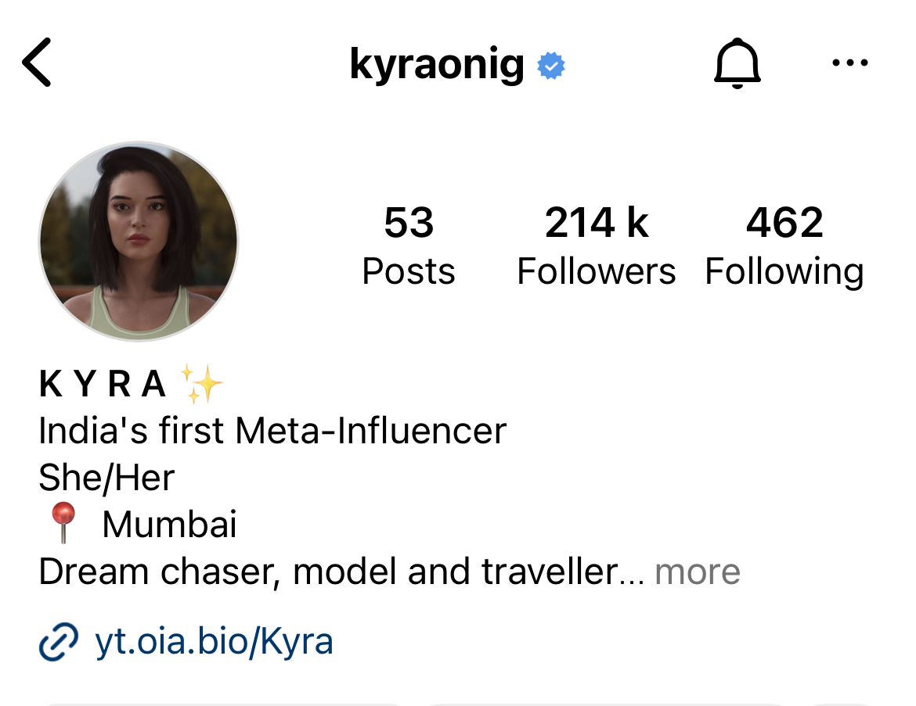
Meet Kyra
India’s First Virtual Influencer
200,000+ Followers on Social Media
21 year old Metaverse Native.

Slide 3
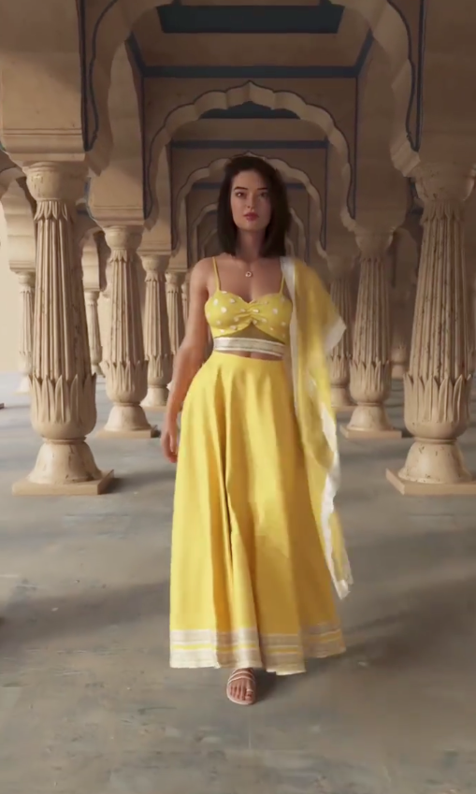
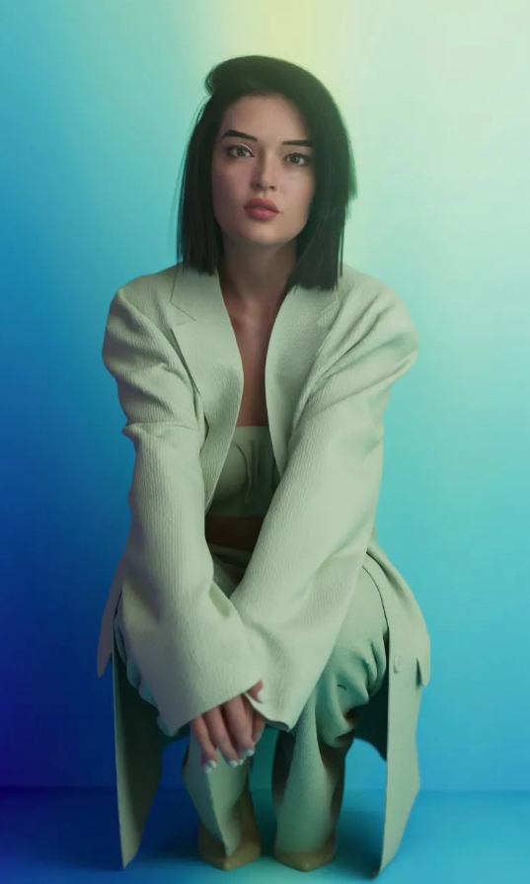
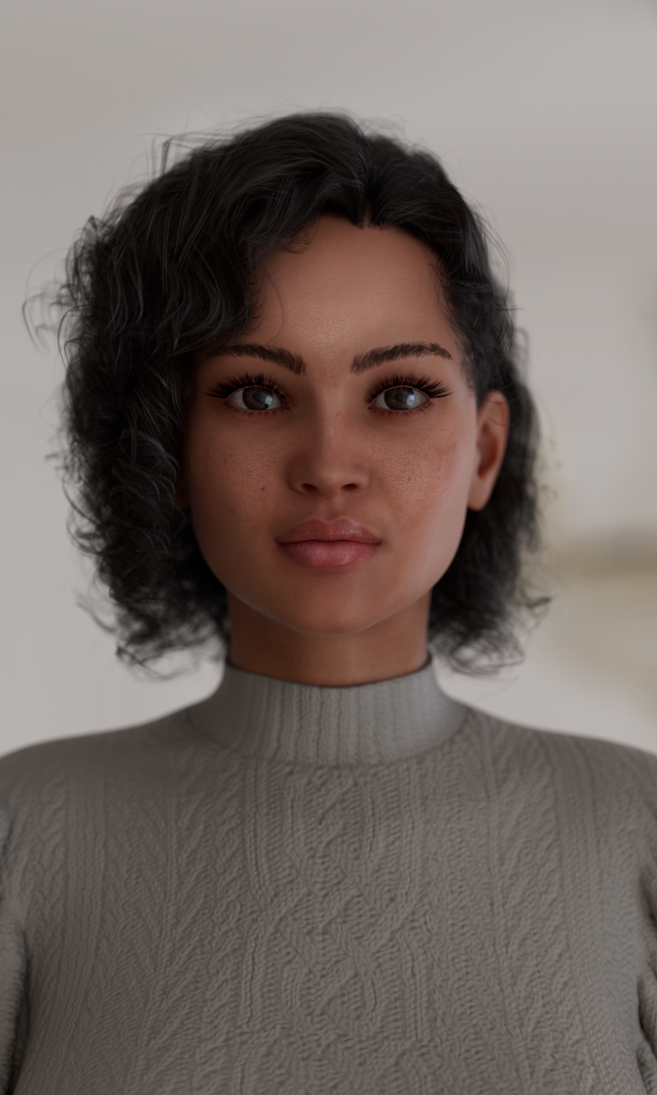
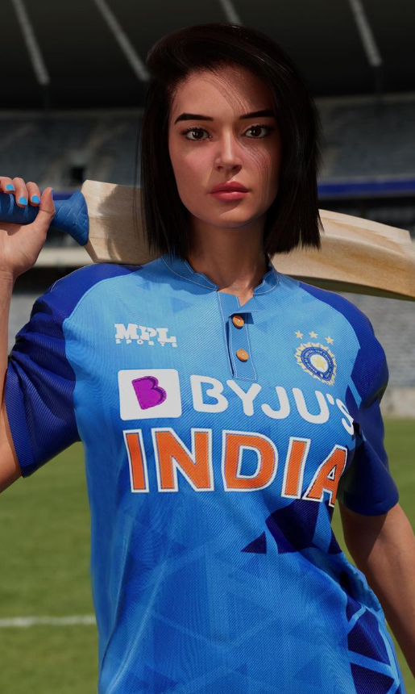
Kyra’s Journey so far
Jan 2022
Jun 2022
Dec 2022
Jan 2023
Jun 2023
Kyra is launched as India’s first Virtual Influencer
@kyraonig on Instagram
Kyra crosses 100,000 followers on Instagram
Kyra works with major brands and is featured on the cover of a travel magazine
Sravya N, the first Virtual Human on LinkedIn is launched.
Kyra’s music video, more virtual humans and AI powered content to come.

Slide 4
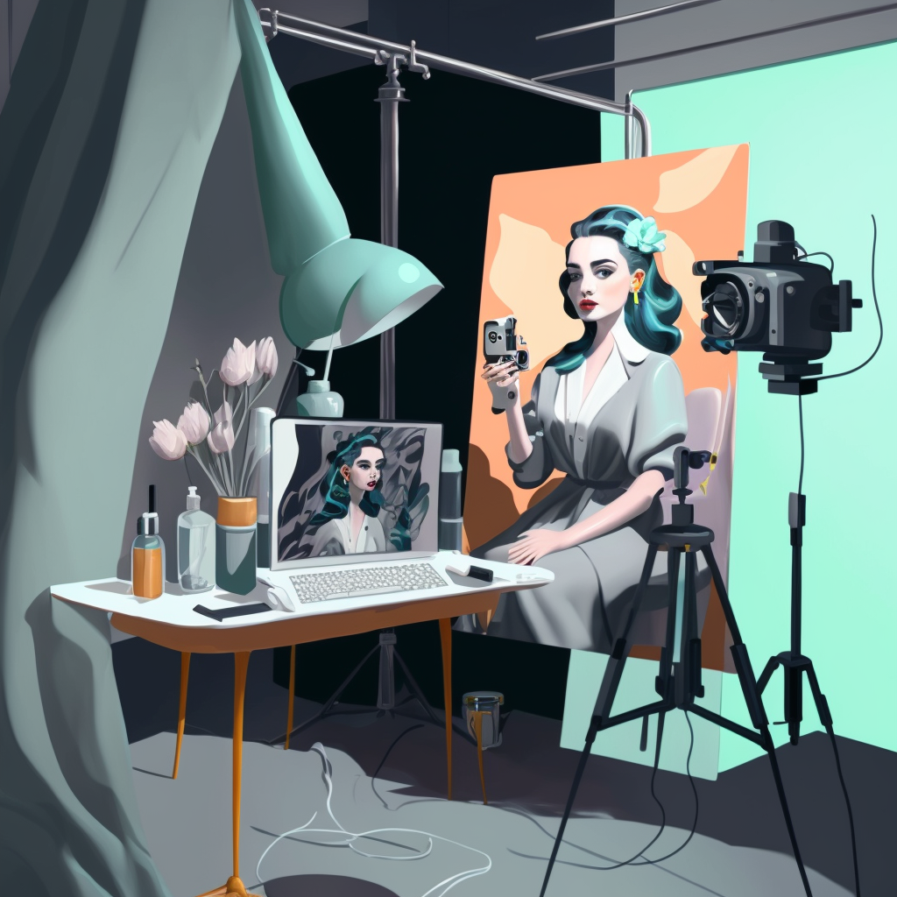
Virtual Influencers
What?
An interactive CGI character that exists in the virtual world
How?
3D + AI + SOCIAL TOOLS
Why?
Tell stories in the metaverse age

Slide 5
Virtual Influencers in the Metaverse
Give life to the Metaverse
NPCs of the Metaverse
Entertain and Educate

Slide 6
WELCOME TO THE FUTR
A universe of Interactive Virtual Humans.
Influence, Entertain, Interact and Educate.
Use Cutting edge Story-Telling, Design and Technology.

Slide 7
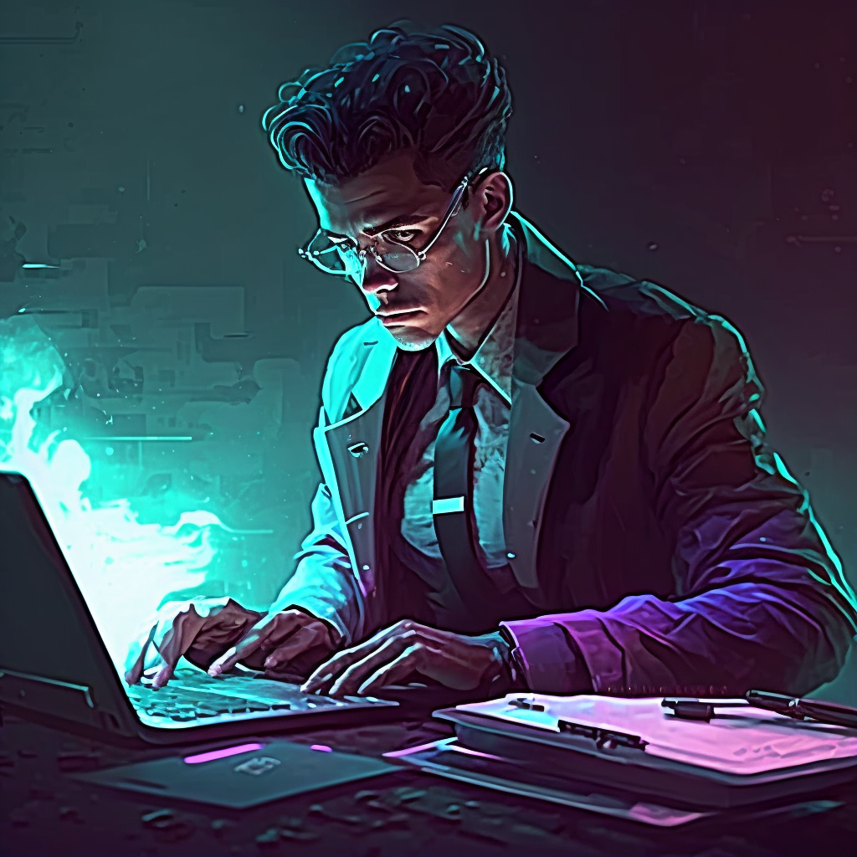
Ip & Metaverse
How to protect Virtual Influencers IP in different Metaverses?
How to transfer our legacy IP to the Metaverse?
How to protect IP of the content that Virtual Influencers create?

Slide 8
Our Suggestions
Accessible and Ease of Use
Decentralised Unique Metaverse Copyright
IP Transfer process from Legacy to Metaverse platforms.

Slide 9
WIPO Conversation
Thank you
Himanshu Goel
Himanshu@futrstudios.in

