Slide 1


Slide 2

Fiat payment rails for metaverses & web3 games to onboard the next 2B+ users

Slide 3

Introduction
Metaverses are a huge opportunity for creative freedom but bring with them unique challenges for IP
2 classes of IP issues – i. Brands – leveraging & licensing their IP; ii. Users – protecting IP created through metaverse interactions
Public versus private regulation – finding the right balance

Slide 4
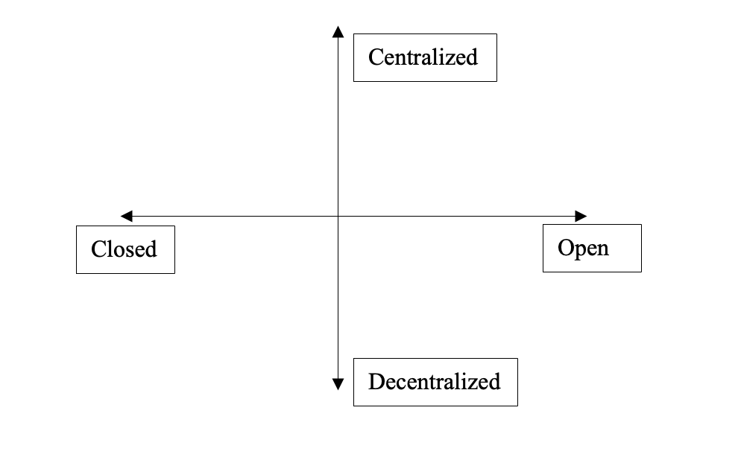
Typology of metaverses
2 spectrums
1. Open versus closed
2. Centralized versus decentralized

Slide 5
Some way off from the ’true’ metaverse experience
Today’s metaverses largely 2D; lack immersive-ness
Two elements to mainstreamed adoption
1. Making metaverses more immersive, realistic & fun
2. Easing onboarding and improving accessibility

Slide 6
The metaverse and its IP implications
Brands and ‘immersive commerce’
User generated content and the incoming creative tsunami

Slide 7
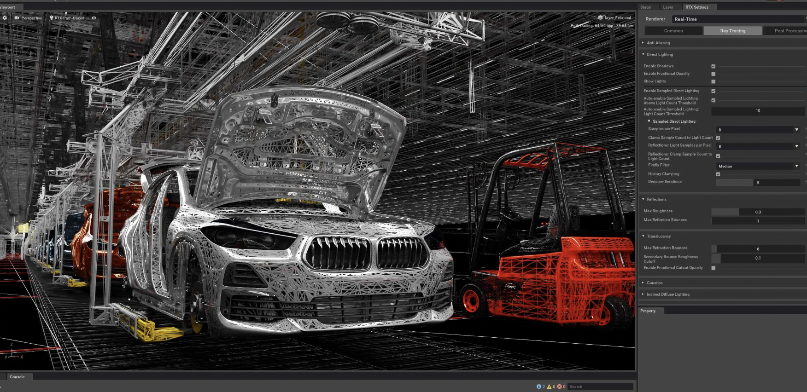
1. NVIDIA Omniverse
- For engineers/architects and for the industrial/production/manufacturing sectors.
- Traditional approach of IP registration and protection probably more appropriate?

Slide 8
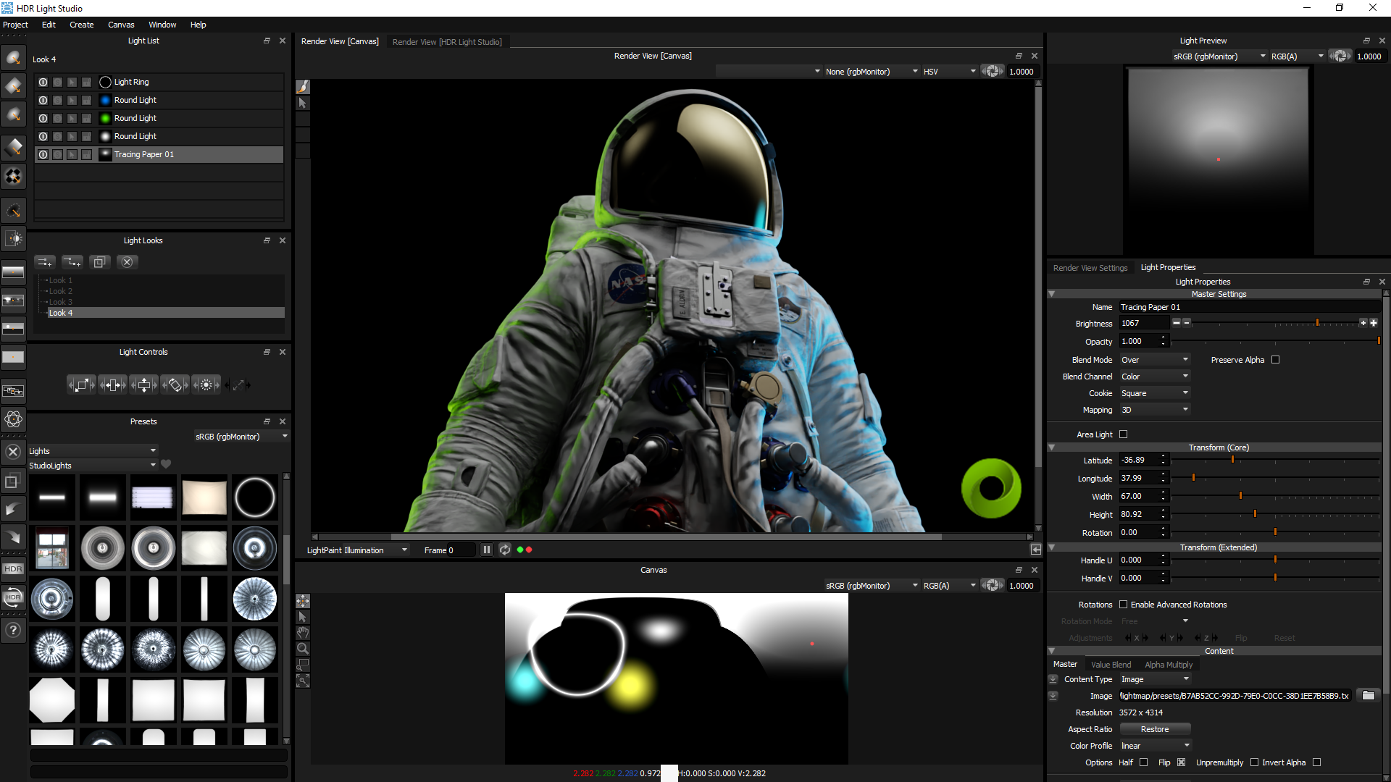

Slide 9
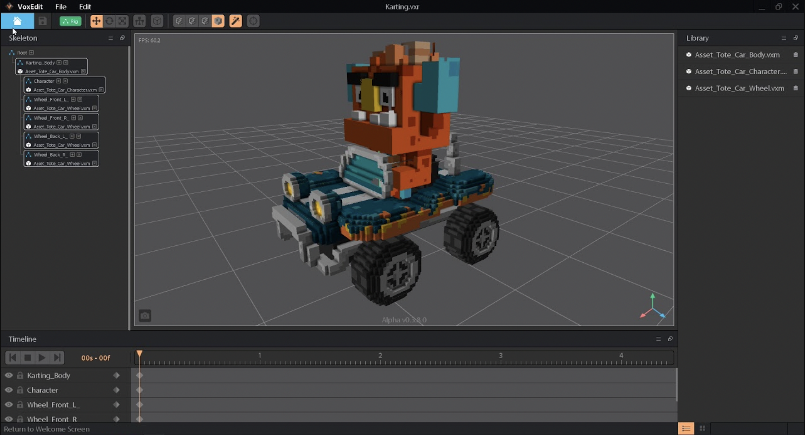
2. Metaverse specific tools to design digital assets/experiences
- For game developers, designers, gamers etc. to create digital assets and gamified experiences
- Private regulation more appropriate?

Slide 10
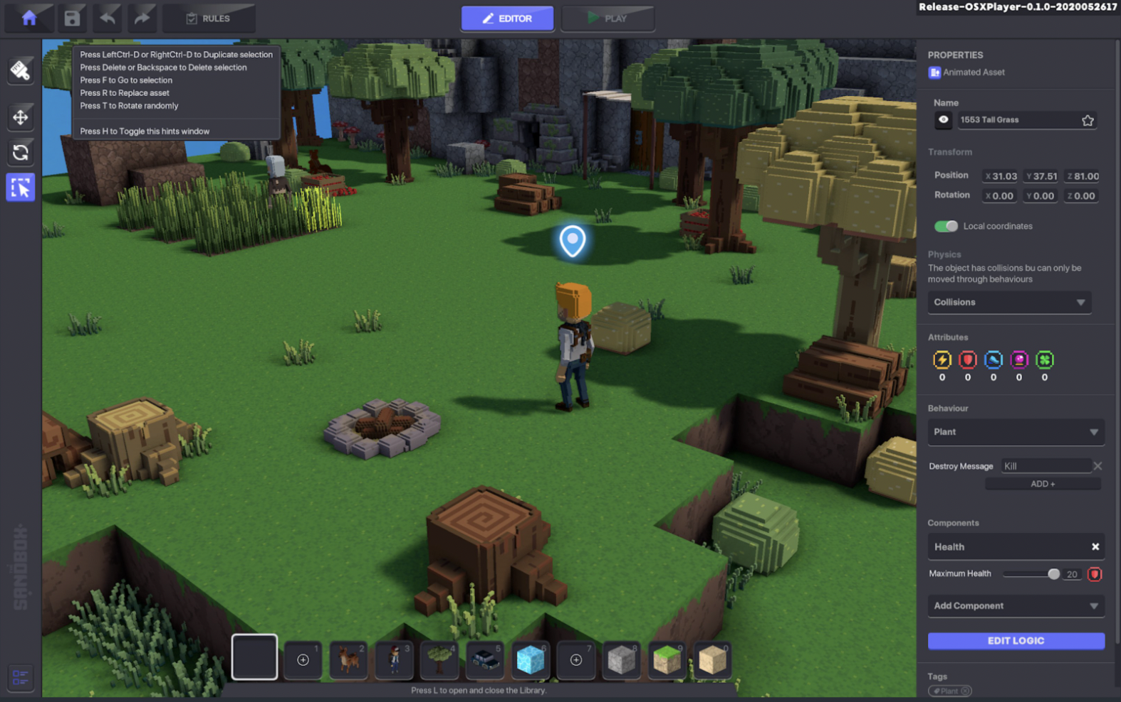

Slide 11
Looking ahead
AI creations and IP
- AI tools to for in-game characters, assets, maps, music etc
- US Copyright office on human authorship
Community ownership of IP
- Decentralized Autonomous Organizations (DAOs) – media DAOs; service DAOs etc
Smart contract standards for digital rights management
- Enable rights holders to monetize their IP better – leasing, streaming royalties
- How different from traditional software standards – trustless & immutable; fully open source; plug-and-play with blockchain infra

Slide 12
Payment rails for Web3
viraj@poko.fund

