Slide 1
Making Programs Make more Systematic use of Evaluations and
their Results
Third Evaluation Seminar
January 29, 2016
Claude Hilfiker, Head, Evaluation Section
Internal Oversight Division
Notes:
2000 – Member States established IAOD with 1 auditor and 1 evaluator
2005 – Member States established Audit Committee, adopted Internal Audit and Oversight Charter as Annex to Financial Regulations and Rules, recommended hiring professionals to carry out oversight activities
2007 to present – Today, all posts filled Director, 3 sections Head, Senior, addtl staff as needed
Charter revised, Internal Advisory Oversight Committee
2014 Charter revised, «IOD», conflicts of interest, terms of Director
2014 Publication Policy: oversight reports public

Slide 2
Oversight Benefits
Ensures
good management
of resources
Promotes learning and accountability
Promotes
good
governance
Improves risk
Management
Enables
system for
internal
control

Slide 3

Evaluation… also to help «navigate» boomer-musings.blogspot.com-

Slide 4



Navigating Towards Expected Results

Slide 5
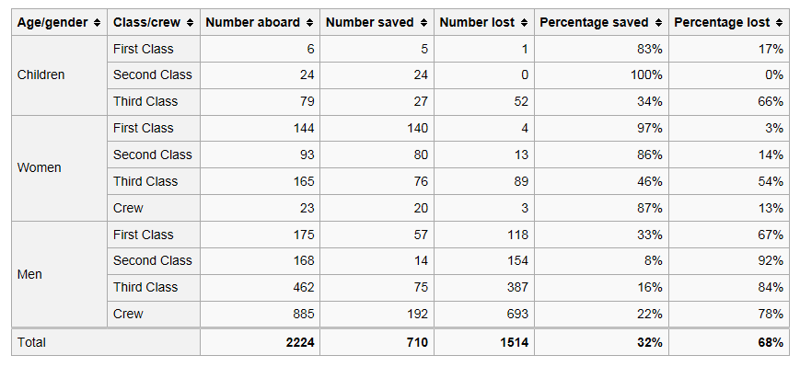
Effective Results by Class and Gender:

Slide 6

en.wikipedia.org-

Slide 7
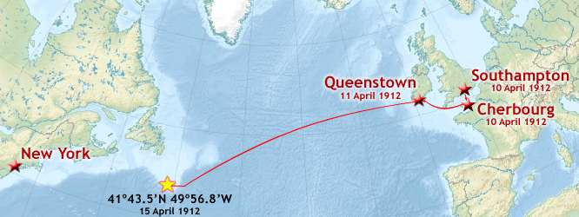
P, M & E: to get there safely!

Slide 8


© Google images

Slide 9
How About Evaluating?
Periodically Reviewing Advancement and Relevance:
Are we on course?
(when) are we getting there (where we want / need)?
How much resources did we use / do we still have?
Do our «passengers» get what they need?
How do we benefit from the journey?
Notes:
Report on achievements and challenges
Improve current implementation and performance as well as future planning
Assist PM in Navigation
Make Decisions

Slide 10
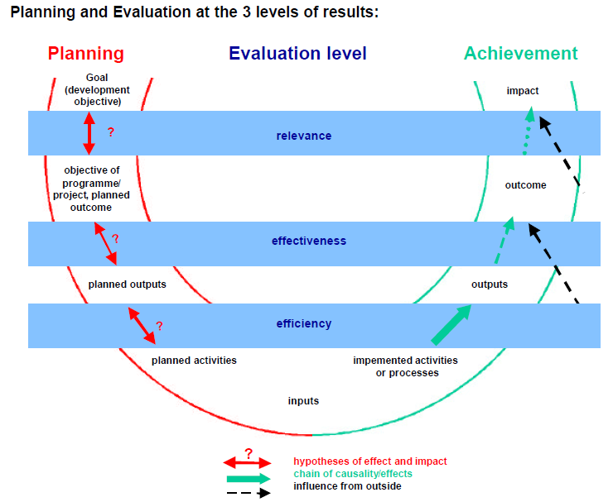
Evaluation is a Comparison

Slide 11


Slide 12
Changes Suggested in the New Policy
Policy Item | Current Practice | New Practice | Comments
Positioning of Evaluation Functions | Independent Evaluations issued by the Evaluation Section of the Internal Oversight Division Some evaluations done by the Programs (e.g. Development Sector, Patents and Technology Sector, Brands and Designs; ?) | Centralized Evaluation Function (CEF) = independent evaluation conducted by IOD; Decentralized Evaluation Function = evaluations conducted by programs with support from IOD as appropriate | IOD centrally records and quality-checks the decentralized evaluations in terms of report templates used, evaluation process followed and methodology applied etc. IOD provides the tools and support needed (evaluation manual in preparation)

Slide 13
Changes Suggested in the New Policy 2
Policy Item | Current Practice | New Practice | Comments
Selection of Evaluation Topics | IOD Evaluation plan is established after consultations with Management and Member States Focus on risks and accountability needs | In addition to its current practice, evaluation topics are also selected based on proposals by Sectors and Programs Main focus should be on utility for learning and decision-making | IOD builds a network of M&E focal points to discuss upcoming needs of the programs

Slide 14
Changes Suggested in the New Policy 3
Policy Item | Current Practice | New Practice | Comments
Evaluation tools | IOD developed its own processes and tools for conducting independent evaluations | IOD shares its good practices and tools with the programs and advises them on their use for their evaluations | IOD to provide advice to programs - from the perspective of their evaluability - on planning and monitoring within existing frameworks. It also supports self-evaluations of programs at their request.

Slide 15
Changes Suggested in the New Policy 4
Policy Item | Current Practice | New Practice | Comments
Evaluation follow-up | IOD tracks the implementation of accepted recommendations Almost all evaluation reports have formal recommendations | IOD follows-up proactively with programs after issuance of reports Some evaluation reports may have only suggestions for improvement | IOD helps the programs through discussions to better understand recommendations and to address challenges in implementing them. Informal follow-up on suggestions needs also to be ensured by IOD

Slide 16
Changes Suggested in the New Policy 5
Policy Item | Current Practice | New Practice | Comments
Equity focus | Certain Evaluations (mainly country evaluations) have addressed equity issues with respect to gender | Equity will be addressed more systematically for gender and other potentially discriminatory factors | Main equity factors for end beneficiaries are gender, social position and health conditions (e.g. disabilities). Access to IP for these categories need to be looked at more systematically.

Slide 17


WIPO Results-Based Management

Slide 18
The Position of Evaluation in RBM
Evaluation
Planning
Implementation / Monitoring
18

Slide 19
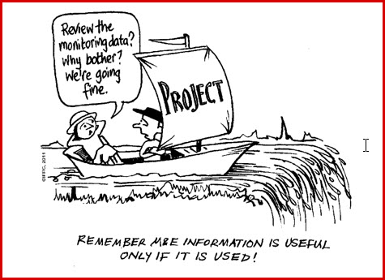
What can happen without M&E?
© aea365.org-

Slide 20
What’s in for Programs?
Support from IOD to
plan, design and conduct evaluations: tools and coaching (evaluation manual in preparation)
network with M&E focal points to discuss upcoming needs of the programs

Slide 21

Expected Result??

Slide 22
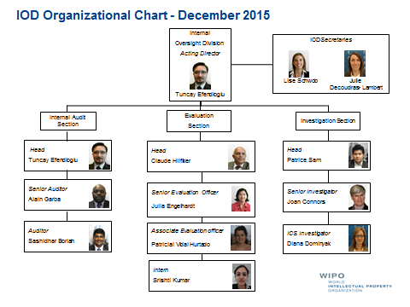
Thank you!
http://www.wipo.int/about-wipo/en/oversight/iaod/evaluation/

Slide 23
Additional Illustrations

Slide 24
Types of Evaluation

Slide 25

Culture of Evaluation

Slide 26
SOME PRINCIPLES
Some simple guiding principles:
Evaluation is a Process → make all key people participate
Evaluation is a Core Task of Program Managers → Make Evaluation Part of the Plans and Budgets
Evaluation is linked to Decision-Making → ask people what they intend to do with the evaluation, what changes they envisage

Slide 27
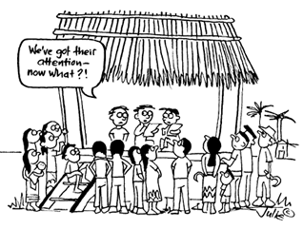
Evaluation : Participation source: ifad.org

Slide 28
SOME PRINCIPLES (2)
You can best Evaluate when there is a Plan or a Logic Model or Framework → often Evaluations require « ex-post » conceptualization before they can start
Evaluation looks at complex subjects → make reports simple and to the spot (less is more!)

Slide 29
SOME PRINCIPLES (3)
The value of Evaluation is in the reproducibility and traceability of Results → Have reports display distinctly findings, conclusions and recommendations and the links between them and the references to primary information sources
People learn better from positive examples → have evaluations identify lessons from good practice for replication

Slide 30
How to Respond to Evaluations
Put recommendations into a management Response Matrix
Request Managers to whom recommendations are addressed to feed back and provide an action plan for accepted recommendations (or arguments for their rejection)
Track the implementation of the recommendations

