Slide 1
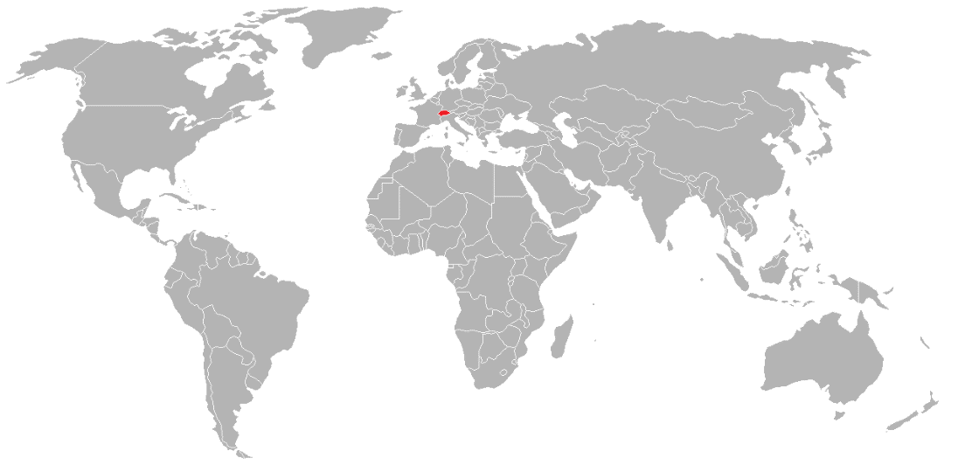
Protecting Designs Internationally
Experience from an Industry/practitioner Perspective
Hubert Doléac – Former Senior Legal Counsel IP - Nestlé
Troller Hitz Troller – Berne/Switzerland – Doleac@trollerlaw.ch
Geneva, July 19, 2018

Slide 2
Introduction
Advising and devising IP Protection strategies for companies with a global international presence requires:
  to think «out of the box» i.e. beyond the usual pure legal considerations and boundaries
  to work in close collaboration with all relevant stakeholders / business partners
  to have a good business understanding and knowledge to anticipate future needs ans constraints
To define proper IP protection strategies with a business focused perspective to facilitate sustainable long term business developments implies to be perceived as a real «Business Lawyer»

Slide 3
Example: Companies like Nestlé manage large portfolios of Brands…
Over 2000 Brands
In total around 160.000 protections: Example NESCAFÉ
197 | Trademarks
4447 | Trademark protections
46 | Designs
1119 | Design protections
375 | Domain names

Slide 4
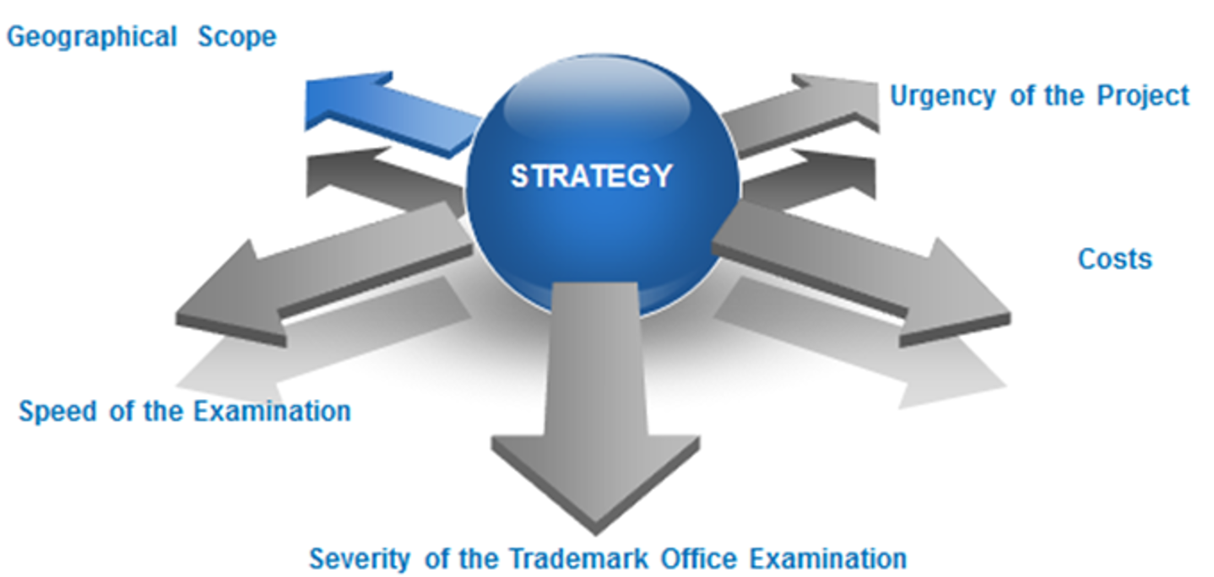
To define a Filing Strategy means looking into all directions and all aspects of projects…!
=> Allows to decide which «route» to chose – National or International?!

Slide 5
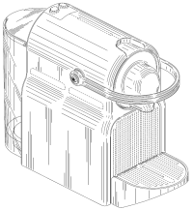
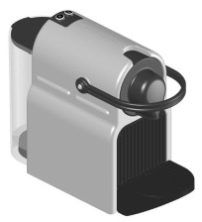
Building a sound Protection Strategy
Seeking a thorough protection strategy implies:
providing the broadest protection word mark vs. logo + design
covering (most of) the existing markets enforcement of protection
constantly adapting it to business plans and launches i.e. be relevant and in line with customer expectations
taking into account the economic situation and ongoing challenges
imitations/counterfeits
Questions to be considered:
What to protect? Whole product? Parts of it?
New, original, functional?
Which countries to cover?
Timing? Consider the launch date… Publication.
Filing requirements (drawings, declaration of transfer of rights, etc.)?

Slide 6

What is the best option of protection…?
National and/or International Filings..?
- The Madrid System
- The Hague System

Slide 7
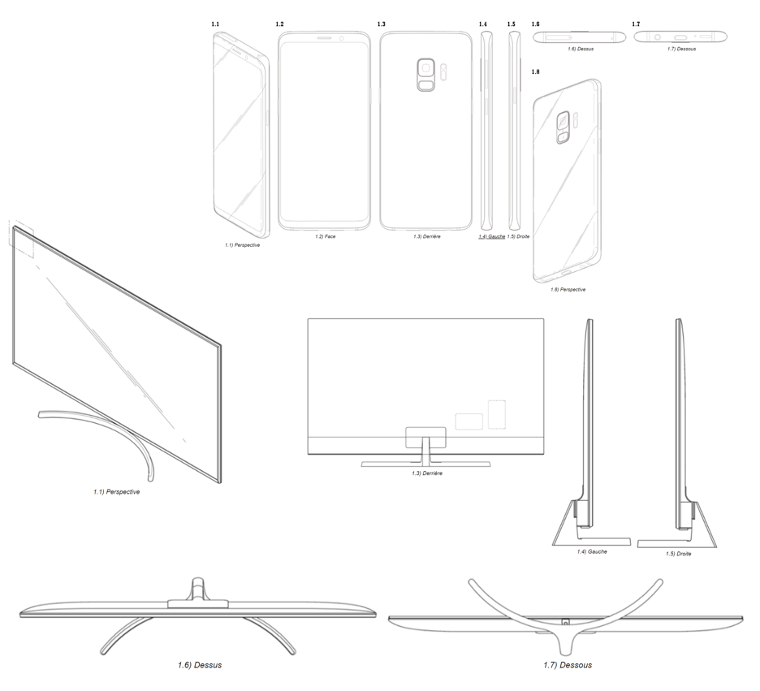
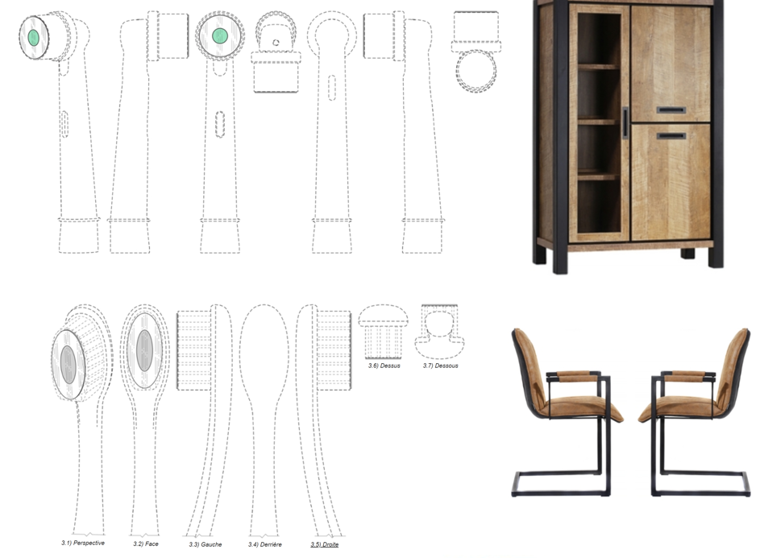
International Registrations – An obvious option for big companies!
While L’Oréal is the top filer for international TM protections in 2017, Samsung Electronics and LG Electronics, both from Korea, are the top filers of Designs in 2017, followed by Fonkel Meubelmarketing of the Netherlands and Procter & Gamble

Slide 8
Nestlé is also a big user of the Madrid Protocol and of the Hague Agreement
Today Nestlé has more than 1.800 active International Trademark Registrations and ranks in the top 12 companies for filing IRs applications in 2017 (although it seems to have slowed down the pace of its filings since in 2016 it was among the 10 major filers).
It has more than 800 active International Design Registrations and it constantly assesses and reviews the list of countries to designate
=> that is for example the case with the recent accessions of Russia and the UK which can be designated in International design applications since February 28, 2018 and June 13, 2018

Slide 9
Basic Criteria for protection of Designs:
Novelty
No identical design has been made available to the public before the
date of application. (Novelty applies worldwide or regional)
➔ a design shall be deemed to have been made available to
the public if it has been published (e.g. in a patent) or exhibited,
used in the trade or otherwise disclosed before the date of application
Individual character
The overall impression differs from the overall impression produced
by any design made available to the public.
In assessing individual character, the degree of freedom of the
designer in developing the design shall be taken into consideration.
=> The clients very often struggle with this!
Notes:
A design shall be deemed to have been made available to the public if it has been published following registration or otherwise, or exhibited, used in trade or otherwise disclosed …except where these events could not reasonably have become known in the normal course of business to the circles specialised in the sector concerned, operating within the Community.
As of 15 September 2008,
358 applications for invalidity of RCDs have been decided by OHIM
217 RCDs were declared invalid, and
141 applications for invalidity were rejected;
78 decisions were appealed
17 invalidity actions were currently pending

Slide 10
Design Protection Strategy – Due Diligence
Liaise with R&D and Patent Colleagues at early stage of new projects
Design protection can be a suitable complement to Patent protection or be a good alternative if Patent protection is not an option (…depends on the nature of the development).
Most countries require «absolute novelty» => Avoid disclosure during development stages and consumer tests => Ask detailed information and secure confidentiality agreements.
Make sure novelty is adequately preserved during development and consumer tests
Review artwork and assess novelty and individual character => conduct search for “prior art” (online and in existing databases -> unfortunately not exhaustive and depending on the classification!)
Identitfy and make primary analysis of elements that could be protected
Novelty requires to know where to protect to preserve validity => Seek assignment as wide as possible without restriction in time or geography!
Secure Assignment of rights from the Agency and the creators of the final designs
Secure Assignment of rights from the Agency and the creators of the final designs

Slide 11
Design Protection Strategy – Assessment Criterias for protection
Query the planned use and importance of the project
The importance of the project and the relevance of concerned business in the market(s) have to be considered to define the territorial coverage.
Assess the competitive environment and risk of facing infringements and the degree of enforcement
The risk of facing infringements is higher in countries like China for example, and for certain business categories (especially for a machine driven businesses, like Nespresso).
Examine the nature of the designs
A stricter approach is recommended for categories where the freedom of the designer is by default very narrow, such as for containers and accessories.
Consider the prior art and freedom of the designer
Is the proposed design sufficiently new and original ?
In overcrowded sectors where the freedom of the designer is more limited, small differences can make the difference (e.g. bottles shapes…but scope of protection may be very narrow!)

Slide 12
Designs - weak protections…?
Burden of proof – Reversed…!
There is a Legal presumption of validity of the designs!
=> Lack of novelty is irrelevant if not proved and the right holder of a design is
not required to prove novelty.
=> Similarly he does not have to prove that the Design has individual character
(interpretation of the General Court of article 85 II of regulation 6/2002
[presumption of validity – defence of the merits])
The “missing examination” of a design is partially “compensated” by the Legal
Presumption of validity
This Legal presumption is an advantage in case of conflicts!
  For sending Cease and desist letters
  In case of preliminary injunctions
  …And for negotiating licences

Slide 13
Hague Union
54 Geneva Act (1999) (including EU and OAPI)
14 Hague Act (1960)
68 Contracting Parties

Slide 14
Extending and planning to further grow…
Recent new Members:
  Russia – Possibility to designate as from February 28, 2018
  UK – Possibility to designate as from June 13, 2018
2 . Potential Accessions:
  - Canada - Mexico
  - China - Morocco
  - Asean Countries - Israel
  Madagascar
=> …and no doubt even more to come in the future… !!!

Slide 15
Why use The Hague System?
Allows for great simplification of the registration procedure
Easier management of the portfolio - > time saving!
Provides a cost efficient way to protect designs abroad -> One set of fees in only one currency!
One single application
One language
One global fee
One Renewal

Slide 16
Practical Advantages of The Hague System
Easy and simple way to obtain wide geographical coverage
(currently up to 68 countries representing 85 jurisdictions )
…But no subsequent extension possible (because of novelty requirement)
Application can be filed directly with WIPO either online or on papers
Formal Examination only by WIPO resulting in very fast procedure
Only substantive examination by the Offices of the designated contracting parties

Slide 17
Practical Advantages of The Hague System
Unlike for Trademarks there is no need for a Prior National Home Basic Application or Registration => No “dependency” and No “Central Attack” risk!
One filing with a maximum of 100 designs for a moderate fee – only condition all designs have to be in the same Locarno class
Filing in only one language (French, English or Spanish)
Attractive fee in comparison with Trademarks and patents system or with other Design protection systems (for example in case of multiple application with a certain number of filed designs

Slide 18
Practical Advantages of The Hague System
All steps of the procedure greatly facilitated by effective online services (fee calculator, guidelines for print requirements, e-filing, e-renewal, e-changes)
Maintenance/changes highly facilitated and easy to perform (change of name and address of the holder, change of ownership, limitations, assignments)
The loss of design protection in one country does not automatically cause the loss of the protection in the remaining designated countries
No need to designate foreign local representatives at the time of filing (only in case of refusals)

Slide 19
Designs - Best Practices
The protection strategy must be defined before any disclosure
=> In most countries, novelty is worldwide ➔ disclosure in e.g. China destroys novelty in e.g. France
- 1st filing must be done prior to any public disclosure
- 1st filing determines 6 months priority to complete protection abroad with same filing date as first filing
Be careful about divulgation when presenting a project to partners or clients. Idem for consumers tests ➔ secure confidentiality agreements!
Ensure that the creator of the design, has transferred to the applicant the copyrights related to the design, ideally worldwide.
Claim of priority can however be very burdensome => plan properly filings and check the requirements! For example for Korea the Priority documents may be filed with the international application; for Japan the priority documents have to sent to the JPO through a local agent within 3 months of publication of the IR. For the USA original priority documents have to be sent to the USPTO at the latest before the “date the issue fee is paid”.

Slide 20
Designs - Best Practices – Continued…
How to deal with variations of shapes? The shape has evolved compared
with the one covered by the 1st filing
  If essential caracteristics are the same ➔ no impact
  If essential caracteristics are affected ➔ new filing
N.B: - Possibility to defer the publication up to 30 months
- Unpublished application is reputed non-existing
- Also allows to hide the design filings to the competitors
Select carefully countries where to protect:
  Check in particular where deferment is possible and if deferment is needed do not designate countries where deferment is not possible
  If enforcement not possible => question usefulness of protection
  If no active or planned business in country => no business impact ➔ no filing
Look at print requirements and quality of specimens to avoid formal objections (refer to the WIPO guidelines)

Slide 21
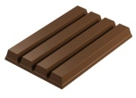
Designs - Best Practices – Continued…
Possibility to file multiple designs gives flexibility -> Helps to also remain costs focused!
Design protection can be a good alternative:
    a) If feature cannot function as a Trademark
    b) Given increased difficulty to secure 3-D Trademark registration (cf. for example the Case between Cadbury and Nestlé re. the protection of the KIT KAT four finger shape!
Scope of the protection obtained through design protections is narrower than Trademark protection -> Explain and Manage clients expectations!
Not experienced a lot of conflicts based on Designs until now -> will no doubt come!

Slide 22
When filing, a combination of various views may be possible
Combination of “different perspectives” + disclaimer
DM/070912 Daimler AG

Slide 23
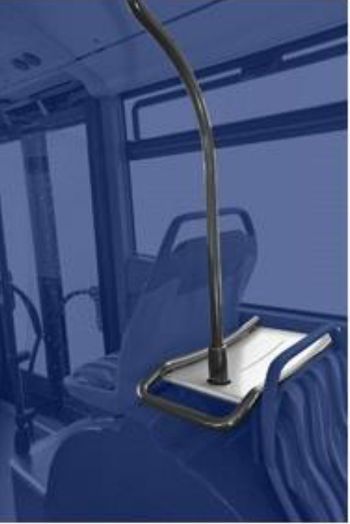
Elements for which protection is claimed should be clear…
Disclaimer
DM/076222
The blue marked parts of designs 8, 9, 10, 11, 12, 13 and 14 are not coming into the scope of the industrial design (disclaimer)
DM/076650 Daimler AG
“The blue marked areas are not coming into the scope of protection, they have the function of a disclaimer
DM/075740

Slide 24
Combination of color and black and white views is possible but…
DM/075961 (15); Hilti, LI
DM/076048 (15); Hilti, LI
Some countries are likely to raise objections…refer to the 2016 Hague Guidance for this! http://www.wipo.int/export/sites/www/hague/en/how_to/pdf/guidance.pdf

Slide 25
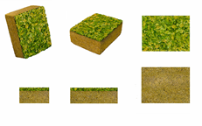
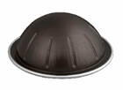


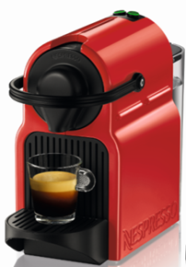
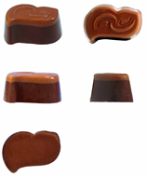

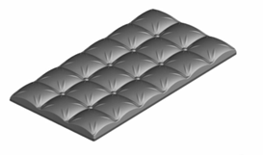
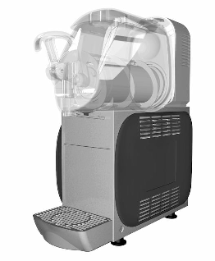
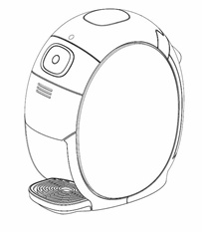
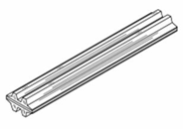
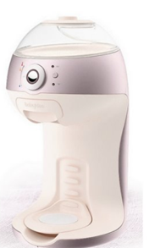
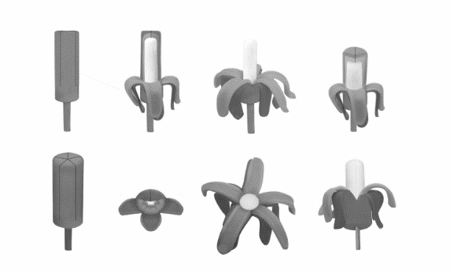
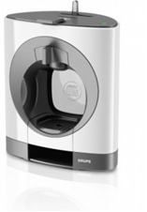
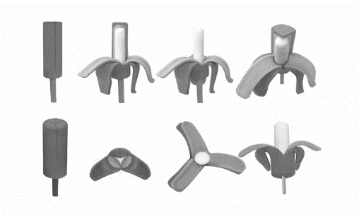
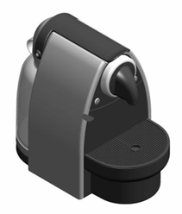
Nestlé protects internationally various types of designs…
Machines
Product shapes

Slide 26
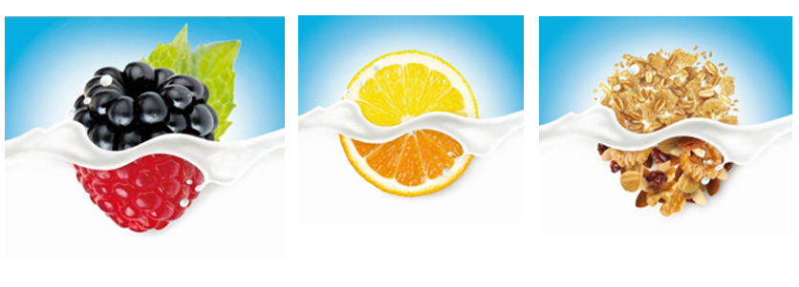
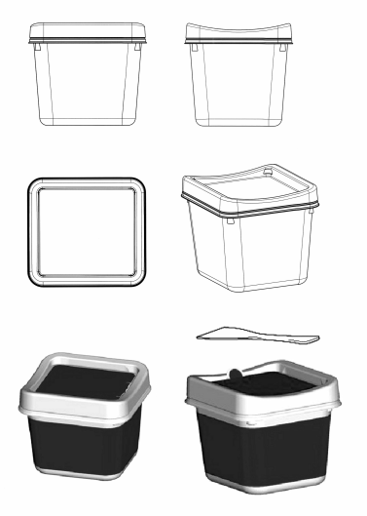
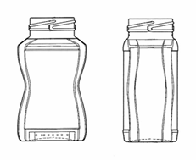
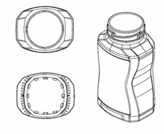
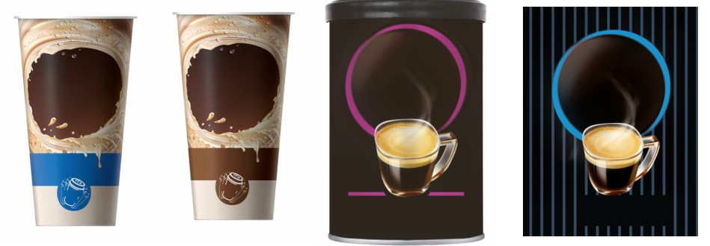
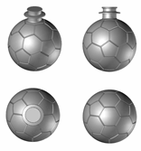
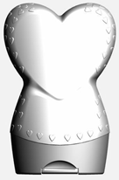
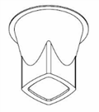
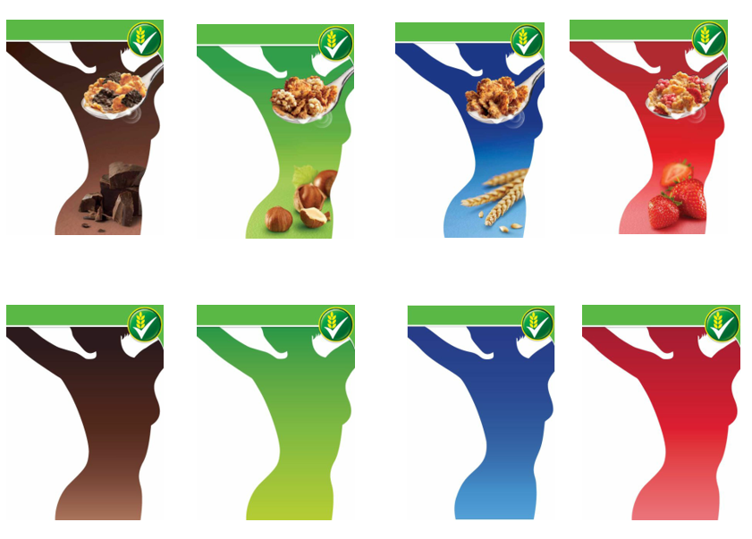
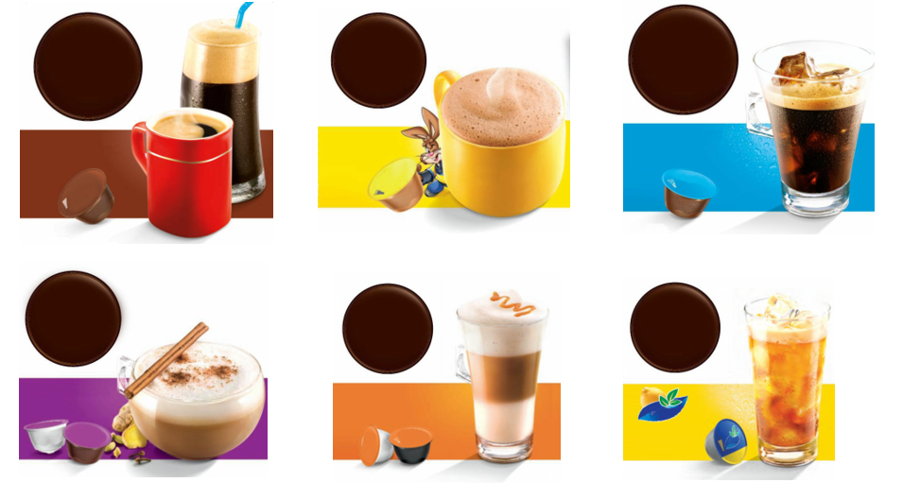
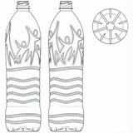
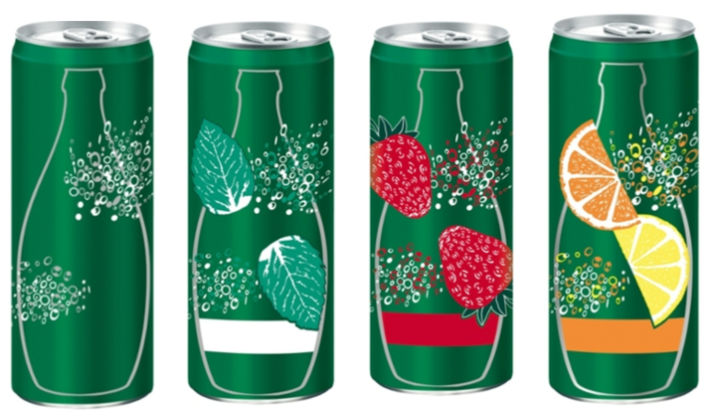

…depending of the nature of the businesses…
Labels and key visuals / 2D designs
Containers
…including also multiple designs

Slide 27

Practical difficulties with new members states may influence the filing strategy…
For example for the USA, Korea and Japan – often facing objections related to the drawings submitted => forces to seek preliminary advice from local agents to secure easier acceptance
Logos per se not registrable in Japan (must appear on an article)
Design must be usable for an industrial purpose in Korea
Criteria for acceptance of multiple designs and drawings are different and lead to frequent objections – For example Multiple design not admitted in the USA if considered distinct (although non distinct designs can be kept as “embodiments” of the one design, multiple designs accepted in Korea and Japan but with indication of the main design and other designs considered “related”
It is hoped filings in the new Member States will go smoothly…☺

Slide 28
Flexibility and simplicity is a key success factor to using the Hague system even more!
Companies welcome very much new developments aimed at simplifying the protection of IP rights and especially Designs (such as e.g. providing the priority documents electronically)
Companies view very favourably an enlargement of the list of Hague members and in particular the potential accession of China, Morocco, Asean Countries, Israel, Canada, Mexico and Madagascar)…and more!
Companies hope to see more flexibility and uniformity in the examination and acceptance of designs/views and priority documents so as to avoid refusals as much as possible

Slide 29
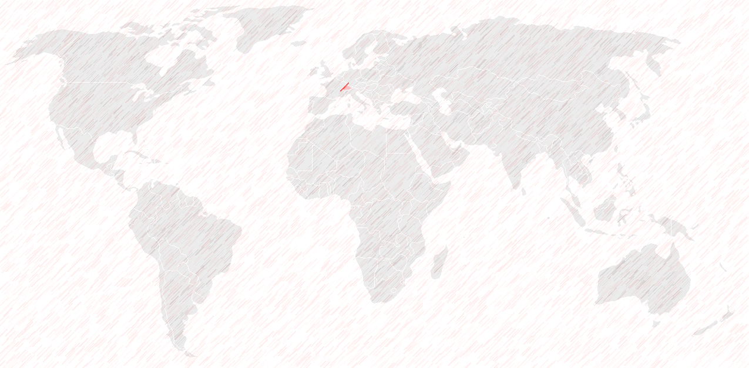
To conclude: The Hague System is altogether….
Simple
Effective
Cost effective
…a tool to be definitely used preferably and as much as possible for international Design filings… ☺

Slide 30


