Slide 1
Accession of Mexico
to the Hague Agreement
19 July, 2018

Slide 2
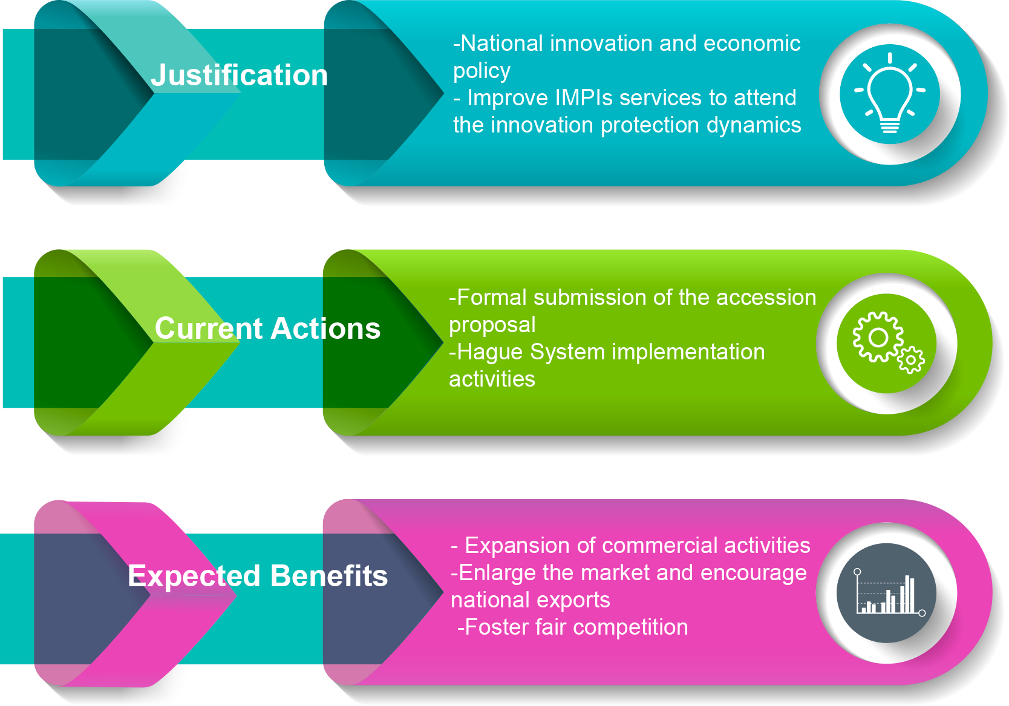

Slide 3
Legal amendments

Slide 4
Article 11(1)(b)
Rule 12(3)
Rule 18(1)(b)
Rule 18(1)(c)(i)
Article 13(1)
Article 16(2)
Article 13(7) and Rule 36(2)
Rule 8(1)(a)(i)
Article 7(2)
Intended declarations to be made by Mexico
Improve IMPIs services to attend the innovation protection dynamics
Rule 18(1)(b)
Rule 18(1)(c)(i)

Slide 5
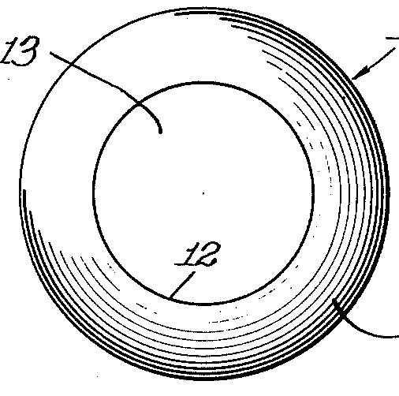
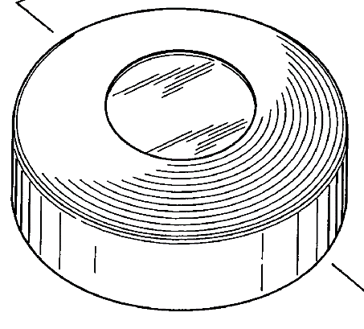
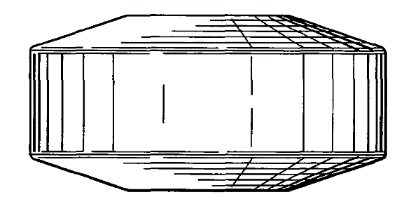
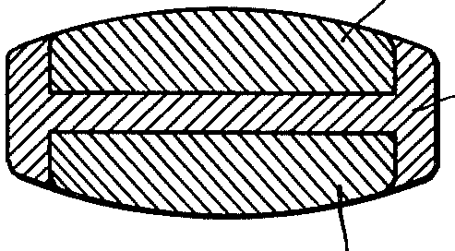
Examination Prior art
Difference 2: Depth of circular shape
Difference 1: Edge of the capsule
Are the designs identical? NO
The design is an independent creation? YES
The design comply with the novelty requirement? YES

Slide 6
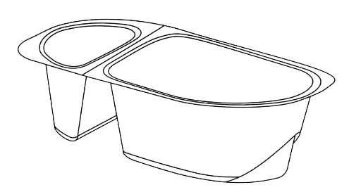
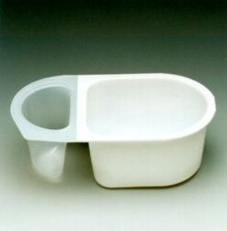
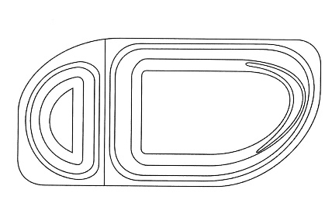
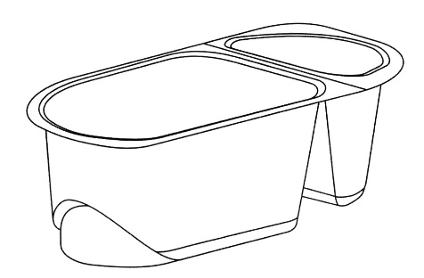
Examination Prior art
Both are packages with two containers, with a similar sequence (small and big)
But they have different edges (asymmetrical vs symmetrical)
Does the design gives a different overall impression? YES
Does the designs differ in a significant degree? YES
The design comply with the novelty requirement? YES

Slide 7
Accession steps and timeline

