Slide 1


Canada’s Accession to the Hague Agreement
Hague Seminar
July 19, 2018
Sandra Newsome
Manager, Policy
Copyright and Industrial Design Branch
Canadian Intellectual Property Office
Building a prosperous and innovative Canada

Slide 2
Outline
Canada’s Innovation and Skills Plan
  The Intellectual Property Strategy
The Canadian Intellectual Property Office (CIPO)
Industrial Design in Canada
Changes to the Industrial Design Regime
  Industrial Design Act
  Industrial Design Regulations
  Industrial Design Office Practice Manual
  Enhanced E-Services
Designating Canada: What You Should Know
Next Steps

Slide 3

Innovation and intellectual property are key government priorities
“We know IP is a critical ingredient in helping Canadian businesses reach commercial success. Canada's IP Strategy will make sure Canadians know the value of their intellectual property and how to leverage it to innovate, increase profits and create middle-class jobs.”
Minister Bains, Innovation Science and Economic Development
(April 26, 2018)

Slide 4
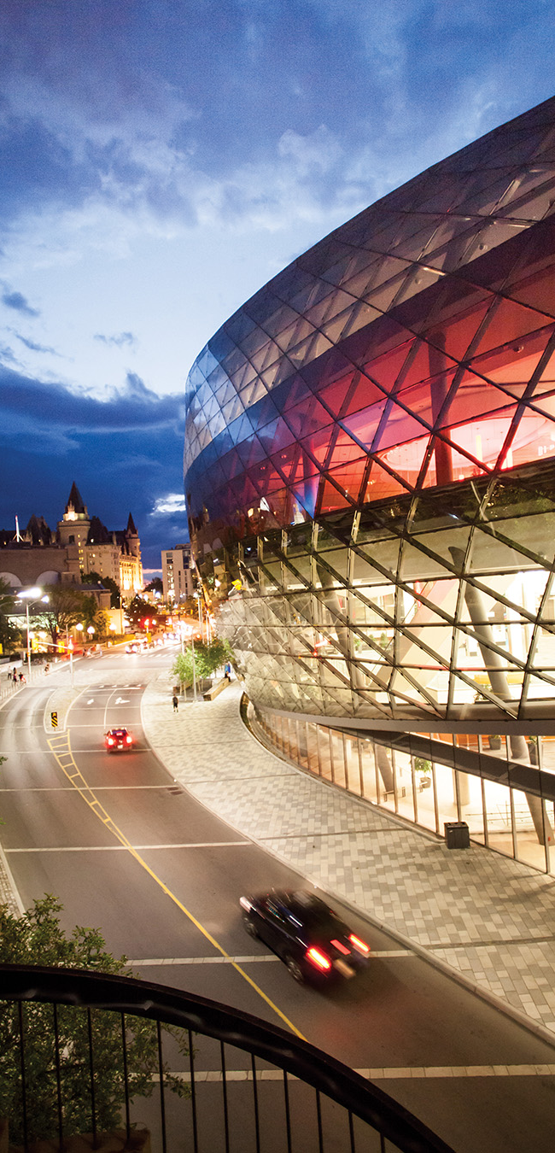
The Innovation and Skills Plan
The Innovation and Skills Plan (2017) advances an agenda to make Canada a global centre for innovation.
Focuses on people and addresses the changing nature of the economy to ensure it works for all Canadians.
Agenda to build Canada as a world-leading innovation economy that will create jobs and grow the middle class.

Slide 5
The Innovation and Skills Plan
The Intellectual Property Strategy
Investment of $85.3 million over five years to help Canadian businesses, creators, entrepreneurs and innovators understand, protect and access IP.
Supports access to the best possible IP resources through:
  IP awareness, education and advice;
  strategic IP tools for growth; and,
  IP legislation.

Slide 6
The Innovation and Skills Plan
Harmonizing Canada’s IP System with International Standards
Joining five key international IP treaties – the Hague Agreement, the Madrid Protocol, the Singapore Treaty, the Nice Agreement for Trademarks, and the Patent Law Treaty – is an essential step.
Helping Canadian businesses looking to enter or expand their presence in international markets:
  Faster, simpler, and cost-effective way to acquire protection in multiple countries.
International Trade and Investment Strategy – realizing transparent IP standards in trade agreements.

Slide 7
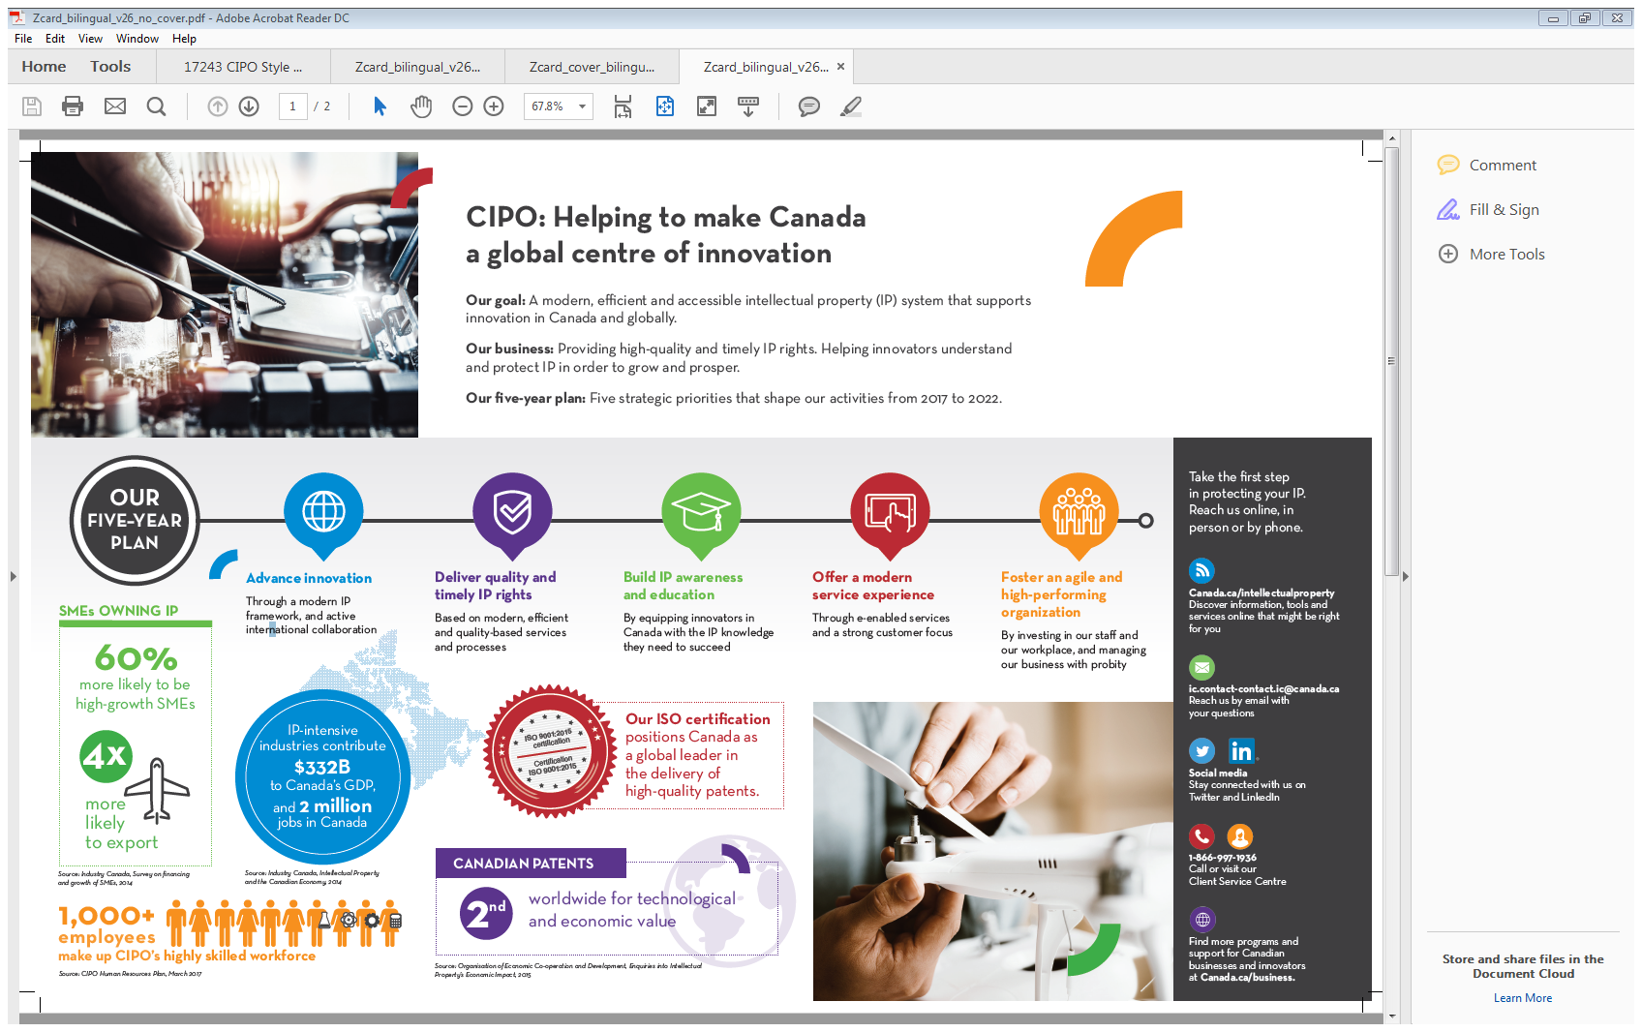


CIPO: Helping Make Canada a Global Centre of Innovation
IP-intensive industries contribute
$332B to Canada’s GDP
and 2 million
jobs in Canada

Slide 8





CIPO: Five Strategic Priorities
Advance innovation
Deliver quality and timely IP rights
Build IP awareness and education
Offer a modern service experience
Foster an agile and high-performing organization
Develop a national IP strategy through international collaboration and evidence-based policies
Provide IP rights and services that respond to client and marketplace needs
Deliver IP education and awareness products and services
Modernize and digitize our services
Attract and retain an engaged and highly skilled workforce
- CIPO’s five-Year Business Strategy 2017-2022

Slide 9
Industrial Design in Canada: Applications
Origin of applications (2014–2018)
Number of applications received (2004–2018)

Slide 10

Industrial Design in Canada: Top Filers
Top 5 Filers
2017-18

Slide 11
Industrial Design in Canada: Top Filers
Top 10 Filers
2017-18
Applicant | Number of Applications
GM Global Technology Operations LLC | 192
Dyson Technology Limited | 134
Kronoplus Limited | 98
Volvo Lastvagnar AB | 84
Google LLC | 62
Delta Faucet Company | 59
Spectrum Brands, Inc. | 59
Ford Global Technologies, LLC | 58
The Procter & Gamble Company | 48
Gamblit Gaming, LLC | 46
Honda Motor Co., LTD | 46

Slide 12


Industrial Design in Canada: Top Filers

Slide 13
Industrial Design in Canada: Top Filers
Top 10 Filers
2013-18
Applicant | Number of Applications
Nike, Inc. | 444
Apple Inc. | 323
Microsoft Corporation | 319
The Procter & Gamble Company | 308
Harry Winston Sa | 288
Honda Motor Co., Ltd. | 287
Ford Global Technologies, LLC | 254
Dyson Technology Limited | 235
Delta Faucet Company | 234
GM Global Technology Operations LLC | 226

Slide 14
Changes to the Industrial Design Regime
Canada is poised to accede to the Hague Agreement and significantly modernize Canada’s industrial design regime with a coming into force date of November 5, 2018.
Membership in the Hague Agreement means key benefits for business:
  One application, one payment, one currency, one place;
  Simpler rights maintenance and management.
Modernizing Canada’s industrial design regime also has key benefits for business:
  Increased term of protection – from 10 to 15 years;
  Less red tape;
  Enhanced e-services.

Slide 15
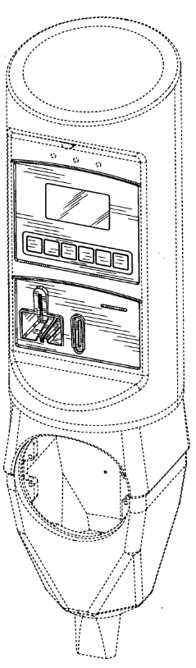
Changes to the Industrial Design Regime Industrial Design Act
The Act was amended in December 2014: first substantive update of the Act since 2001.
Highlights include:
  Clarification that a certified copy of an entry in the Register of Industrial Designs is admissible evidence in any court.
  Any error in the Register of Industrial Designs may be corrected within six months, if the mistake is obvious from documents in the Minister’s possession. Previously, corrections were limited to clerical errors.
  Codification and modernization of the novelty test.
  Mandatory publication of applications after 30 months.
  Extended the maximum term of protection from 10 to 15 years.
Parking Meter by J.J Mackay Canada Limited
(ID registration 164824)

Slide 16
Changes to the Industrial Design Regime Industrial Design Regulations
The final Regulations were published in the Canada Gazette, Part II, on June 27, 2018.
Highlights include:
  Representation – an applicant no longer needs to provide signed authorization to appoint an agent. The previous requirement to have a representative for service, in the case of foreign applicants, has been removed.
  Application requirements have been simplified:
    Prescribed application form no longer required.
    Description is now optional because the application is deemed to relate to all four features of the design (shape, configuration, ornamentation and pattern) unless specified in a statement of limitation.
    Designs no longer need to be shown applied to a finished article.
    Applications are no longer limited to a single environmental view.

Slide 17
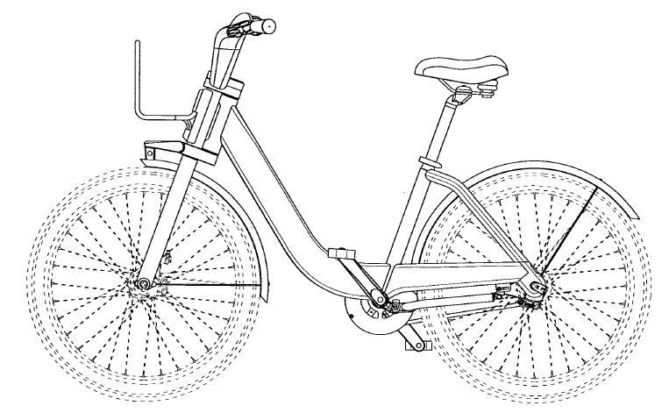
Changes to the Industrial Design Regime Industrial Design Regulations
  Filing date requirements have also been simplified to align with international standards.
    The title, description and complete mailing address are no longer required. To obtain a filing date, applicants need only to provide:
        an indication that registration of a design is sought;
        a means of identifying the applicant;
        contact information; and,
        a representation of the design.
  For more details,
  consult the new Regulations.
Bicycle by PBSC Urban Solutions Inc.
(ID registration 128732)

Slide 18
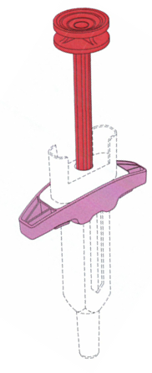
Changes to the Industrial Design Regime New Industrial Design Office Practice Manual
Complete revamp of the Industrial Design Practice Manual (IDOP).
Significantly expanded sections on the following:
  drawing techniques;
  jurisprudence;
  use of colour;
  computer-generated animated designs; and,
  methods of disclaiming.
  New sections on Hague applications and transitional provisions.
Public consultations closed June 29, 2018.
  Published on the new user-friendly interface, “Qweri”.
Target publication later this summer.
Syringe by Gilead Science, Inc.
(ID registration 173286)

Slide 19
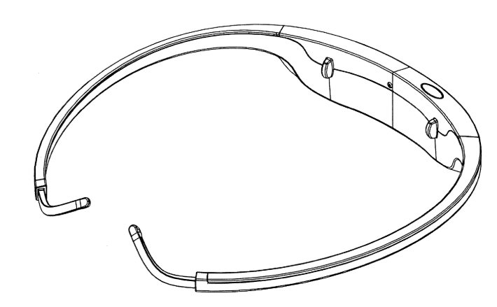
Changes to the Industrial Design Regime
Enhanced E-Services
CIPO is working with stakeholders to improve e-services.
Release 1 (November 5, 2018)
  Improved e-filing interface: many new functionalities, including the capability to submit images in colour, and allow for a greater number of file formats including PDF, JPEG, TIFF, GIF.
  Simplified/streamlined portions of the e-filing application.
Release 2 (2019)
  New platform for electronic correspondence between CIPO and clients.
  E-amendments: fully integrated online amendment form.
Brain Sensing Headset by Personal Neuro Devices Inc.
(ID registration 168672)

Slide 20
Canada’s Declarations
Indirect Filing
Article 4(1)(b): An international application may not be filed through the Canadian Intellectual Property Office.
Individual Designation Fees
Article 7(2): the international application fee is $400 CAD for each design. The renewal fee, for the first renewal is $350 CAD for each design, any subsequent renewals are free of charge.
Maximum Duration of Protection
Article 17(3)(c): begins on the date of international registration and ends on the later of 15 years from the date of international registration or 10 years from the date of registration in Canada.
Refusal Period
Rule 18(1)(b): the period of six months for the notification of refusal of the effects of an international registration referred to in Rule 18(1)(a) shall be replaced by a period of 12 months.

Slide 21
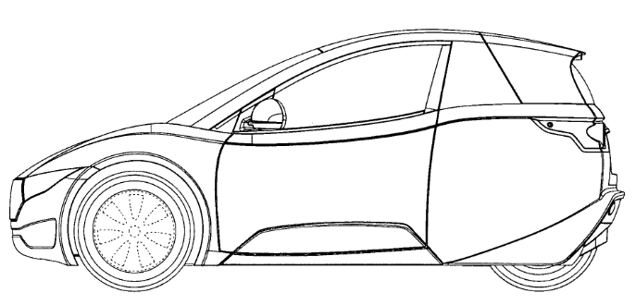
Designating Canada: What You Should Know
Deferment of Publication
Canada will allow for the maximum period of deferment under Hague, i.e. 30 months from the filing date or, if there is a priority request, from the earliest date of priority.
Filing Date Requirements
Simple filing date requirements that aligns with international standards.
Application
Simple application requirements. No patent claims or description of the design are required. No specific views of the design are required. No security clearance requirements.
Vehicle by Electrameccanica Vehicles Corp.
(ID registration 168377)

Slide 22
Designating Canada: What You Should Know
One Design per Application
An application must be limited to one design applied to a single finished article or set or variants applied to a single finished article or set.
In order to accommodate an international registration with multiple designs, CIPO will divide each design contained in the international registration into individual and separate “Hague Applications”.
Increased Term of Protection
The maximum term of exclusive right is increased from 10 years to 15 years.
Expedited Options
Prosecution of your application may be expedited by using our other services such as advanced search (free of charge) and advanced examination ($500 CAD).

Slide 23

Next Steps
Final IDOP publication (summer 2018)
Outreach with stakeholders (October 2018)
Coming into force (November 5, 2018)
Industrial Design Practice Committee stakeholder consultations (spring 2019)
Release 2 implementation (2019)
June 27, 2018
Gazette II – ID Regulations
publication
Mar
IDPC IDOP consultation
2019
Release 2
implemented
November 5, 2018
Coming into force
Dec to Jan
Gazette I – ID Regulations
(30 days)
May to June
IDOP consultation
(30 days)
Summer
final IDOP
publication
Spring 2019
IDPC
consultation
Stakeholders
outreach
Consultations and Finalize Industrial Design Regime Changes
Post-coming into force
2018
2019

Slide 24



Thank you!
Any questions?
Follow CIPO on Twitter
@CIPOCanada
Connect with CIPO on LinkedIn
@Canadian Intellectual Property Office

