Slide 1


Global IP Platform
Hague Seminar
Caroline Horridge, Project Manager
Global IP Platform Program
Geneva, July 19, 2018

Slide 2
Overview
What is the Global IP Platform?
What does this mean for me?
Presentation of prototype portal

Slide 3
What is the Global IP Platform?
WIPO initiative aimed at improving customer experience by establishing a common external presence across online transactional services.
‘Transactional services’ are those that you interact with to manage IP, for example:
Filing systems
Search databases
Classification tools
Renewals
Payment processing
The implementation of a new customer portal will ‘join up’ the different services, allow you to navigate seamlessly and access them from one central point.

Slide 4
What does this mean for me?
The services you interact with will not need to change much, but you will see standardization of the way that they look, and can expect long term that they will look the same.
The way you can access the services will be improved.
The way that you can make payments to WIPO will be consistent.
You will have a direct way of accessing your user profile.
There will be a single user account for all services, with the possibility to manage corporate accounts to specify and delegate access rights to individual users.
You will be able to access a new portal, where you can customize what you want to see ‘at a glance’ and build your own Dashboard.
The Dashboard will be further explained in the following presentation.

Slide 5
Thank you!

Slide 6
Annex Screenshots

Slide 7
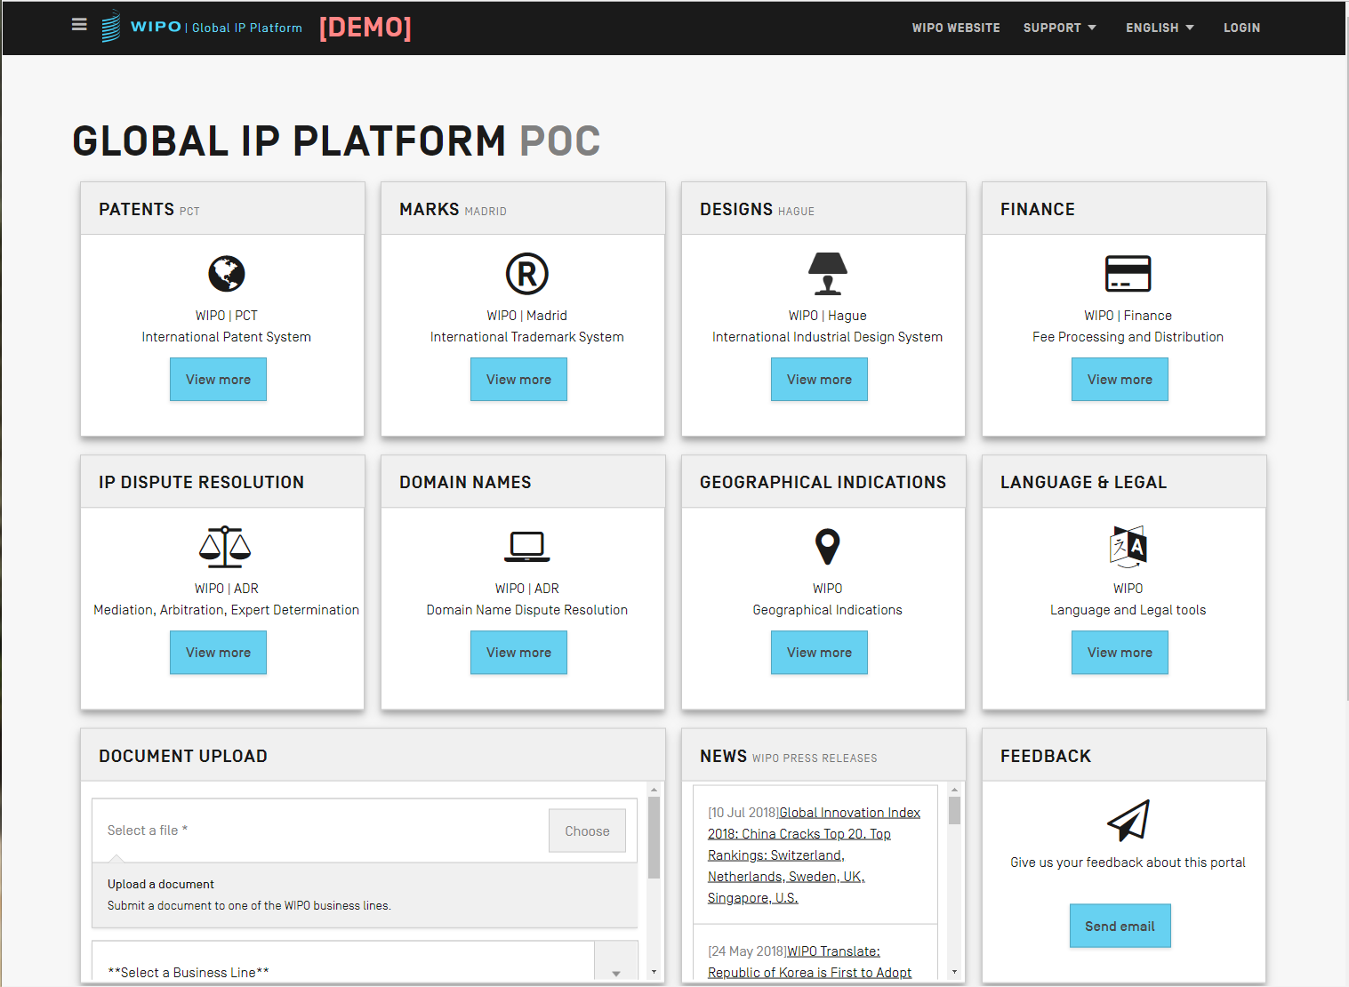
Homepage (not logged in)

Slide 8
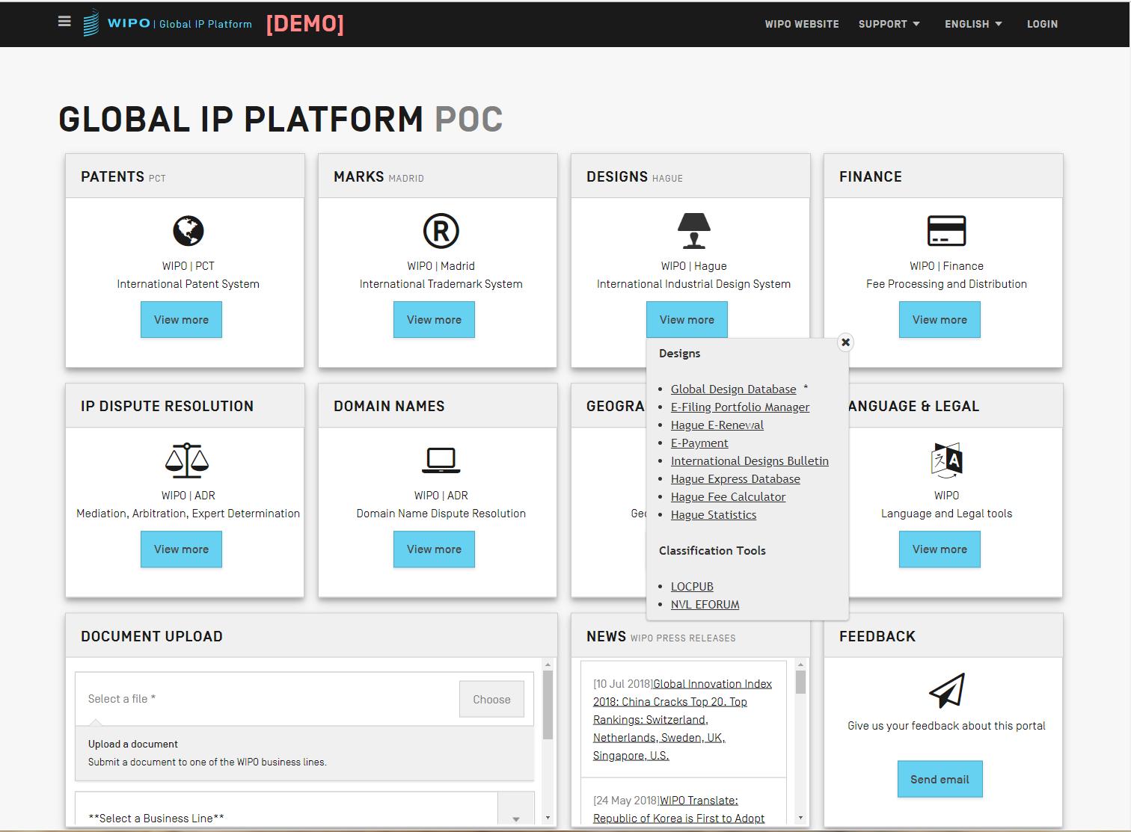
Access to all services from one page - ‘View More’ menu

Slide 9
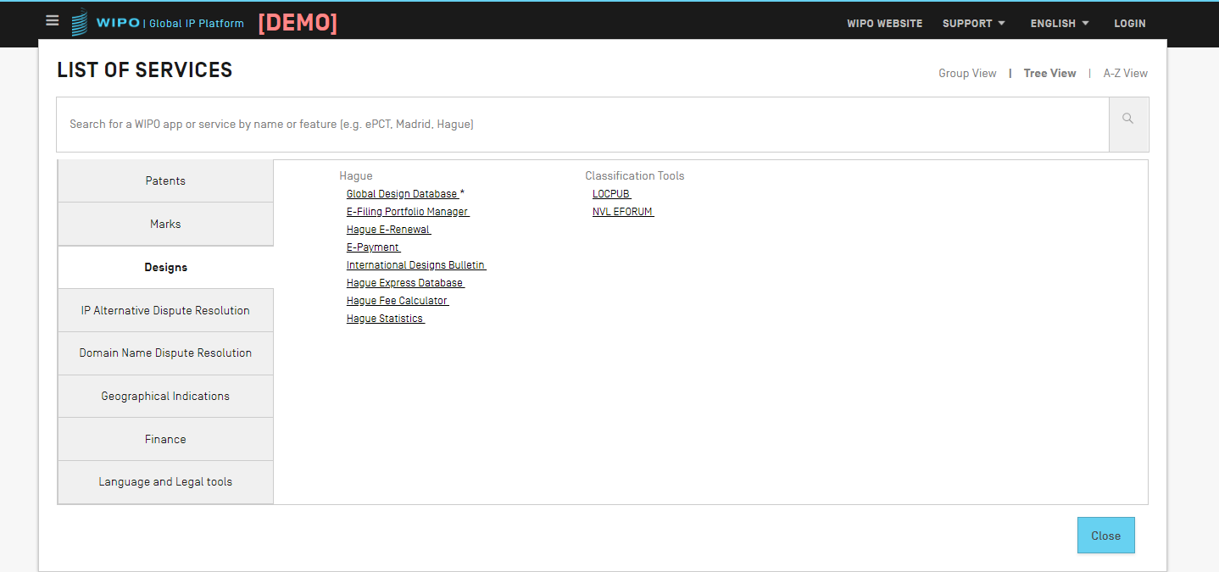
Menu icon – always available across the services

Slide 10
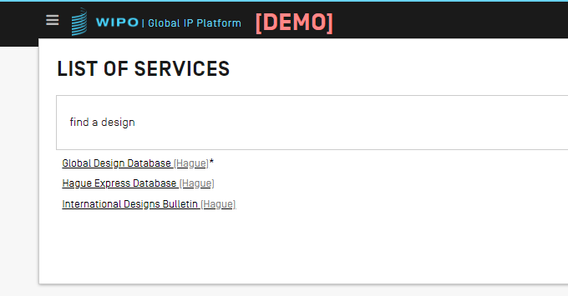
Menu is searchable to help find the service you need

Slide 11
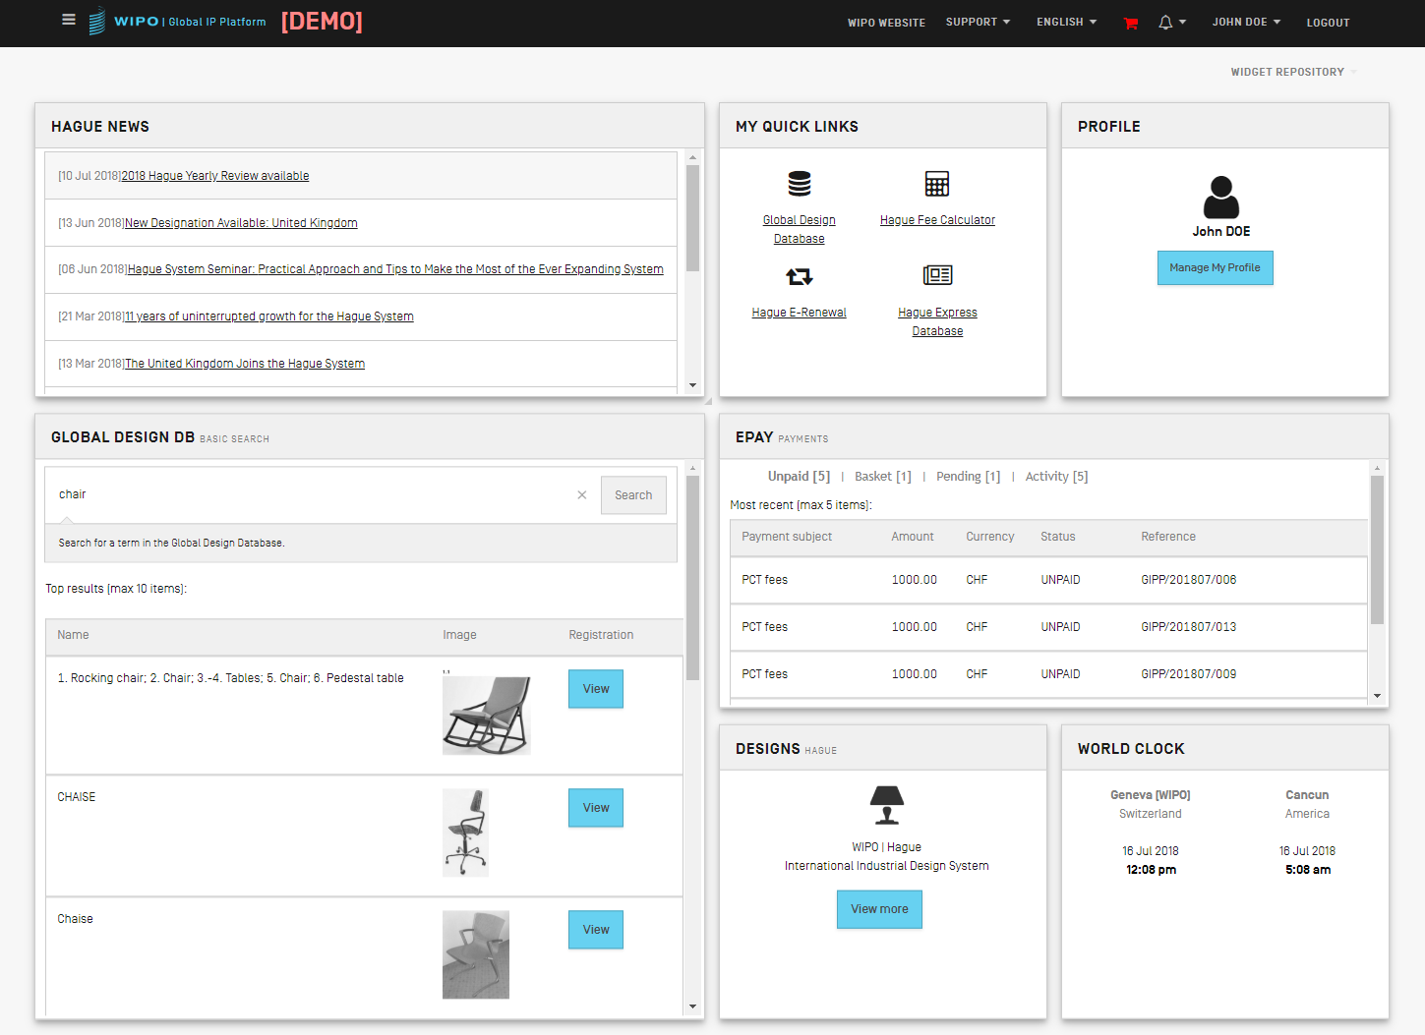
User logged in - Customizable dashboard
Boxes (widgets) can be moved around the screen, added and removed.

Slide 12
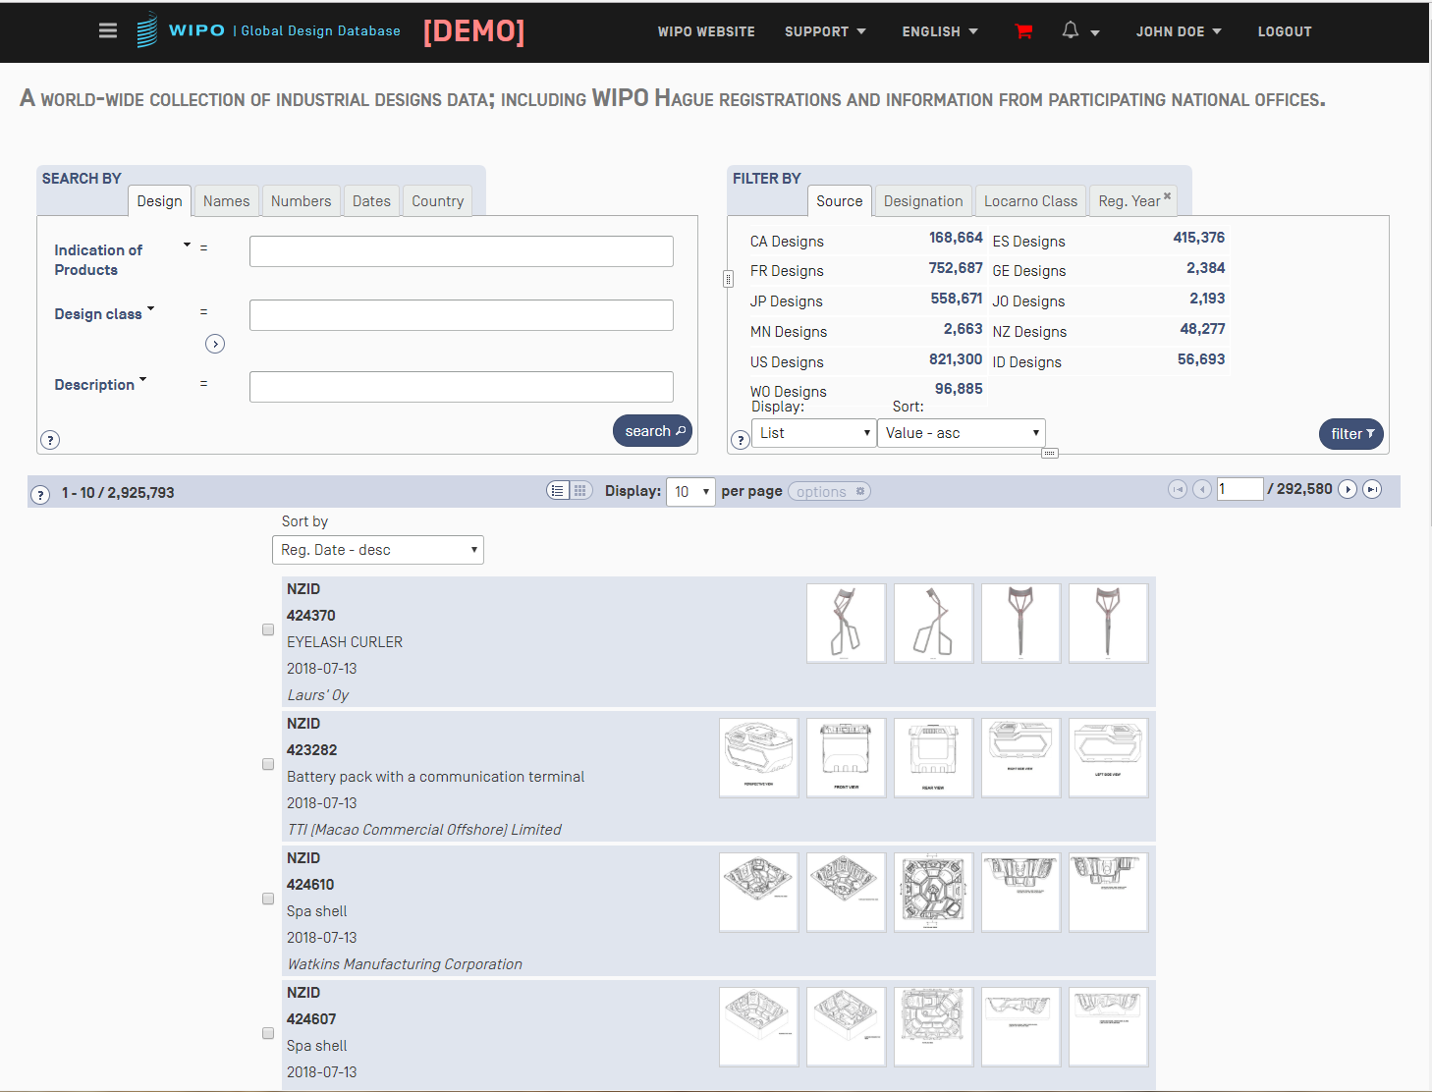
Global Design DB with same top bar as portal
Example of an existing service showing consistent options across the top, e.g. menu icon, profile, support, notifications, WIPO website. Eventually, all services will have same options.

Slide 13
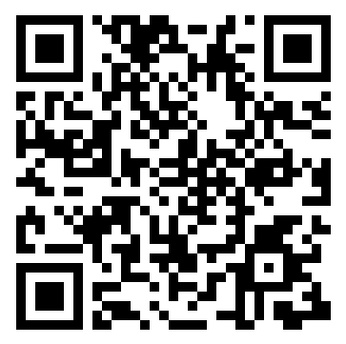
Your feedback is welcome!
https://www.surveygizmo.com/s3/4472521/WIPO-Services-Survey-GIPP-Prototype

