Slide 1
WIPO Office in the Russian Federation (WRO)
Geneva
Thursday, October 3
2019
Side-Event at the 2019 WIPO Assemblies

Slide 2
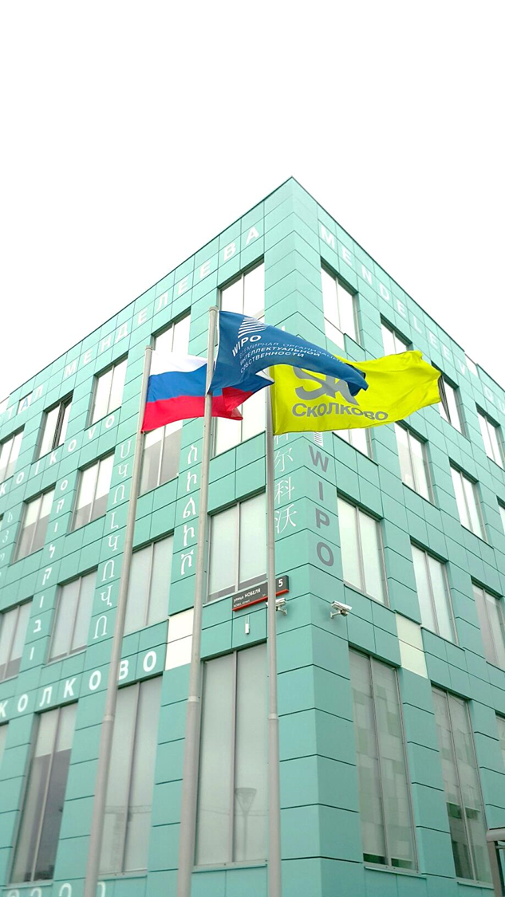
About the WRO
Established in July 2014
Located in Moscow

Slide 3
WRO – Resources
Personnel Resources
Staff
1 - Director (D1)
1 - Senior Counsellor (P5)
1 - National Program Officer (NPO-B)
Non-staff
1 - ICS
1 - Intern
Non-Personnel Resources available for Program Implementation
CHF 150,000

Slide 4
Strategic Focus of the WRO
Provide services (Service Centre) to users of WIPO’s Global IP Services by providing information and feedback to questions in Russian;
Promote the use of WIPO’s Global IP Services in a strategic manner by reaching out to current and potential users, as well as relevant IP authorities, through targeted activities, promoting and providing tailored information and advice on the use of these services in Russian;
Provide advice and assistance to the Government of the Russian Federation, on request, to facilitate Russia’s accession to the Hague System;
Further extend the existing network of TISCs established in the Russian Federation to broaden their impact in promoting access to and use of IP information by a broad range of stakeholders, both public and private;
Reinforce and enhance engagement and communication with governmental bodies, academic circles, inventors’ societies and other stakeholders with which the Office has developed strong and productive relationships; create new partnerships, raise awareness and build capacity in the field of IP, particularly among educational and scientific institutions.

Slide 5
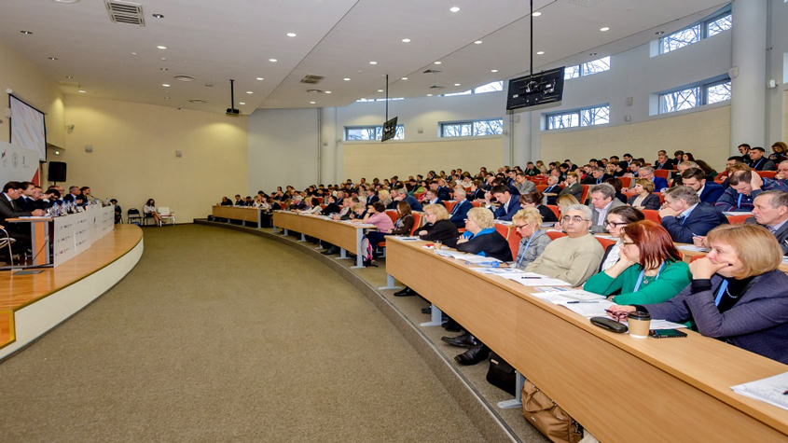
Key Achievements of the WRO (1)
National Project on IP Policies for Universities and Research Institutions
Considerable progress has been achieved within the National project on IP Policies for Universities and Research Institutions with the adoption by the Ministry of Science and Higher Education of the Russian Federation of the customized ‘Model WIPO IP Policy Template for Universities and Research Institutions’ and the circular letter from the Ministry to more than 1.000 subordinate academic and scientific institutions with the recommendation to use it to harvest and leverage their IP. The model document was further promoted and explained at major events held by WIPO and the Ministry at the Federation Council and at the Lomonosov Moscow State University.

Slide 6
Key Achievements of the WRO (2)
Promotion of WIPO Global Services and Platforms
WRO in cooperation with Rospatent and other key partner institutions concentrated on capacity building and training activities in more than 30 cities across Russia. The activities were aimed at various IP related topics, such as promotion and marketing of WIPO Global Services (PCT, the Madrid, the Hague, the Lisbon systems and the AMC), WIPO online platforms and databases, IP teaching, IP Policies for universities, IP for SMEs, IP in the digital era, copyright and related rights, and others.

Slide 7
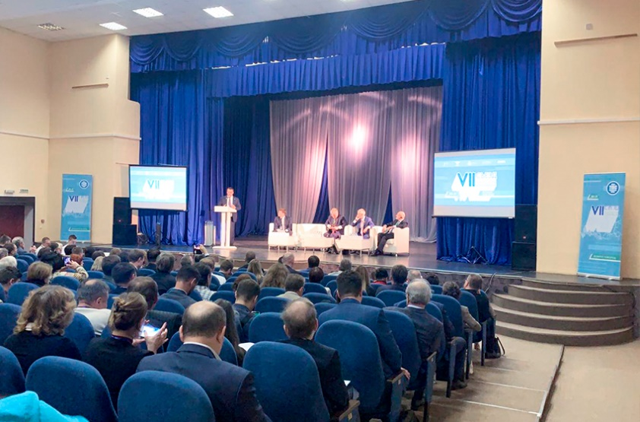
Key Achievements of the WRO (3)
Technology and Innovation Support Centers
WRO in cooperation with colleagues from HQ and the Russian authorities continued to support the countrywide network of Technology and Innovation Support Centers (TISCs) in the Russian Federation, comprising more than 170 TISCs. Emphasis was made on ensuring the sustainability of the network, expanding the portfolio of TISCs’ services and at enhancing the capacities of the TISCs’ staff through regular training and experience exchange activities, such as the VII TISC Congress held in Veliky Novgorod on May 30 and 31, 2019, uniting TISC’ representatives from across the country.

Slide 8
Outreach & Customer Service
More than 400 requests for assistance received from customers, in Russian and English languages, through telephone, online contact form and Facebook page.
A large number of events held in the Russian Federation to celebrate the World IP Day 2019, including in Moscow and Saint-Petersburg.
Promotional videos to endorse the WIPD campaign were secured by WRO from UEFA and Olympic Champion in Speed-Skating Ms. Svetlana Zhurova.
WRO Facebook page launched.
WRO through local media contacts and local partners supported the GII, WIPI, WIPR.

Slide 9
The Year Ahead
Major events (Digital Transformation and TISC Congress)
GI promotion
Outreach to the business community
Support for the National IP Strategy
IP Policy for Academia
Support for SMEs

Slide 10
Thank you for your time.

