Slide 1
WIPO Japan Office (WJO)
Geneva
Thursday, October 3
2019
Side-Event at the 2019 WIPO Assemblies

Slide 2
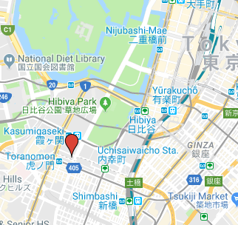
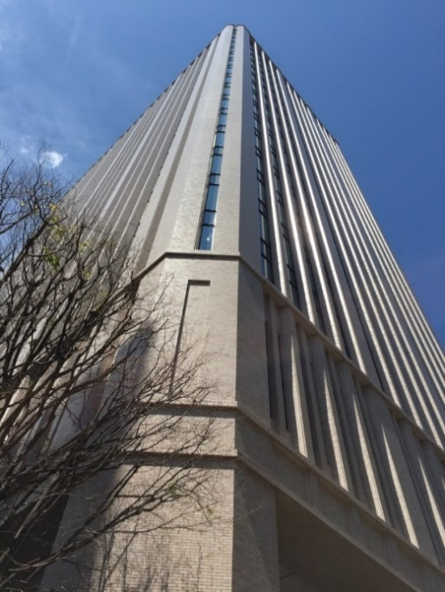
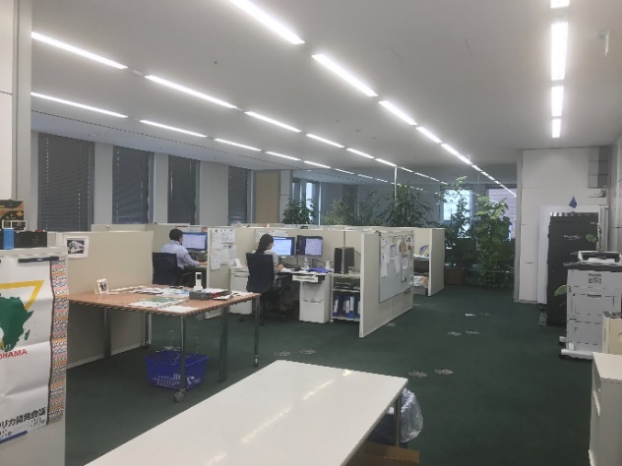
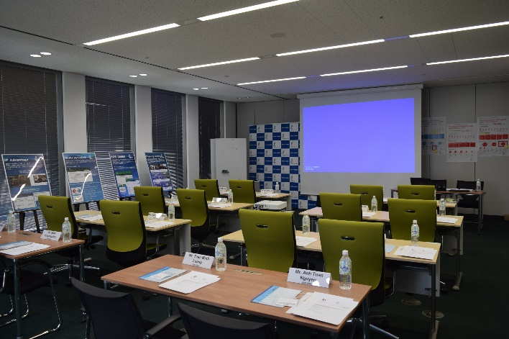
About the WJO
Established September 1, 2006
Located in Tokyo

Slide 3
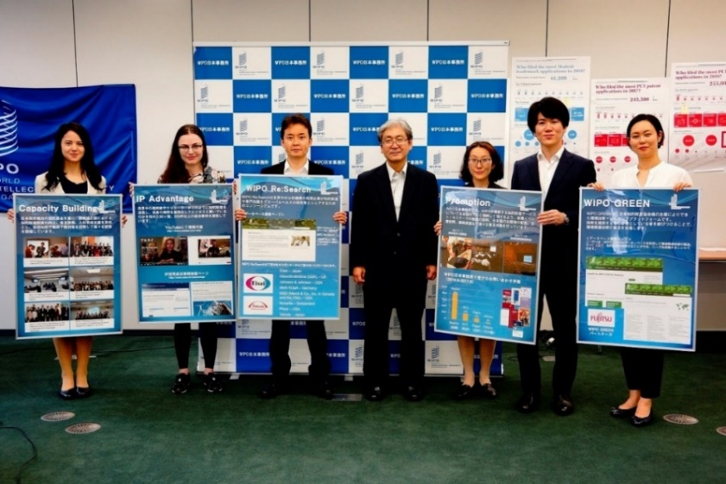
Resources of the WJO
Personnel Resources (7)
Staff (4)
Director (D1)
Counsellor (P4)
Associate Research Officer* (P1)
Assistant* (G4)
*Financed by Japan Funds-in-Trust
**Financed by the Madrid Registry
Non-Staff (3)
Individual Contract Specialists (2)
Hague
Madrid**
Agency Worker (1)
Non-Personnel Resources***
Regular Budget (CY 2019)
CHF 100,000
Japan Funds-in-Trust IP Global (FY 2019-20) CHF 380,000
***Available for program implementation
Photo: Mr. KazuhitoTakahashi (JIPII)

Slide 4
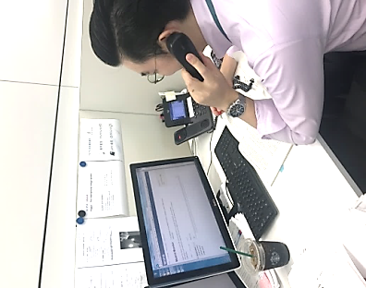
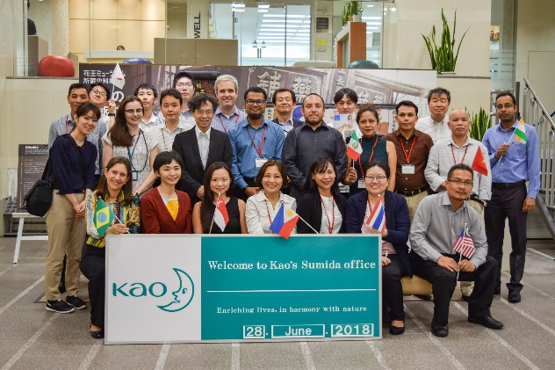
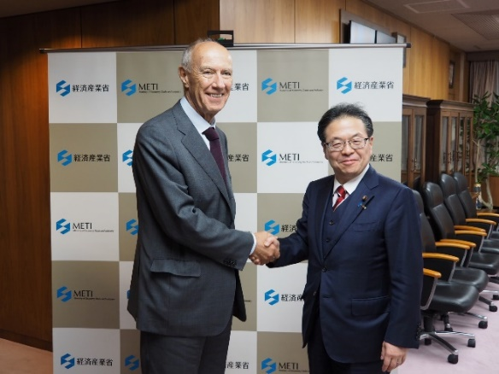
Strategic Focus of the WJO
1. Promotion of WIPO’s Premier Global IP Services and Databases (Strategic Goal II.1.3.5, IV.2)
2. Capacity Building activities (Strategic Goal III.2)
3. Promotion of WIPO GREEN, WIPO Re:Search (Strategic Goal VII.1)
4. Communication to the broad public about IP and WIPO’s role (Strategic Goal VIII.1)
Service Center
Photo: Kao Corporation
Photo: Ministry of Economy, Trade, and Industry

Slide 5
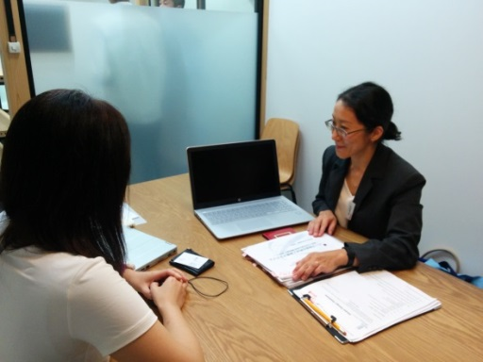
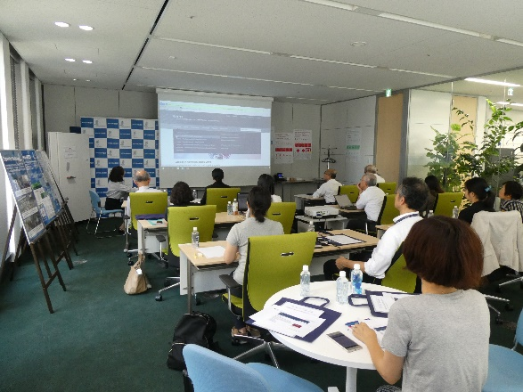
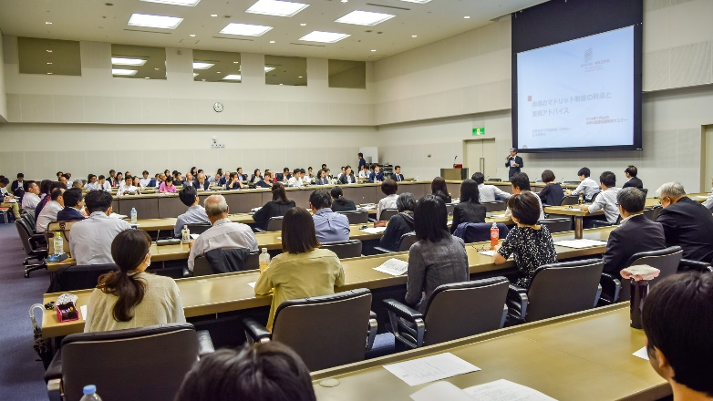
Key Achievements of the WJO (1) Promotion of WIPO’s Global IP Services
In 2018, increased Madrid applications from Japan by 22.8%, designs filed with Hague system by 47.0% and PCT applications by 3.1%
In the past 12 months, WJO staff presented on WIPO’s Services at 59 venues all over Japan to 5,865 participants
Visited 69 Madrid and 58 Hague (current and potential) users
Updated users by quarterly newsletters and information published in a popular journal on IP (“Hatsumei” Journal)
Visit to users’ offices
Hague Online Tool Seminar (Aug 2019)
WJO Seminar (May 2019)
Photo: Ryohin Keikaku Co., Ltd.
Photo: WJO
Photo: WJO

Slide 6
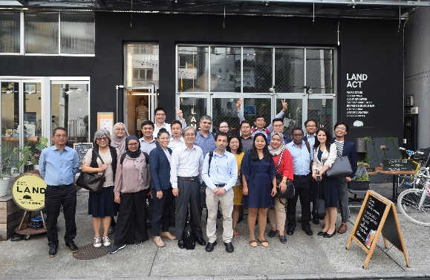
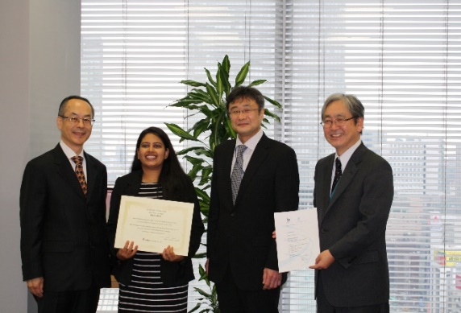
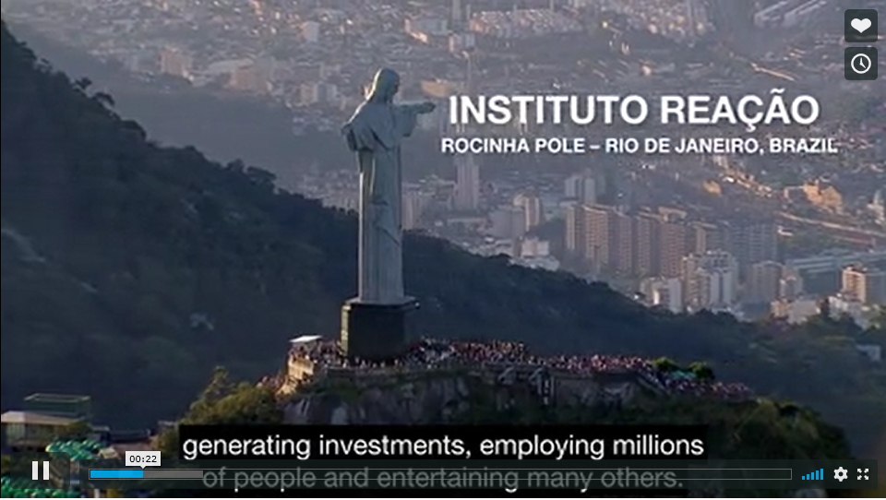
Key Achievements of the WJO (2) Capacity Building for Developing Countries
In 2018, organized 4 regional workshops, inviting 61 government officials and private sector stakeholders from various developing countries
Hosted three IP trainees from developing countries for two weeks internship
IP Advantage Initiative
Added 5 new cases and updated 4 old cases
Created 5 sets of new training materials
Developed 5 video clips in cooperation with the WBO
Organized 2 national workshops in cooperation with local universities
SME Workshop (Aug 2019)
Ms. Soni Seema from India (Feb 2018)
Screenshot of a video clip
Photo: Gotaro Dekura
Photo: WJO
Photo: WJO

Slide 7
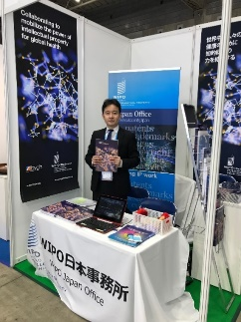
Key Achievements of the WJO (3) WIPO Re:Search
Promotion of WIPO Re:Search
October 2018, held a series of meetings with 8 Japanese pharmaceutical companies together with Director of GCD
Organized a seminar on WIPO Re:Search in cooperation with JPMA
Set up WJO booth at “BioJapan” exhibition
Translated WIPO Re:Search publications into Japanese
WIPO Re:Search Five Year Strategic Plan (Japanese)
BioJapan (Oct 2018)
WIPO Re:Search Annual Report 2018

Slide 8
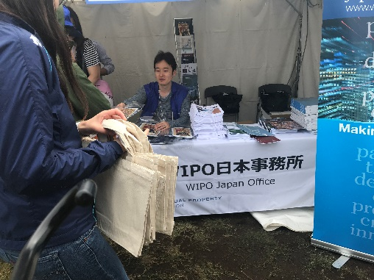
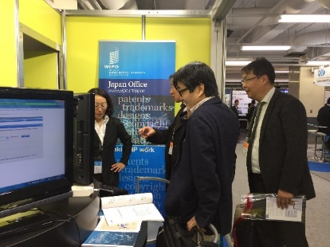
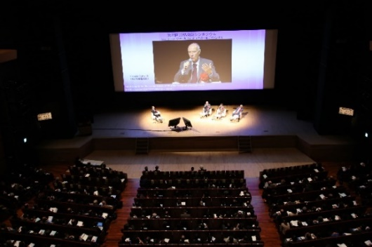
Key Achievements of the WJO (4) Communication to a broad public about IP and WIPO’s role
Translated major WIPO publications, including “DG’s Report to the Assemblies 2018,” into Japanese for dissemination
Frequently updated the WJO webpage in English and Japanese
Sent quarterly newsletters to over 300 subscribers
Set up WJO booth at relevant events and exhibitions
Organized meetings for DG and other high-level visits
DG’s Report 2018 (Japanese )
Global Festa (Sep 2018)
Patent Information Fair (Nov 2018)
JIPA Symposium (Feb 2019)
Photo: WJO
Photo: WJO
Photo: JIPA

Slide 9
Outreach & Customer Service (1)
In the past 12 months, responded to 1,736 inquiries about WIPO’s Global IP Services and Databases
Madrid 937, Hague 420, PCT 328, Others 51
*
**
*Total includes queries on domain names, copyright, etc.
**Figures for 2019 are estimated based on the numbers from Jan.to Aug.2019.

Slide 10
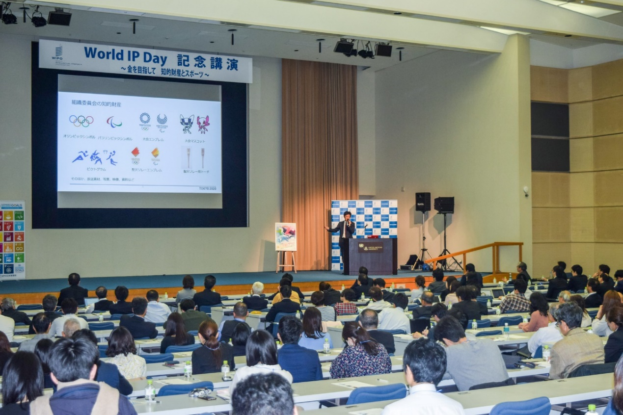
Outreach & Customer Service (2)
Organized a World IP Day event in Tokyo, inviting as speakers:
Mr. Nagao, Paralympic Athlete, 1988-2008 & 2016, Japan
Mr. Igarashi, Director of Tokyo 2020 Olympics Committee and
Mr. Fujiwara, Head of Sports Business Development, Fujitsu
Photo: WJO

Slide 11
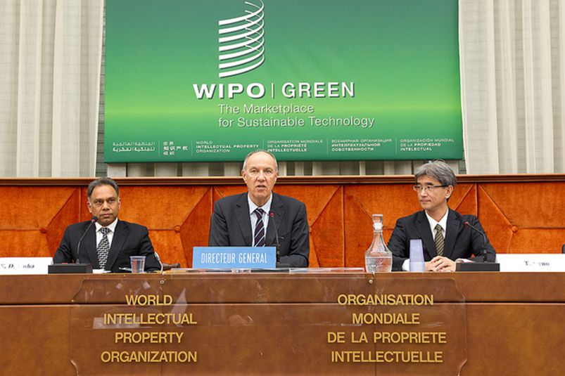
For The Year Ahead
Increase the number of applications from Japan to the Madrid and Hague Systems
Develop new Capacity Building projects with J-FIT
Further promotion of WIPO GREEN in Japan
How to Explore Ideas Using IP (textbook on IP for young people)
WIPO GREEN Launch (2013)

Slide 12
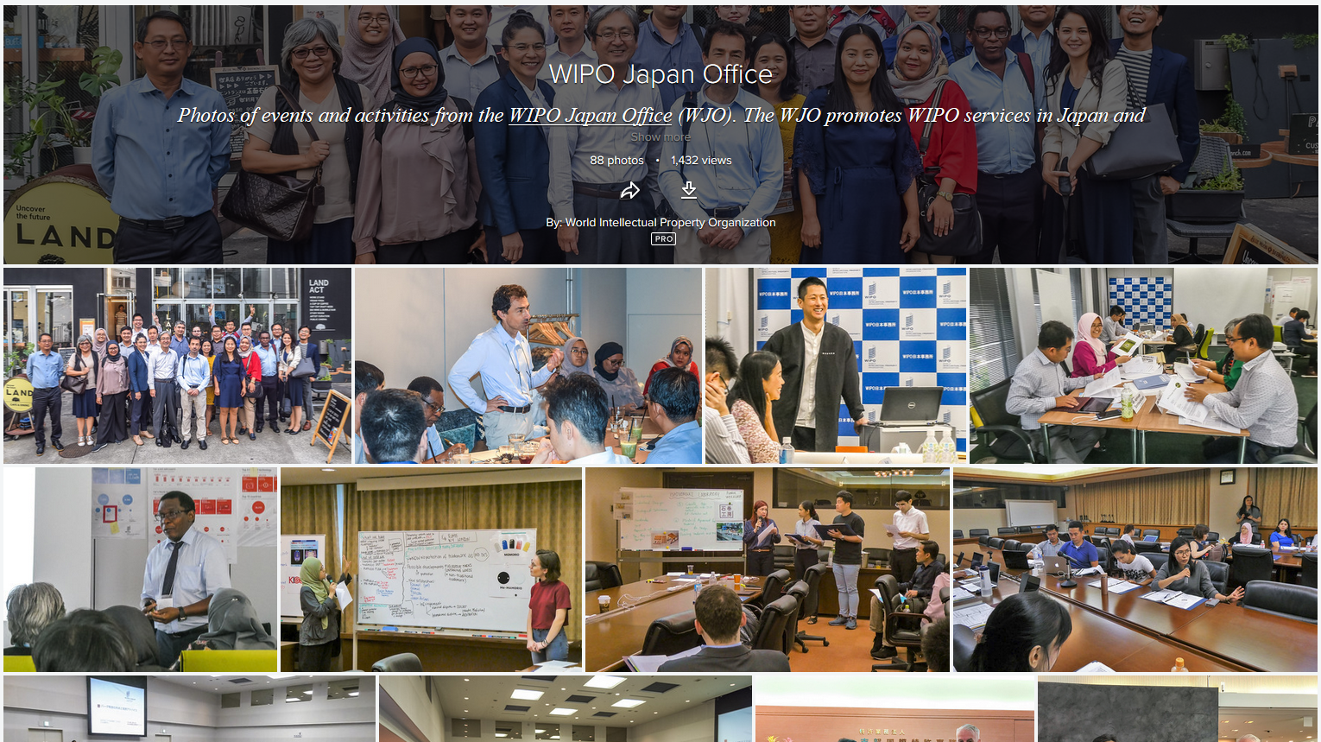
Thank you for your time.
WJOFlickr Album: www.wipo.int/japan

