Slide 1
WIPO Algeria Office
Geneva
Thursday, October 3
2019
Side-Event at the 2019 WIPO Assemblies

Slide 2
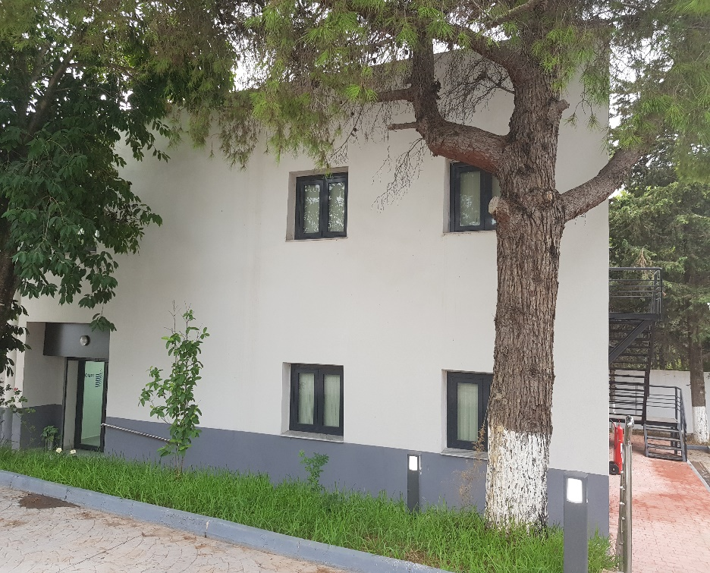
About the WAO
Established February 2019
Located in Algiers

Slide 3
WOA – Resources in 2019
Personnel Resources:
D1 – Director
G4 – Administrative staff
Non-Personnel Resources available for Program Implementation
CHF 150 000 (Total budget 2019)
Office set-up and provision of technical assistance

Slide 4
Strategic Focus of the WAO
Facilitate the use of IP for development by organizing and contributing to activities aimed at enhancing human resource capabilities in the area of IP in Algeria;
Develop and implement strategic communications and outreach activities aimed at building awareness of the new WIPO External Office and aimed at building awareness of IP and of WIPO’s role;
Promote and provide tailored information on the use of WIPO’s Global IP Services, including in Arabic;
Enhance further the network of TISCs to broaden their impact

Slide 5
Key Achievements of the WAO
Operationalization of the Office
Establishment of contacts with the authorities of the Host Government
Commencement of technical assistance activities:
National Branding Day Event
Judicial Colloquium
PCT Study Visit
Support for a national start-up IP Academy
Initiatives to strengthen TISCs
Relaunch of the IP strategy process

Slide 6
Outreach & Customer Service
A limited number of enquiries from users and stakeholders about WIPO’s Global IP Services, databases and platforms;
Coordination with INAPI on the design of World IP Day activities;
Promotion of WIPO main publications in meetings with academics, journalists and private Sector.

Slide 7
The Year Ahead
Full operationalization of the WAO;
Finalization of the needs assessment and formulation of a National IP Strategy;
Implementation of targeted IP for development activities;
Expansion of the network of relationships and further raising-awareness of WIPO, its activities, the Global IP Services and platforms.

Slide 8
Thank you for your time.

