Slide 1
AI and Examination of IP Applications
Dr Frances Roden
Deputy Director General
IP Australia

Slide 2
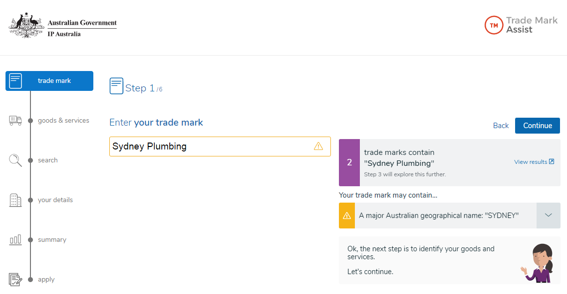
Trade Mark Assist

Slide 3
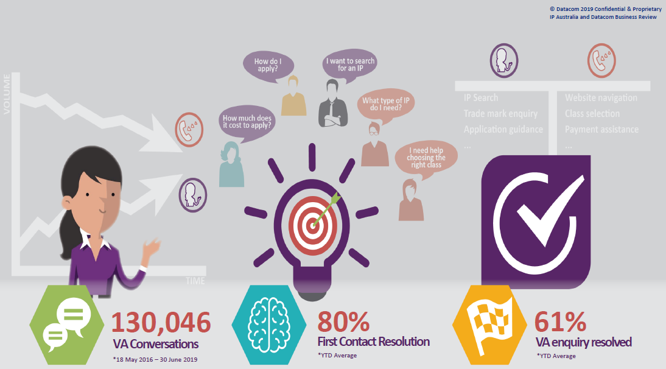
Virtual Assistant - Alex

Slide 4
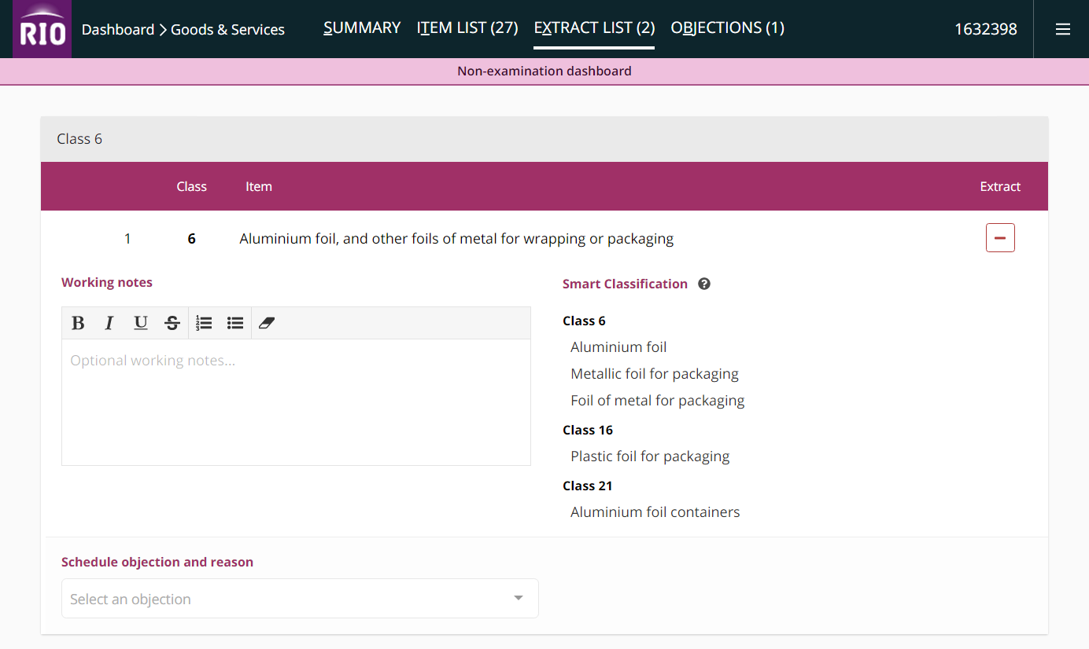
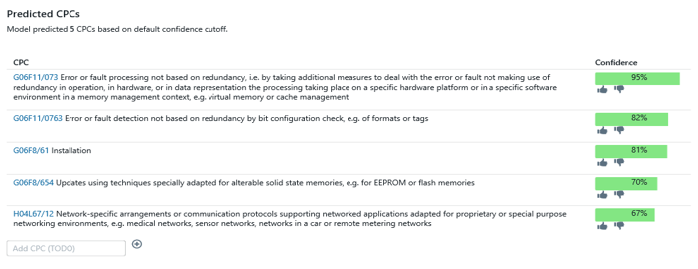
Patent Automatic Classification Tool
Goods and Services Assistant

Slide 5
Key takeaways
Trust
Governance
Legislation

