Slide 1
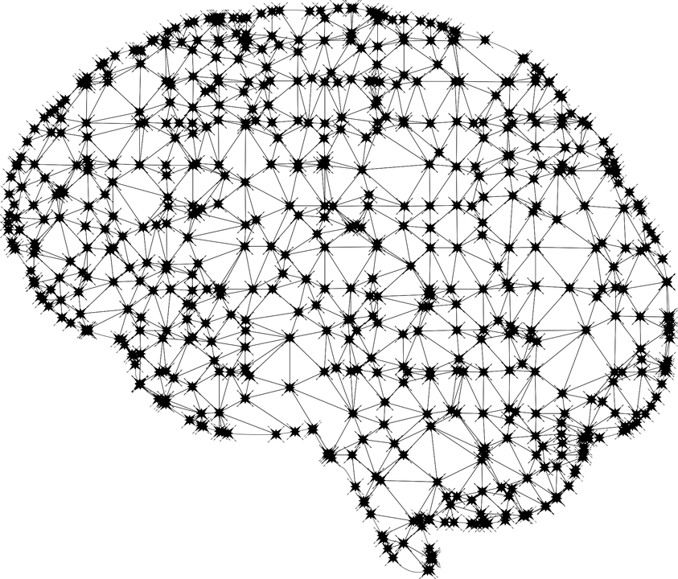
ARTIFICIAL INTELLIGENCE @ EUIPO
Miguel Ortega
Geneva, 27 September 2019

Slide 2
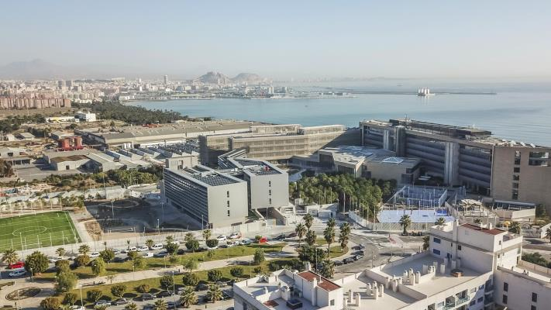
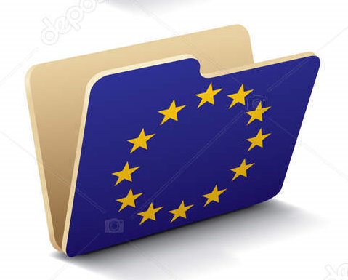
European Union Intellectual Property Office (EUIPO) - Introduction
EU agency with a global focus that offers IP rights protection to businesses and innovators across the EU and beyond
Based in Alicante, Spain, since 1994, from our foundation, our core business has been the registration of Trade marks and Designs.
Over 1.600 employees working directly and indirectly.
We register more than 150,000 EU trade marks and up to 100,000 Community designs annually, offering IP protection to companies and individuals in a market of over 500 million consumers.
The Office uses 5 working languages (English, French, German, Italian and Spanish) and processes applications in 23 official EU languages.

Slide 3
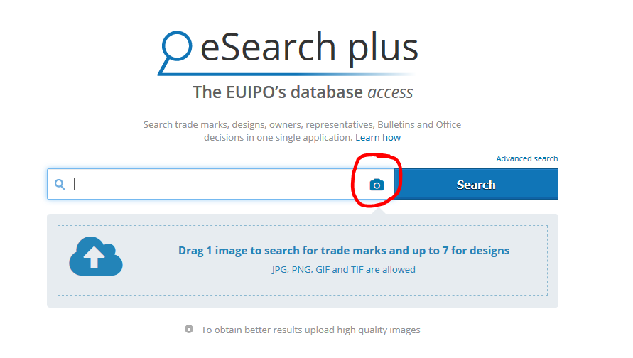
What have we done in AI
Public Trademark/Design Search.
Classification model for Goods and Services
(G&S).
Work load distribution, intelligent allocation of tasks.
Letter Analysis.
Machine Translation.

Slide 4
Planned use cases
Simplify the way we work and make us much more efficient.
Virtual Assistants: AI-powered chatbots, multilanguage.
Machine Translation.
Preclearing Systems.
Validation of data, reduction of deficiencies.
Image Recognition.
Enforcement.
Natural Language Processing.
AI technology is not to replace the examiner!
Tool to Manage the volume of filings at the office and reduce backlogs.

Slide 5
Miguel Ortega
Geneva, 27 September 2019

