Slide 1
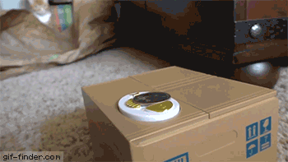
Do Androids dream of electric copyright?

Slide 2
Meet bot dylan
Notes:
“recurrent neural network” (RNN), trained using 20k folk songs shared in website https://thesession.org/ where people upload folk music, copyright uncertain.

Slide 3
 | Public domain | sui generis | Computer generated works
Where? | Continental Europe/USA | Japan? | UK
originality | Intellectual creation / Creativity | Economic tested | Skill and Labour
Effect | ¯\_(ツ)_/¯ | ¯\_(ツ)_/¯ | ¯\_(ツ)_/¯

