Slide 1
Japan’s Regional Collective Trademark System
-Activated support of the regional economy
through protecting Geographical Indications under Trademark System-
Tatsuo TAKESHIGE
Director of the Multilateral Policy Office,
Senior Administrative Patent Judge,
Japan Patent Office (JPO)
The 37th SCT Meeting
March 28, 2017
Geneva

Slide 2
1. Three Systems where Geographical Indications (GIs) can be protected in Japan
(1) Protection of trademarks under the Regional Collective Trademark System based on the Trademark Act
(The number of Registrations: 603)
As of March 21, 2017
(1) All goods and services
(2) Alcoholic beverages
(3) Agricultural products, etc.
(2) Protecting GIs based on the Act on Securing of Liquor Tax and on Liquor Business Associations
(The number of Registrations: 8)
(3) Act on Protection of the Names Protecting GIs based on the of Specific Agricultural, Forestry and Fishery Products and Foodstuffs
(The number of Registrations: 28)

Slide 3
2. Outline of the Regional Collective Trademark System
Recently, as part of community development, many local communities in Japan are actively working to make regional brands, which distinguish their special products and services from those of other regions.
In the process of establishing the regional brands, many trademarks consisting of “the regional names” and “the names of goods or services” are used to name the regional special products and services after the names of their origins.
A Regional Collective Trademark* “the regional name the name of goods (services)”
=
+
* In case the trademark has become known to some extent in Japan.
By protecting the regional brands
Activated support of the regional economy
Notes:
2

Slide 4
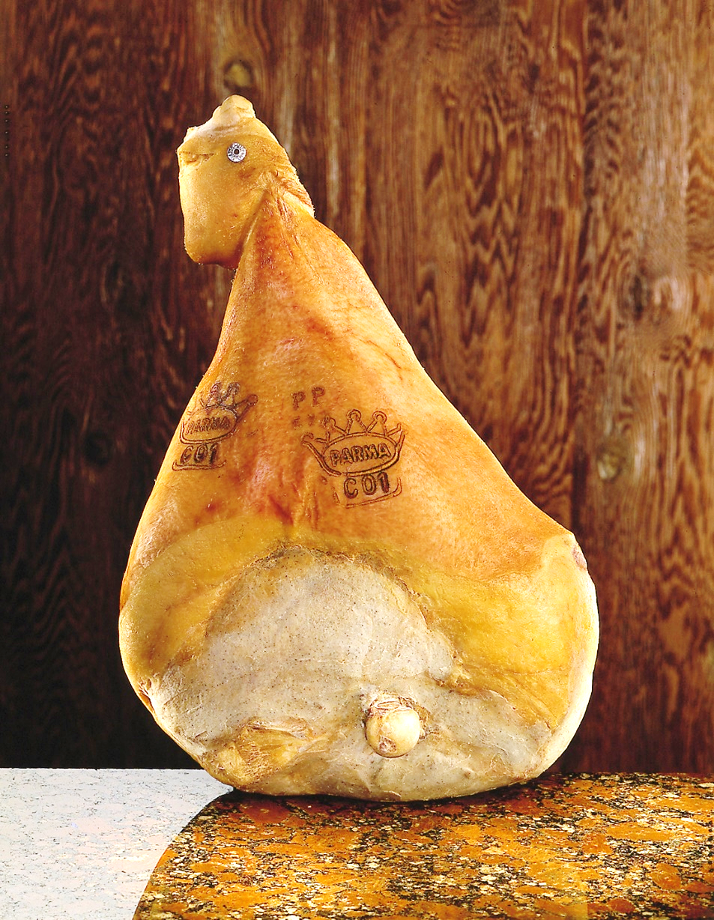
3. Examples of Regional Collective Trademarks (1)
Mark : Prosciutto di Parma
Right holder : Consorzio del Prosciutto di Parma
Country of origin : Italy
Registration No. : 5073378
Source: Regional Collective Trademark Page on JPO website (JP)

Slide 5
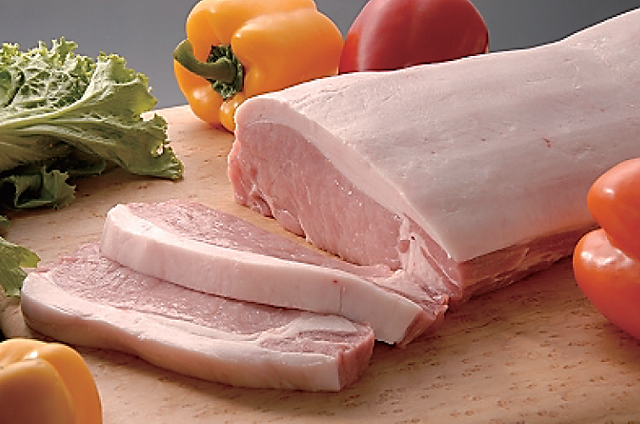
3. Examples of Regional Collective Trademarks (2)
Mark : カナダポーク（Canada Pork）
Right holder : Canada Pork International
Country of origin : Canada
Registration No. : 5129558
Source: Regional Collective Trademark Page on JPO website (JP)

Slide 6
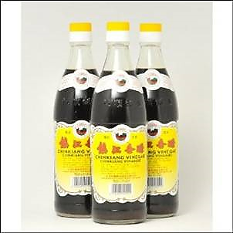
3. Examples of Regional Collective Trademarks (3)
Mark : (Zhenjiang Vinegar)
Right holder : Zhenjiang Vinegar Association
Country of origin: CHINA
International Registration No.: 965547
Source: Regional Collective Trademark Page on JPO website (JP)

Slide 7
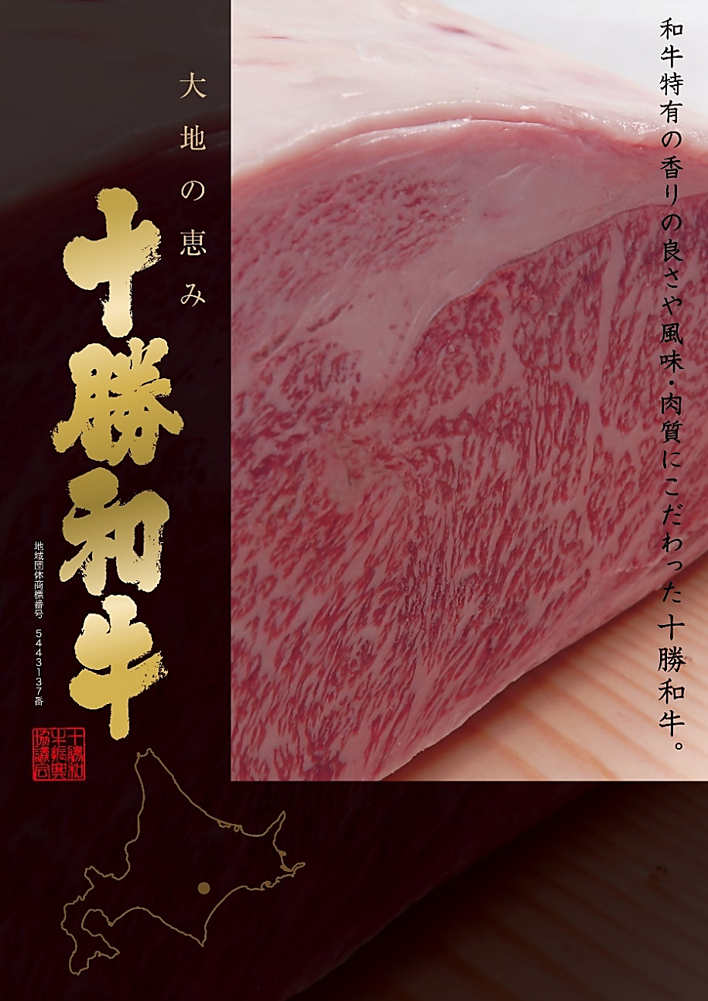
3. Examples of Regional Collective Trademarks (4)
十勝和牛
Tokachi Wagyu Beef
Right holder: HOKUREN Federation of Agricultural Cooperatives
Registration No. : 5443137
Source: Regional Collective Trademark Page on JPO website (JP)

Slide 8
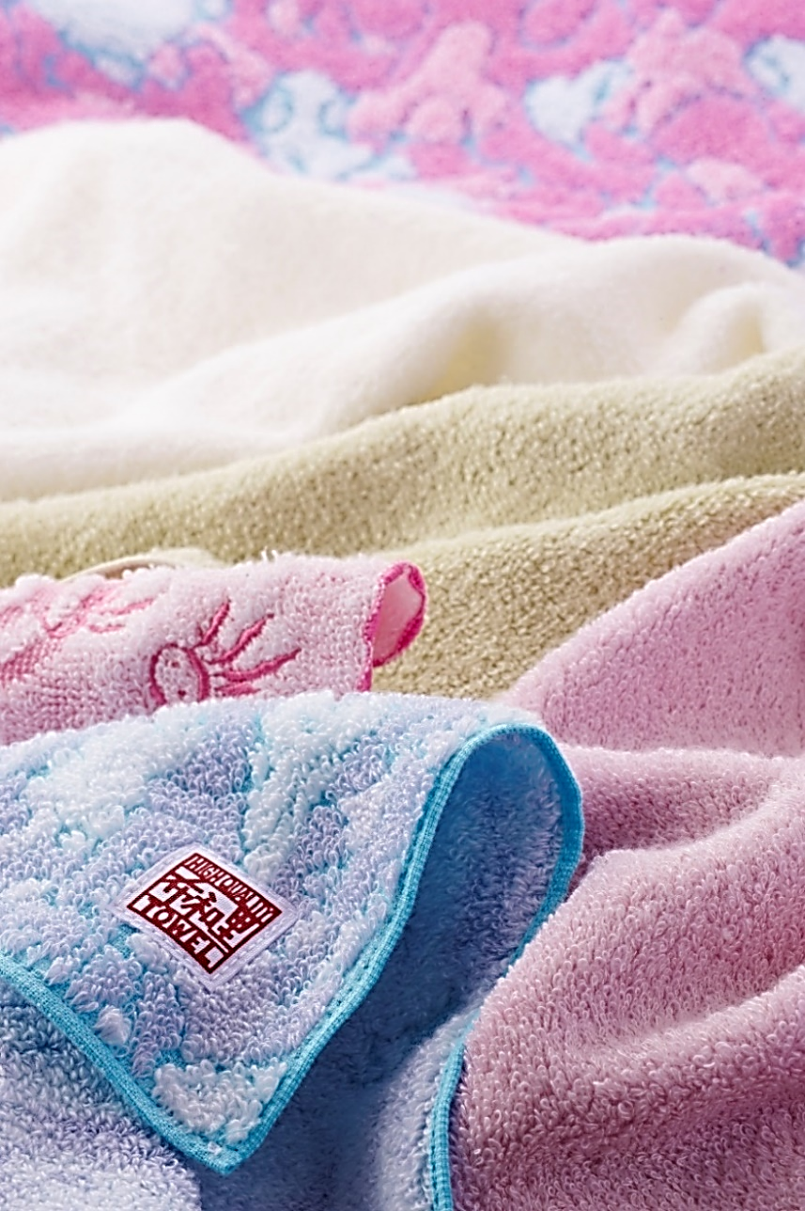
3. Examples of Regional Collective Trademarks (5)
今治タオル
“Imabari Towel”
Registration No.: 5341974
Right holder: IMABARI TOWEL INDUSTRIAL ASSOCIATION
Right holder: Shikoku Towel Industrial Association
Registration No.: 5060813
Source: Regional Collective Trademark Page on JPO website (JP)

Slide 9
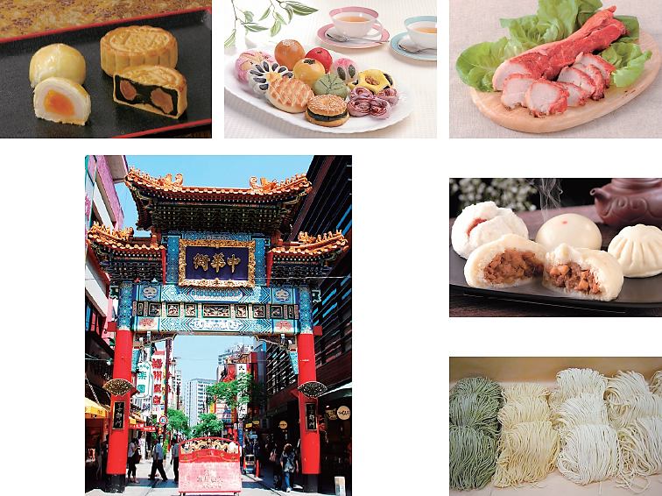
3. Examples of Regional Collective Trademarks (6)
横濱中華街
Yokohama
Chinatown
Right holder: Yokohama Chinatown Development Association
Registration No.: 5069264
Source: Regional Collective Trademark Page on JPO website (JP)

Slide 10
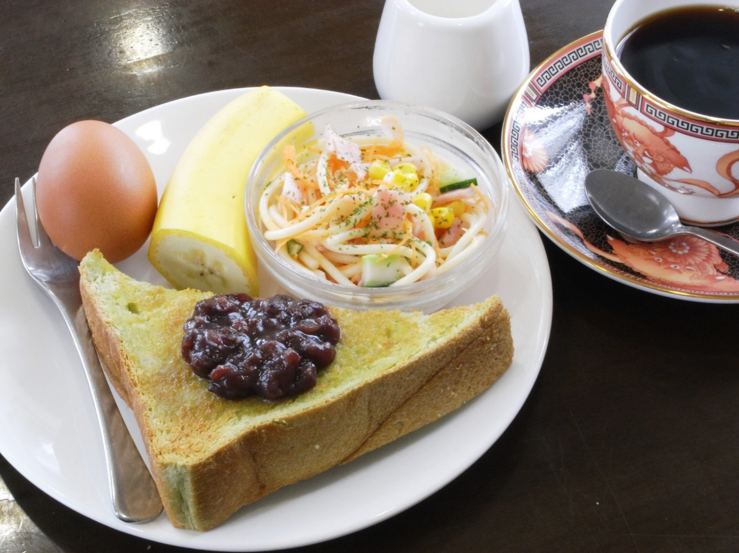
3. Examples of Regional Collective Trademarks (7)
一宮モーニング
“Ichinomiya Morning”
Right holder: Ichinomiya Chamber of Commerce & Industry
Registration No.: 5825571
Source: Regional Collective Trademark Page on JPO website (JP)

Slide 11
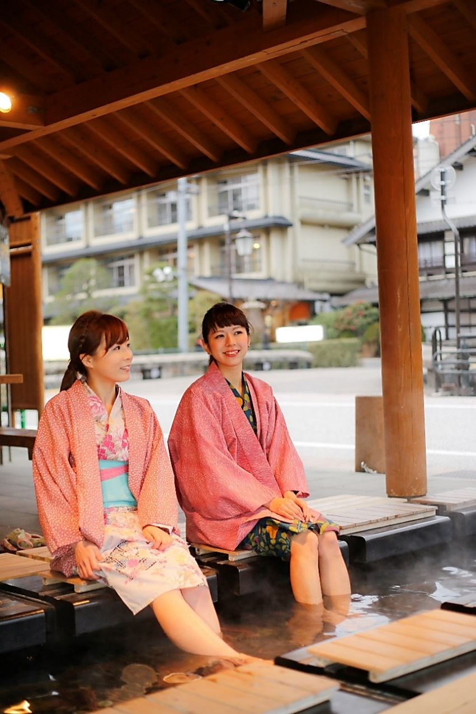
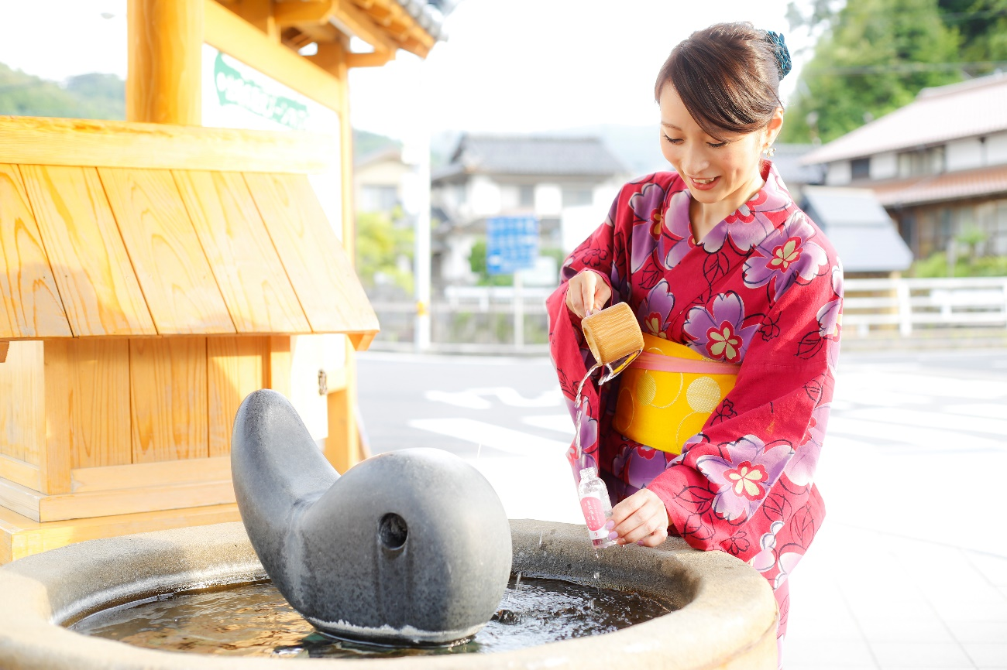
3. Examples of Regional Collective Trademarks (8)
玉造温泉
“Tamatsukuri Onsen (Spa)”
Right holder: Tamatsukuri Onsen Inns Association
Registration No.: 5137683
Source: Regional Collective Trademark Page on JPO website (JP)

Slide 12
4. Examples of Utilizing Regional Collective Trademarks in Business Activities (1)
(1) Legal Consequences – License Agreements –
“Kameda-Jima (Kameda Striped Textile)”
(Niigata Prefecture)
- Trademark rights were acquired as conditions to forming alliances with large companies and government offices; and
- The acquisition of regional collective trademark rights provided significant benefits for business activities.
“Shizuoka Cha (Shizuoka Green Tea)”
(Shizuoka Prefecture)
- Made license agreements with a major food and beverage manufacturing company.
“Katsuura Tantanmen Noodle”
(Chiba Prefecture)
- Made license agreements with some companies to provide its Tantanmen Noodles at their company cafeterias.
Registration No.: 5661445
Registration No.: 5062720
Registration No.: 5703819
Source: Regional Collective Trademark Page on JPO website (JP)

Slide 13
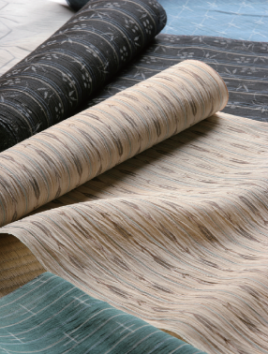
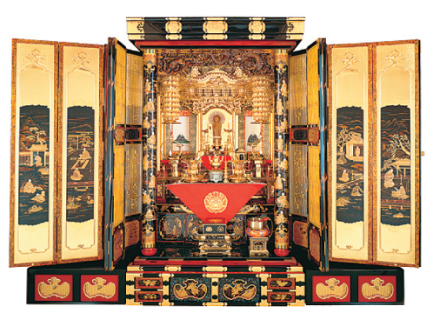
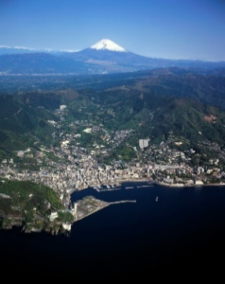
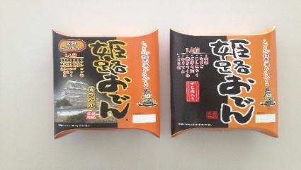
4. Examples of Utilizing Regional Collective Trademarks in Business Activities (2)
(2) Legal Consequences – Measures against Illicit Use
“Hida no Kabu (Furniture)”
(Gifu Prefecture)
- Prevented stores from being opened that would use its trademark without permission
Registration No.: 5103618
Reg. No.: 5018285
“Ojiya Chijimi (Crepe Fabric)” (Niigata Prefecture)
“Mikawa Butsudan (in-home Buddhist Altar)”
(Ishikawa Prefecture)
- Reduced unauthorized use of the trademark (product name)
Registration No.: 5053375
“Atami Onsen (Spa)” (Shizuoka Prefecture)
“Himeji Oden (Stew)” (Hyogo Prefecture)
“Fuchu Kagu (Furniture)”
(Hiroshima Prefecture)
- Claimed trademark rights against
similar or counterfeit goods and services
Registration No. ：5377749
Registration No. ：5431595
Reg. No：5030831
Source: Regional Collective Trademark Page on JPO web site(JP)

Slide 14
4. Examples of Utilizing Regional Collective Trademarks in Business Activities (3)
(3) Effects of Differentiation
– Increasing the appeal of goods and services/
Increase in sales volume
“Gamagori Mikan (Mandarin Orange)”
(Aichi Prefecture)
- Taking the opportunity of obtaining trademark rights, the oranges have been used in school lunches in the Prefecture.
“Ichinomiya Morning” (Aichi Prefecture)
- After obtaining trademark rights, the number of searches for the website has been increasing (up around 40% from the previous month); and
- Increase in number of opportunities reported in the mass media
“Biratori Tomato” (Hokkaido)
- The use of the single name “Biratori Tomato” increased the reliability of the products;
- The tomatoes have been sold at major supermarkets in the Tokyo metropolitan area by the name of “Biratori Tomato;” and
- The sales amount increased after acquiring rights.
Registration No.: 5140387
Registration No.: 5825571
Registration No.: 5503346
Source: Regional Collective Trademark Page on JPO website (JP)

Slide 15
4. Examples of Utilizing Regional Collective Trademarks in Business Activities (3)
“Tokachikawanishi Nagaimo (Yam)”
(Hokkaido)
- Trademark rights were acquired also in foreign countries by using the JPO’s system of subsidies for filing foreign applications; and
- Total export amounts increased 4.1 times from 1999 to 2014.
Registration No.: 5002095
“Ichikawa no Nashi (Japanese Pear)”
(Chiba Prefecture)
- Since the Agricultural Cooperative acquired the regional collective trademark rights for Ichikawa Pear, it succeeded in jointly developing a product containing the pears, with Yamazaki Baking, a major food company. The product has been used as jam for Yamazaki’s bread products, leading to nationwide sales; and
- After obtaining rights, the amounts of both local consumption in direct sales and nationwide shipments have grown year by year, increasing 15% compared to the time before acquiring the rights.
Registration No.: 5066922
“PROSCIUTTO DI PARMA” (Italy)
- After acquiring trademark rights, the sales increased 41% from 2007 to 2015; and
- 88,442 in 2007 => 124,920 in 2015
Registration No. ：5073378
Source: Regional Collective Trademark Page on JPO website (JP)

Slide 16
5. Advantage of the Regional Collective Trademark System (1)
Benefits to Trademark Rights Holders
Legal rights
(1) Have exclusive rights to use trademarks
throughout Japan; and
(2) Stop any unauthorized use of trademarks by others;
In Addition,
Local communities can gain various benefits from establishing and protecting their local specialty products and characteristic services by themselves:
(3) Strengthen the cohesiveness of overall communities and
group members and raise the brand awareness;
(4) Reduce damages caused by counterfeits; and
(5) Advertise goods and services and heighten the image
Notes:
15

Slide 17
5. Advantage of the Regional Collective Trademark System (2)
Benefits to Administrative Agency (System Operator)
* Can utilize the framework of the existing trademark system
Under the framework of the existing trademark systems used
worldwide, trademarks consisting of the names of regions and
the names of goods or services can be protected worldwide as trademarks.
* Low Administrative Costs
Since the level of quality of goods and services is decided and managed by trademark rights holders themselves, governments and administrative agencies do not need to regulate the quality.
* Sustainable System based on the policy of the
obligation of beneficiaries
Trademark rights holders have to pay trademark renewal fees to maintain their trademark rights.
Notes:
16

Slide 18
APPENDIX

Slide 19
Obtaining Regional Collective Trademark Rights

Slide 20
Outline of the Major Requirements for Registering Regional Collective Trademarks
1. Entities (both Japanese and non Japanese are eligible)
Association including a business cooperative association
A commercial and industrial association, a chamber of commerce and industry, and non-profit juridical entities *Extended from August 1, 2014.
2. Constitution of Trademark
the trademark consists of a “regional name” combined with the “name of goods (services)”.
3. Connection between the Regional Name and Goods (Services)
“The regional name” must have a connection with the “goods (services)” : e.g. “the regional name” is the origin of the goods.
4. Well-known Character
As a result of the use of the trademark in Japan by the applicant or its members, the trademark must be well known in terms of indicating goods or services in connection with the business of the applicant or its members.
Notes:
19

Slide 21
1. Eligible Entities
Eligible entities are:
(1) Associations such as business cooperative associations established pursuant to a special Act who:
a. Have judicial characteristics
b. Do not refuse the enrollment of any persons eligible to become members
(2) A commercial or industrial association
(3) A chamber of commerce and industry
(4) Non-profit juridical entities
◆Further, the trademark must be used by the members of the applicant and be well known as a result of its use by the members.
The applicant must submit a document to certify eligibility at the time of filing.
(1) A certificate showing the registration of the Association etc.
(2) A copy of governing law for incorporation to show the freedom of anyone to join
If there are several applicants, all of them must satisfy the requirements.
◆All of the applicants must submit the certificates.

Slide 22
2. Constitution of a Trademark
【Point】
1) The trademark shall not be combined with any numerical figure.
2) The character of the trademark shall not be a design.
3) The trademark shall be a “regional name “ combined with the “name of a goods or service”.
4) The trademark shall not be a common name.
Common name of goods or services
Commonly used characters as
those indicating places of
the origin of the goods, etc.
（home, local specialties,
special products, production
in ○○, ○○of ）
Regional name
or
Commonly used name of goods or services

Slide 23
3-(1) Close Connection with the Region
A regional name shall have a close connection with goods/services of the region where the trademark has been used before the application is filed.
(1) applicant
(members)
(2) trademark
(including the regional name)
(3) the goods
or services
Fact that (1) produces and uses (3) with (2) in the region
The applicant must submit documents to show that all requirements of the (1) to (3) above are satisfied.
(Example) A newspaper article
□□ agricultural cooperative starts shipping ○○, a local product. ○○ produced in □□ is famous for its distinctive taste and flavor, and is sold under the name “□□ ○○” in the metropolitan area at 20 % higher prices than usual ○○.
★Examples of the documentary evidence to indicate the close relationship with the region
(1) Articles from newspaper, magazines, books
(2) Certificates by official institutions
(3) Pamphlets, catalog, internal regulations
(4) Various receipts including delivery slips and order slips
■The of the associations, trademarks and the goods all must be listed in pamphlets.

Slide 24
3-(2) Designated Goods
Since the regional collective trademark might cause misunderstanding as to the quality of the goods (services), the designated goods (services) shall be specifically described.
【Designated goods (designated services)】○○（regional name）produced in □□（name of goods）
To limit the region
So as not like to mislead in terms of the quality of the goods (services)

Slide 25
4-(1) Well-known Characters
A trademark must be recognized among consumers (end consumers or businesses) to some extent in Japan.
The applicant must submit documents to certify that as a result of the applicants’ and its members’ using the trademark, the trademark is well known to some extent.
【Examples of documents certifying “well known” status】
・Documents to certify that the trademark has been attached to the goods by the applicant and its members before filing
・Documents to certify that at present, the trademark is attached to the goods by the applicant and its members
・Documents to certify total sales, share of the market, and sales areas of the goods
・Documents to certify the method, number, content or the like involved with advertising the goods
Documents to certify
well-known character
=
① Name of the applicant
(members)
＋
② Trademark
＋
③ Name of goods(services)
Documents by which all of the above ①～③ can be confirmed is effective.

Slide 26
4-(2) Well-knownness (its judgment and relationship with third-parties)
Whether or not the trademark is well-known is determined based on a record of use by the applicant and its constituent members and also by confirming the situation in which third parties might have used the trademark on certain conditions.
① If someone who is not a member of the applicant organization is using the filed trademark:
1. If the user is among other unions or chambers of commerce, which have been using the filed trademark to a considerable extent, it is difficult for the applicant to have the trademark registered by itself alone.
※It is possible for the applicant to have the trademark registered by filing a joint application with such organizations as above.
2. If the user has not been using the filed trademark to a considerable extent, or if the trademark has not been admitted as being well-known, the applicant will be able to have the trademark registered.
② If there exists a council or the like including the applicant, which promotes regional brands:
If a council or the like exists to promote regional brands, the council is mostly involved in such activities as
supporting and developing regional brands with all the efforts made by the council. In this case, if the applicant is
a union that is a member of the council, it is required for the applicant to obtain an approval from the council or
other organizations as below.
Filing an application in the name of ＡCooperative
Registration can be possible by first clarifying the
relationship between ○○Promotion Council and
A Cooperative and then submitting a consent
document in which ○○Promotion Council agrees
that A Cooperative will have the trademark
registered.
○○Promotion Council
ＡCooperative
Members
ＢLocal Municipality
Authenticating ○○brand
Advertising/Promoting ○○
Using ○○trademark
ＣSupport Company

Slide 27
Protection of the Legitimate Use by Third Parties
Protecting the user prior to the filing of application for trademark registration
Using the trademark as a display of commodity characteristics
<Prior user rights to regionally based
collective trademarks>
Any person who has been using a regionally based collective trademark with no intention to be engaged in unfair competition prior to the filing of application for trademark registration, shall have the right to continuously use the said trademark. (Article 32-2, Trademark Act)
[Note] It is required to clarify the use situation of the regionally based collective trademark prior to the filing of application for relevant registration. The same shall apply to “those by whom such business is succeeded”.
<Limitations of effects of trademark rights>
Judging from the displayed modes, a trademark right shall have no effect on any of those trademarks which merely indicate the common name, place of origin, quality, etc. of goods only in a common manner, without functioning as an indicator of the place of origin (Article 26, Trademark Act). Such cases shall not thus be regarded as infringements of trademark rights.
→ Judging from the displayed modes according to the use by third parties, if the use is not regarded as the use of trademark, a trademark right shall not have any effect on the use.
The right holder of regionally based collective trademark may
request the person who has the right of prior use to affix an appropriate
indication that may prevent any confusion.
(Article 32-2, Trademark Act)
Notes:
26

Slide 28
Current Status of Filings/Registrations for Regional Collective Trademarks (As of March 21, 2017)
Total number of applications: 1,162
Hokkaido | Aomori | Iwate | Miyagi | Akita | Yamagata | Fukushima | Ibaraki | Tochigi | Gunma
52 | 21 | 10 | 14 | 18 | 22 | 15 | 8 | 10 | 13
Saitama | Chiba | Tokyo | Kanagawa | Niigata | Nagano | Yamanashi | Shizuoka | Aichi | Gifu
12 | 26 | 34 | 20 | 34 | 30 | 12 | 37 | 35 | 43
Mie | Toyama | Ishikawa | Fukui | Shiga | Kyoto | Osaka | Hyogo | Nara | Wakayama
29 | 17 | 43 | 25 | 28 | 150 | 17 | 63 | 15 | 17
Tottori | Shimane | Okayama | Hiroshima | Yamaguchi | Kagawa | Tokushima | Kochi | Ehime | Fukuoka
6 | 14 | 12 | 27 | 11 | 7 | 8 | 9 | 17 | 27
Saga | Nagasaki | Kumamoto | Oita | Miyazaki | Kagoshima | Okinawa | Other
9 | 18 | 19 | 15 | 18 | 23 | 43 | 9
As to collective trademark registrations extending across more than two prefectures are counted into the total
number of each respectively. (e.g. (1) Honba Yuki Tsumugi (lit. high grade Yuki silk textile in Tochigi and Ibaraki,
and (2) Edo Kimekominingyo (lit. a type of Japanese wooden doll in Tokyo and Saitama)
Total number of registrations: 603
Hokkaido | Aomori | Iwate | Miyagi | Akita | Yamagata | Fukushima | Ibaraki | Tochigi | Gunma
28 | 10 | 6 | 6 | 9 | 10 | 4 | 2 | 8 | 9
Saitama | Chiba | Tokyo | Kanagawa | Niigata | Nagano | Yamanashi | Shizuoka | Aichi | Gifu
6 | 14 | 18 | 8 | 12 | 8 | 5 | 22 | 15 | 29
Mie | Toyama | Ishikawa | Fukui | Shiga | Kyoto | Osaka | Hyogo | Nara | Wakayama
15 | 9 | 29 | 16 | 11 | 62 | 11 | 35 | 11 | 13
Tottori | Shimane | Okayama | Hiroshima | Yamaguchi | Kagawa | Tokushima | Kochi | Ehime | Fukuoka
6 | 7 | 6 | 15 | 7 | 5 | 6 | 5 | 12 | 17
Saga | Nagasaki | Kumamoto | Oita | Miyazaki | Kagoshima | Okinawa | Other
7 | 8 | 12 | 12 | 7 | 14 | 15 | 3

Slide 29
Thank you!!

