Slide 1
practices related to geographical indication systems: the european union wipo sct geneva 28 march 2017
Francis FAY
Head of Unit ‘Geographical Indications’
DG Agriculture and Rural Development
European Commission

Slide 2
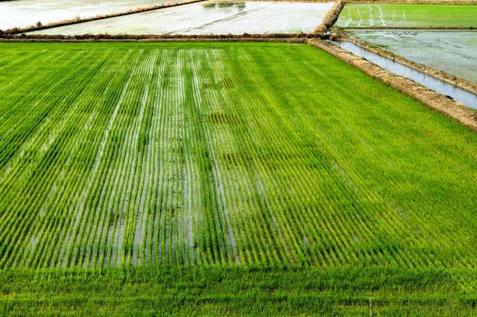
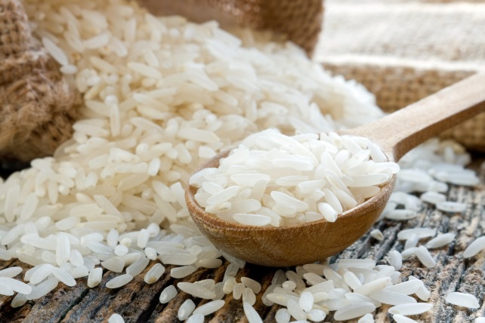
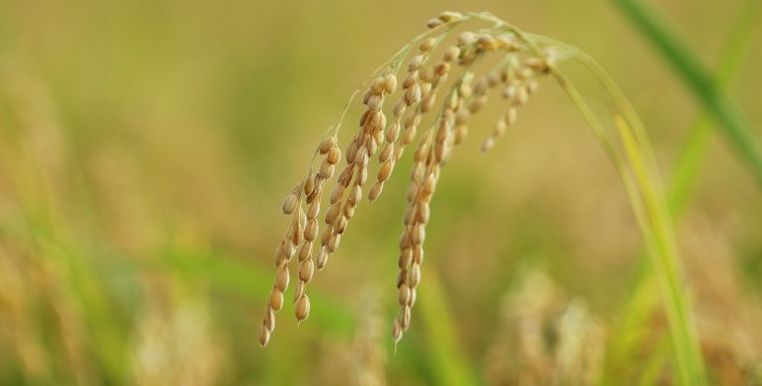
Protecting links between product, people and place
+
2 Specific product
3 Link between 1. and 2.
1 Defined geographical area
+
=
GI

Slide 3
Registration system
Product linked to territory
Producer group: Writes specification
Control system – either certification or official controls
Administrative process
Check the area, the link between product and environmental/human factors or reputation
Assess prior uses
Opposition process
Final decision: register or reject

Slide 4
Rights and ownership
Positive right
Explicit right to use the registered name
For any operator marketing authentic product (producer, cooperative, importer, distributor, wholesaler, retailer)
Protection against wrongful uses:
Absolute protection for registered name.
Extended protection against specific misuses, including ‘evocation’ and translations

Slide 5
Respect for prior rights and territoriality
Territorial principle: integral to IP systems
Generic terms cannot be registered
Trade marks earlier in time :
Either prevent registration or apply coexistence: Both GI and trade mark enjoy right of use
All other trade mark rights unimpaired
Plant varietals and animal breeds
Either prevent registration or apply coexistence

Slide 6
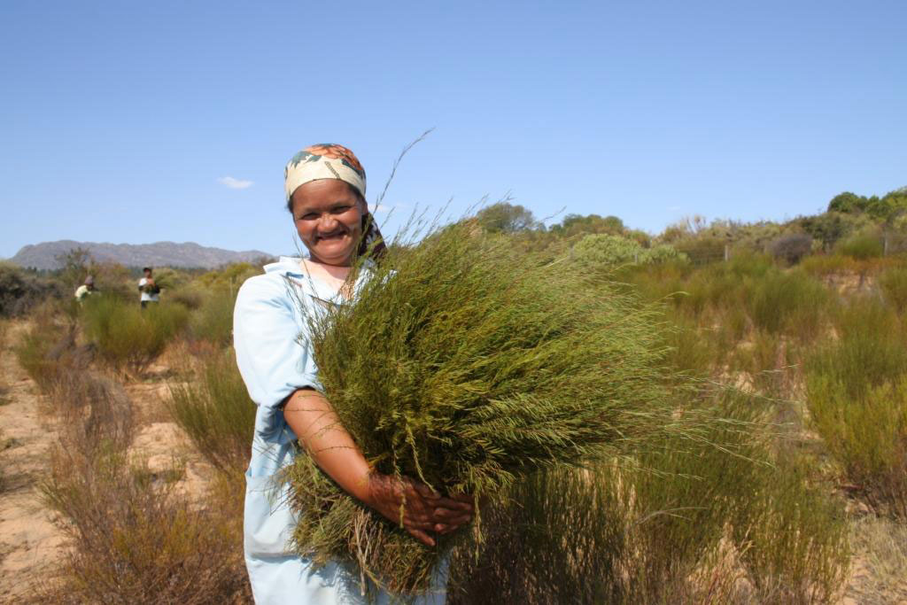
Practices: openness to non-EU applications
Direct applications welcomed
No need for government intervention
No need for government certification and control
Must show GI is protected in its country of origin for the specific product
Entry in EU Register gives right to use EU logos

Slide 7
thank you for your attention practices related to geographical indication systems: the european union wipo sct geneva,28 march 2017
Francis FAY
Head of Unit ‘Geographical Indications’
DG Agriculture and Rural Development
European Commission
francis.fay@ec.europa.eu

Slide 9
Protected designation of origin Protected geographical indication

