Slide 1
CWS
Electronic Application Form Project_Version 2 (PV2)
Geneva, March 22, 2016

Slide 2
OVERVIEW
Background
Electronic Application Form (PV1)
Electronic Application Form (PV2)
Validation of PVP-XML Schema Version 2.0 (V2.0)
Next steps
2

Slide 3

UPOV MISSION STATEMENT
“To provide and promote an effective system of plant variety protection,
with the aim of encouraging the development of new varieties of plants,
for the benefit of society”

Slide 4
UPOV: INDEPENDENT INTERGOVERNMENTAL ORGANIZATION
The International Convention for the Protection of New Varieties of Plants
established in 1961
The International Union for the Protection of New Varieties of Plants
Union internationale pour la
protection des obtentions végétales

Slide 5
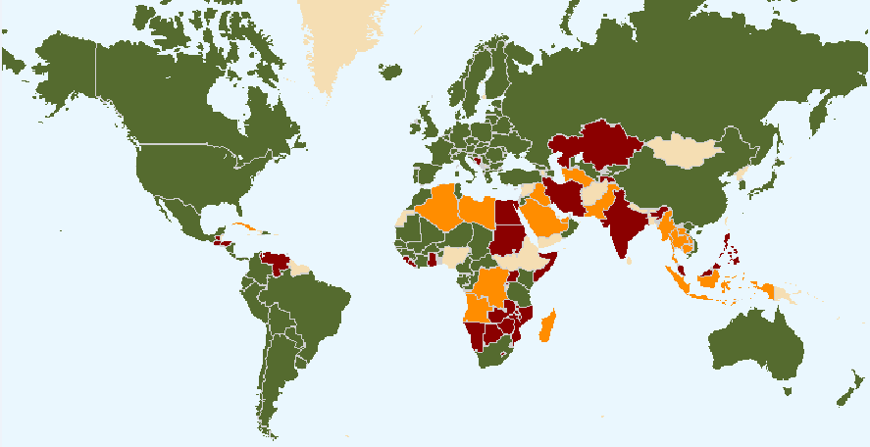
UPOV Situation in 2016
Members of UPOV (74)
Initiating States (15) and Organization (1)
States (23) and Organization (1) in contact with the UPOV Office
The boundaries shown on this map do not imply the expression of any opinion whatsoever on the part of UPOV concerning the legal status of any country or territory

Slide 6
Background
The original description of the aim of the project on a prototype electronic form was to develop a multilingual, electronic form containing questions relevant for plant breeders’ rights (PBRs) applications.
The aim of the prototype would be to develop an electronic form covering all relevant information required for a PBR application (including Technical Questionnaire) in the members of the Union concerned and with questions translated in the relevant languages for the members of the Union concerned.
(see document CAJ/66/5 “Electronic Application Systems”, paragraph 2).

Slide 7
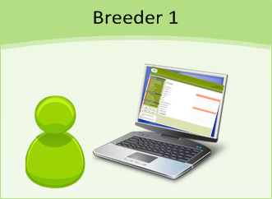





Available in different languages (EN, FR, ES, DE, Other)

Slide 8
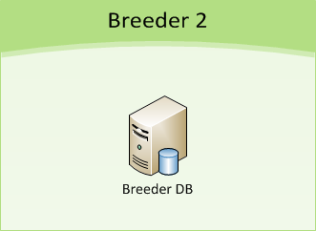

Slide 9



TRANSFER OPTIONS
Regular Mail
Hard Paper
E-mail
XML and/or PDF
Link to download application data (SFTP * Server)
System to System
XML and/or PDF
* Secure File Transfer Protocol

Slide 10
Benefits of the EAF system
Multilingual system: possibility to read all questions in all languages of participating members
Provide and electronic PVP system for participating members who don’t have one
Facilitate exchange of data in a standard format (PVP-XML)
Offer the possibility to reuse existing application data

Slide 11
OVERVIEW
Background
Electronic Application Form (PV1)
Electronic Application Form (PV2)
Validation of PVP-XML Schema Version 2.0 (V2.0)
Next steps
11

Slide 12
Target for Prototype Electronic Application Form Version 1 (PV1)
Functioning Prototype
by October 2015 (EAF/6 meeting)
=
Data can be transferred (and reused) from participating breeders to participating PVP Offices
according to the specific information that they require for an application
in the requested format

Slide 13
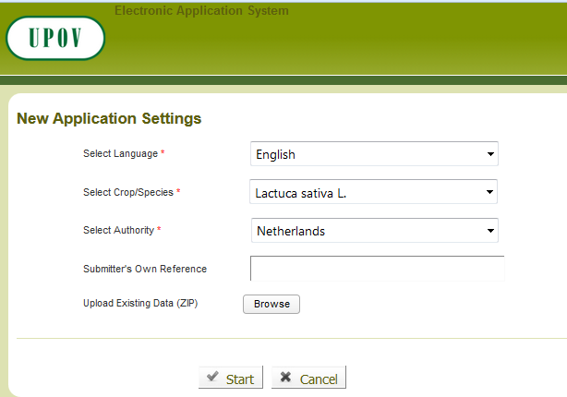
Start a new application from scratch

Slide 14
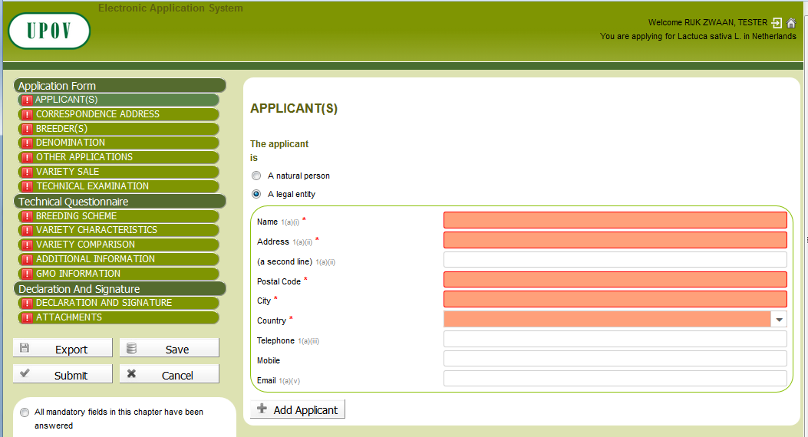
Form Generation
Reference to UPOV Application Model Form
Set up of specific constraints and dependencies
Chapter grouping
Dynamic display

Slide 15



Action Buttons
Export: Save the application data into the local drive
Save: Save the application data into UPOV DB -> Pending Application
Submit: Save the application data into UPOV DB and direct transfer to the designated PVP office -> Submitted Application

Slide 16
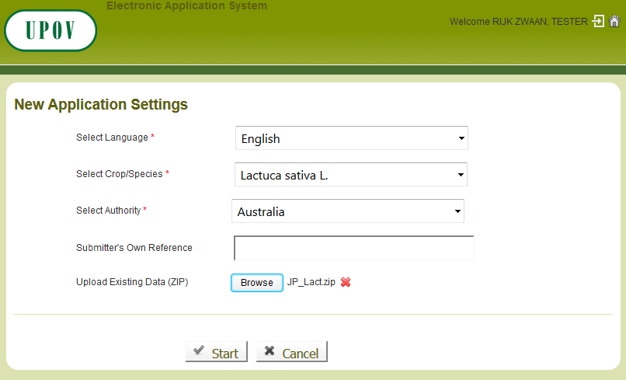
Reuse of existing data- Exported data

Slide 17

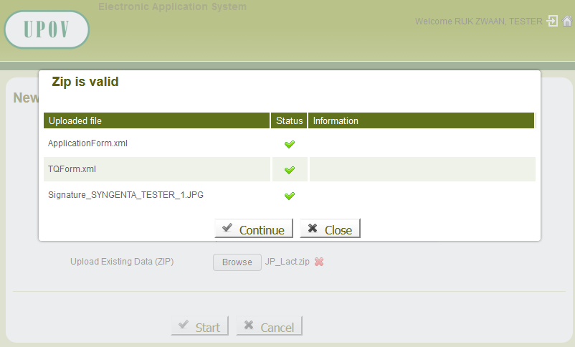
Reuse of existing data- Exported data

Slide 18
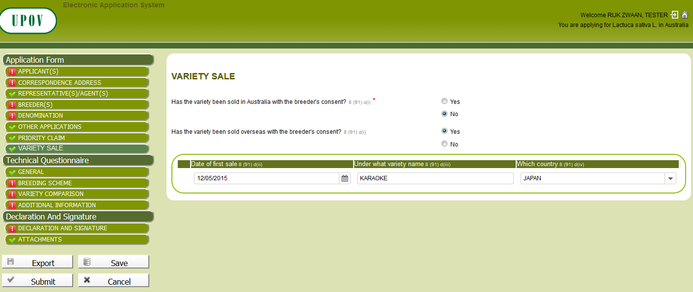
Reuse of existing data- Exported data

Slide 19
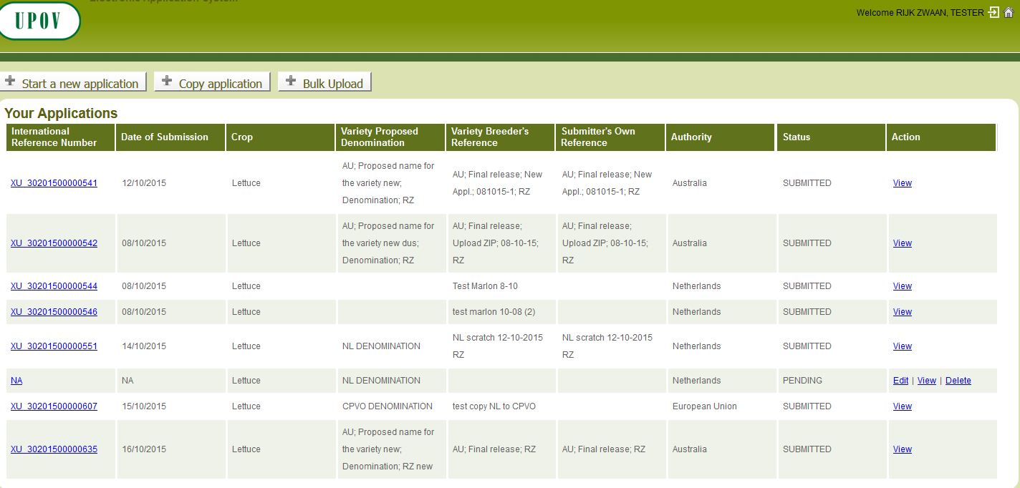

Reuse of existing data: pending application

Slide 20
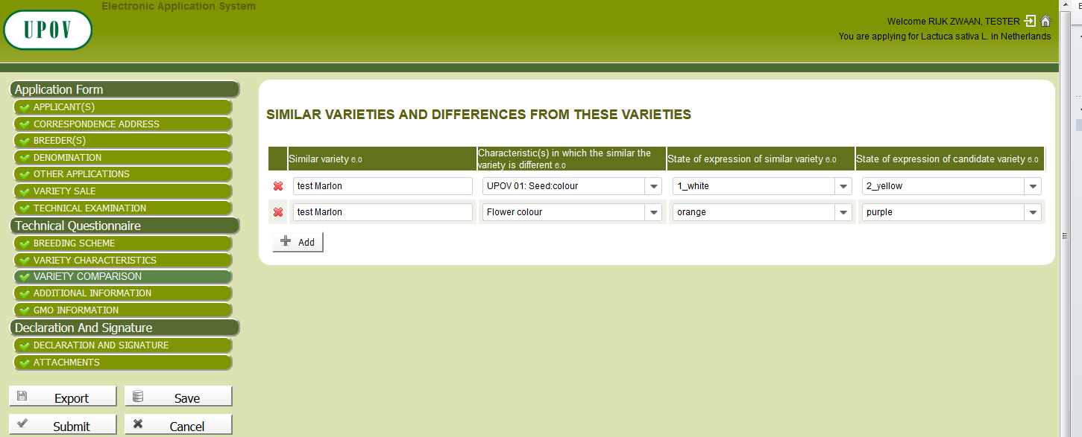
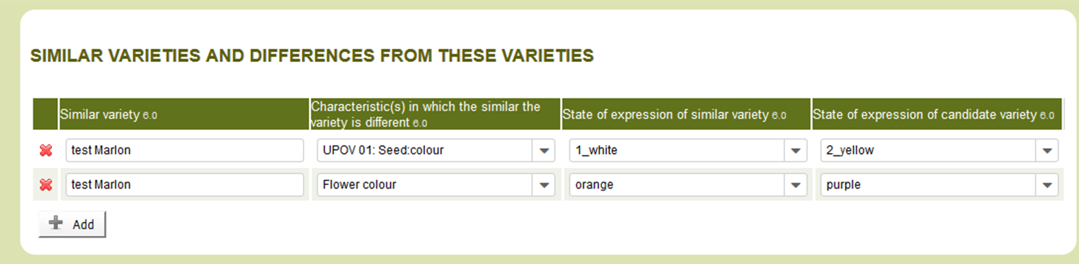
Reuse of existing data: pending application

Slide 21
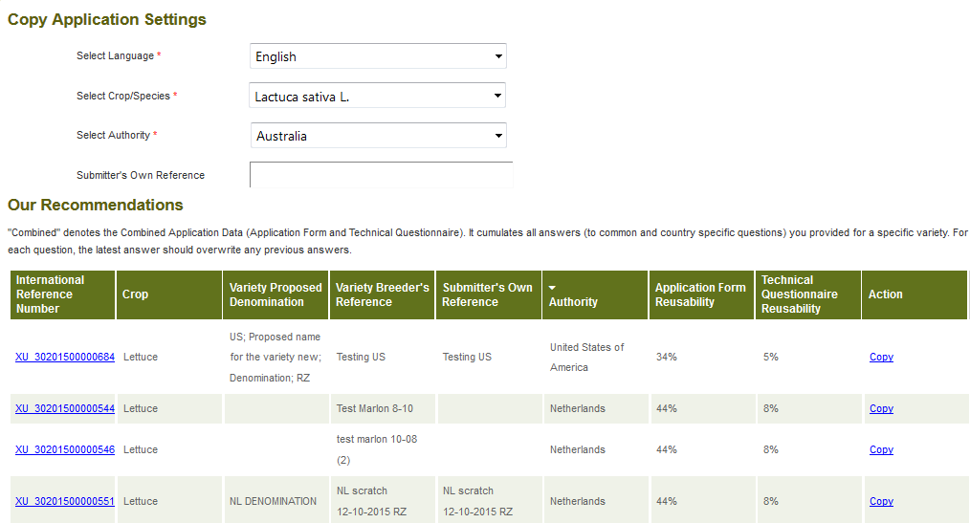
Reuse of existing data

Slide 22
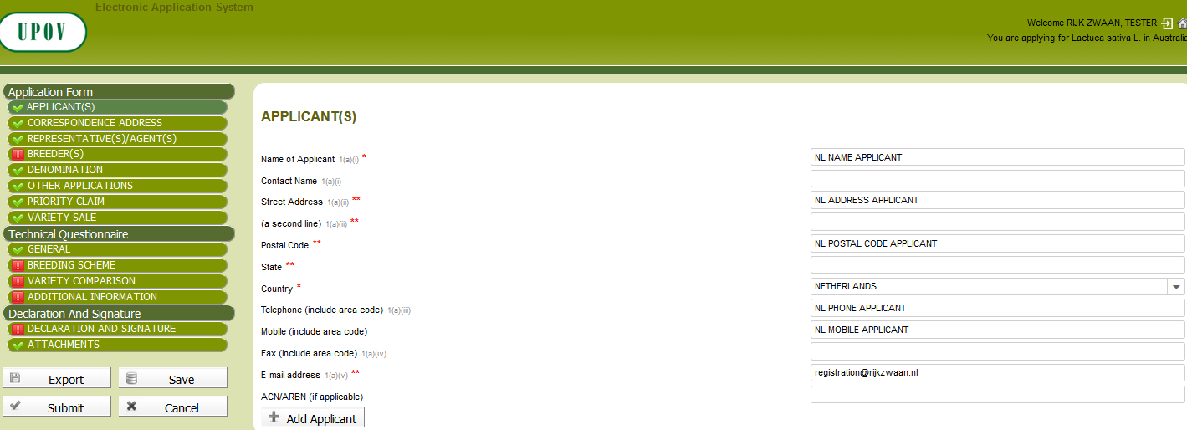
Reuse of existing data: Submitted data (Copy)

Slide 23
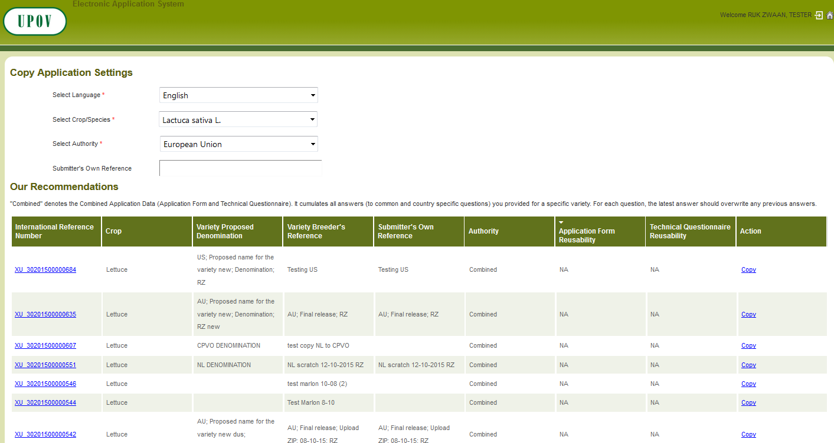
Reuse of existing data: Copy combined application data

Slide 24

Validation of PV1
  Done
  Validation by participating members and UPOV members
    EAF/6 (October 26, 2015)
    CAJ (October 27, 2015)
    Consultative Committee (October 28, 2015)
24

Slide 25
OVERVIEW
Background
Electronic Application Form (PV1)
Electronic Application Form (PV2)
Validation of PVP-XML Schema Version 2.0 (V2.0)
Next steps
25

Slide 26
Target for
Prototype Version 2 (PV2)
Functioning system by October 2016
Including:
Scaling-up of the system, i.e. addition of further crops, languages and PVP Offices, and
Enable implementation by PVP Offices for the application process (filing, authorization, payment, submission…)
for the selected crops

Slide 27
Participating Authorities in PV2*
Authorities (26)
Argentina | Canada | Kenya | Organisation Africaine de la PI (OAPI) | South Africa
Australia | Czech Republic | Republic of Korea | Sweden | Switzerland
Bolivia | European Union | Mexico | Tunisia
Brazil | France | Netherlands | United States of America
Chile | Georgia | New Zealand | Uruguay
Colombia | Japan | Norway | Viet Nam
26
UPOV members cover 69 countries
* Participating UPOV members in the EAF who provided their forms /information to be used in the prototype electronic form PV2

Slide 28
Supported crops in EAF-PV2
Crops | Priority*
Rose (17) | 1
Soya Bean (20) | 1
Lettuce (19) | 2
Apple Fruit Varieties (18) | 2
Potato (18) | 3
* According to time available

Slide 29
OVERVIEW
Background
Electronic Application Form (PV1)
Electronic Application Form (PV2)
Validation of PVP-XML Schema Version 2.0 (V2.0)
Next steps
29

Slide 30
PVP-XML
Well-defined structure to store application data
Data placeholder for data exchange
Harmonization at XML level
  Question wording may differ from one authority to another

Slide 31
PVP-XML for PV2
Based on:
  WIPO XML Standard ST.96 Version 2.1
    XML Schemas
      Common components
      Patent components
      Trademark components
    ST.96 Annex I: DRCs
  PVP_XML Version 1 released in 2015 and used in PV1
  The forms received :
    Application Form (26 authorities)
    Technical Questionnaire (5 crops)
  Test Campaign feedback

Slide 32
PVP XML Schemas
Generic ApplicationForm
TechnicalQuestionnaire for Lettuce, Rose, Soya Bean, Apple Fruit Varieties and Potato
PVP common components

Slide 33
ST96. Representative
CPVO requests to inform about representative position
Use of ST.96 Representative component
Request to add RepresentativeCategoryText
  Submitted to XML4IP Task force

Slide 34
OVERVIEW
Background
Electronic Application Form (PV1)
Electronic Application Form (PV2)
Validation of PVP-XML Schema Version 2.0 (V2.0)
Next steps
34

Slide 35
Tentative timetable for the launch of the EAF
Subject to approval by EAF participants, CAJ and Consultative Committee, it is proposed to seek the approval by the Council at its fiftieth session, to be held in Geneva on October 28, 2016, to approve the launch of the EAF at the end of 2016 or beginning of 2017.

