Slide 1
WIPO XML Standards and their usage at the UK IPO

Slide 2
WIPO “XML” Standards used by the UK IPO
ST.36 (Patents) – Data exchange with the EPO
ST.66 (Trade Marks) – No formal usage though TM10 is aligned with ST.66 where practical
MECA (Trade Marks) for Trade Marks Madrid – migration to ST.96 on backlog
ST.86 (Designs) – Not used
ST.96 (All IP Rights) – XML schema implemented for Patents eRenewals system

Slide 3
Information/Data Strategy Work Streams
Two work streams have been established with the aim of improving our data quality and the understanding of our data
Data Modelling
  ST.96 is the central pillar for our data modelling work which will produce a picture of all our data assets, initially just across the IP Rights area, and will ultimately provide access to all the information business and technical users need about our data
Data Quality
  Using Experian’s Data Quality Platform to carry out data profiling and where necessary to re-structure, cleanse and de-duplicate our data; the main area for this work is name and address data

Slide 4
Data Modelling Work Stream
What we have done:
The first step was to establish the business case for a dedicated data modelling tool – our business analysts use Sparx Enterprise Architect which had the capability to draw data models but didn’t add any value to them.
Secondly as there was limited expertise in this area at the IPO we established an excellent relationship with the UK supplier of Erwin and have had 2 of their consultants working with us for 8 months helping to establish the tool and training a permanent member of staff.

Slide 5
ST.96 as the UK IPO’s Naming Standard
Quotation from the ST.96 standard:
“The XML4IP Task Force was established by the former Standards and Documentation Working Group (SDWG) in March 2007 to prepare a proposal for a dictionary of International Common Elements (ICE), and model XML (eXtensible Markup Language) schemas...”
UK IPO Goals:
Make ST.96 the centre piece of the Information Strategy
Provide a consistent naming standard across all IP rights
Overcome the popular misconception that ST.96 is “just” an XML Standard for data exchange

Slide 6
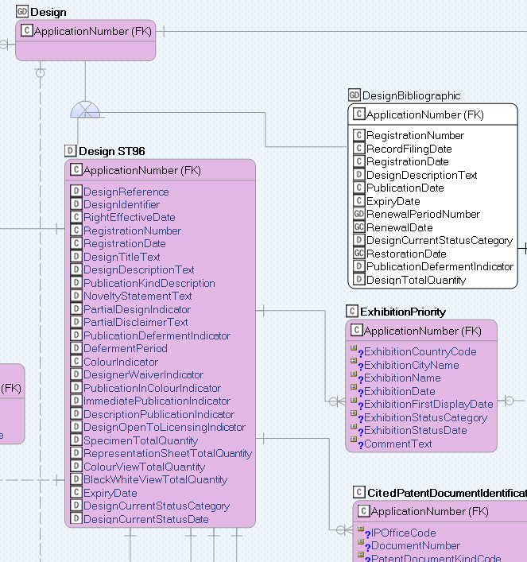
Reverse engineer ST.96 into Erwin Data Modeller

Slide 7
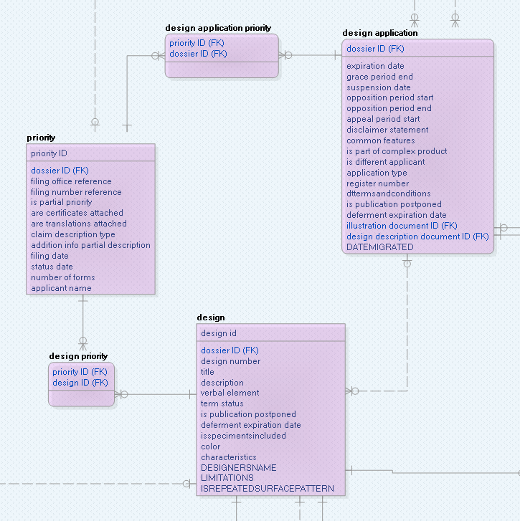
Reverse engineer existing databases into Erwin

Slide 8
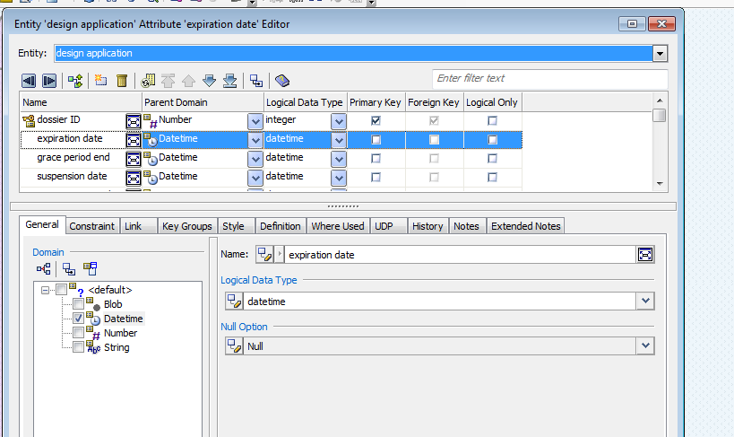
Add Structure information

Slide 9
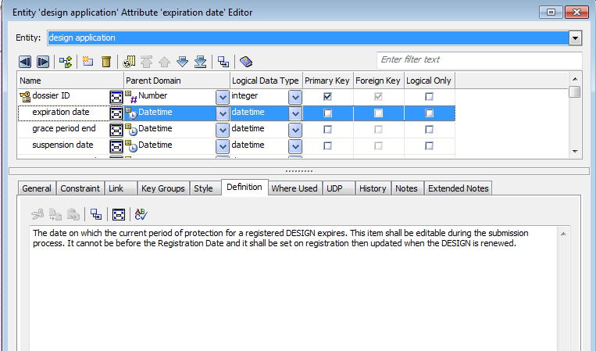
Add Definitions

Slide 10
Accessibility - target audience are not data modellers!
Provide a simple, customizable, web-based interface that allows both business and technical users across the IPO to easily visualize the important metadata information that is stored in the data models.
Allows the mapping of our Enterprise Model based on ST.96 to our Physical Models

Slide 11
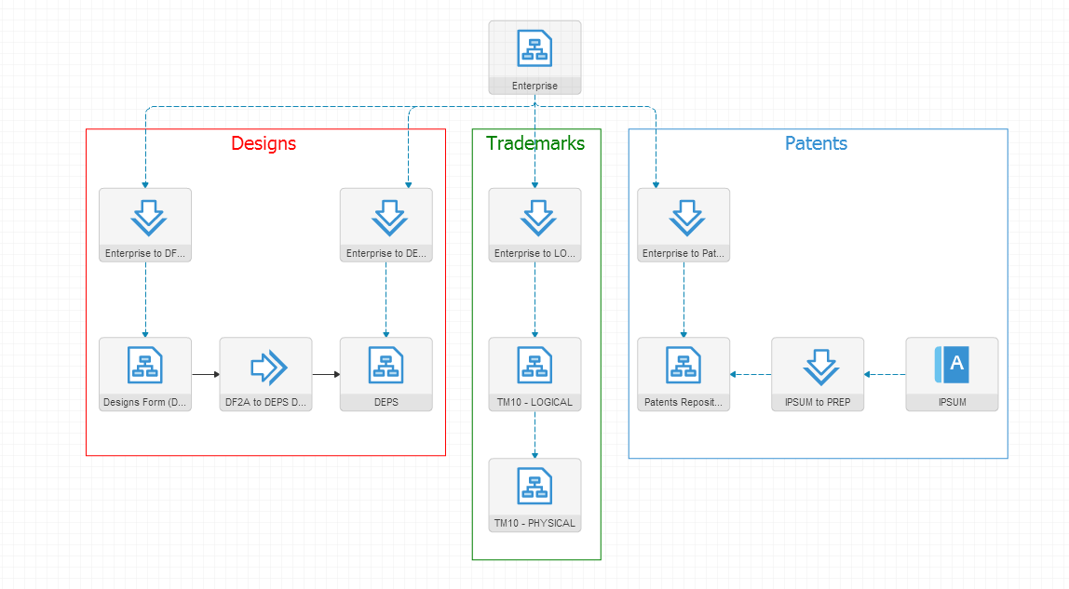
CA Erwin Web Portal – Architecture Diagram

Slide 12
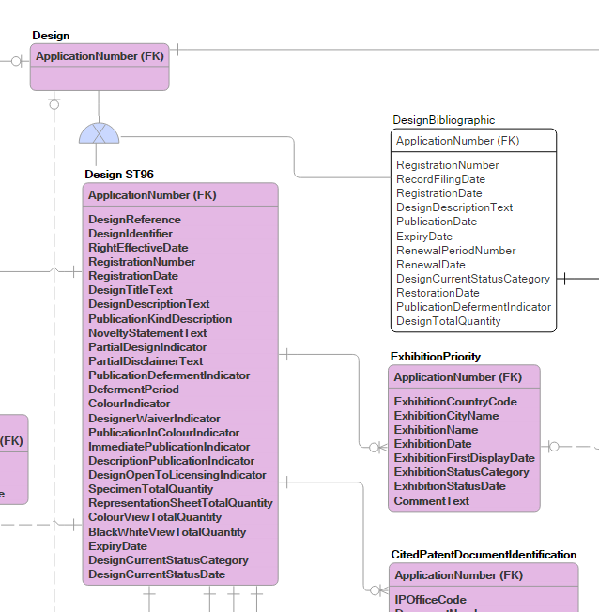
Enterprise Logical Model (ST.96)

Slide 13
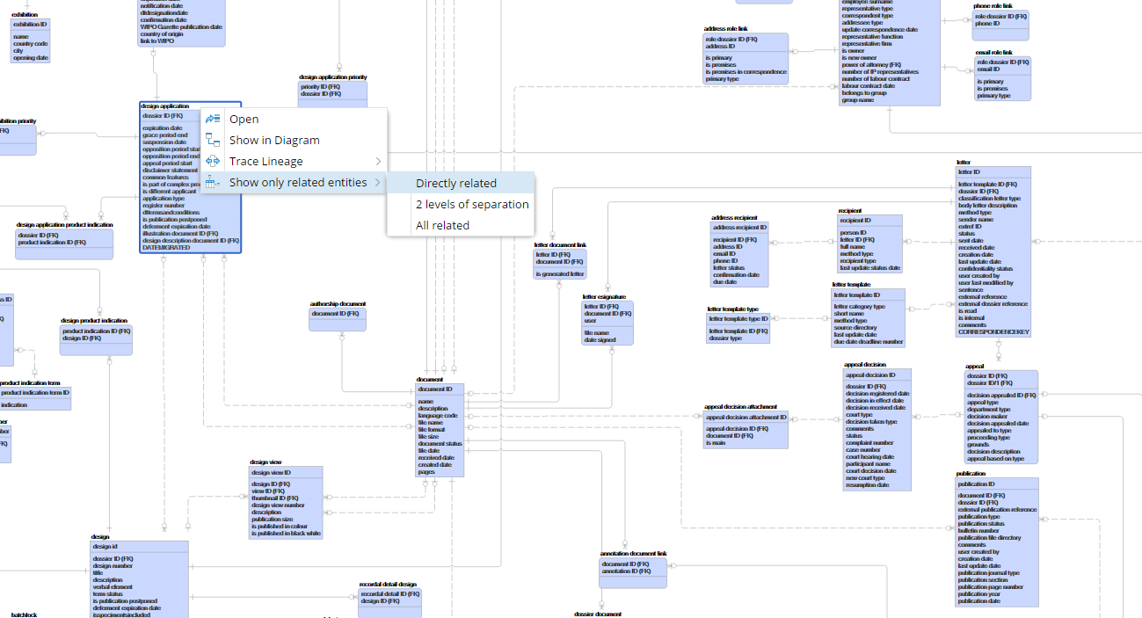
Designs Data Model

Slide 14
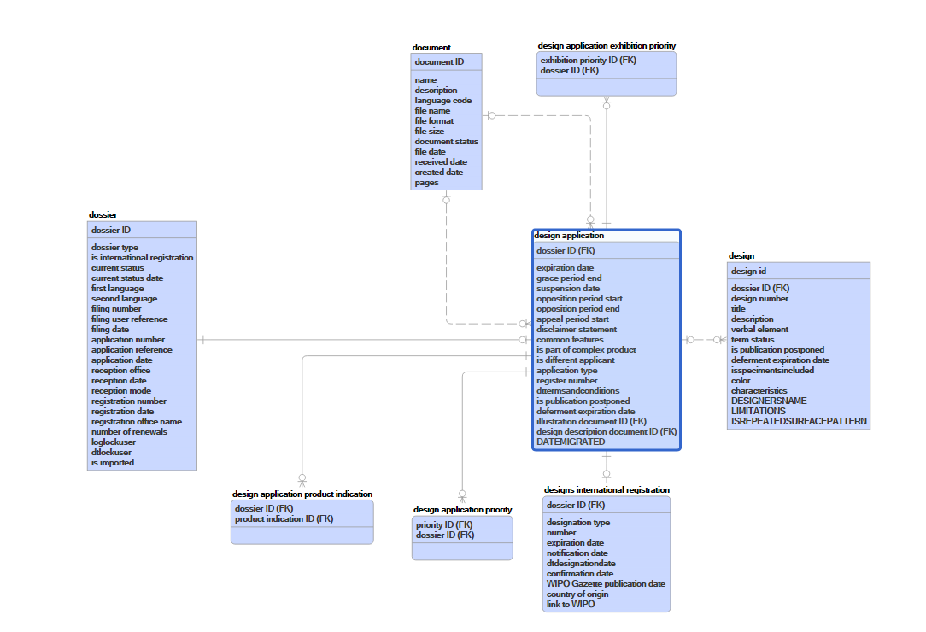
Section of the Data Model

Slide 15
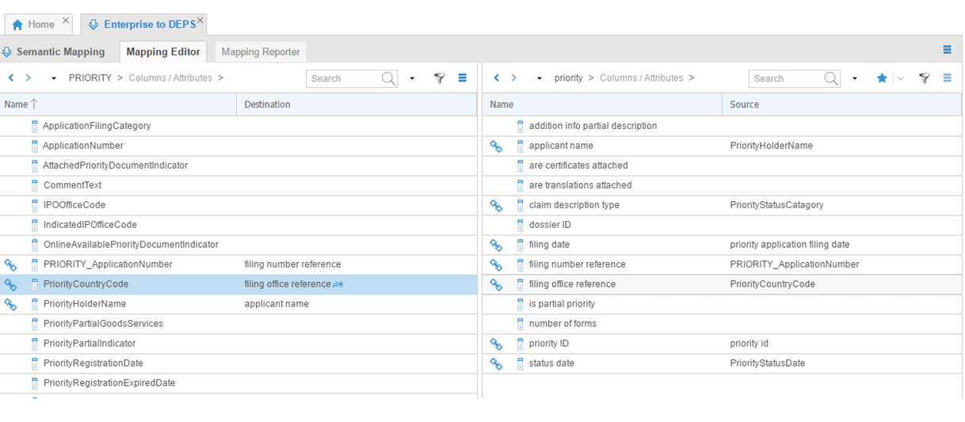
Mapping the Enterprise Logical Model to the Physical Model

Slide 16
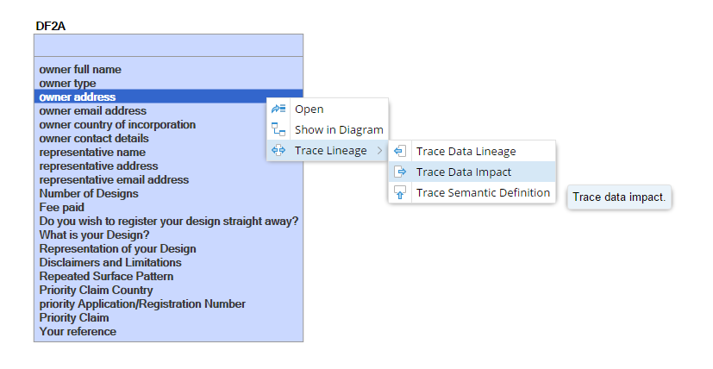
Apply For a Design – Web Form (DF2A)

Slide 17
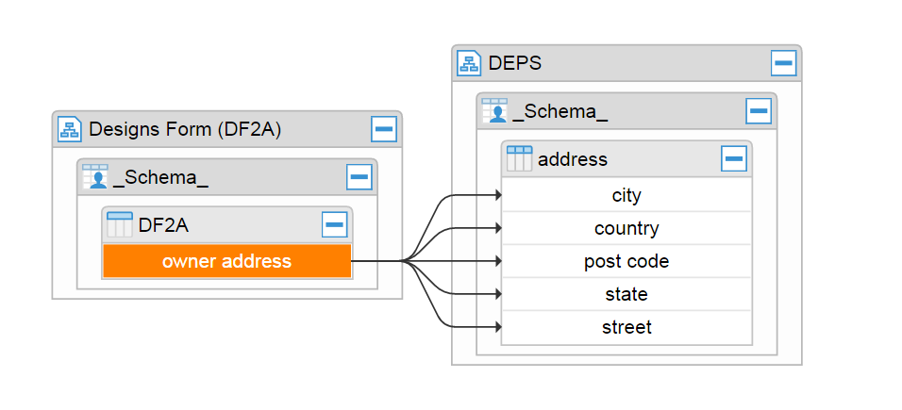
Trace Data Impact

Slide 18
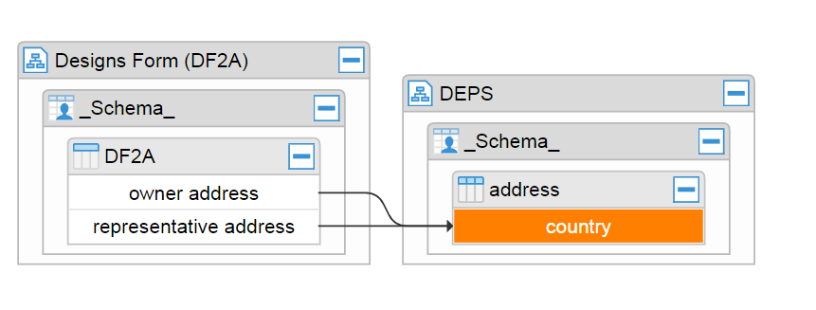
Trace Data Lineage

Slide 19
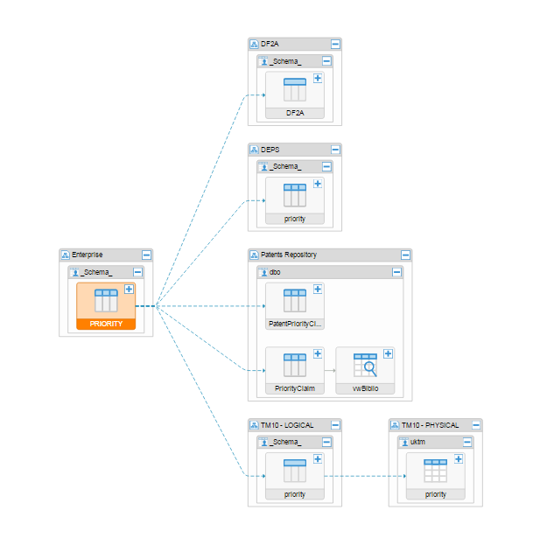
Semantic Usage for “Priority”

Slide 20
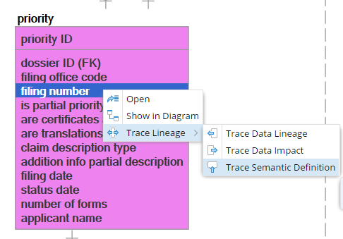
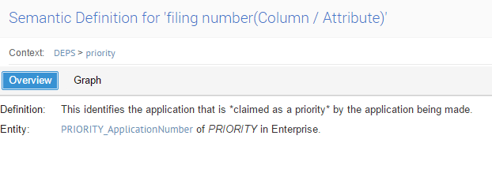
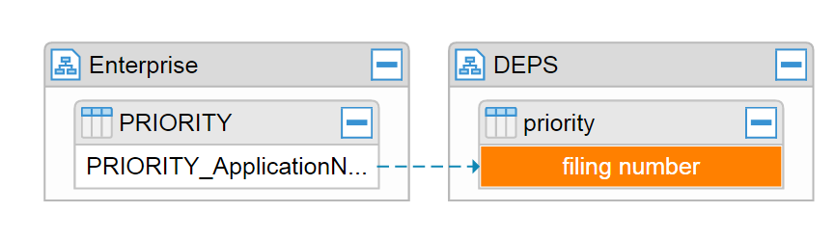
Semantic Definition for Filing Number

Slide 21
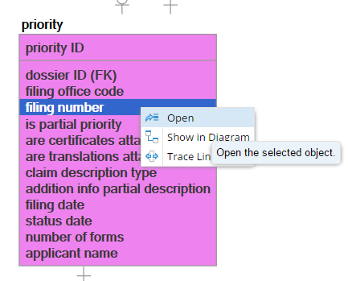
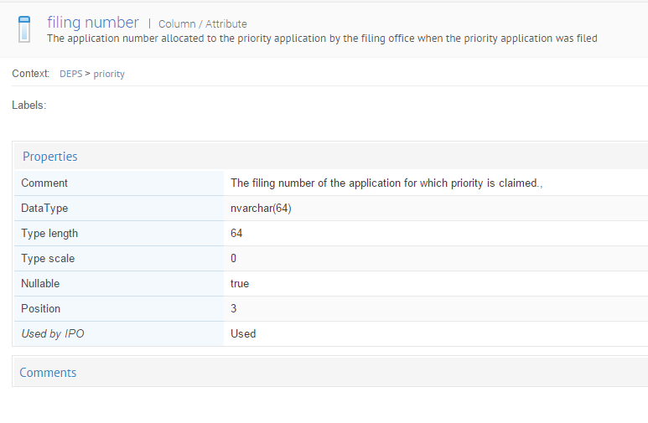
Displaying Structure Information

Slide 22
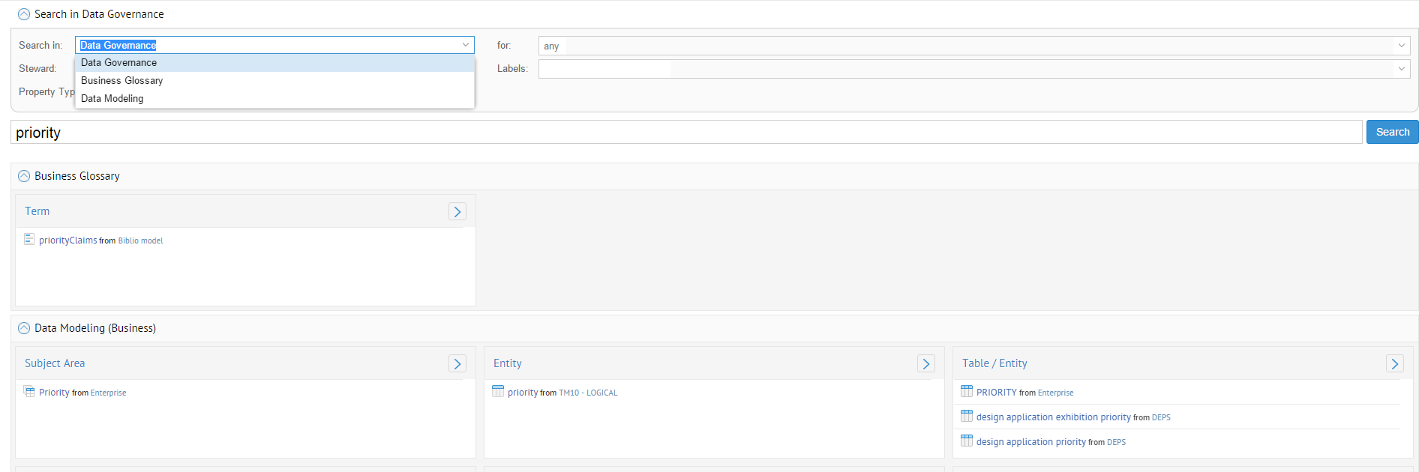
Searching the Portal

Slide 23
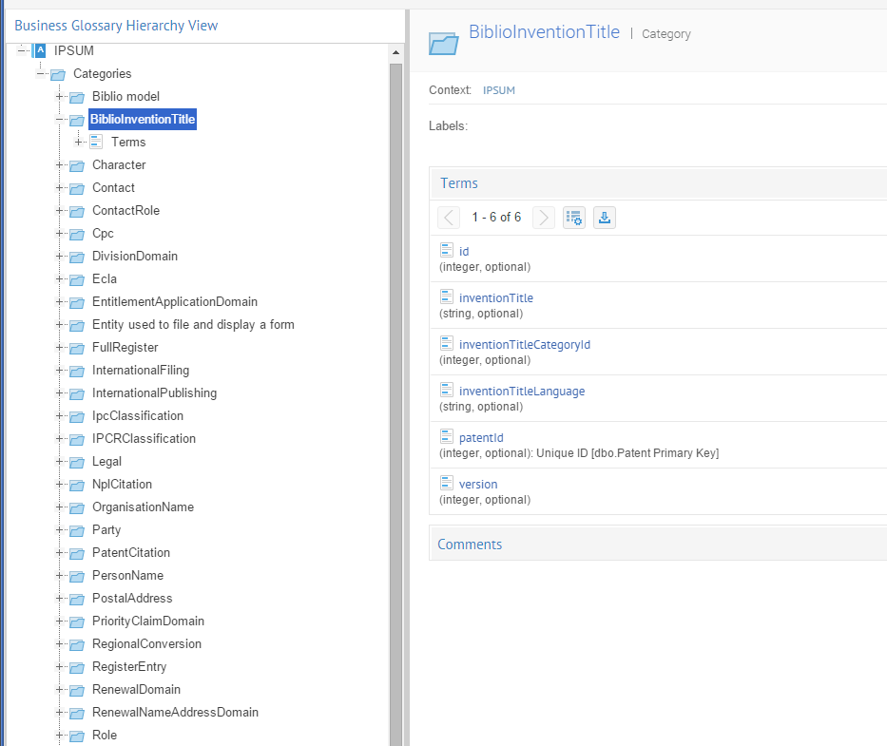
Business Glossary Hierarchy View

Slide 24
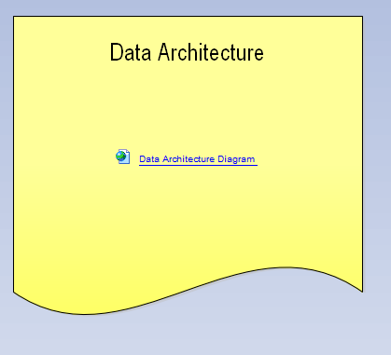
Link to Business Architecture (EA Sparx)

Slide 25
Any Questions?

