Slide 1
Annual Technical Reports
CWS/4BIS, Agenda item 22
Geneva
March 21 to 24
2016
Anna GRASCHENKOVA
Industrial Property Information Officer

Slide 2
Plan
ATR Wiki:
advantages, address, structure, new features, workflow
Statistics 2014

Slide 3
ATR Wiki – advantages
User-friendly interface
Platform used by the WIPO for many projects
One profile for ATRs, Task Forces, etc.
Clear and intuitive interface
More control on the content and format of ATRs
Hyperlinks, lists, tables, etc., are available now
No more input section by section (one template per report)
Labels to retrieve ATRs
Possibility to receive notifications when new reports are published (Watches)
Etc.

Slide 4
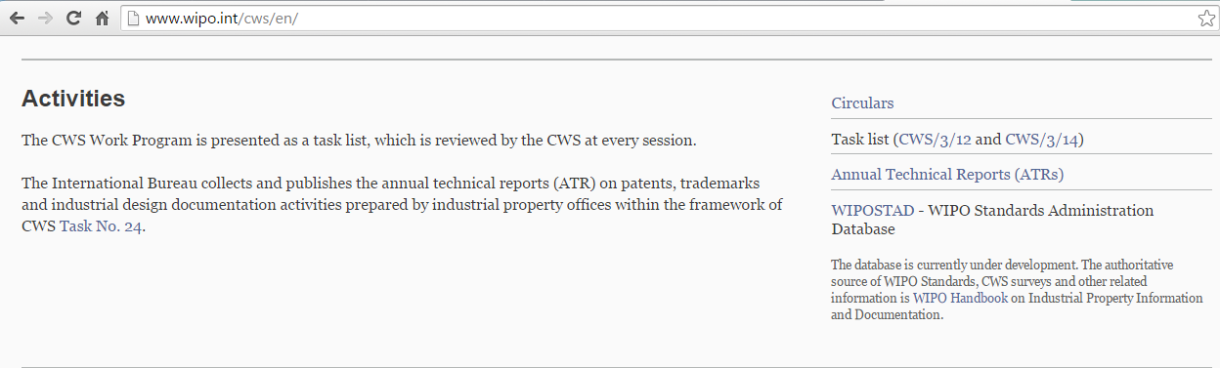
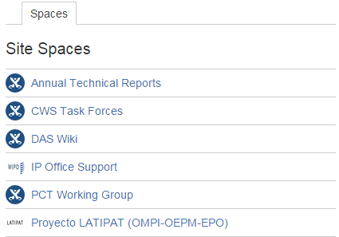
ATR Wiki - Address
Direct link:
https://www3.wipo.int/confluence/display/ATR/Annual+Technical+Reports+Home
Navigation:
  CWS web-site, Activities
  WIPO Wiki Dashboard, Site Spaces

Slide 5
ATR Wiki - Structure
Public
Restricted
  ATRs from 1998 to 2014
  Keyword search
  Browse by
  Year
  IP Office
  ATR modality
  Recommended contents
    in English, French and Spanish
  Guidelines (!)
  Link to the restricted area
templates for the ATRs
  in English, French and Spanish
ATRs under preparation

Slide 6
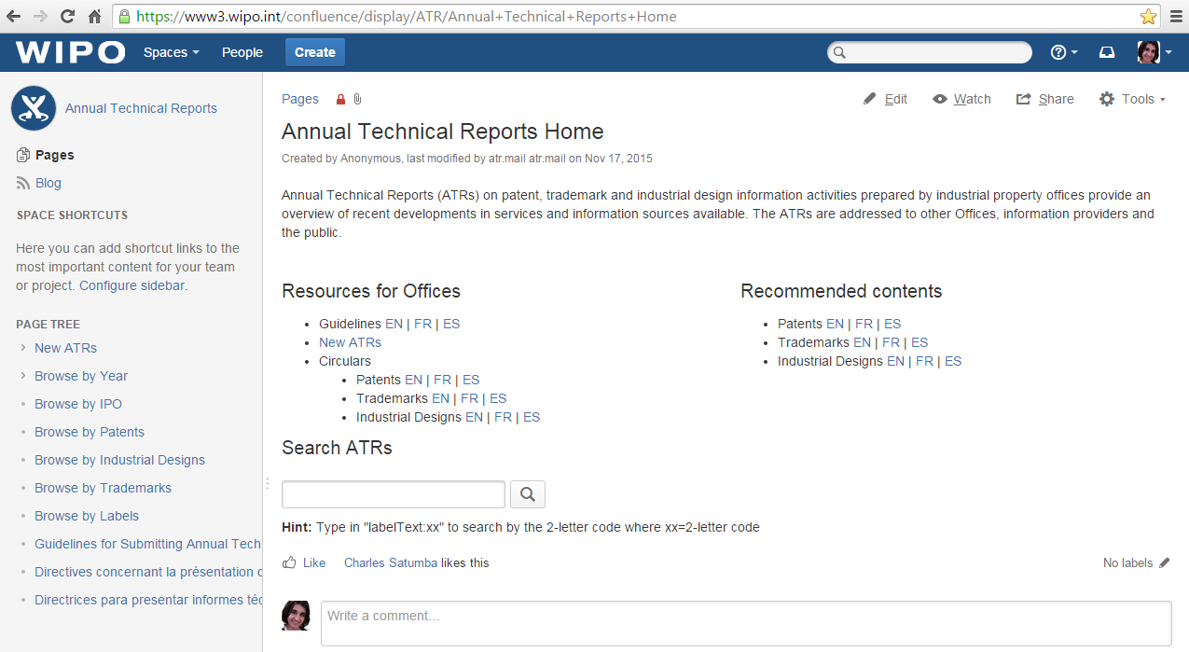
ATR Wiki – Home page

Slide 7
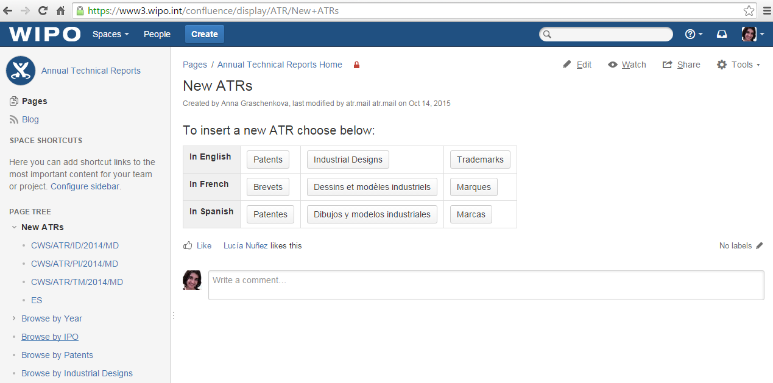
ATR Wiki – Restricted part

Slide 8
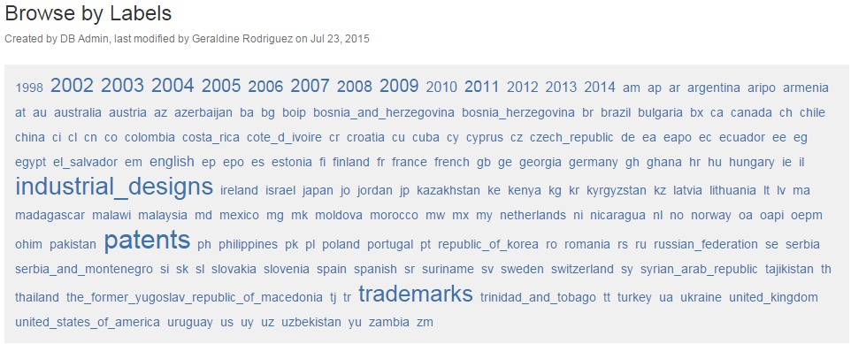
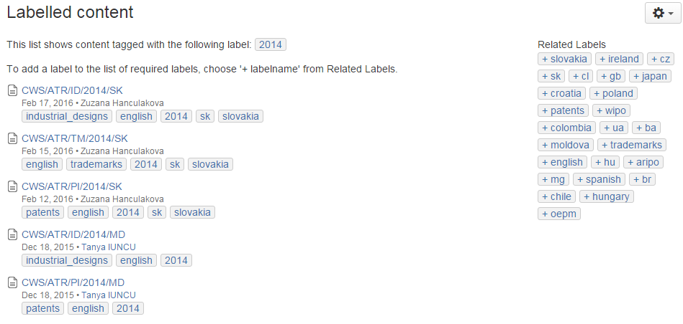
ATR Wiki – New features - Labels
  For each ATR
    Country
    (name and code)
    Year
    Modality
    Language (from 2014)
  Can be combined

Slide 9
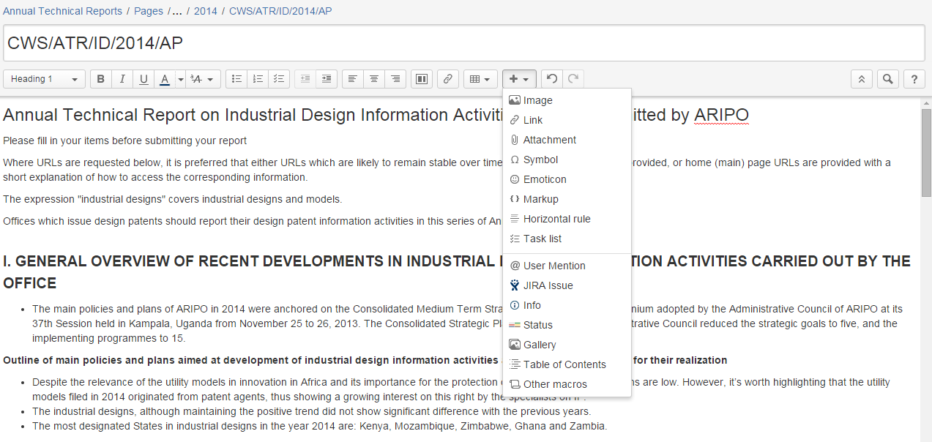
ATR Wiki – New features – Formatting
  Lists
  Tables (!)
  Hyperlinks
  Attachments
  Spacing
  etc.

Slide 10
ATR Wiki – Workflow - user
Reference: Guidelines for submitting ATRs
Invitation (C.CWS 57-06)
Create WIPO User center account (you probably have one!)
Let us know the username and other details, we will grant you access the restricted area (atr_users group)
Log in (create or edit ATRs) vs anonymous access (read only)
New ATRs -> Choose the template -> prepare the ATR
Let us know when the ATR is ready to be published, i.e., to be transferred to the public pages

Slide 11
ATR Wiki – Workflow - report
Template
  Viewing – atr_group and atr_admin (by default)
  Editing – no additional restrictions
  Page title “CWS/ATR/IP/YYYY/Country code”
  Labels – year, modality, language
ATR under preparation
  Viewing – YOU and atr_admin
  Editing – no additional restrictions
  Page title “CWS/ATR/IP/YYYY/CC” (unique!)
  Labels – year, modality, language, country name and code
Published ATRs
  Viewing – anonymous
  Editing – atr_admin only

Slide 12
ATRs – Statistics 2014
Industrial Property Office | on Patent Information Activities (CWS/ATR/PI/2014): | on Trademark Information Activities (CWS/ATR/TM/2014): | on Industrial Design Information Activities (CWS/ATR/ID/2014):
ARIPO Australia Bosnia and Herzegovina Brazil Chile Czech Republic Egypt Spain United Kingdom Croatia Hungary Ireland Japan Lithuania Madagascar Norway Poland Slovakia Ukraine Uruguay | CWS/ATR/PI/2014/AP CWS/ATR/PI/2014/AU CWS/ATR/PI/2014/BR CWS/ATR/PI/2014/CL CWS/ATR/PI/2014/CZ CWS/ATR/PI/2014/EG CWS/ATR/PI/2014/ES CWS/ATR/PI/2014/GB CWS/ATR/PI/2014/HR CWS/ATR/PI/2014/HU CWS/ATR/PI/2014/IE CWS/ATR/PI/2014/JP CWS/ATR/PI/2014/LT CWS/ATR/PI/2014/MG CWS/ATR/PI/2014/NO CWS/ATR/PI/2014/PL CWS/ATR/PI/2014/SK CWS/ATR/PI/2014/UA CWS/ATR/PI/2014/UY | CWS/ATR/TM/2014/AP CWS/ATR/TM/2014/AU CWS/ATR/TM/2014/BR CWS/ATR/TM/2014/CZ CWS/ATR/TM/2014/HR CWS/ATR/TM/2014/HU CWS/ATR/TM/2014/JP CWS/ATR/TM/2014/LT CWS/ATR/TM/2014/MG CWS/ATR/TM/2014/NO CWS/ATR/TM/2014/PL CWS/ATR/TM/2014/SK CWS/ATR/TM/2014/UA CWS/ATR/TM/2014/UY | CWS/ATR/ID/2014/AP CWS/ATR/ID/2014/AU CWS/ATR/ID/2014/BA CWS/ATR/ID/2014/BR CWS/ATR/ID/2014/CL CWS/ATR/ID/2014/CZ CWS/ATR/ID/2014/HR CWS/ATR/ID/2014/HU CWS/ATR/ID/2014/JP CWS/ATR/ID/2014/LT CWS/ATR/ID/2014/MG CWS/ATR/ID/2014/NO CWS/ATR/ID/2014/PL CWS/ATR/ID/2014/SK CWS/ATR/ID/2014/UA CWS/ATR/ID/2014/UY
20 IPOs | 19 | 14 | 16
March 17, 2016

Slide 13
Thank you for your attention
Questions?
Anna Graschenkova
Anna.Graschenkova@wipo.int
ATR.mail@wipo.int
www.wipo.int/standards/en
https://www3.wipo.int/confluence/display/ATR/Annual+Technical+Reports+Home

