Slide 1


The Marrakesh Treaty:
The publishers’ perspective
José Borghino
Secretary General

Slide 2

Summary
The IPA
Publishers and the Marrakesh Treaty
The Accessible Books Consortium
Conclusions
International Publishers Association

Slide 3
International Publishers Association
In numbers
76 associations of publishers, including MABOPA
65 countries
Thousands of publishers
Over 5.6 million consumers
International Publishers Association

Slide 4
International Publishers Association
What we do
Promote the interests of publishers around the world
Defend copyright
Defend and celebrate the freedom to publish
Promote literacy and education
Champion the social, economic, cultural and poilitical benefits of publishing
International Publishers Association

Slide 5
IPA and Marrakesh
Diplomatic Conference concluded 27/06/2013
Entry into force: September 2016 with the ratification of Canada as the 20th country
IPA has supported ratification. We advised our members to collaborate with AEs and governments
IPA actively supports WIPO’s efforts to sprerad the word about Marrakesh and accessible publishing
International Publishers Association

Slide 6
IPA and Marrakesh
IPA has produced a guide to the Marrakesh Treaty for publishers’ associations:
IPA is actively involved in the Accessible Books Consortium (ABC) alongside authors, CMOs, libraries and VIP community
International Publishers Association
Notes:
https://www.internationalpublishers.org/images/Accessibility/IPA_Guide_to_the_Marrakesh_Treaty.pdf

Slide 7

IPA and ABC
Launched in 2014
Supports practical work to increase availability of books in accessible formats
Rightsholders, authorised entities, libraries and organisations representing VIPs
IPA encourages publishers to sign the ABC charter
AccessibleBooksConsortium.org
for more information
International Publishers Association
Notes:
http://www.accessiblebooksconsortium.org/portal/en/charter.html

Slide 8

IPA and Marrakesh
IPA Backs WIPO Accessibility Work
International Publishers Association
Notes:
https://www.internationalpublishers.org/policy-issues/visually-impaired-persons/knowledge-bank-vips/637-ipa-backs-wipo-accessibility-work

Slide 9
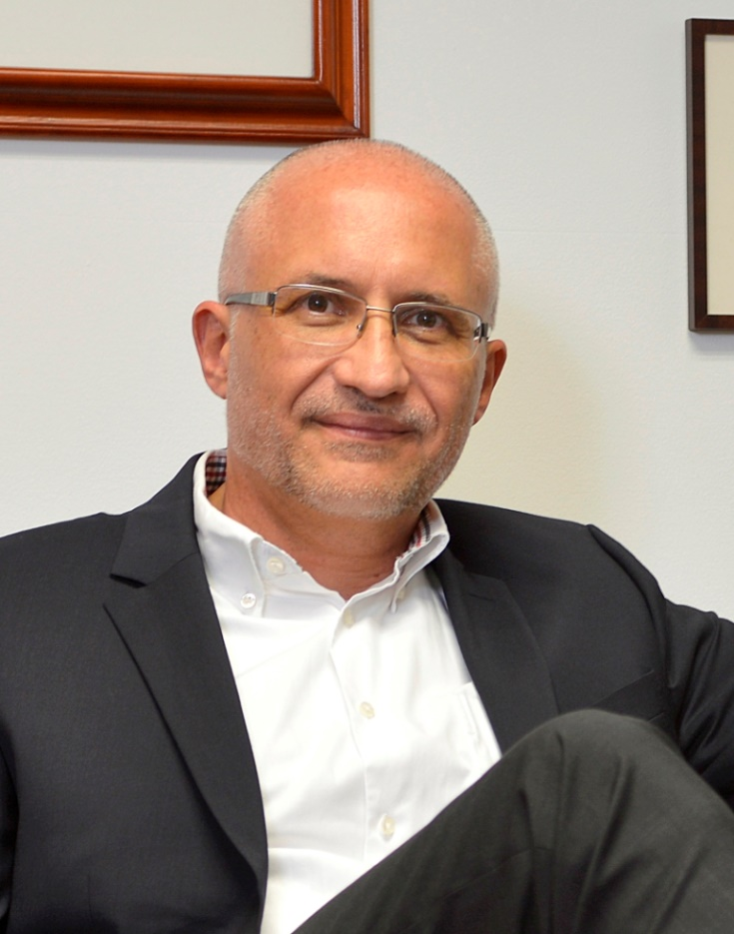
IPA and Marrakesh
Not only is accessible publishing the right thing to do, it also makes perfect business sense
IPA Vice President, Hugo Setzer
International Publishers Association

Slide 10
The Marrakesh Treaty today
43 countries have ratified the Marrakesh treaty
2 are in ASEAN (Indonesia, Singapore)
The last country to ratify the Treaty was Afghanistan
International Publishers Association

Slide 11




The Marrakesh Treaty today
Significant ratifications ahead
Discussions well advanced in USA
EU agreement reached on 15 Feb 2018. Ratification expected soon
Thailand
Malaysia?
International Publishers Association

Slide 12
After Ratification comes the hard part: Implementation
Some Concerns:
Bills used for ratification including broader exceptions than provided for in the Treaty
IPA recommends including commercial availability as part of the Treaty
IPA also recommends including remuneration
Always consult with local publishers and IPA re possible unforeseen consequences
International Publishers Association

Slide 13


Implementation of the Marrakesh Treaty
Mexico case-study
  Adopted text too vague
  Call for clarification by publishing industry
  Issue resolved by the Supreme Court
Colombia as a good example (includes commercial availability)
Singapore and Australia also good examples
International Publishers Association

Slide 14
Conclusion
Publishers support the Marrakesh Treaty
We want to see correct implementation (consult widely with WIPO and publishers)
We want to work with all parties to increase the number of born accessible publications
Actively involved in the Accessible Books Consortium (ABC) and we strongly encourage publishers and PAs to sign the Charter
International Publishers Association

Slide 15
Thank you!
José Borghino
IPA Secretary General
@JoseBorghino
borghino@internationalpublishers.org
www.internationalpublishers.org
International Publishers Association

