Slide 1
Marrakesh Treaty to Facilitate Access to Published Works for Persons Who Are Blind, Visually Impaired, or Otherwise Print Disabled
(MVT or Marrakesh VIP Treaty, 2013)
Paolo Lanteri
Copyright Law Division
Copyright and Creative Industries Sector
Singapore
November 1, 2017

Slide 2
It is not only a matter of Legislation
Trusted Intermediaries
Enabling Legal Regime
Development Dimension
Concerns in the Digital Environment
Technological Tools
Standards Interoperability
Information and Training

Slide 3
Structure
Preamble
Relation to other Conventions and Treaty
Definitions (works; accessible format copy; authorized entity)
Beneficiary Persons
National level
Cross-border exchange
Importation
Technological Protection Measures
Respect for Privacy
Cooperation to facilitate exchange
Implementation provisions
Respect for Copyright provisions
Other Limitations and Exceptions

Slide 4
General Non-Derogation Clause
“Nothing in this treaty shall derogate from any obligations that Contracting Parties have to each other under any other treaties, nor shall it prejudice any rights that a Contracting Party has under any other treaties.”
The principle is repeated (e.g. agreed statements to Articles 4.3, 5.1, 5.4 b); Article 11)
Notes:
4
4

Slide 5
What can be transformed into an “accessible format”?
“Works”
broad definition of the Berne Convention
limited in the form of text, notation and/or related illustrations, whether published or otherwise made publicly available in any media
includes such works in audio form, such as audiobooks (agreed statement)
It also applies “mutatis mutandis” to object of Related Rights

Slide 6
Definition: Accessible format copy
Defined with reference to the functional activities that can be carried out by beneficiaries and refers to “permit[ting] the person to have access as feasibly and comfortably as a person without visual impairment or other print disability”
(e.g. Braille, Daisy, large print);
Must respect the integrity of the work;
Used exclusively by the beneficiary person.
Notes:
6
6

Slide 7
Definition: Authorized entity (1)
Broad definition that encompasses many non-profit and government entities, whether they are specifically authorized by the government or “recognized“ by the government (including through receiving funds) as entities that provide many functions including education and information access;
Notes:
7
7

Slide 8
Definition: Authorized entity (2)
authorized or recognized by the government;
on a non-profit basis;
Serving VIP as “primary activities” or institutional obligations;
Duties: (1) verify conditions for being a beneficiary; (2) limit distribution to them; (3) discourage unauthorized uses; (4) maintain due care and keep records.
Notes:
8
8

Slide 9
Autorized Entities: examples
Libraries
Blinds’ Associations
Education Institutions

Slide 10
The Authorized Entities
With primary activity or institutional obligations
Non-profit organizations
Education, instructional training, adaptive reading or information access to beneficiary persons
Recognized or authorized by the government
governmental organizations

Slide 11
Beneficiary Person
is blind;
has a visual impairment or a perceptual or reading disability which cannot be improved (agreed statement to clarify doesn’t include all possible medical diagnostic or treatment) to give visual function substantially equivalent to that of a person who has no such impairment or disability and so is unable to read printed works to substantially the same degree as a person without an impairment or disability; or
is otherwise unable, through physical disability, to hold or manipulate a book or to focus or move the eyes to the extent that would be normally acceptable for reading, regardless of any other disabilities”.
Notes:
11
11

Slide 12
Limitations and exceptions at the National level (I)
Should permit changes needed to make a work accessible (by default);
Mandatory: rights of reproduction, distribution, and making available to the public; optional: public performance. Translation is not included (Agreed statement 4(3));
Authorized entities can: (1) make accessible format, (2) obtain it from another entity and (3) supply to beneficiary (including persons acting on her behalf, caretaker or caregiver).
Notes:
12
12

Slide 13
Limitations and exceptions at the National level (II)
“(..) by any means, including by non-commercial lending or by electronic communication by wire or wireless means, and undertake any intermediate steps to achieve those objectives, when all the following conditions are met:”
Lawful access to the work;
No changes other than those needed to make the work accessible;
Supply exclusively to be used by beneficiary;
Non-profit basis.
Notes:
13
13

Slide 14
Limitations and exceptions at the National level (III)
Commercial availability (under reasonable terms) requirement is optional. Through a notification Member States can set the absence of availability of accessible format as a pre-condition for the limitations and exception;
A system for remuneration is also optional.
Notes:
14
14

Slide 15
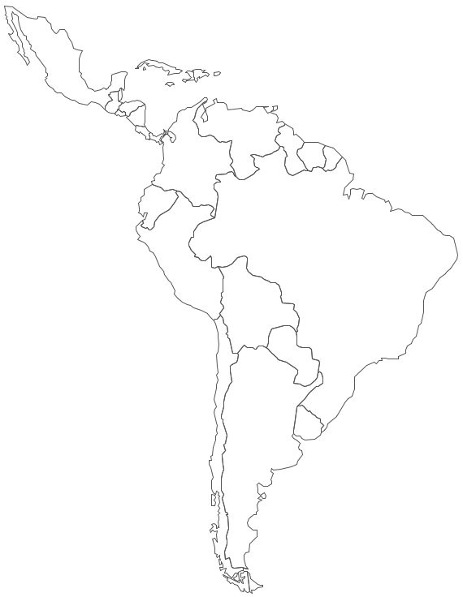
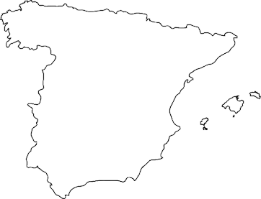
Cross-Border Exchange (I)

Slide 16
Cross-border Exchange (II)
When an accessible format can be created at the national level, authorized entities can also:
Distribute or make available accessible formats to other authorized entities in other Member States;
Distribute or make available accessible formats directly to beneficiary persons in other Member States;

Slide 17
Cross-border Exchange (III) conditions:
Both countries (exporting and importing) are members of the Marrakesh Treaty;
Accessible format copy is created legally, for instance according to a limitation and exception;
Exported by an authorized entity;
Imported by an authorized entity or a beneficiary;
The work in accessible format is used by a beneficiary.

Slide 18
Cross-border Exchange (IV)
Limits to Exportation (Article 5.4):
If authorized entity not in a Contracting Part of the Berne Convention or TRIPS;
If Contracting Party is not member of WCT and has no obligations to limit its national limitations and exceptions (applicable to the right of distribution and of making available) to the three-step test.

Slide 19
Cooperation to Facilitate Cross-Border Exchange
1. Contracting Parties shall endeavor to foster the cross-border exchange of accessible format copies by encouraging the voluntary sharing of information to assist authorized entities in identifying one another. The International Bureau of WIPO shall establish an information access point for this purpose.
3. The International Bureau of WIPO is invited to share information, where available, about the functioning of this Treaty.

Slide 20
Information Access Point (I) – questionnaire sent to MS
1. Please indicate the relevant provisions in your national legislation providing for or regulating the limitations and exceptions to facilitate access to published works for persons who are blind, visually impaired, or otherwise print disabled.
2. Does your national legislation permit the cross-border exchange (i.e. exportation) of “accessible format copies”, as defined in Article 2 b) MVT? If yes, under which conditions?
3. Does your national legislation allow the importation of “accessible format copies”, as defined in Article 2 b) MVT? If yes, under which conditions?

Slide 21
Information Access Point (II) – questionnaire sent to MS
4. Does your national legislation provide a definition of “authorized entity”, as defined in Article 2 c) MVT? If yes, please provide the reference.
5. Please provide a list with contact details of entities that can operate as authorized entities in your territory, and any further information that you can provide, such as number of accessible titles in the catalogue of the authorized entity and the languages covered.

Slide 22
Signatories
Afghanistan, Argentina, Australia, Austria, Belgium, Bosnia and
Herzegovina, Brazil, Burkina Faso, Burundi, Cambodia,
Cameroon, Central African Republic, Chad, Chile, China,
Colombia, Comoros, Congo, Costa Rica, Côte d’Ivoire, Cyprus,
Czech Republic, Democratic People’s Republic of Korea,
Denmark, Djibouti, Dominican Republic, Ecuador, El Salvador,
Ethiopia, European Union, Finland, France, Germany, Ghana,
Greece, Guatemala, Guinea, Haiti, Holy See, India, Indonesia, Iran
(Islamic Republic of), Ireland, Jordan, Kenya, Lebanon, Lithuania,
Luxembourg, Mali, Mauritania, Mauritius, Mexico, Mongolia,
Morocco, Mozambique, Namibia, Nepal, Nigeria, Norway,
Panama, Paraguay, Peru, Poland, Republic of Korea, Republic of
Moldova, Sao Tome and Principe, Senegal, Sierra Leone,
Slovenia, Sudan, Switzerland, Syrian Arab Republic, Togo,
Tunisia, Turkey, Uganda, United Kingdom, United States of
America, Uruguay, Zimbabwe (80)

Slide 23
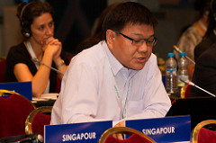
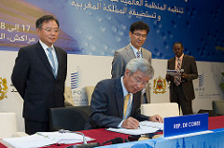
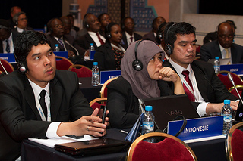

Slide 24
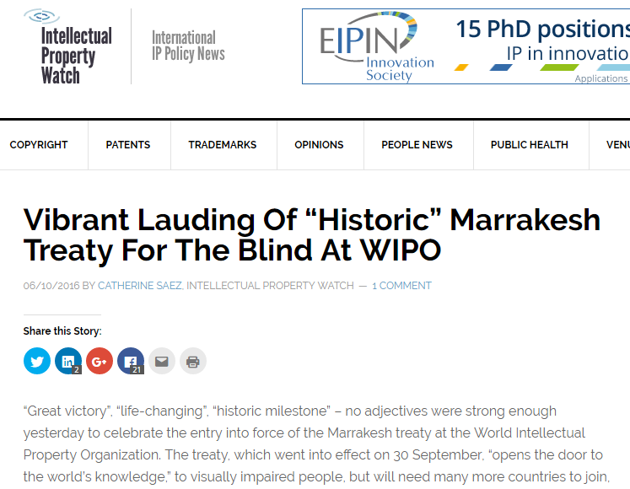

Slide 25
Ratifications and Accessions (33)
Argentina, Australia, Botswana, Brazil, Burkina Faso, Canada, Chile, Costa Rica, Democratic People’s Republic of Korea, Ecuador, El Salvador, Guatemala, Honduras, India, Israel, Kenya, Kyrgyzstan, Liberia, Malawi, Mali, Mexico, Mongolia, Nigeria, Panama, Paraguay, Peru, Republic of Korea, Saint Vincent and the Grenadines, Singapore, Sri Lanka, Tunisia, United Arab Emirates, Uruguay.

Slide 26
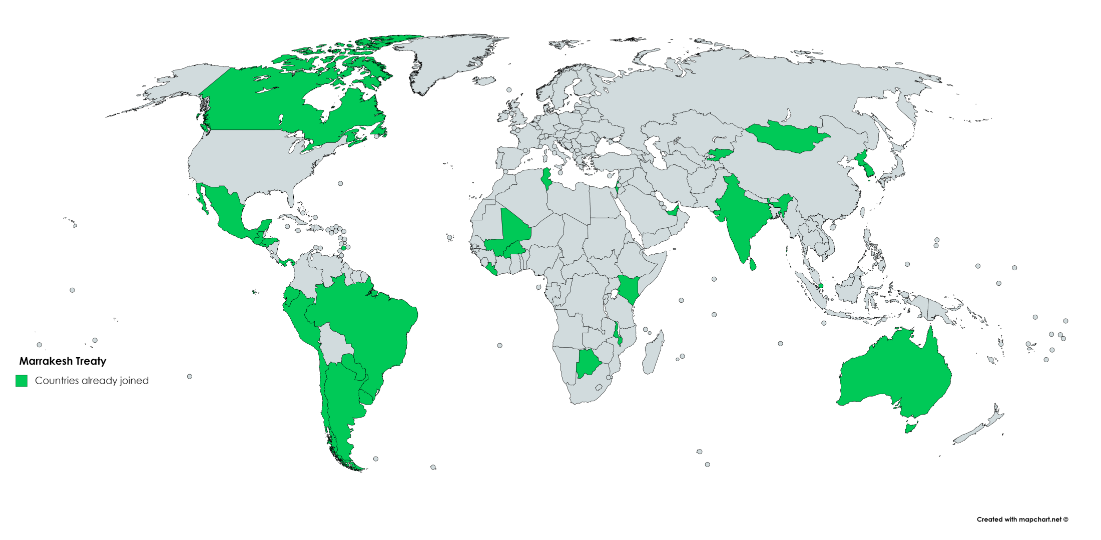
Marrakesh Treaty

Slide 27
Thank you!
www.wipo.int/copyright
Paolo.Lanteri@wipo.int

